Slide 1
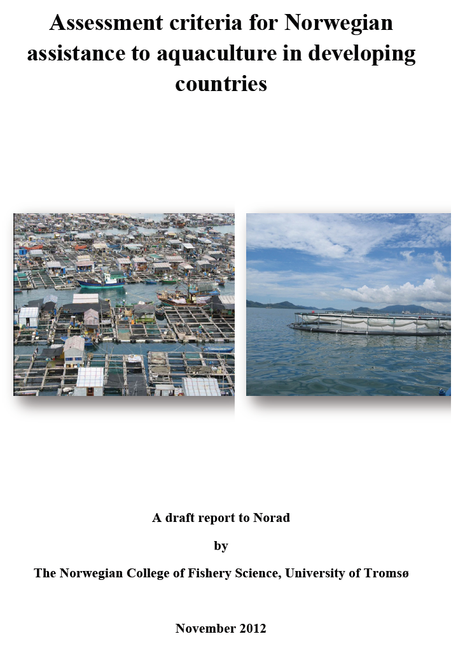

Slide 2
Background
TOR:
Assessing the potential for commercial aquaculture in different parts of the developing world accordingly Natural resources, institutional, historical and cultural framework conditions;
Role and importance of the different actors within the aquaculture sector
Identifying critical factors in the aquaculture sector
Discussing the relevance of Norwegian competence
Recommendation for criteria to be used
TEAM:
Hersoug/Revold (NCFS- UIT) - Engelsen(CDCF), White(Akvaplan-NIVA), Ricardsen (SINTEF), Killie (NCFS- UIT), Olsvik (UIT)
20 interviews with key persons in the Norwegian aquaculture sector

Slide 3
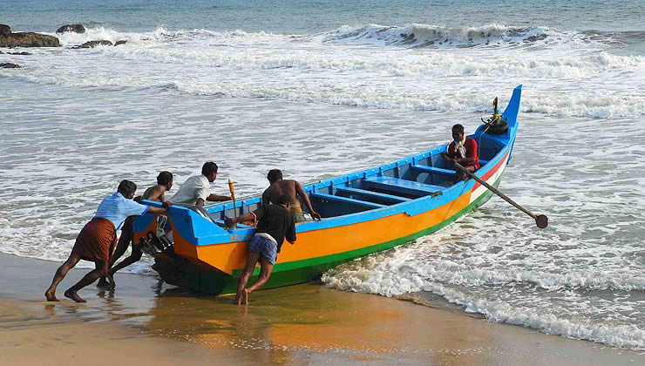
Why now?
Norway involved in fisheries development assistance since 1952 (Kerala, India)
Norway has followed the different fads and fashions, now concentrating on research, education, laws and regulations, management, MCS, institution-building, etc.
So far very moderate involvement in aquaculture

Slide 4
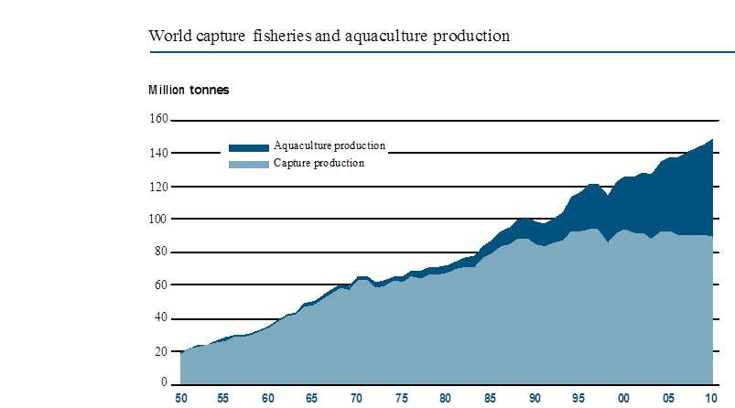
The increasing importance of aquaculture
1952: 1 mill. tons
2011: 63.6 mill. tons
Freshwater: 60 %
Brackish water: 8 %
Marine waters: 32 %
2012: 50% of food fish from aquaculture
Aquaculture growth: 7.1 %
Population growth: 1.5 %
Source: FAO – SOFIA 2012

Slide 5
Asia rules!
89 % of world production in Asia
61.4 % in China
Africa 2.2 %
Norway 2%
97 % of fish farmers in Asia
Top 10 producers 2010:
Source: FAO – SOFIA 2012

Slide 6
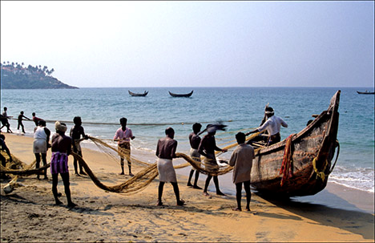
Aquaculture and poverty alleviation
No precise assessment but important in several Asian nations (Vietnam, China, Indonesia, Myanmar)
Lack of food (fish) not the main problem, but lack of buying power
Good governance network important (the problem of «sector islands»)
Successful projects characterized by ownership by the beneficiaries, farmers first, & participatory approach
Making aquaculture sustainable may be a long-term project ; do not make (environmental ) regulations too cumbersome for small-scale farmers
Notes:
Steadily less marine feed necessary as part of feed for carnivore species – 10 % by 2020? (Prof. Ragnar Olsen)
Many in the field of fisheries are reluctant and afraid of a too strong development of aquacultured marine carnivore species. The answer is close monitoring of the stocks, use of forage fish not suitable for human consumption and careful and monitored use of plankton species (krill and calanus)

Slide 7
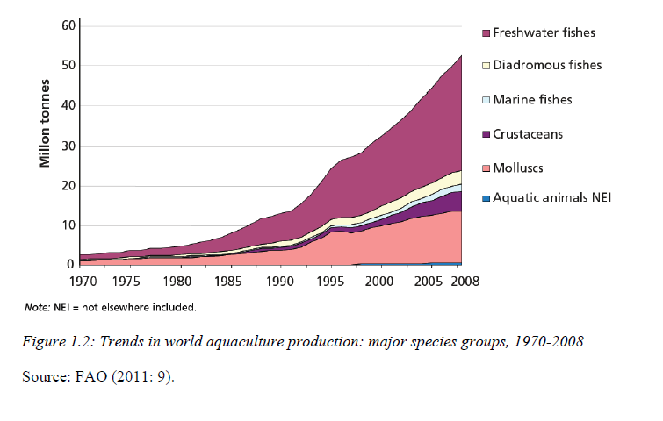
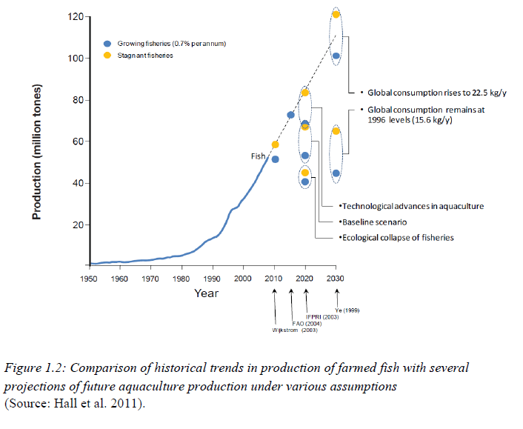
Future trends

Slide 8

The main stakeholders
Management authorities
Private investors
The research community
Civil society (CSOs)
Key to development: systematic organisation

Slide 9
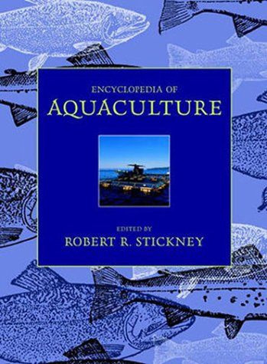
Critical factors in aquaculture
Environmental impacts
Alien species
Fish for feed
Employment and food security
Fish health
Institutional frameworks
Investment climate and corruption

Slide 10
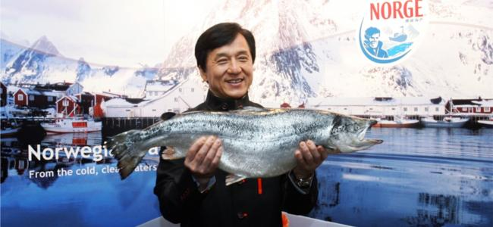
What can Norway offer?
Norway is the world’s leading producer of salmon (and trout)
On an industrial scale
Limited experience of extensive aquaculture
Limited experience from Asian aquaculture
BUT:

Slide 11
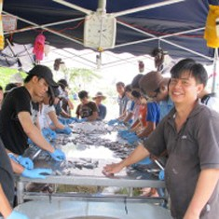
Generic knowledge
Generic knowledge in fish health, vaccination, breeding, fry-production etc.
Industrial and semi-industrial technology (marine/land-based)
Public aministrative competence, including planning, siting, rules and regulations etc.
A limited pool of people with experiences from developing countries
Aquaculture related education and research

Slide 12
Relevant Norwegian competence and institutions
Management and legislation
Environmental aspects and ICZM
Establishment of brood stocks/genetic improvements
Hatchery production
Fish feed
Farming in cages
Fish health, disease prevention
Aquaculture equipment
Water treatment
Value added production
Certification and food control
Training and education
Aquaculture research
Aquaculture companies, including supplies and service providers
Research institutes (Sintef, Nofima, IMR, NIVA, etc.)
Universities and regional colleges(UIO, UIB, UIT, NTNU, UMB, NVH)
Management institutions (Ministry of Fisheries and Coastal Affairs, Directorate of Fisheries etc.)
NGOs (WWF, Bellona, etc.)

Slide 13

Checklist for Norwegian embassies
Water quality and zoning arrangements
Environmental effects
Fish health conditions
Specific requirements for introduction of alien species
Availability of fish feed
Availability of infrastructure/logistics
Availability of (qualified) manpower
Availability of markets
Certification requirements for export

Slide 14

Two alternatives:
«Business as usual»: small projects in a number of countries,
Research, laws and regulations,management
Dependent on demand (request for Norwegian expertise)
Fisheries and aquaculture only 0.6 of development assistance budget (2012)

Slide 15
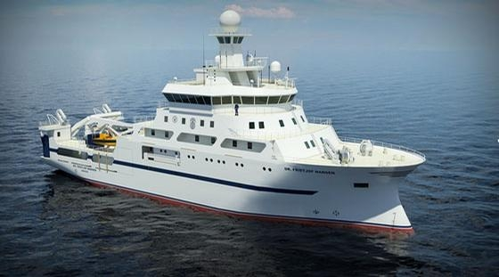
Or: a new «Nansen»- program for aquaculture
A larger regional program; 150-200 million NOK (over four years),
Strategically oriented (several disciplines and areas)
Based in a few Asian institutions
Linked up with FAO and regional networks
Possibilities for linking up African and Latin American participants
CDCF/IMR as a possible coordinator on the Norwegian side

