Slide 1
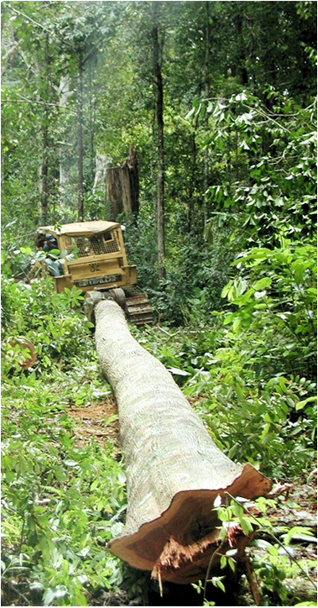
Global Comparative Study on REDD+
GCS-REDD+
Objectives
support REDD+ policy arenas and practitioner communities with science-based
  information
  analysis
  tools
ensure 3E+ outcomes
  effectiveness
  efficiency
  equity
  co-benefits
Notes:
In the face of numerous emerging first-generation REDD+ activities – both projects and national strategies – CIFOR has started in 2009, a global comparative study on REDD+.

Slide 2
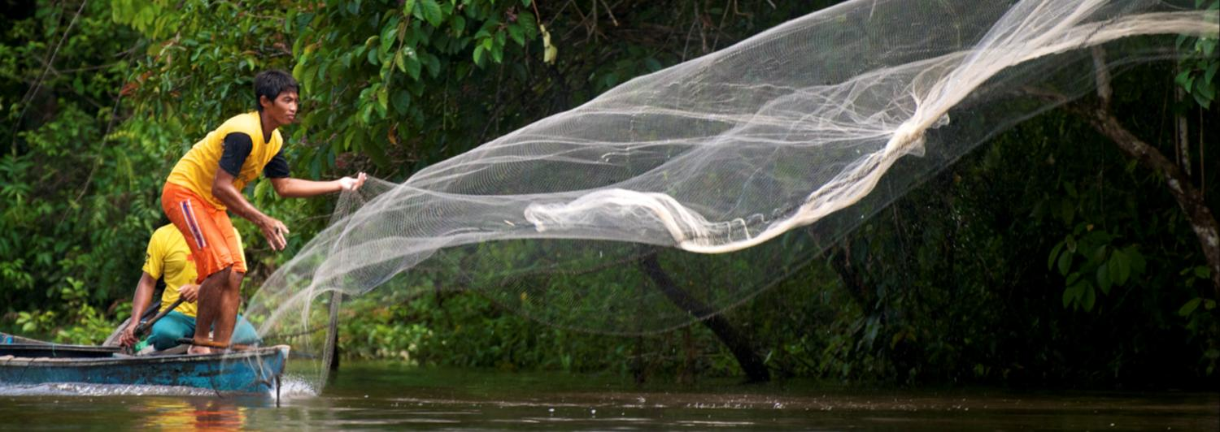
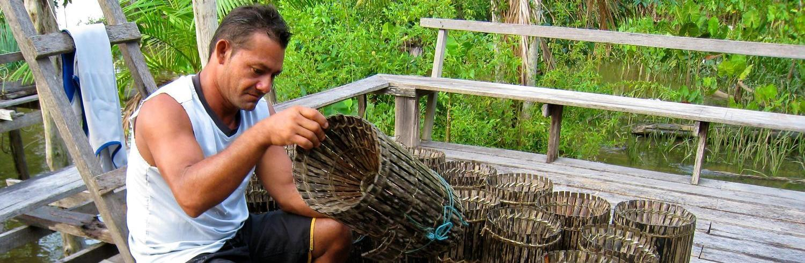





Thanks to

Slide 3
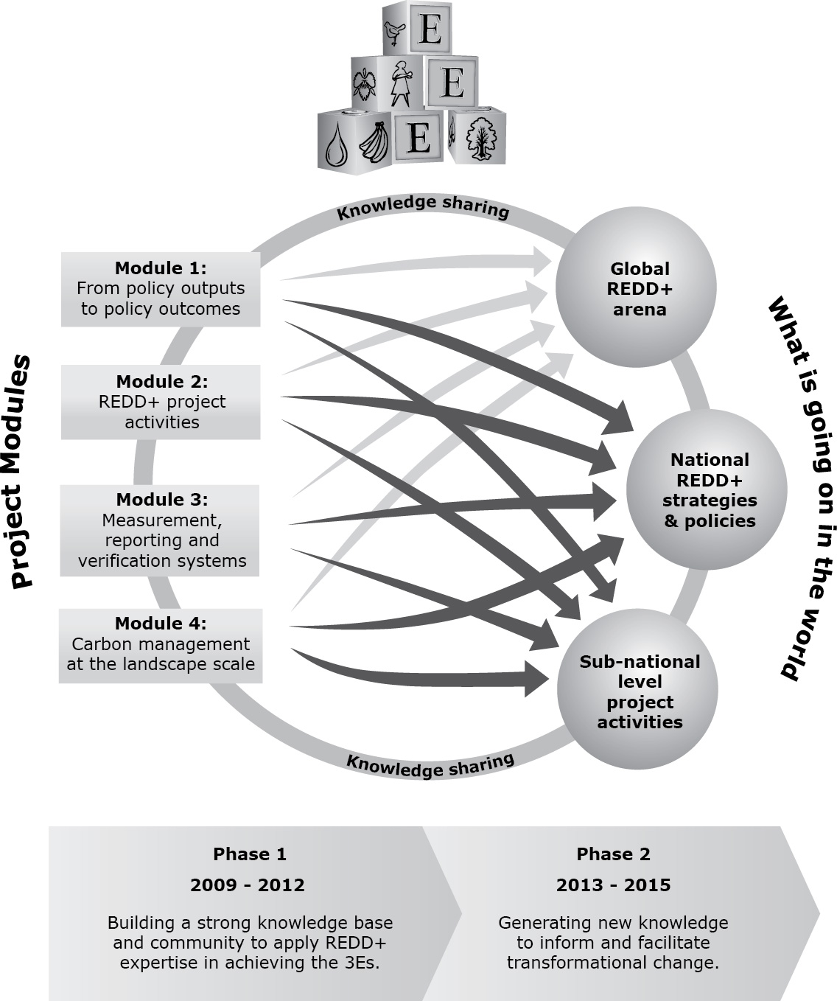
GCS-REDD
Structure
Notes:
What do we do:
4 research modules & 1 outreach module
duration: 2009-2015
analytical lenses: 3E+ (carbon effectiveness, cost efficiency, and equity) , and to identify obstacles and opportunities for transformational change necessary to realise a 3E REDD+ we apply the 4Is (institutional path dependencies, interests, ideas and ideologies, and information)

Slide 4
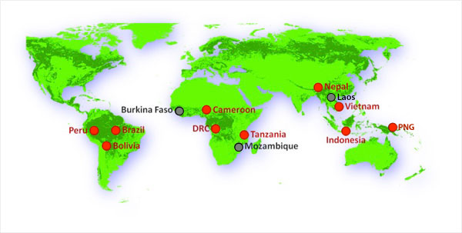
Where GCS works
Notes:
Where we are working :
National policy analysis in 13 countries including Laos , which is not yet on the map
REDD project analysis in 6 countries

Slide 5
Where GCS works
Policy analysis
12 countries since 2009
Laos added 2013
Ethiopia, Mexico 2014
Notes:
Where we are working :
National policy analysis in 13 countries including Laos , which is not yet on the map
REDD project analysis in 6 countries

Slide 6
Where GCS works
Project analysis
6 countries
23 REDD project sites
190 villages
4524 households
Notes:
Where we are working :
National policy analysis in 13 countries including Laos , which is not yet on the map
REDD project analysis in 6 countries

Slide 7
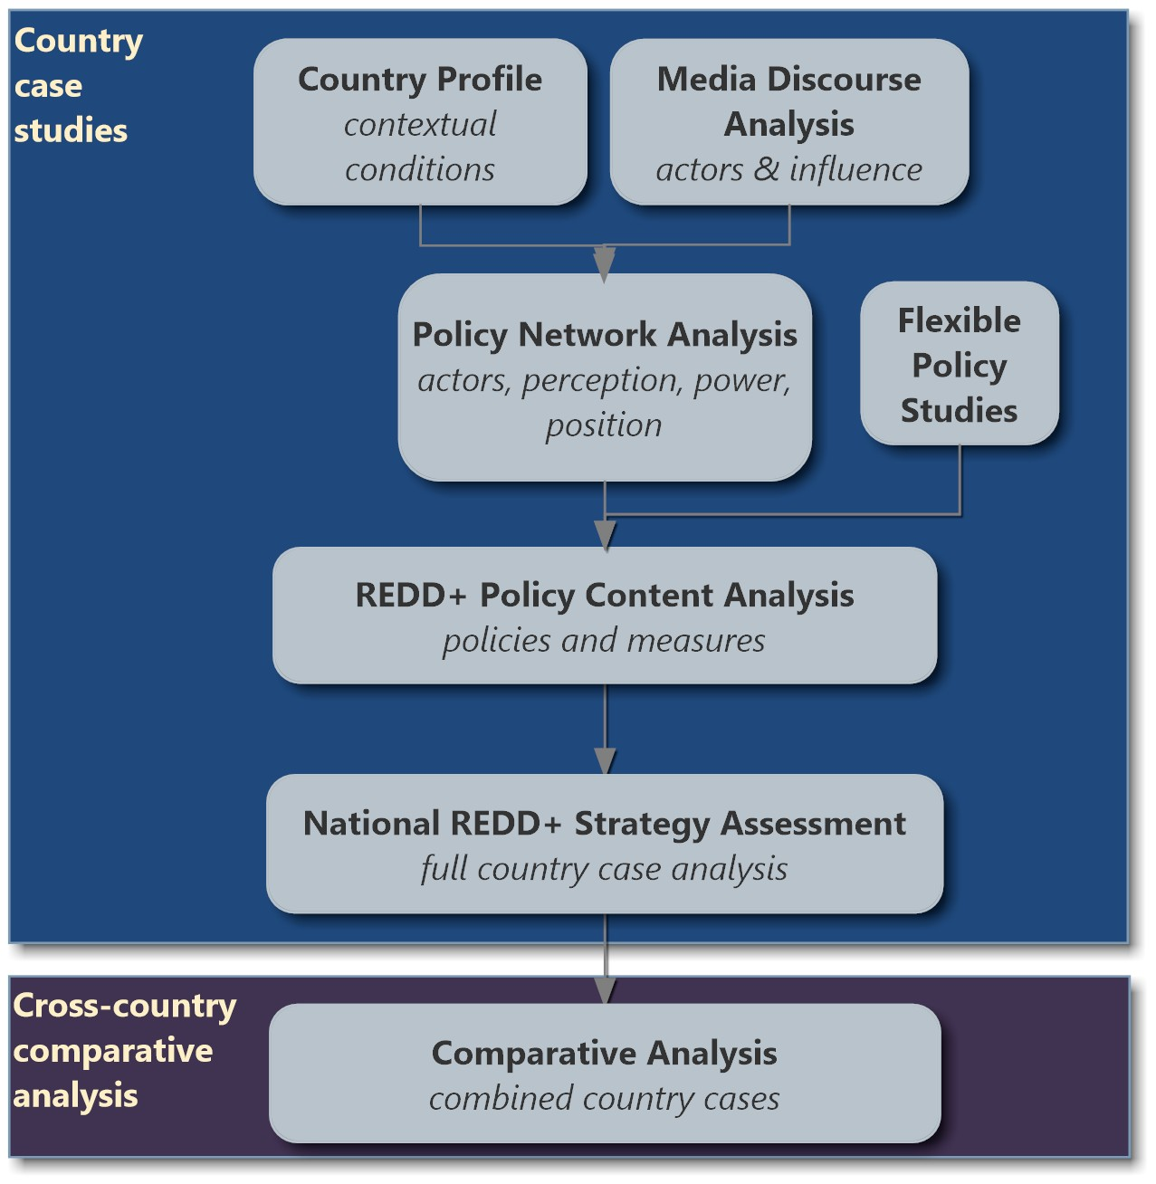
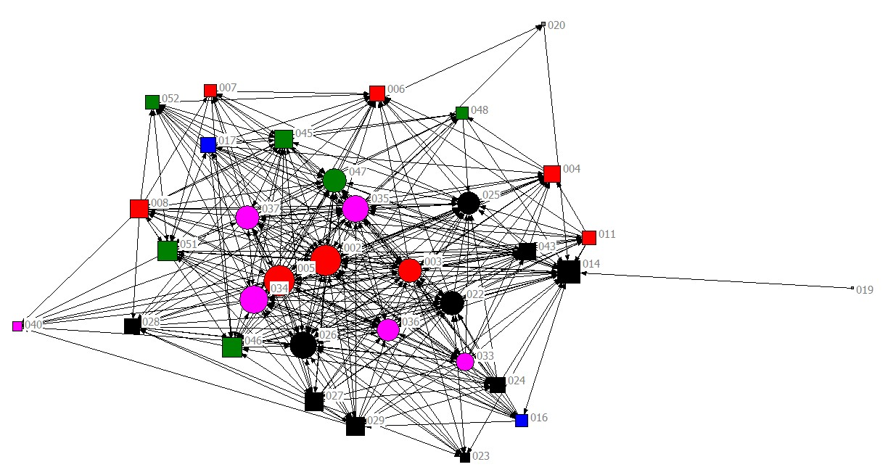
Module 1
REDD+ strategies, policies and measures
new research
links of national & international political processes
benefits-sharing

Slide 8
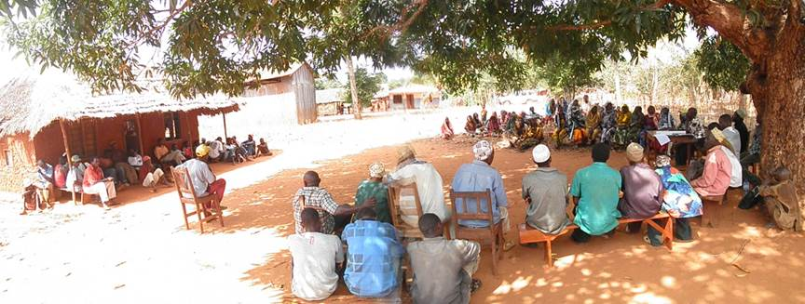
Module 2
REDD+ Project Sites
“BACI” research design
Comparison Control
Project site Intervention
 | Before | After
Control
before
Control
after
Intervention
before
Intervention
before

Slide 9
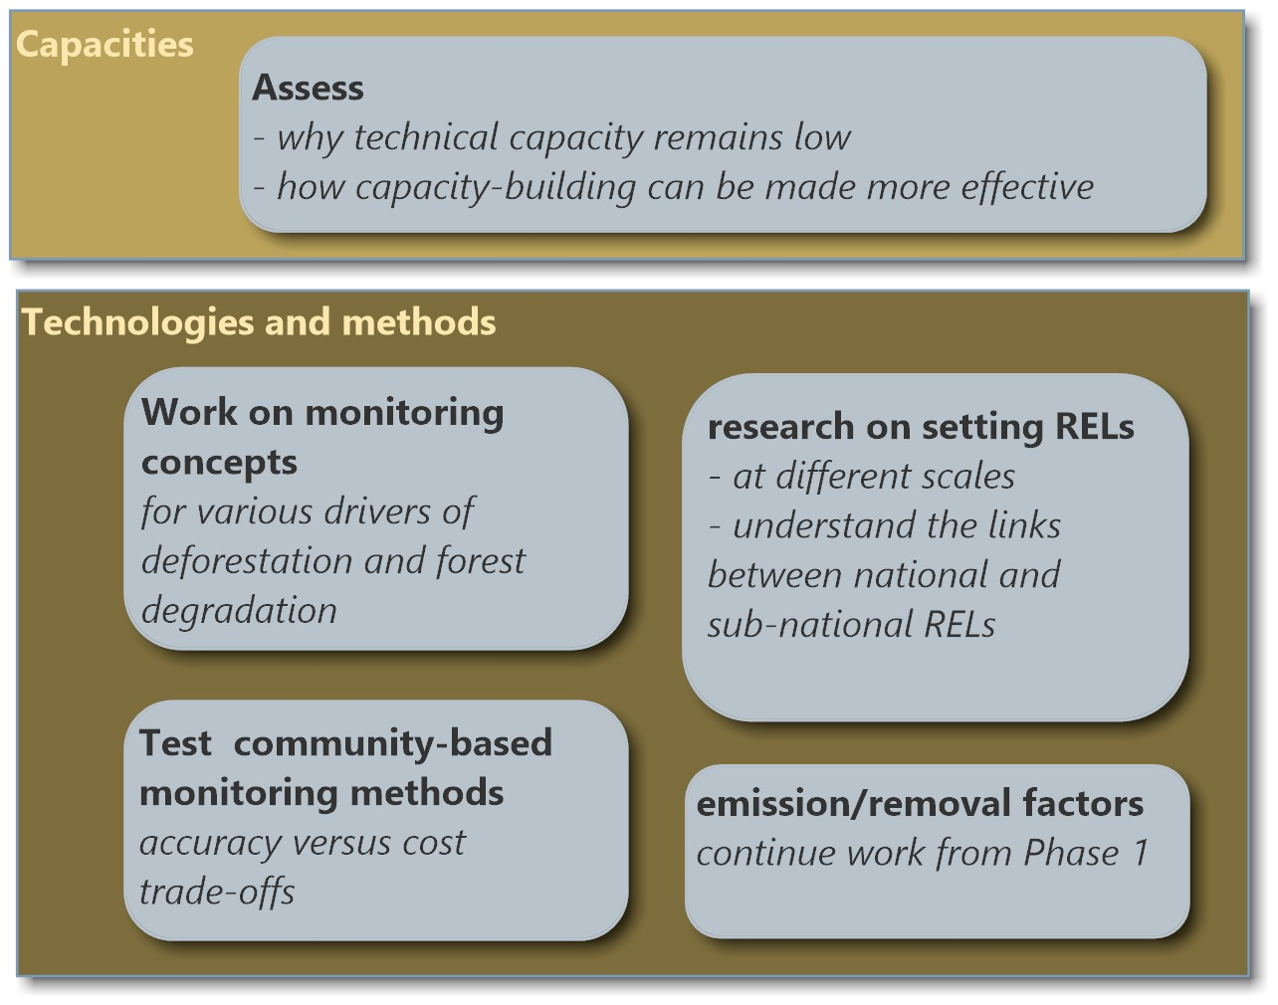
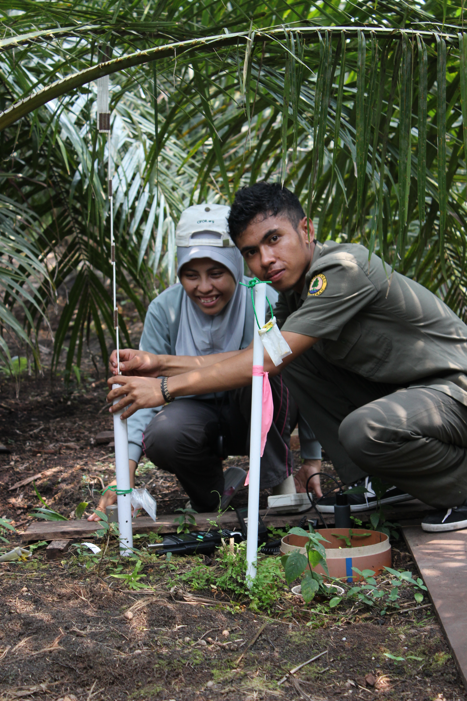
Module 3
Monitoring and Reference Levels
Improve procedures & practices for estimating & managing carbon stocks
Hallmark:
Stepwise approach to RELs & MRV (considers countries’ capacities)

Slide 10
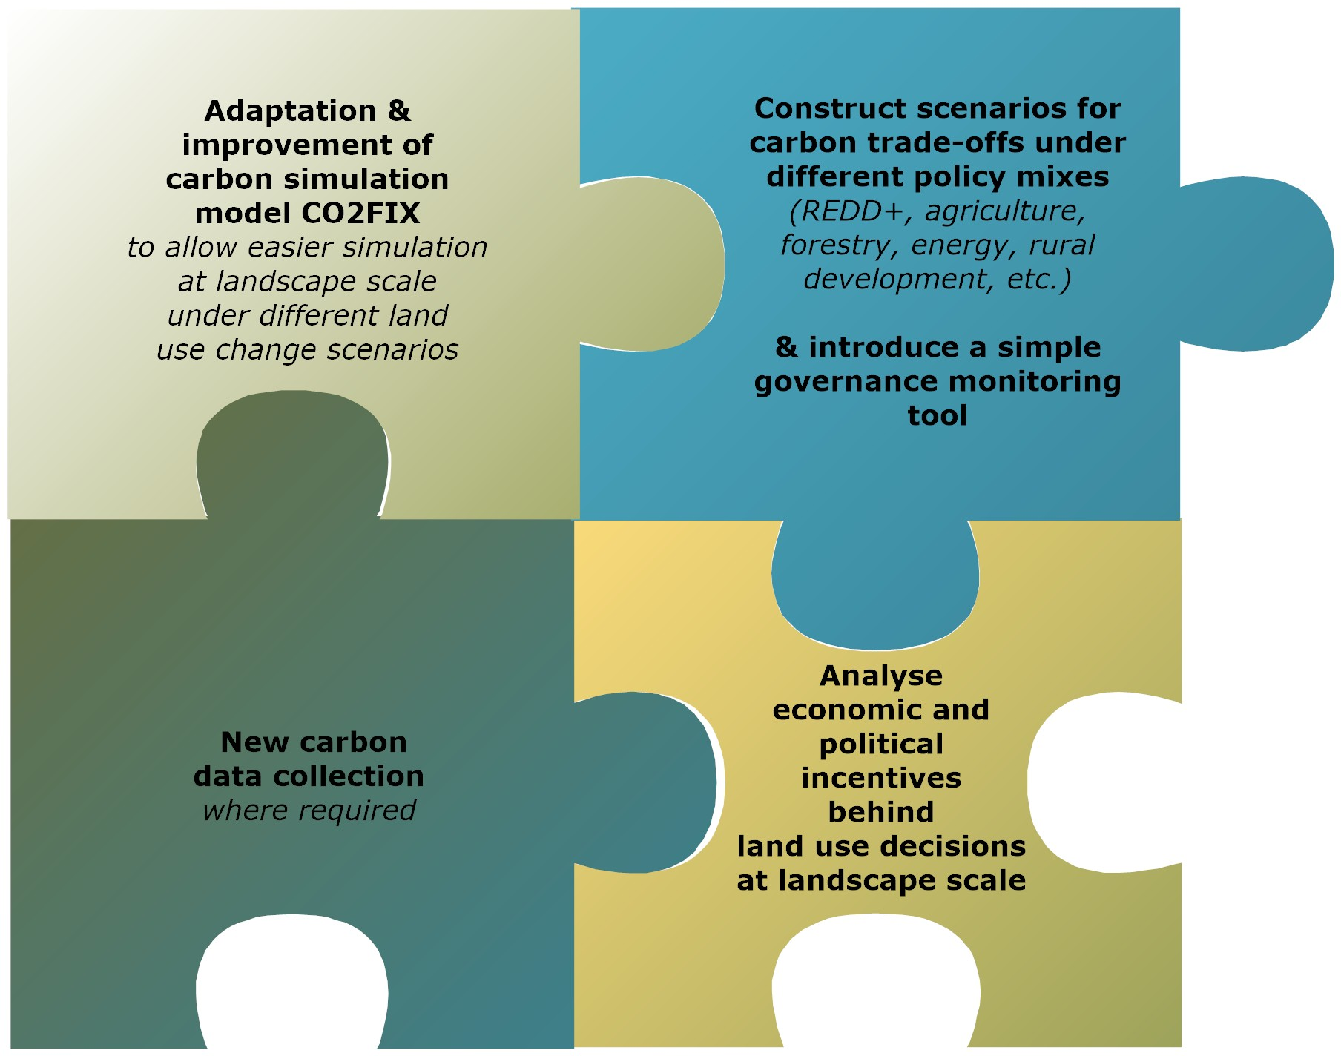
Module 4
Carbon management at the landscape scale
Improve the design of multilevel institutions and processes
to overcome economic and policy barriers to REDD+ and other low carbon land use policies

Slide 11

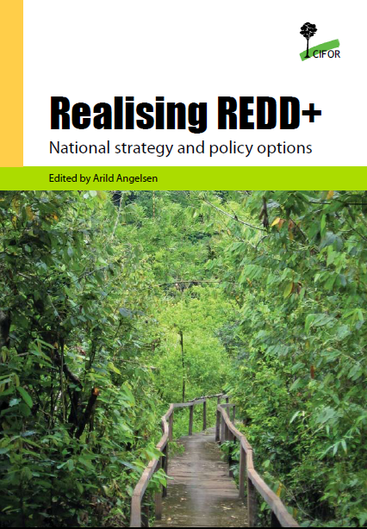
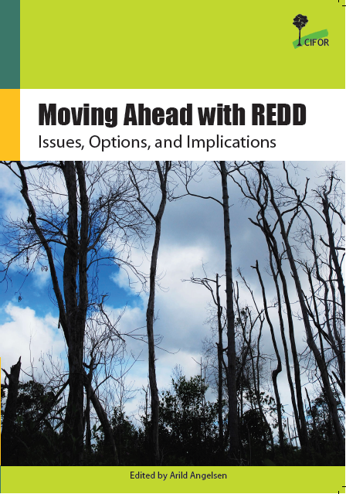
GCS output & results
2012
2009
2008
+ country profiles
+ scientific publications
Notes:
Some major outputs of CIFOR’s global comparative study.

Slide 12
Theory of Change
Boundary partners
Knowledge uptake
Co-production of science
Rigorous, salient, ethical science
Internalization and uptake by boundary partners
Partner-centered knowledge dissemination
Effective, efficient and equitable REDD+
CIFOR and research partners
Knowledge generation
download rates
trainings
conferences
national / NGO
MRV, development strategies
new climate
change regimes
stakeholder
workshops
peer-reviewed
publications
controllable indicators
non-controllable indicators

Slide 13

Non-controllable indicators
  national partners (Module 1) providing high quality information for national REDD+ policy processes
  research used by
    Indonesia: development of national strategy (scientist seconded to work on national REL), negotiations over the NOR-IND LoI
    Ethiopian REDD+ taskforce: developing national MRV roadmap
    Common Market for Eastern and Southern Africa (COMESA)
  integration of “stepwise” idea into UNFCCC decisions
  our expertise called upon by national and sub-national governments and roundtables (e.g. Mesa REDD Peru)
  solicitation to contribute to REDD+ efforts by other international organizations (e.g. RECOFTC, JRC)

Slide 14
GCS Phase I results
→ Results bar
Scale matters
Information across levels: comprehensive and fact-based
Carbon: stepwise approach to RELs and MRV
Tenure security: needed locally, enforce nationally

Slide 15


Slide 16
Non-controllable indicators
  national partners (Module 1) emboldened to connect with and influencing national REDD+ policy processes by providing high quality information
  our experts called upon by national and sub-national governments and roundtables (e.g. Mesa REDD Peru)
  research outputs used in negotiations over the NOR-IND LoI
  research used in development of national strategy in Indonesia
    scientist seconded to CIFOR to work on national REL with our team
  research used by Ethiopian REDD+ taskforce in national MRV roadmap
  Common Market for Eastern and Southern Africa (COMESA) requests our participation in REDD+ efforts
  integration of “stepwise” idea into UNFCCC decisions
  solicitation of our collaboration by other international organizations to contribute to REDD+ efforts (e.g. RECOFTC, JRC)

Slide 17
Key Messages
Conditions for REDD+ success (7 countries)
  autonomy of state from interests driving DD
  presence of strong coalitions for transformation
  national ownership of REDD+ policy process
  multilevel coordination
    enhance and harmonise information flow between local and national levels
    incentives: establish benefit sharing mechanisms that are perceived as fair
      fundamental conflicts over REDD
    national institutional structure and policies
      e.g. tenure and carbon rights
  safeguards dialogue needs to move to action on the ground
Notes:
QCA study results

Slide 18
GCS Key Messages
As an idea, REDD+ is a success story
  Significant result-based funding to address an
  urgent need for climate change mitigation
  Sufficiently broad to serve as a canopy, under
  which a wide range of actors can grow their own trees
REDD+ faces huge challenges
  Powerful political and economic interests
  Coordination across various government levels and agencies
  Benefits to balance effectiveness and equity
  Tenure insecurity and safeguards must be genuinely addressed
  Transparent institutions, reliable carbon monitoring and realistic reference levels to build result-based systems

Slide 19
Key Messages
REDD+ requires - and can catalyse – transformational change
  New economic incentives, new information and
  discourses, new actors & new policy coalitions;
  all have the potential to move domestic policies
  away from the BAU trajectory
REDD+ projects are hybrids in high deforestation areas
  Mix the enforcement of regulations and support to alternative livelihoods (ICDP) with result-based incentives (PES)
  Projects located in high deforestation and high forest carbon areas, yielding high additionality if they succeed

Slide 20
Capacities of countries to monitor forests
Consideration of factors for capacity assessment:
Requirements for monitoring forest carbon on national level (IPCC GPG)
Existing national capacities for national forest monitoring
Progress in national GHG inventory and engagement in REDD
REDD particular characteristics: importance of forest fires, soil carbon, deforestation rate
Specific technical challenges (remote sensing)

Slide 21
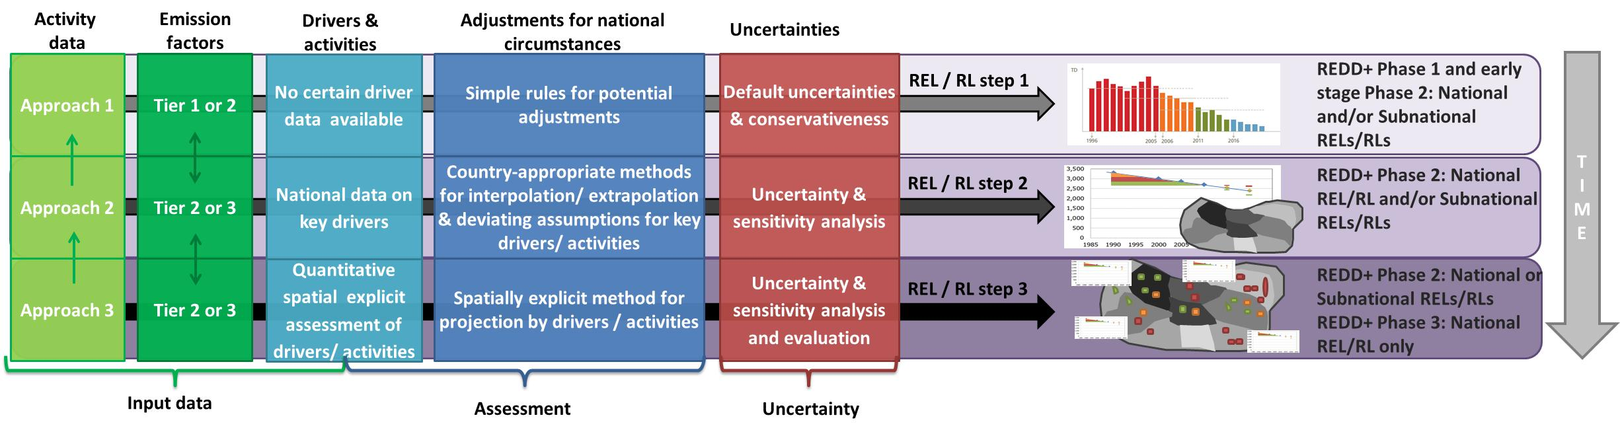
Reference emission levels
Criteria for comparing country circumstances and strategies
determining RELs posed technical hurdles
policy makers did not have clear ideas on modalities for countries to determine RELs
Idea of a tiered approach for establishing RL/RELs initially by Huettner et al. (2009)

Slide 22
Moving forward:
A “no regrets” agenda
Build broad political support and legitimacy for REDD+ framed as an objective rather than a program
Invest in foundations for REDD+ success, such as filling MRV information and capacity gaps
Focus on policy changes that would be desirable irrespective of climate objectives:
  Clarify land tenure
  Remove perverse agricultural subsidies
  Strengthen rule of law, tenure and forest governance

Slide 23

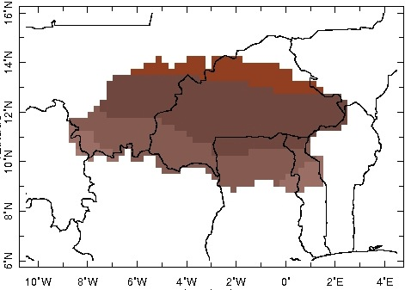
Domain averaged precipitation anomalies
Jun-Jul-Aug rainfall
Long-term trend
Up to 14% variance
explained
Decadal
Up to 44%
Interannual
Up to 92%
Kátia Fernandes
unpublished
West Africa

Slide 24
Domain averaged precipitation anomalies
Jun-Jul-Aug rainfall
Long-term trend
Up to 14% variance
explained
Decadal
Up to 44%
Interannual
Up to 92%
Kátia Fernandes
unpublished
Mitigation
Adapta-tion
West Africa

Slide 25
The 235 adaptation and mitigation project analyzed

Slide 26
Explicit contribution of mitigation projects to adaptation (and vice versa)
Possible synergies
Synergies
71
15
37
1
22
89
Without explicit contribution to adaptation
Explicit unsubstantiated contribution to at least one dimension of adaptation
Explicit and substantiated contribution to at least one dimension of adaptation
Explicit and substantiated contribution to mitigation
Explicit unsubstantiated contribution to mitigation
Without explicit contribution to mitigation
Mitigation projects (n=123)
Adaptation projects (n=112)

