Slide 1
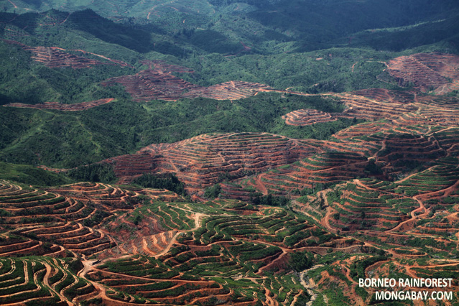




Market transformation:
Shifting demand to deforestation-free vegetable oil and other commodities
or
Notes:
Introductions:
Topic, UCS, speakers
Photo credit: Deforestation for palm oil production in Malaysian Borneo, Mongabay, Photo by R. Butler

Slide 2
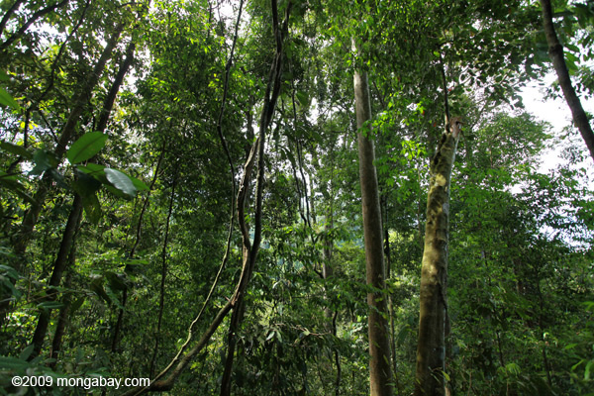
Main goal
End deforestation and peat conversion for palm oil, cutting palm oil related emissions in half by 2020
Strategies:
  Reducing global demand for vegetable oil
  Creating demand for sustainable, deforestation-free production of palm oil
Notes:
Palm oil can be grown in a way that is truly sustainable for the climate and not in conflict with tropical forests. Deforestation-free (Responsible) palm oil would not allow the clearing of primary forests, high carbon stock forests, high conservation value forests, and would not allow planting on peat. This would need to be coupled with strong environmental and social safeguards to ensure that the local environment and local peoples and workers are all treated well.
Photo credit: Mongabay, 2009, Indonesian tropical forest

Slide 3
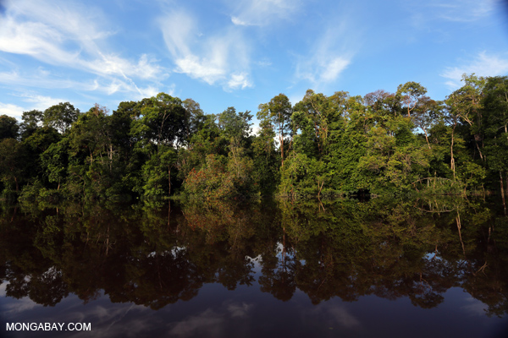
Working on 3 main streams of work:
Market transformation campaign
Investigation on the ground in the palm oil producing countries
US and EU biofuels policy

Slide 4
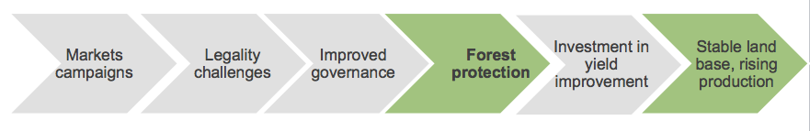
Theory of Change
Markets Campaigns: The Bridge to Conservation
Markets campaigns can transform industry leaders’ approach to governments.
Once they make commitment to No Deforestation-No Exploitation policy, strong incentive to make sure competitors don’t have a perceived unfair commercial advantage by cutting corners
Turn from opposing government enforcement to supporting it to create a level playing field in the industry.
Source: Koh 2007, Defiries 2011.
Notes:
Koh, Lian Pin. 2007. “Impending disaster or sliver of hope for Southeast Asian forests? The devil may lie in the details,” Biodiversity & Conservation. DeFries et al. 2011. “High-yield oil palm expansion spares land at the expense of forests in the Peruvian Amazon.” Environmental Research Letters

Slide 5





Markets Initiatives: Where to focus?
Persuade >6bn shoppers?
Engage with 100’s of major producers?
CONSUMERS
PRIMARY PRODUCERS/ EXCTRACTORS
Or work with/on 4-6 major traders?

Slide 6
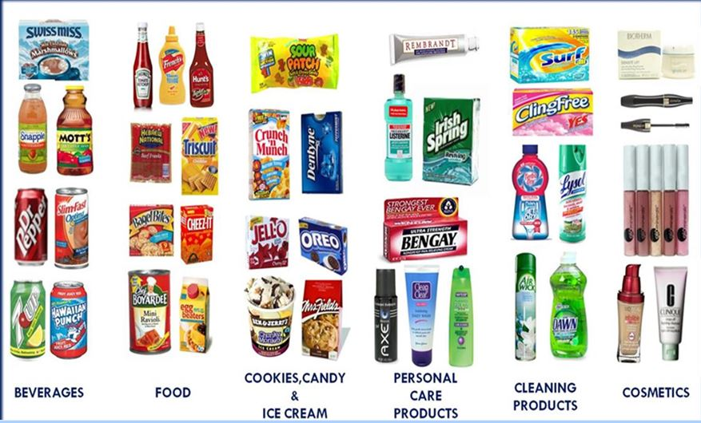
Target major brands to adopt deforestation-free palm oil procurement policies
Notes:
UCS will engage its members, activists, the business community, and the American public about the connection between unsustainably sourced palm oil and its impacts on the environment in order to exert pressure along the palm oil supply chain.
Send our Scientists Statement to companies—sent to 80 major companies, follow up occuring now.
Issue a Scorecard and push the findings out to the media in February 2014--starting with 30 major companies; ten of the largest companies by revenue in three sectors (fast food, personal care, packaged foods)
Target select brands through media outreach, events at food shows, phone calls and emails, and shareholder resolutions
To convince consumer-facing companies to adopt or strengthen palm oil purchasing policies requiring that they use only deforestation-free palm oil, we will engage in a number of activities this year. We will redeploy our December 2012 Scientists Statement on the Roundtable on Sustainable Palm Oil’s Draft Revised Principles and Criteria for Public Consultation letter, which urgently called on the RSPO to include two critical missing components in their palm oil standards: a ban on planting palm oil on peatlands and a ban on converting high carbon stock secondary forests to palm oil plantations. This year, we will send the Scientists Statement directly to 84 members of the RSPO with a branded consumer or retail presence in the American marketplace requesting meetings with UCS to address the risks inherent in their current palm oil sourcing policies.
We are also publishing a print scorecard rating the palm oil purchasing policies of the top 10 leading companies in three sectors: fast food, packaged foods, and personal care products. The release strategy for the scorecard in February 2014 will include a printed scorecard, outreach through social media, and dedicated outreach through UCS web and listserv channels, as well as through partners in the zoo, NGO, and scientific communities. As part of its promotion, UCS will engage in a media outreach strategy to help key food reporters understand this issue as a way of increasing the number of mainstream articles about deforestation and climate emissions. We will follow up with numerous companies through dialogue, ultimately selecting three laggards for public campaigning activities, aiming to secure public deforestation-free commitments by the close of 2014. We will target decision-makers in those three companies through a variety of public outreach activities, including generating negative media publicity, email action alerts, shareholder resolutions and participation at annual shareholder meetings, and targeted outreach at food conferences and trade shows.

Slide 7

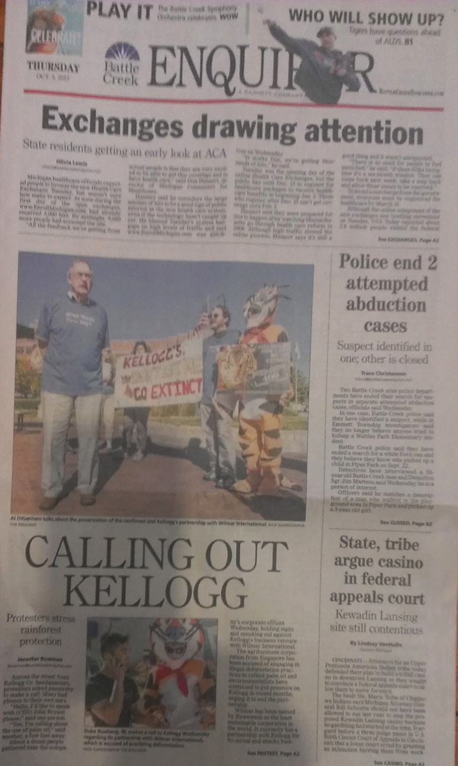

Forest Heroes Campaign

Slide 8
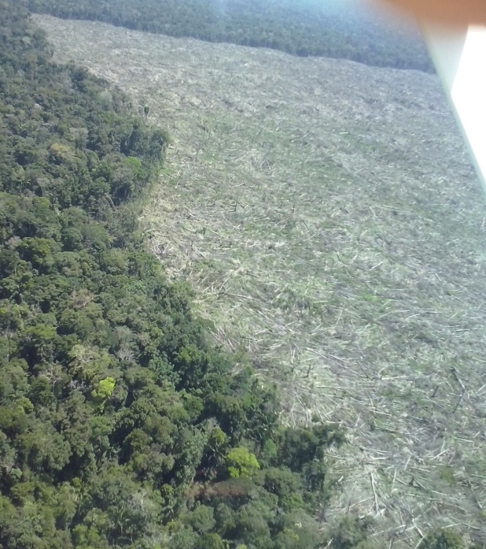
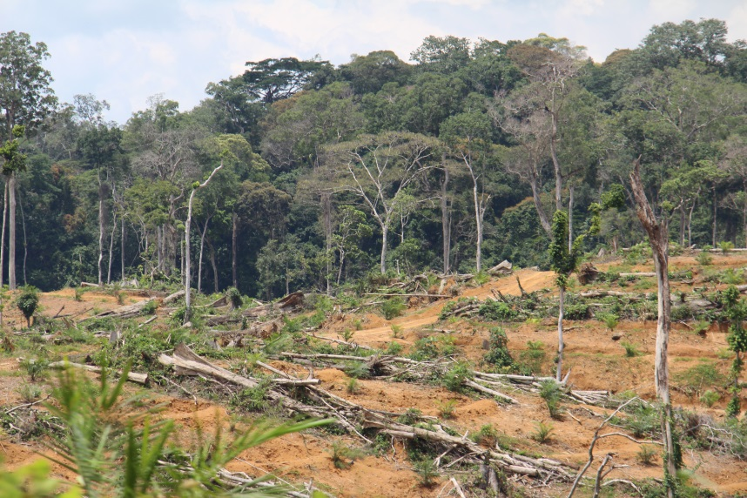
Investigations and Capacity Building
Expose harmful, corrupt and illegal practices of palm oil producers
Empower indigenous peoples and forest dependent communities to recognize and assert their rights

Slide 9
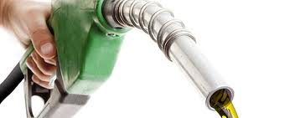
Biofuel Campaign
Ensure the best science on carbon emissions directs biofuel policies in the US, EU and California
Ensure that vegetable oil based biodiesel demand is low
Notes:
Push EPA to set new biodiesel volume mandates and reject a palm oil pathway under the RFS.
Led by UCS Senior Scientist Jeremy Martin, we will work with the UCS Science Network to submit detailed technical guidance to EPA and weigh in with public comments during EPA rulemaking process to set new volume limits for advanced biofuel/biodiesel mandates. UCS has met with Environmental Protection Agency (EPA) staff. The meeting confirmed the importance of building a stronger technical case on the relationship between additional U.S. biodiesel consumption and palm oil production overseas, as well as the need to provide whenever possible concrete numeric recommendations regarding volumes. Jeremy is now partnering with allies to craft an economic model to use as the basis for simulations that provide more a concrete analytical basis and empirical support for our argument that increased U.S. soybean oil use will drive an expansion of palm oil production in Southeast Asia. The work is progressing quickly and the initial results will be done by the end of the fiscal year. Our recent interactions with EPA and others reinforced the need for this analysis to support both our regulatory interactions with EPA and our palm oil campaign.
We will also work with coalition partners to ensure that the EPA sticks to the science and upholds their initial findings not to approve a palm oil specific pathway under the RFS. In California, UCS will be produce an analysis to submit to the California Air Resources Board that reinforces previous studies that show the high carbon cost of palm based biofuels. A recent U.S. Department of Energy-sponsored GTAP analysis of biofuels land use change which makes several key analytical decisions that tend to minimize land use change emissions. In response, we are in early stages of exploring how to refine a model for biodiesel scenarios that will allow us to evaluate implications of California, U.S. and EU biodiesel use for global palm oil markets, which could be very valuable in our palm oil campaign.

Slide 10

Biofuels campaign
EU currently revising its biofuels policy
It is reducing the volume of biofuels from food crops and incorporating emissions from indirect land-use change (ILUC)
US deciding whether to approve palm oil as renewable fuel

Slide 11
ADDITIONAL SLIDES

Slide 12
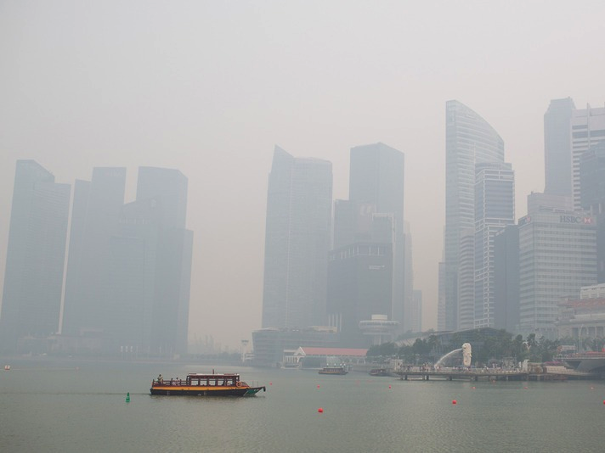
Changing Wilmar from Outside In
Case Study

Slide 13
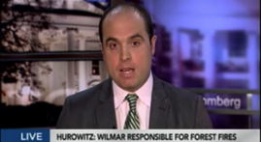
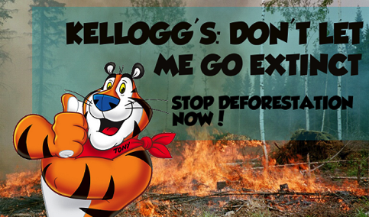
Wilmar: Market Transformation
Drive business media attention around Wilmar’s responsibility for SE Asia forest fires
Focusing on points of maximum leverage with Wilmar:
  Kellogg’s joint venture
  Buyers
  Financiers
Working with SumofUs.org for large-scale online, grassroots action
On the ground organizing in Michigan
Poised to launch campaigns in Asia targeting aspirational Asian consumers
Direct engagement with Wilmar executives
Notes:
Koh, Lian Pin. 2007. “Impending disaster or sliver of hope for Southeast Asian forests? The devil may lie in the details,” Biodiversity & Conservation. DeFries et al. 2011. “High-yield oil palm expansion spares land at the expense of forests in the Peruvian Amazon.” Environmental Research Letters

Slide 14
EU’s 10% biofuels target

Slide 15
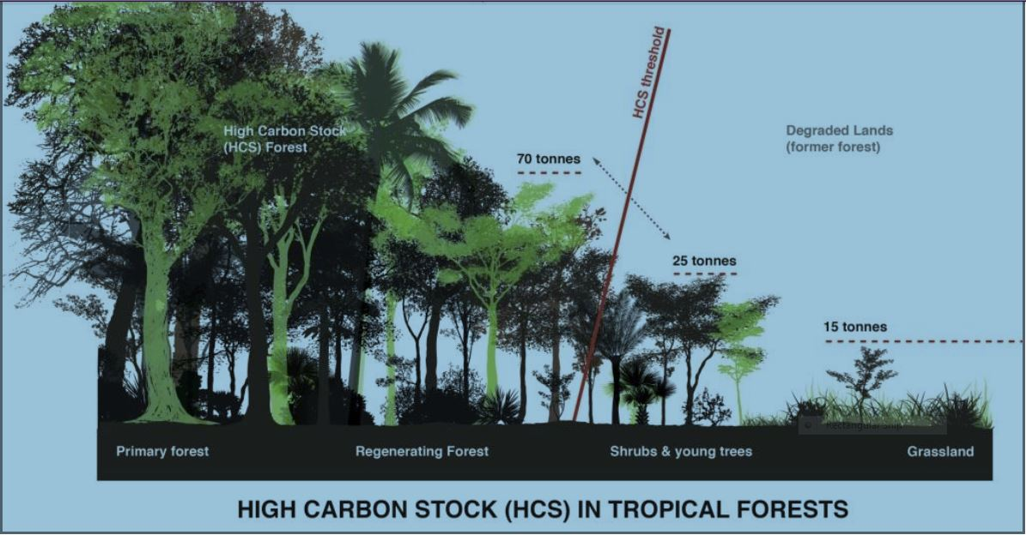
Build support for methodology to determine “High Carbon Stock” forests
Notes:
Contribute to industry-wide adoption of methodology for identifying and protecting high carbon stock forests that must considered ‘off limits’ to the development of palm oil. This methodology is a scientifically robust and cost effective tool for categorizing land to ensure we protect secondary forest that store the greatest quantity of carbon and biodiversity, while still identifying land that would be best used for agriculture. This work will allow us to highlight a specific on the ground practice that producers can use to meet the global marketplace’s demands for deforestation-free palm oil.
In order to ensure that this methodology is based on the best available science and has buy in from the academic community, we will organize a session on this topic at the annual Association of Tropical Biology and Conservation meeting, and give presentations at ESA and other conferences. We will recruit an estimated 50-60 experts/scientists to join a webinar to understand—and comment on--the methodology. Finally, we will draft a basic draft of an article about the methodology in order to begin recruiting co-authors for revision and submission in next fiscal year to a peer-reviewed journal.

Slide 16
Strategy Assessment:
One company dominates global trade in palm oil
Deforestation free policy from Wilmar could transform entire industry: everyone sells to Wilmar
Source: Annual reports, WWF and Boston Consulting Group
Notes:
Wilmar Annual Report, 2011.

Slide 17
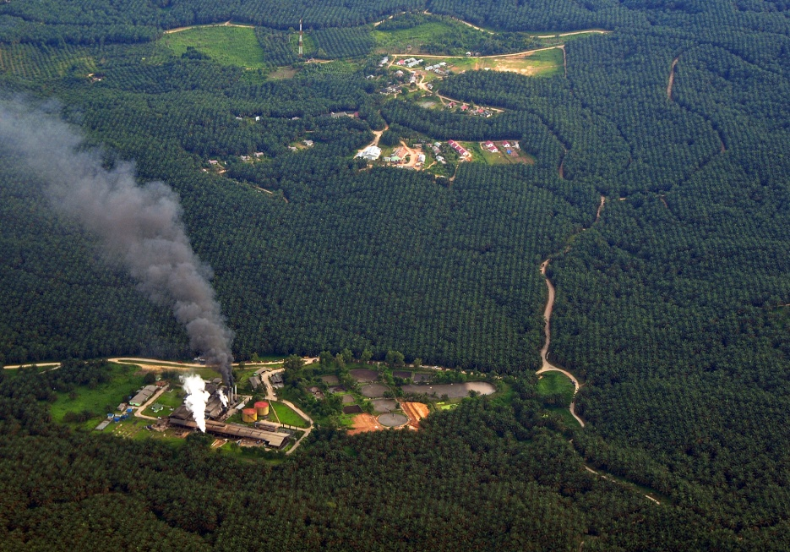

Focus on the science: reports on health impacts of consumption, environmental impacts of production
Notes:
We will research and evaluate the health impacts of palm oil, including via diet and indirect health impacts (i.e, smoke inhalation from fires or pesticide runoff into rivers from palm oil expansion). The goal is this report will be to cut through the rhetoric and hyperbole on both sides of the palm oil health debate (i.e. “the saturated fats in palm oil make it terrible for your heart” vs. “red palm oil is a miracle food full of micronutrients and phytochemicals”) and present an objective review of the science on the issue. Due to the complex and sensitive nature of the topic, we will be planning a two stage release of the report. In early summer 2014 we will release a near final version of the report to key partners in the NGO community. We will then consult with them extensively over the subsequent months to evaluate and develop the best outreach strategy for a final public release in early fall 2014.
We will continue to issue other reports and analysis focused on palm oil production, including factsheets, remote sensing analysis, and analysis of palm oil-based biofuels and carbon emissions.

Slide 18
Carbon intensity of biofuels

Slide 19
The impact on palm oil demand

Slide 20
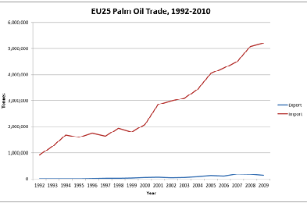
EU palm oil trade

Slide 21
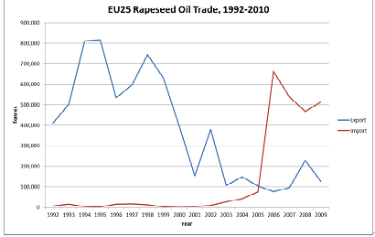
EU rapeseed oil trade

Slide 22
Key results of biofuels work
EU proposed to cap biofuels produced from food crops at current levels
And introduce ILUC for reporting
European Parliament strengthened the dynamics of the cap
Included ILUC in a stronger way (in one of the laws)
The decision might be delayed until the end of 2014

