Slide 1
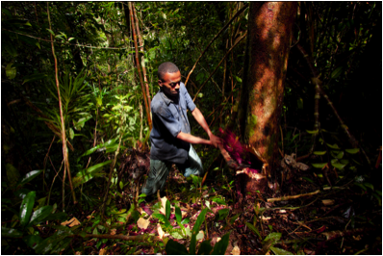
Achieving Cost-Effective Reductions in Emissions through Leverage of Demand-side Measures and Local Capacity Building
Environmental Investigation Agency 2013-2015 Project Description

Slide 2

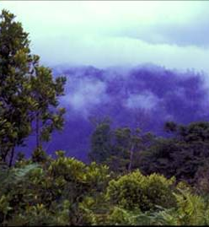
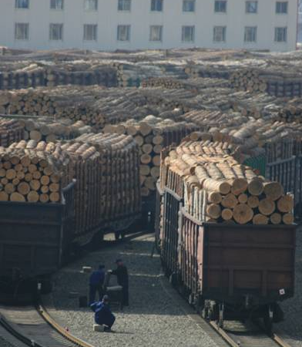


Illegal logging: Why do we care?
Serious global impacts for ecosystems, economies, human rights, climate and rule of law
UN report estimates that it generates approximately US$30 - $100 billion annually in criminal proceeds
Creates an unlevel playing field for companies operating legally and undermines sustainable development

Slide 3
Vision for 2015 and Beyond
Forests around the world are governed more equitably, transparently and responsibly, and in which the rule of law functions effectively for these ends.

Slide 4
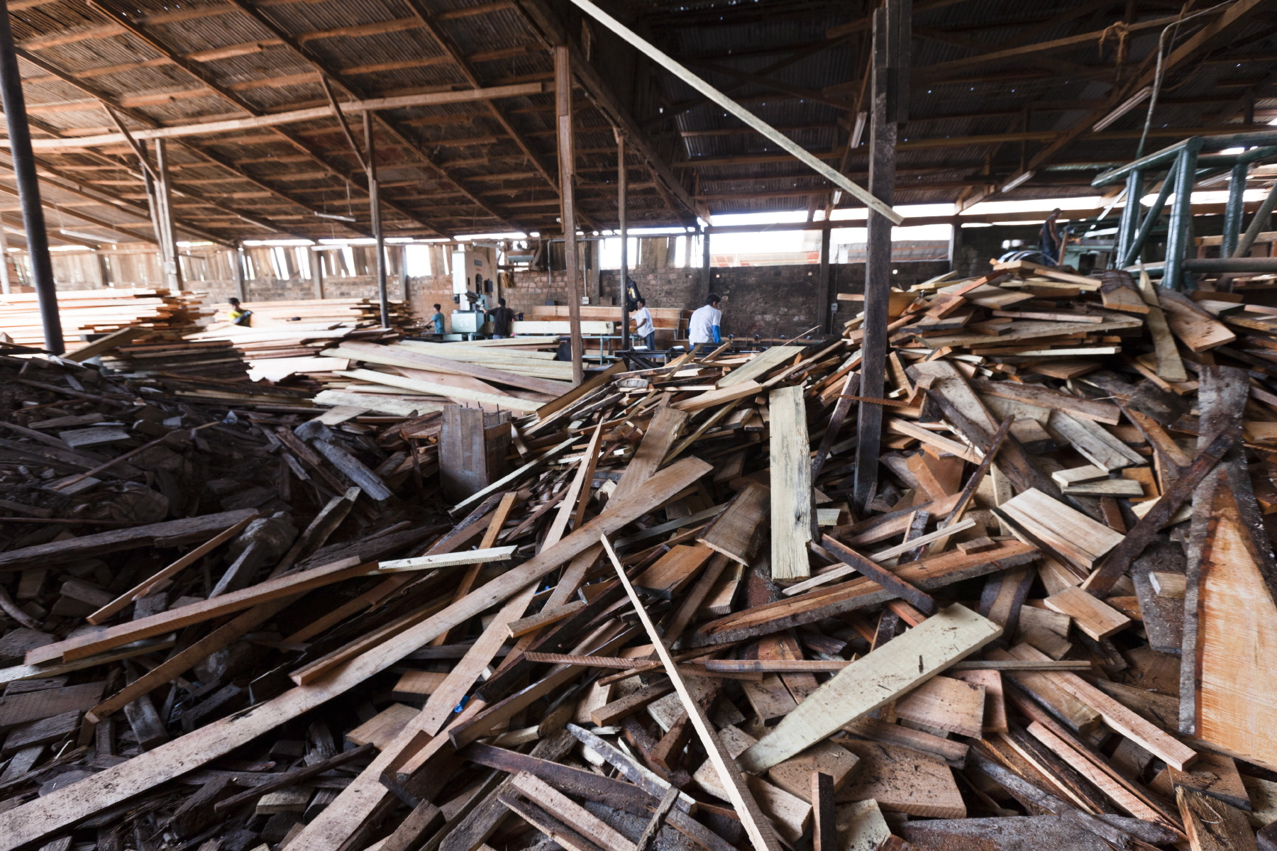
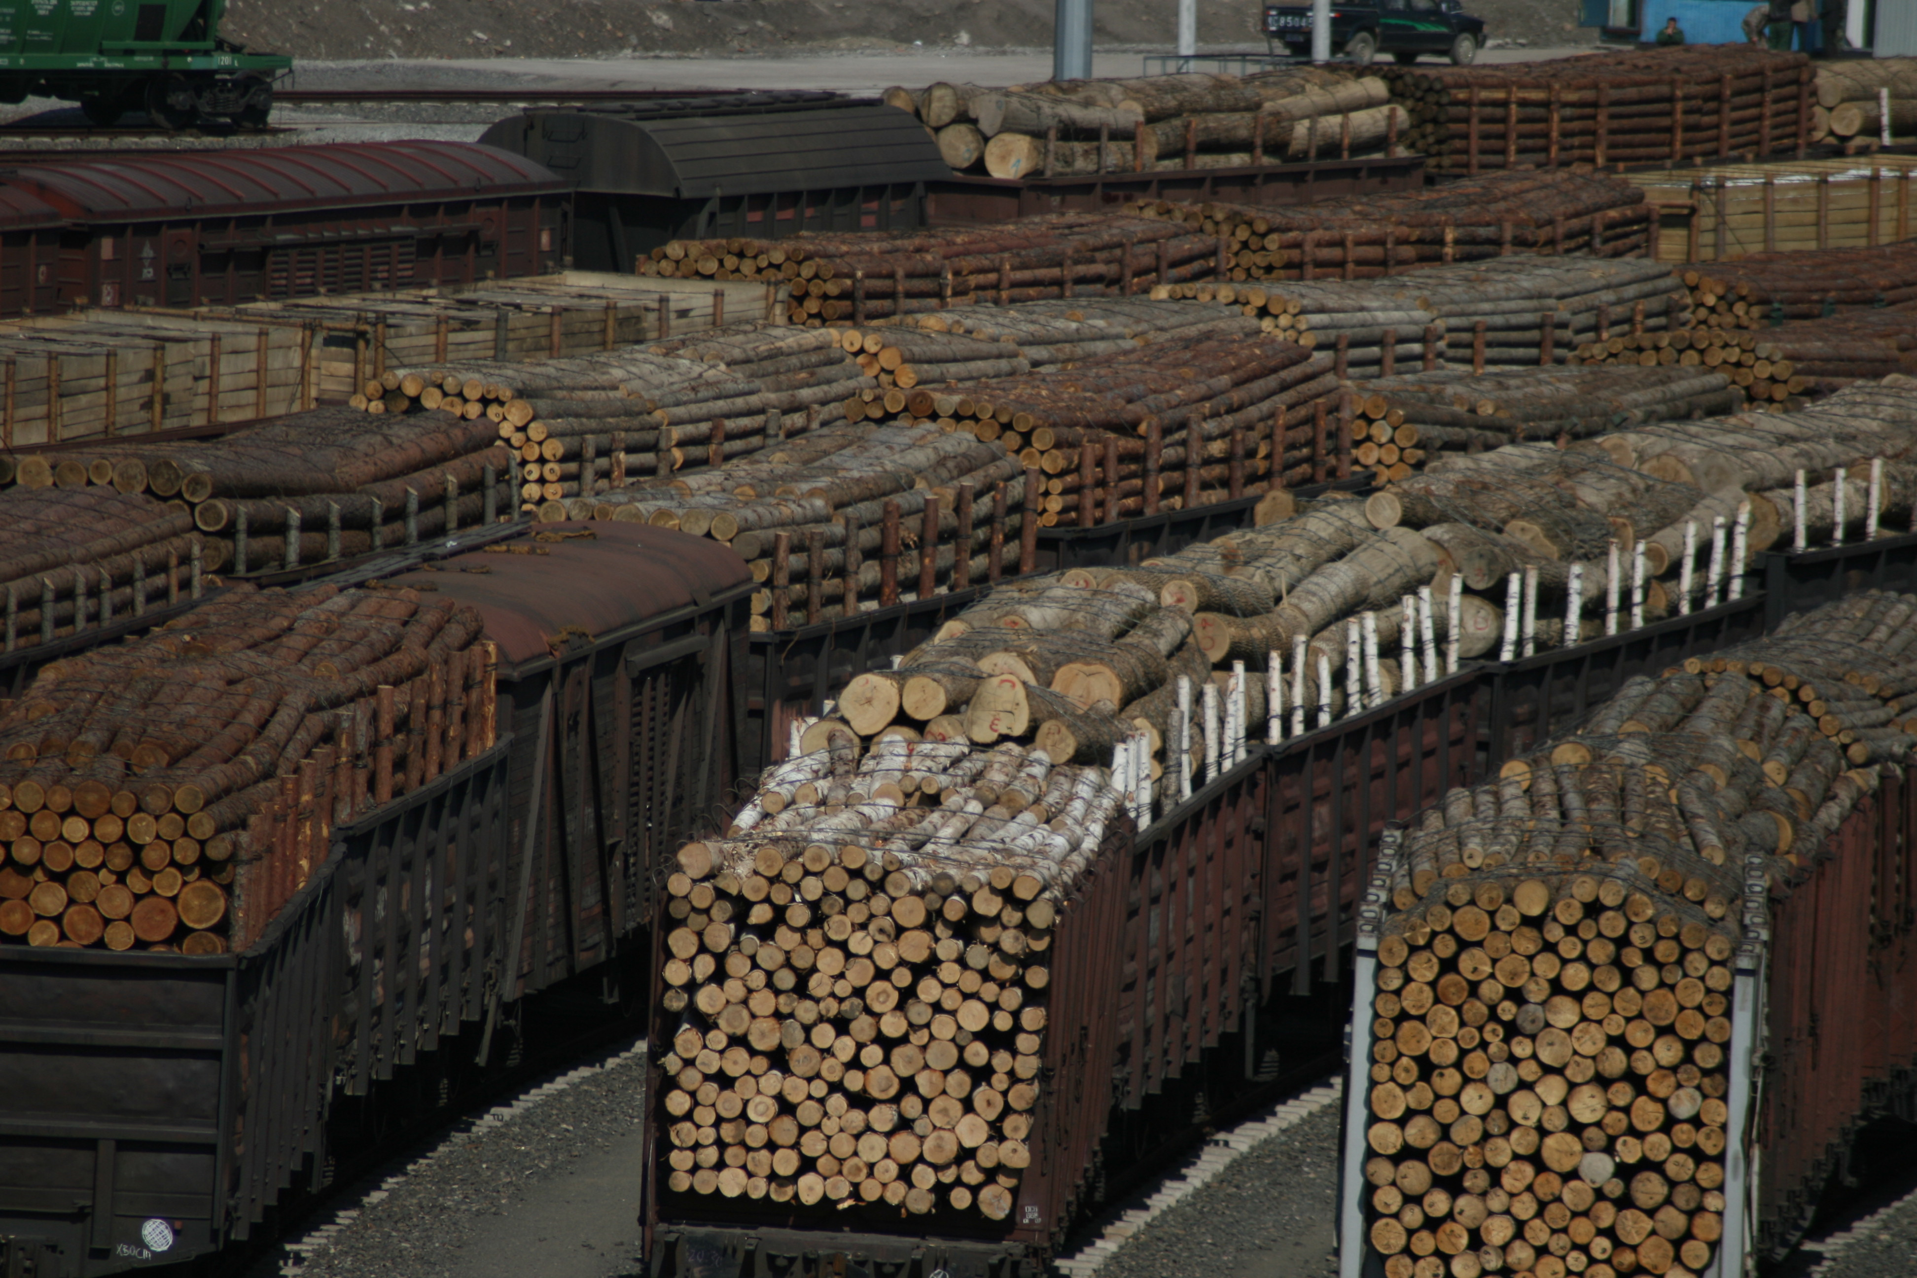
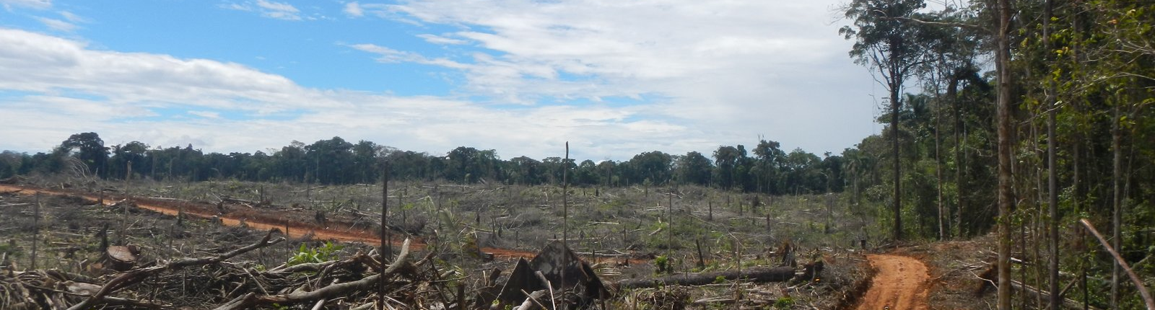
Ensure emerging consumer country legality policies are implemented and enforced

Slide 5
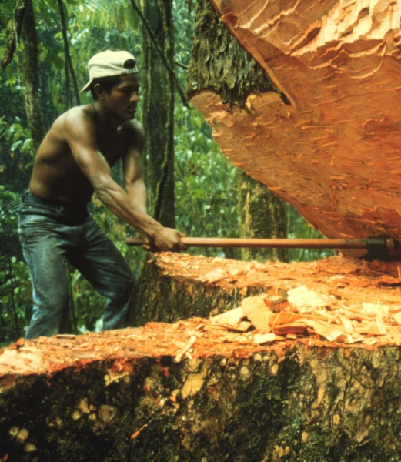
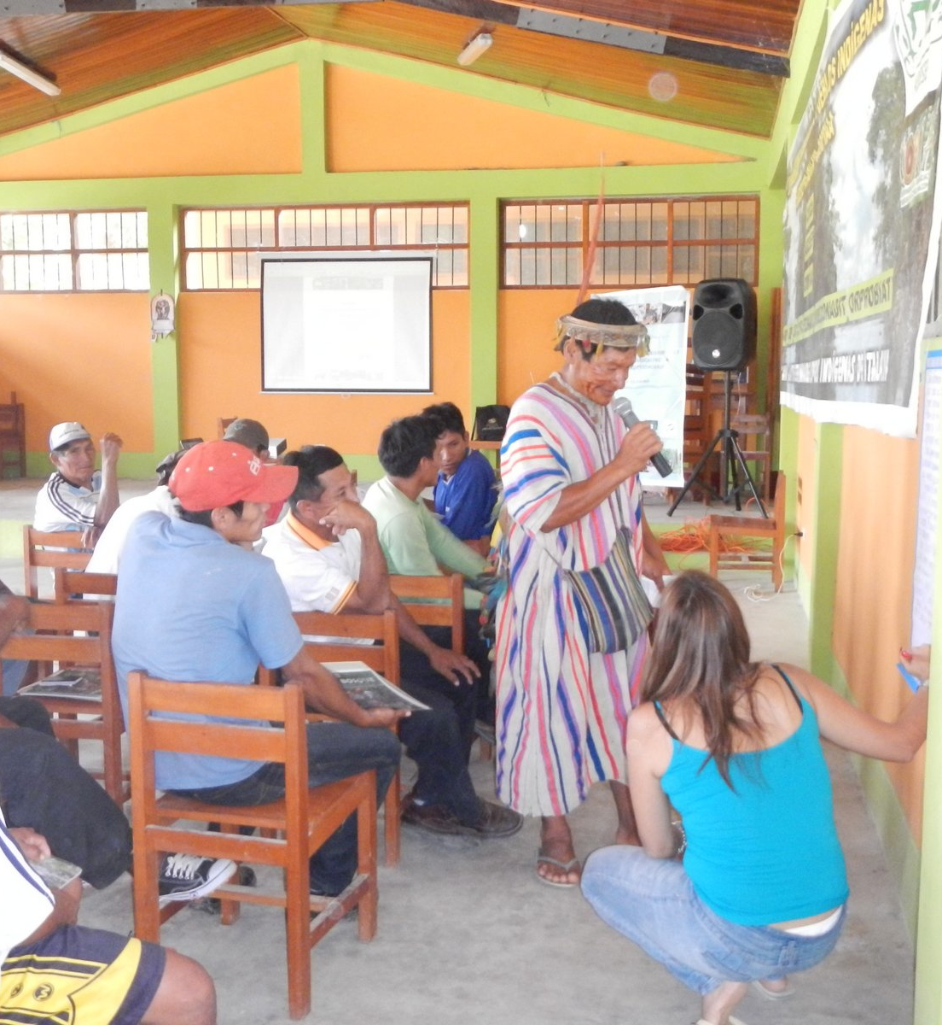
Improve forest governance through investigation, education, civil society training, and capacity building

Slide 6

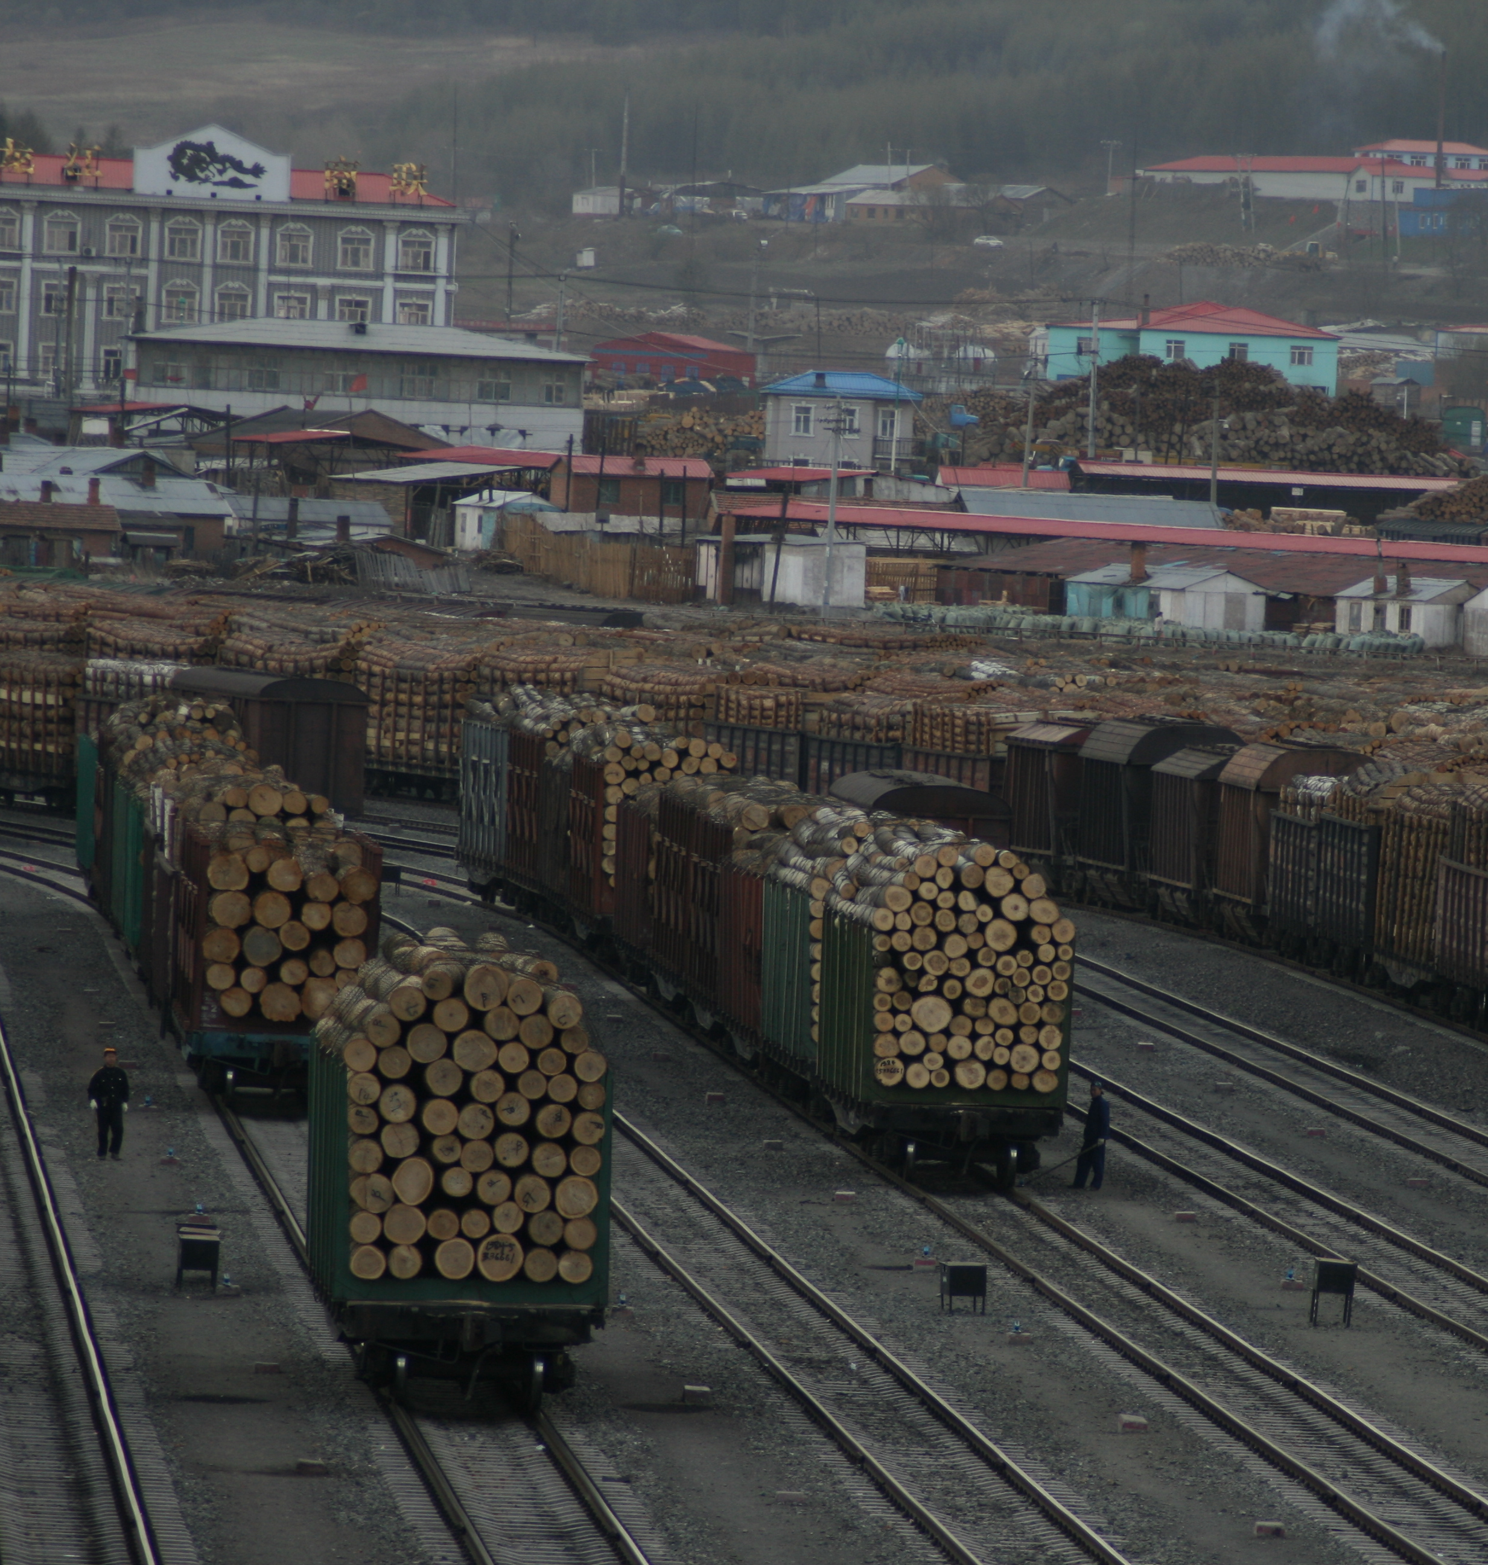
Achieve structural changes in key manufacturing sectors and consumer countries currently lacking legality policies
Notes:
In Madagascar we found this $1 million rosewood bed on sale in a high-end shopping in Shanghai. We tracked the wood here from Madagascar, where $10 dollars of the $1 million remained.

Slide 7
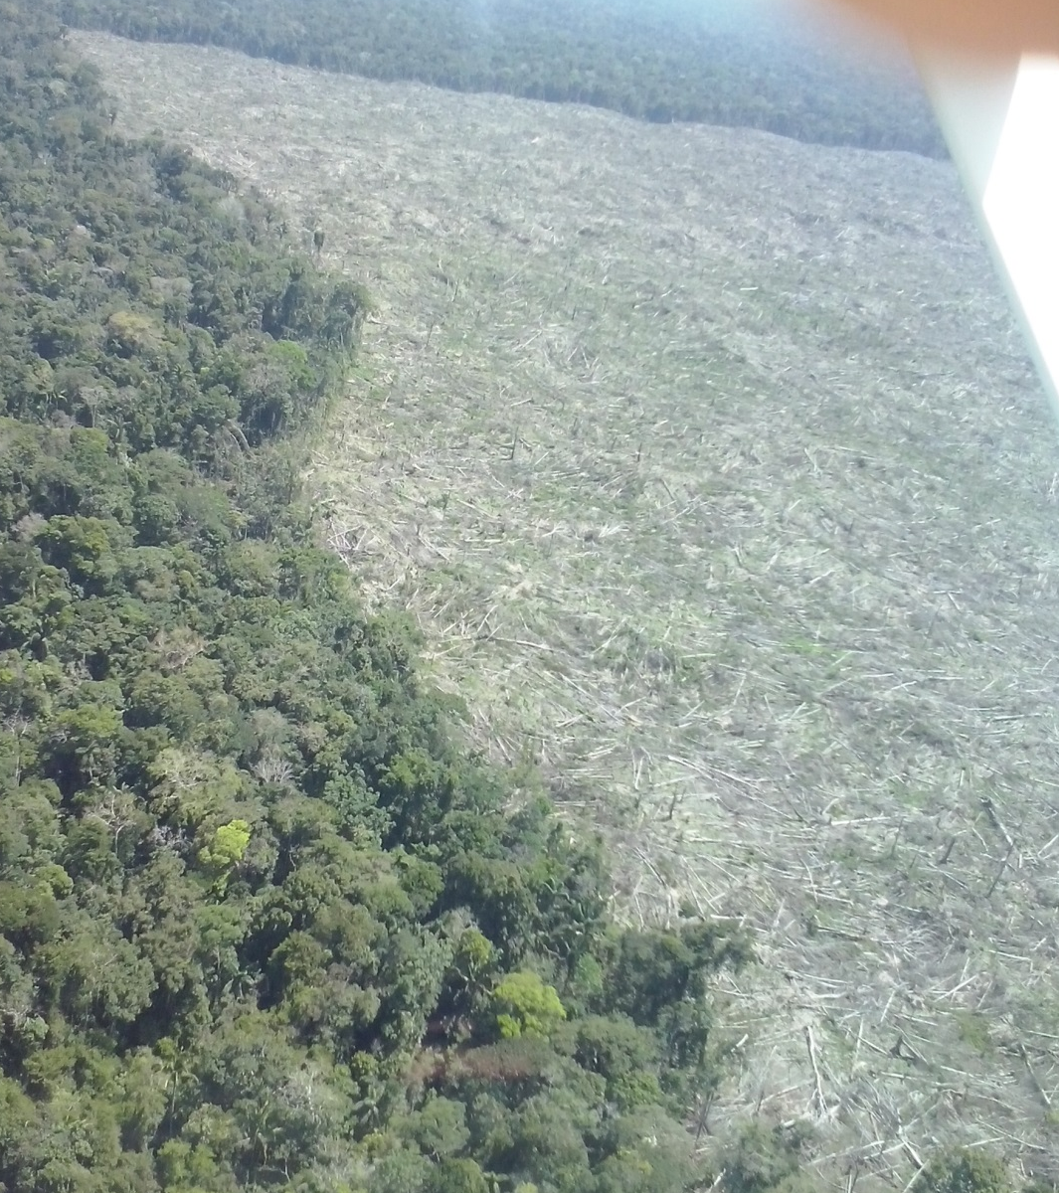
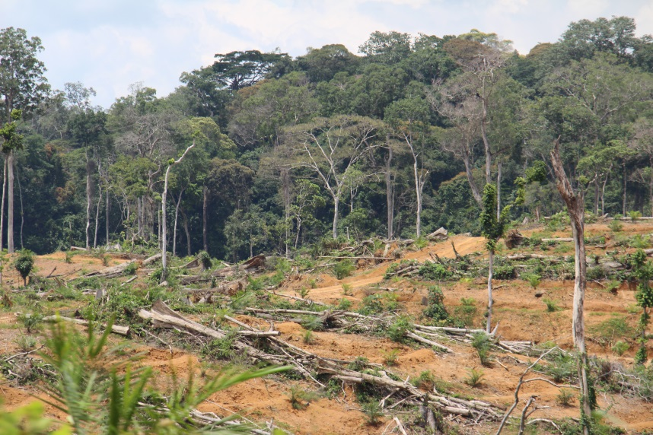
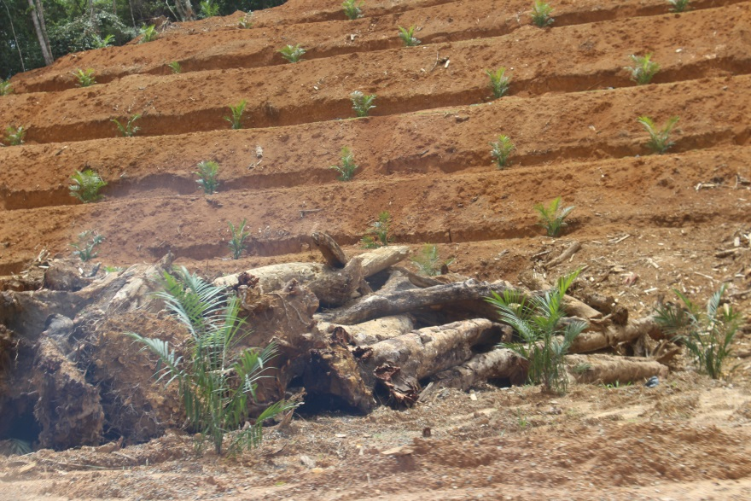
Apply model of full legal responsibility to a broader set of commodities

Slide 8

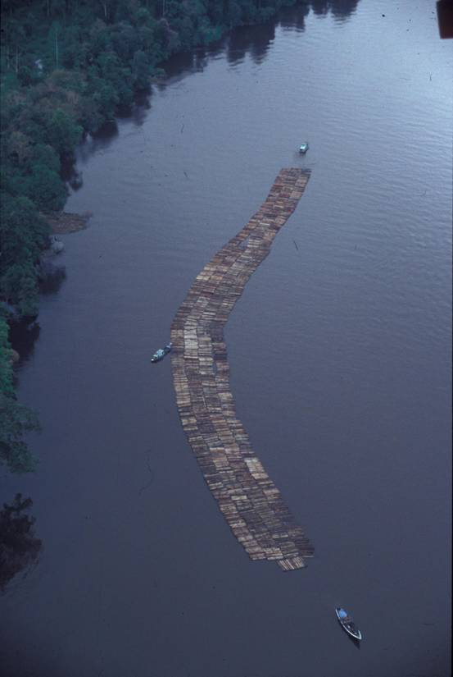
“Expecting or asking one country to combat illegal logging while at the same time receiving or importing illegal logs of course does not support efforts to combat these forest crimes. In fact …allowing import and trade [in] illegally cut timber and associated products could also be considered as an act to assist or even to conduct forest crime.”
- Indonesia’s former forest minister
Mohamad Prakosa
Notes:
This is a problem that cannot be dealt with in supply countries alone. The powers of a largely no questions asked international market is driving these activities. Over the years, producer countries have articulated the need for strong market signals to curb the illegal trade.

