Slide 1
Project PILaR – Private Investment in Landscape Restoration
Advancing REDD+: Mobilising private investment for community-based, carbon-intensive landscape restoration
Brazil, Ghana, Guatemala and Mexico

Slide 2
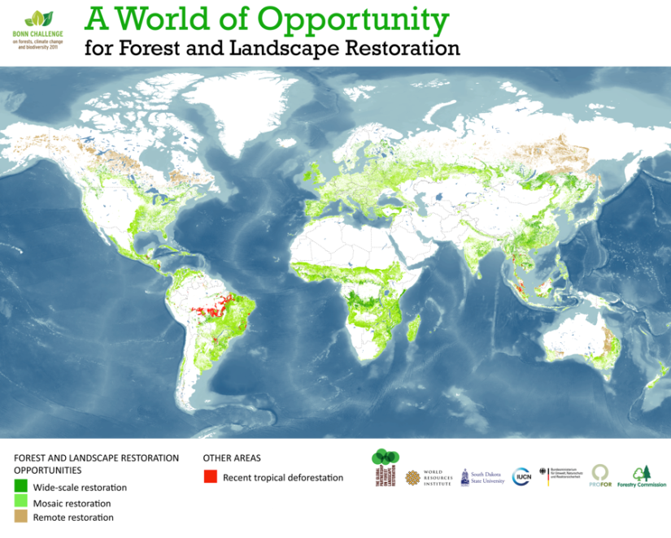

Slide 3
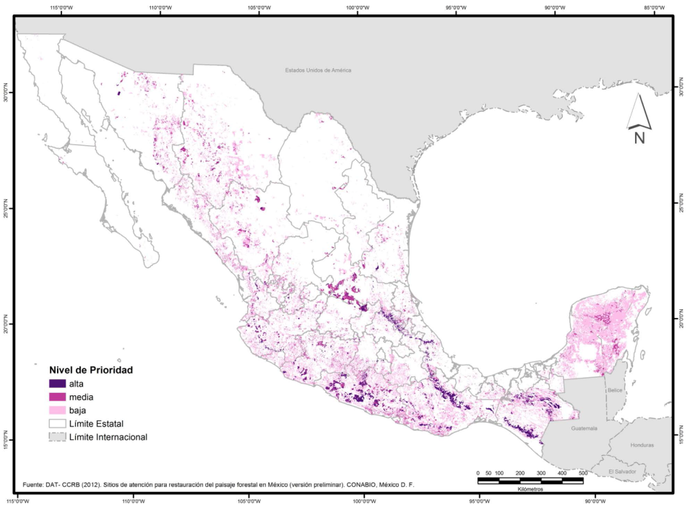
PILaR Project – Raison d’etre:
Moving from priority areas to restored areas
Notes:
To take early action to achieve cost-effective and verifiable reductions in greenhouse gas emissions:
The project will initiate forest landscape restoration activities that will begin immediately to enhance removals of carbon.
Restoration offers cost effective options – doubling the current (gross) rate of forest and agro-forest landscape restoration to approximately 15 million hectares per year over the next decade could reduce the current emissions gaps by an additional 1 GtCO₂e per year.
To work towards the inclusion of emissions from deforestation and forest degradation in a new international climate regime:
Innovative community-private sector collaboration
Restoring political ambition back to pre-Copenhagen levels and maintaining the momentum from Cancun and Durban
THROUGH
Ensuring that new methodologies, practical restoration experiences and investment models from real forests and real sustainable landscapes help to shape the ongoing negotiations for the new climate arrangements.

Slide 4
Impact Statement
“Sustainable forest landscapes that enhance carbon stocks and improve social and economic returns to farmers, communities and investors, facilitated by private sector investments”
Indicators
Pilot initiatives based on locally negotiated and economically viable restoration activities, that are carbon-intensive and open to the participation of a range farmers and communities, are established and scaled up via joint project and private sector investments.
Livelihood improvements within the communities across the targeted landscapes are a result of locally negotiated and economically viable project and private sector investments in restoration activities.
Restoration activities and associated private sector investments are scaled up as a consequence of the feedback loops disseminating best practices to local, national and international stakeholders.
Notes:
Generic outcomes:
Degraded forest and agro-forest landscapes are transformed through an expansion of activity in the areas of forest and landscape restoration
Achieved by wide range of strategies from natural regeneration to well managed plantations and biodiversity corridors, thereby leading to the maintenance and enhancement of carbon sinks.
The pilot sites will be delivering packages of co-benefits through investment in the right kinds of actions and approaches.
An integrated approach based on forest and landscape restoration will be used not only to deliver carbon mitigation but also to drive economic activity and generate income to benefit local communities.
Specific Outcomes:
1: Assessment and Capacity – Local, national and international partners mobilized with capacities to identify, negotiate and agree the terms of forest landscape investment opportunities
2: Piloting and Scaling Up – Investments in carbon intensive sustainable landscape restoration aimed at delivering a suite of co-benefits piloted and scaled up
3: Learning, Outreach and Uptake – Real-time feedback loops demonstrate and communicate successful investment strategies to national, regional and international policy makers and international investors
Indicators
Willingness by sectoral Ministries and Departments, Private Sector, and Local level authorities and community groups to include approaches to enhancing investments in landscape restoration in their strategic and operational plans;
Local communities are actively engaged in restoration activities and implementing restoration action plans in partnerships with the private sector;
Restoration activities established with private sector investment are delivering co-benefits to communities and investors in selected priority landscapes, and carbon stocks enhanced.

Slide 5
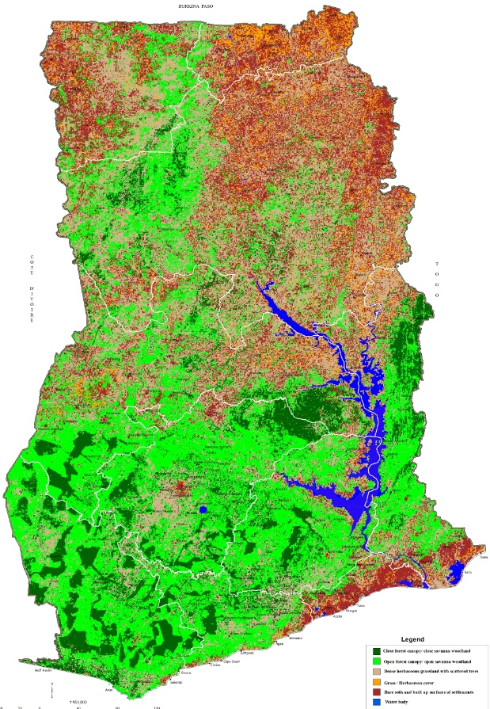
Ghana’s Proposed Outcomes
Two major outcomes are envisaged in Ghana during the implementation of this project. These are:
  A) Mobilizing local and national partners with capacities to identify, negotiate and agree on terms of forest landscape investment opportunities; and
  Piloting private sector investments in carbon intensive sustainable landscape restoration with at least four Ghana forest restoration investors.

Slide 6
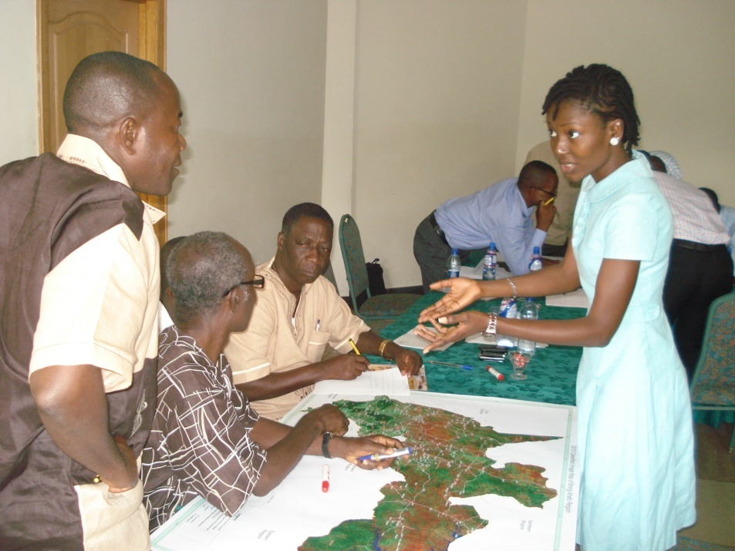
Ghana’s Current and Planned Activities
  Through a multi-stakeholder process, drawing on scientific and indigenous knowledge, assess and map landscape restoration potential, including ecological and socio-cultural values.
  Carry out an appraisal of the net economic benefits of different restoration interventions across the selected landscapes.
  Conduct local value chain analyses and market studies of major forestry products that could lead to improved forest restoration.
  Support the negotiation and implementation of rigorous and feasible landscape restoration strategies and operational plans in selected pilot sites.
  Establishment of livelihood and biophysical baselines to permit periodic monitoring and assessment of the delivery of tangible co-benefits from landscape restoration activities

Slide 7
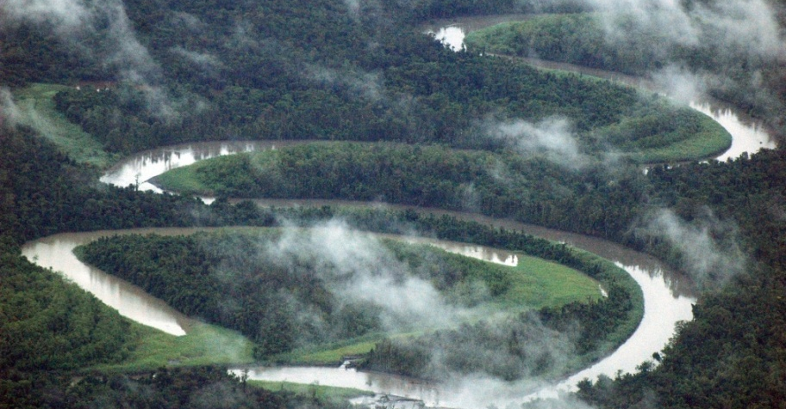
www.iucn.org/redd
@IUCN_REDD
Adewale (Wale) ADELEKE
Forest Governance Coordinator
Accra, Ghana
adewale.adeleke@iucn.org
Gretchen WALTERS
PILaR Project Officer
Gland, Switzerland
gretchen.walters@iucn.org
Patrick WYLIE
Global Senior REDD+ Advisor
Washington, DC
patrick.wylie@iucn.org

