Slide 1
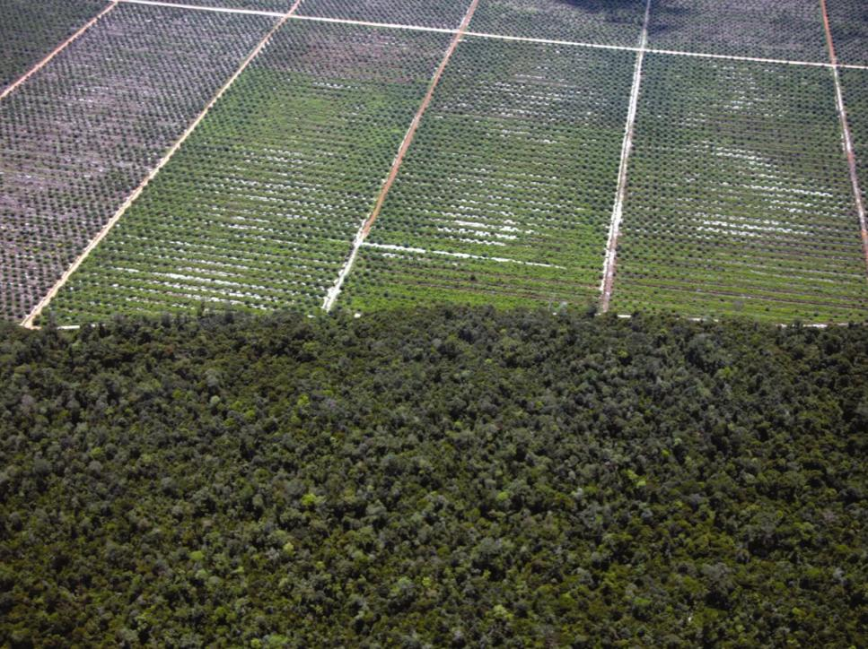
Promoting Deforestation-Free Agricultural Commodity Supply Chains and the Link to Jurisdictional REDD+ Frameworks
National Wildlife Federation | Environmental Defense Fund | Amigos da Terra-Amazônia Brasileira | University of Wisconsin-Madison | U.S. National Aeronautics and Space Administration

Slide 2
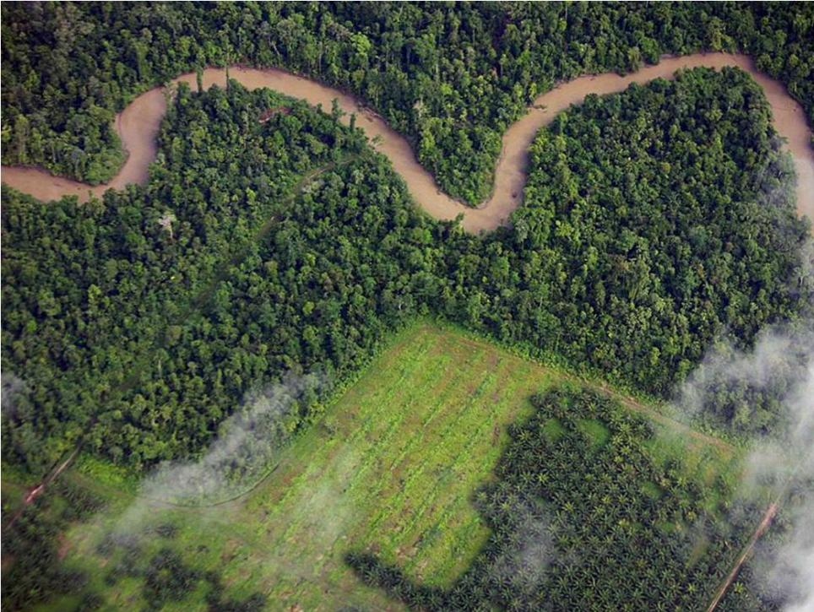
Commodity Roundtables, REDD+ and Deforestation Monitoring
Commodity roundtables, other multi-stakeholder groups, and individual companies aiming to reduce or eliminate deforestation in their supply chains have faced similar challenges.
Have certification, voluntary moratoria and “zero deforestation” policies reduced deforestation at the regional scale?
There are potential synergies between efforts to develop sustainable agricultural supply chains and REDD+ programs at jurisdictional (state or country) levels.
Notes:
Roundtables: RSPO, RTRS, BonSucro, RSB, GRSB
Multi-Stakeholder and Industry Groups: CGF, GTPS, LWG

Slide 3
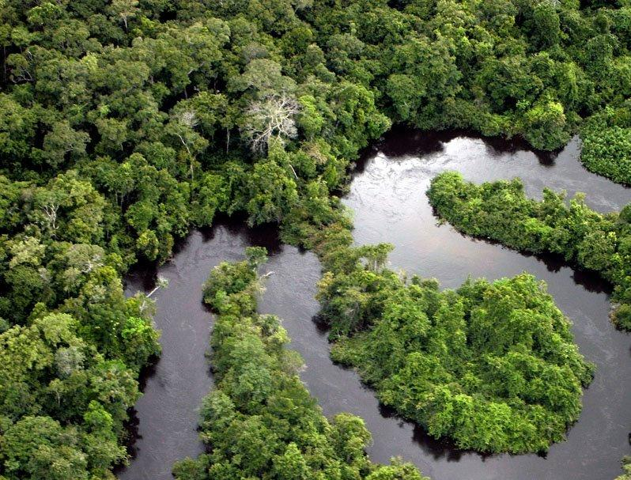
Linking Deforestation Monitoring with Commodity Certification
A deforestation monitoring system for roundtables at the jurisdictional level could:
1) enable the wider impacts of commodity certification on regional deforestation to be determined;
2)account for leakage;
3) provide a means to link roundtables with jurisdictional REDD+ and other regional deforestation-reduction efforts;
4) decrease costs and increase robustness/uniformity of deforestation monitoring to determine compliance with roundtables’ standards.
Notes:
How should money be spent ?
Now we still haven’t figured out how to do it … but there is a lot of debate on how – the beauty is we’re creating a new system , so we should all see it as an opportunity rather than a constraint (although there are constraints…)

Slide 4
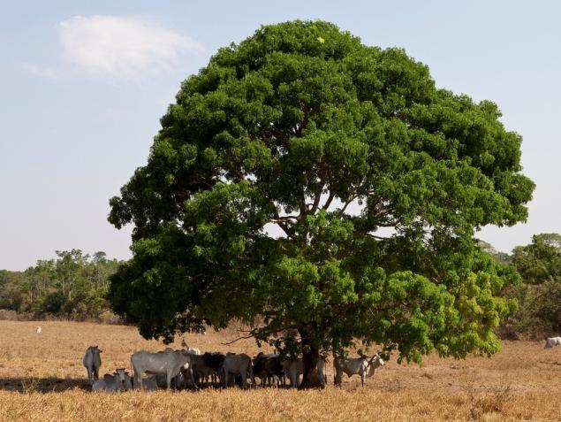
Cattle and Soy
Leverage leadership of GRSB-GTPS Joint Working Group
Support meatpackers’ zero-deforestation policies
Rancher outreach
Supply chain traceability for soy

Slide 5
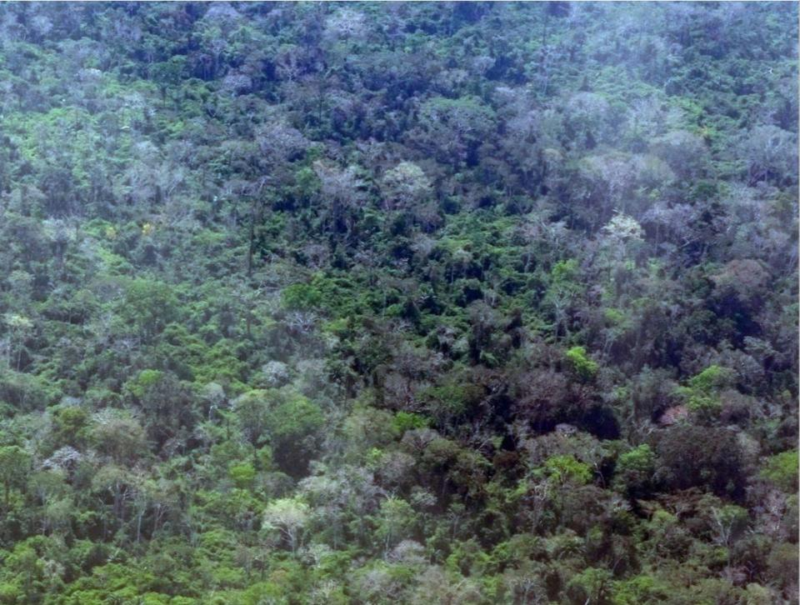
Palm Oil
Assess impacts of the Roundtable on Sustainable Palm Oil (RSPO) certification in Kalimantan, Indonesia
Jurisdiction-wide assessment to reduce costs of certification and verification
Dissemination of results to other roundtables
Utilisation of results by CDP Forests to garner corporate interest and concern in deforestation monitoring

Slide 6
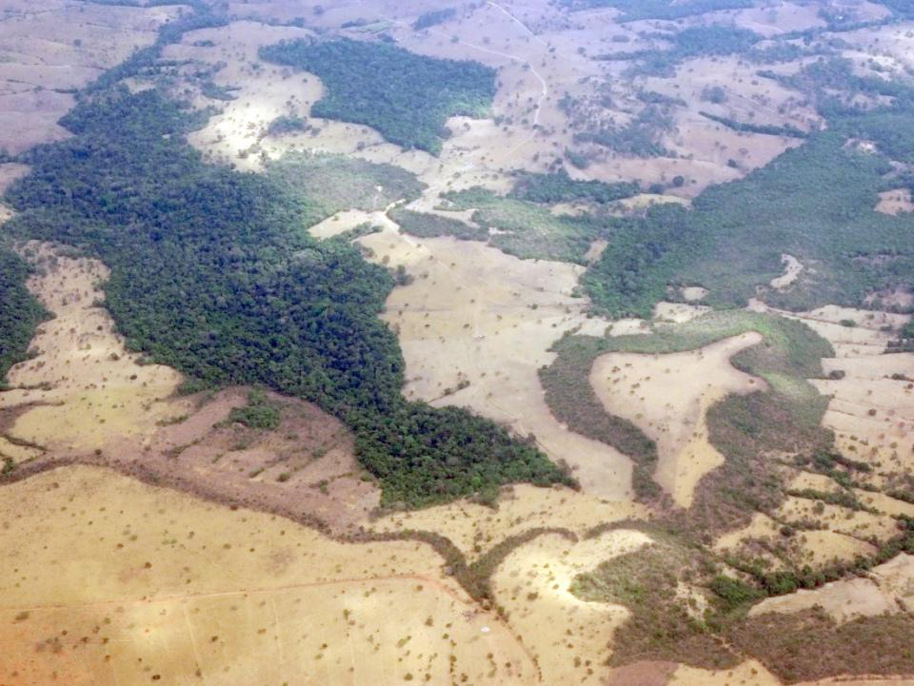
Biomaterials
Develop a deforestation monitoring system for the Roundtable on Sustainable Biomaterials (RSB) in southeastern Mexico
Results will be disseminated throughout Mexico
Workshop to identify the value of the RSB for small producers of biomass and biofuels
Case study identifying technical, financial, and market barriers faced by smallholders in Mexico
Results will feed into development of a new draft smallholder standard for the RSB

Slide 7
REDD+ Modelling
Model REDD+ Scenarios in Brazil, Indonesia, and Mexico using the OSIRIS model
Model REDD+ and Voluntary Mechanisms
Map zero deforestation landscapes
Formulate policy proposal to integrate voluntary mechanisms with REDD+ systems
Build support among stakeholders and corporate outreach

Slide 8
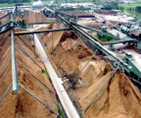
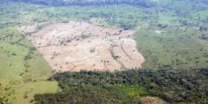
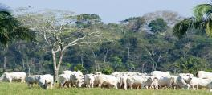
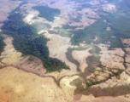
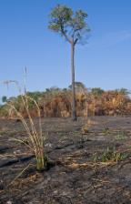
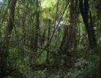
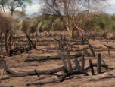
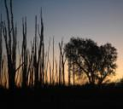
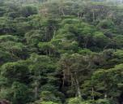
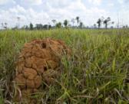
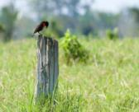
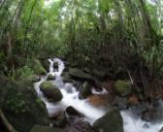
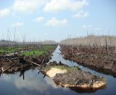
Thank you!
Contact:
Nathalie Walker (walkern@nwf.org)

