Slide 1
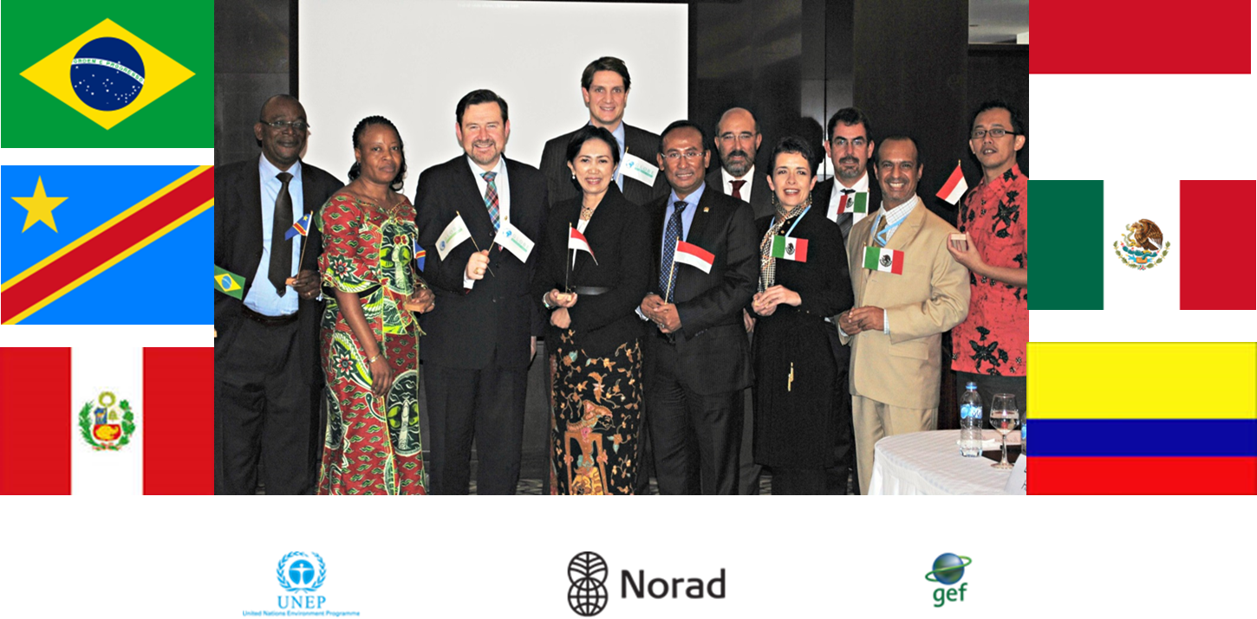
THE GLOBE FOREST LEGISLATION INITIATIVE
Marlene Grundstrom
Director, GLOBE Forest Legislation Initiative
28th October 2013
Oslo

Slide 2
GLOBE International – The Global Legislators Organisation
A network of cross-party legislators in more than 40 countries (and growing fast)
Provides a forum for legislators to showcase progress, share good practice on legislation and scrutiny, and learn lessons from experience
Currently working on legislation on climate change, tropical forests/REDD+, natural capital accounting
Presidency of GLOBE International rotates; currently with UK parliament
Visit www.globeinternational.org for more information

Slide 3
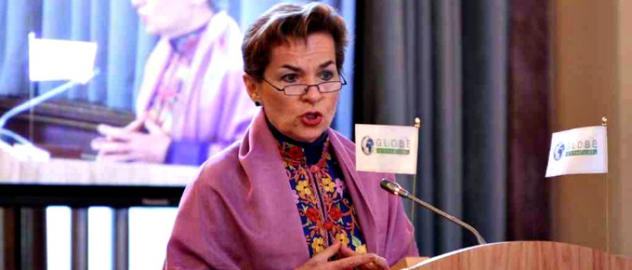
ROLE OF CLIMATE/FOREST LEGISLATION
“Domestic legislation on climate is the absolutely critical, essential, linchpin between action at the national level and international agreements. It is absolutely at the centre.”
“…nothing is going to be agreed internationally, until enough is legislated domestically.”
Christiana Figueres, Executive Secretary of the UNFCCC,
speaking at the first GLOBE Climate Legislation Summit in London,
14th January 2013.

Slide 4
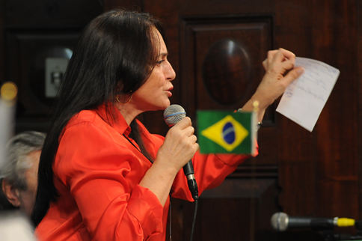
GLOBE Forest Legislation Initiative
Main Objectives
The GLOBE Forest Legislation Initiative (GFLI) seeks to: strengthen legislation and parliamentary oversight, support efforts to Reduce Emissions from Deforestation and forest Degradation (REDD+), promote Sustainable Forest Management (SFM) and safeguard the rights of local communities and indigenous peoples in forested developing countries.
The initiative works directly with senior legislators to improve forest governance, law enforcement, financial scrutiny, accountability and policy coordination whilst facilitating progressive and early engagement of national parliaments with REDD+.

Slide 5
Key information
Project Goal: To facilitate effective, efficient and equitable REDD+ implementation through support to parliaments and national legislation
Target group: National legislators in Brazil, DRC, Indonesia and Mexico (and Colombia and Peru from mid-2013 and onwards)
Local partners: Local GLOBE chapters in the parliaments of each participating country. Each chapter consists of a cross-party network of legislators and a small secretariat/focal point, supported by GLOBE. The national focal points are responsible for day-to-day support and advice to legislators, providing regular REDD+ analysis, identifying needs for further research and opportunities for political action.
Activity profile: Development and passage of legislation through capacity building, research, international dialogues, technical and legal support.

Slide 6
4Key results 2011-2013
Establishment of cross-party groups of legislators working on REDD+ in Brazil, DRC, Indonesia and Mexico, supported by capacity building and technical advice
Production of four national-level studies of REDD+ legislation and recommendations on necessary legal reforms
Groundbreaking legislation related to REDD+ passed in Mexico and preparations ongoing in the DRC and Brazil
Enhanced dialogue on REDD+/forests between Parliaments, the Executive and Civil Society in all project countries
South-South exchange, enhanced legislators’ participation in international negotiations on REDD+, initiation of an annual Legislators’ Forest Forum, and adoption of a Forest Declaration by legislators from over 30 countries in January 2013
Comprehensive GLOBE International Forest Legislation Study to be launched at COP 19 in Warsaw on November 18

Slide 7
Next steps 2013-2015
Brazil: Support to REDD in the context of PES legislation in Brazil
DRC: Support to Legislative Working Group on REDD to Implement ‘2013 Road Map’ of legislative reforms
Mexico: Support to comprehensive REDD legislative reform and dialogue between the legislative and the executive branches in Mexico, building on success of 2012
Indonesia: Enable Capacity Building on REDD+ through support to Green Economy Caucus in Indonesian Parliament
Colombia: Identification of interested legislators in Colombia and research on options for REDD+ legislative reform
Peru: Identification of interested legislators in Peru and research on options for REDD+ legislative reform
GLOBAL: Continued research, international dialogue among legislators on REDD+, South-South exchange, participation in World Summit of Legislators 2014 in Mexico City

Slide 8
Thank you!

