Slide 1
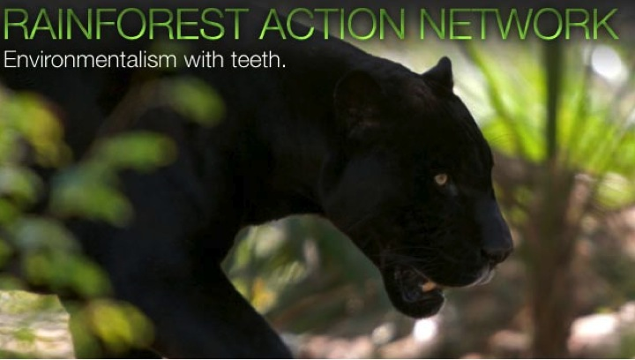
Notes:
Dubbed “some of the most savvy environmental agitators in the business” by the Wall Street Journal, RAN uses hard-hitting markets campaigns to align the policies of multinational corporations with widespread public support for environmental protection. We believe that logging ancient forests for copy paper or destroying an endangered ecosystem for a week’s worth of oil is not just destructive, but outdated and unnecessary.
Founded in 1985 to help protect forests and forest peoples rights – has added energy as climate change has emerged as huge threat to forests and ecosystems
Rainforest Action Network (RAN) is headquartered in San Francisco, California with staff in Japan and Indonesia plus thousands of volunteer scientists, teachers, parents, students and other concerned citizens around the world that form our network.
We believe that a sustainable and just world can and must be created in our lifetime, and that it will take individuals and communities standing together to confront corporate power to get us there.

Slide 2
Key elements of our brand of corporate campaigning:
Strengthen “marketplace democracy”
Pressure companies to ‘do well by doing good’.
Leverage well-known brands to influence companies down the supply chain.
Secure voluntary concessions and policies.
Open political space for government action.
Work with diverse range of organizations from grassroots groups to customers
to institutional investors
Believe that environmental issues and human rights are intertwined
Notes:
In our twenty-seven years, we have won major corporate policy changes that have transformed the home building, food product, automobile, oil, paper and banking industries.
I’ll talk about a couple of our current campaigns a little later. But first a little bit of RAN’s history. I’m going to take a moment to talk about a few of our key victories since our founding.

Slide 3



Program Areas
Forests
STOP DEFORESTATION IN INDONESIA
Energy and Finance
TRANSITION OFF OF FOSSIL FUELS
GOALS:
Pulp & Paper
Tar Sands
CAMPAIGNS:
Palm Oil
Coal
The Snack Food 20
TARGETS:
Notes:
Asia Pacific Resources International Limited (Indonesia’s 2nd largest pulp and paper producer)

Slide 4
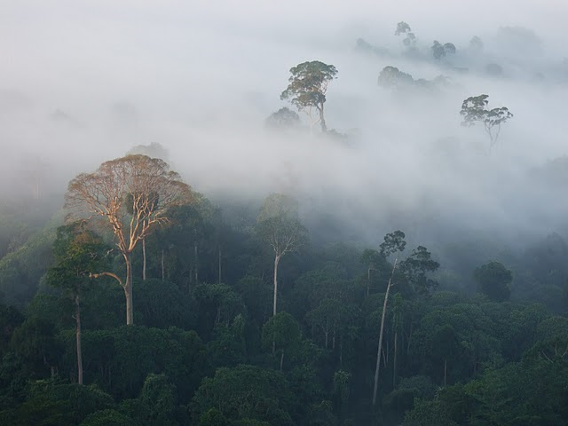
RAN’s Forest Program
Notes:
Rainforest Values and Impacts of Loss
Biodiversity - extinction crisis. scientists say we are entering the sixth great extinction, this time driven by human activity, with up to 80% of species to be impacted by deforestation and climate change under current trends. Half of the world’s 50 million plus of terrestrial plant, animal and insect species are estimated to be found in tropical rainforests covering little less than 6% of the world’s land area
Forest dependant communities and livelihoods – human rights abuse and loss of livelihoods. 300 million IP. >1 billion dependent on forest landscapes for basic livelihoods.
Climate – Climate change. Deforestation is important component, around 15%. Forests also important carbon sinks. Lungs of earth.
Healthy ecosystems fundamentally underpin our economy and our future but are still largely off the radar screen of most businesses across virtually every sector.
Business as usual is not an option. Sustainability needs to hard wired into our economy and corporate behaviour if we are to survive.

Slide 5
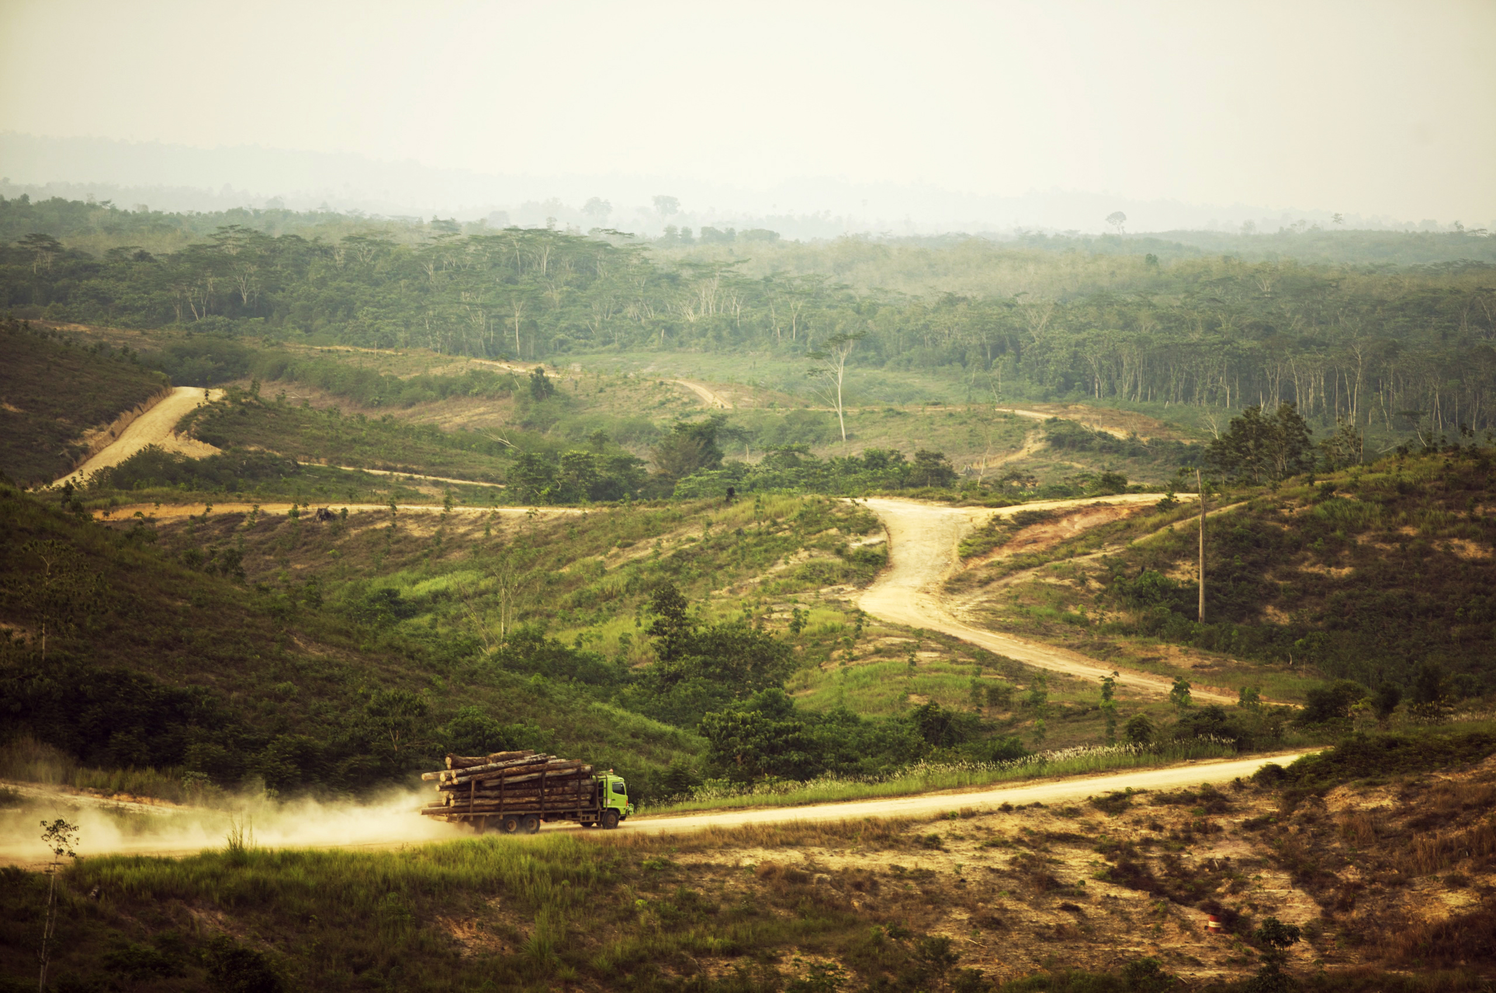
Rainforest-Free Paper Campaign
Notes:
Why Target Pulp & Paper?
Pulp from cleared rainforests is made into cheap copy paper, books, tissue, packaging and toilet paper and luxury shopping bags that are then sold to consumers all over the globe
Asia Pulp and Paper (APP), Indonesia and China's biggest pulp and paper company, and its main competitor Asia Pacific Resources International (APRIL), are rapidly clear cutting and draining huge areas of Indonesia's diverse rainforests and peatlands.
These logging giants then convert the degraded land into monoculture acacia pulp wood plantations to make cheap paper products.
This deforestation is devastating communities and their livelihoods and driving species like the Sumatran tiger toward extinction.
The Rainforest-Free Paper campaign at RAN
The Rainforest Free Paper campaign was started in 2009.
Goals
End the conversion of natural forests and peatlands
Secure rights for forest peoples
Reduce North American consumption of paper made from natural forests and plantations and replace remaining fiber needs with recycled fiber when possible or FSC when necessary.
Focus was APP, in Feb announced a policy. RAN not convinced until see action through implementation. Currently monitoring and informing their customers of the company’s progress.
Now working to move APRIL, in an internal phase.

Slide 6
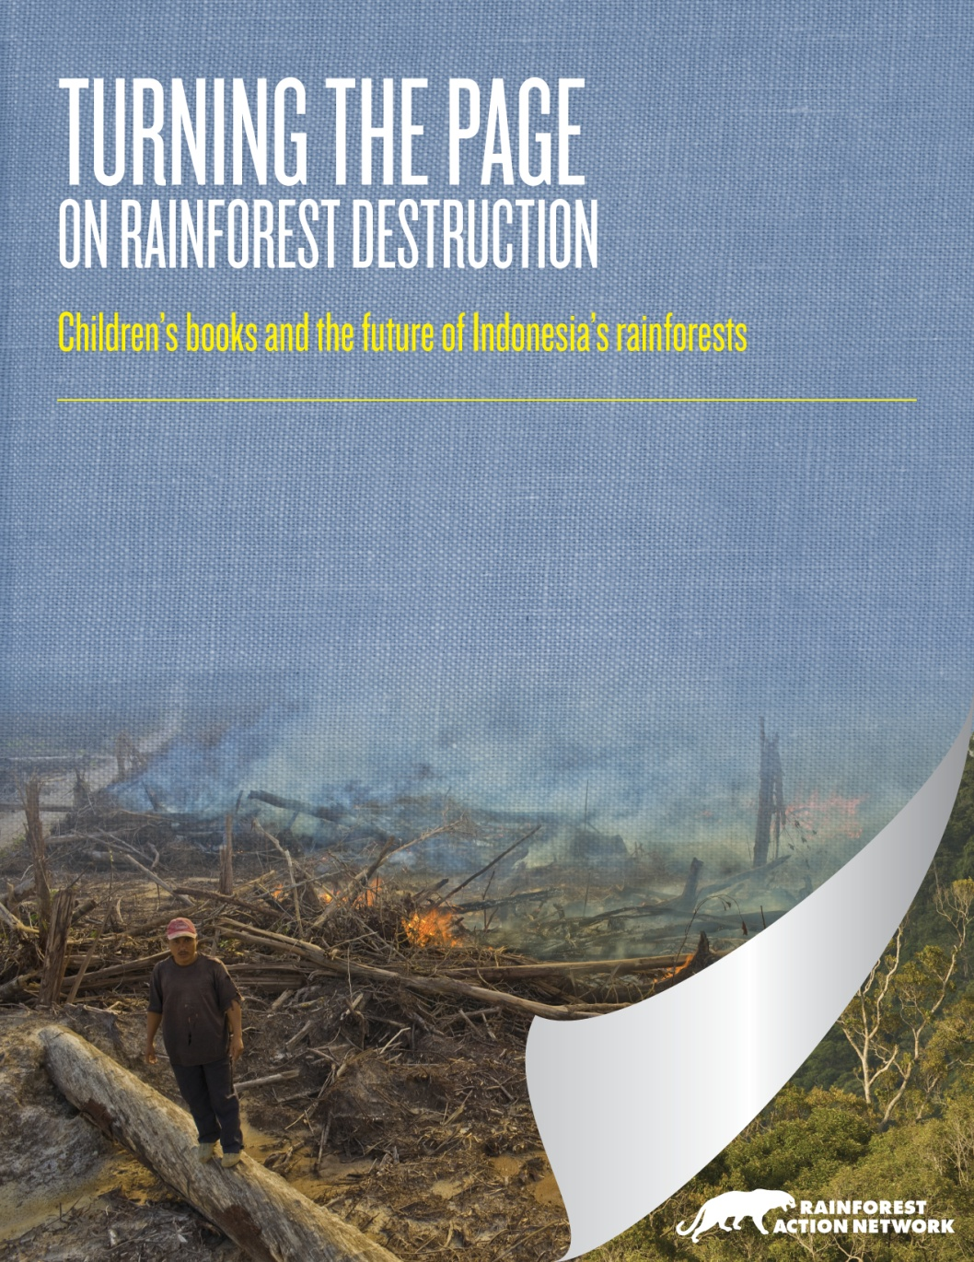
Notes:
In March 2010, RAN commissioned fiber testing of 10 top children’s publishers’ books, finding that 60% of paper tested was linked to Indonesian rainforest destruction.
RAN then warned the publishers of their ties to Indonesian rainforest destruction and released a comprehensive report about fiber used in children’s books linked to deforestation in Indonesia.
By December 2010 8 of the 10 agreed to stop sourcing paper from Indonesia’s rainforests and to strengthen their environmental paper policies. Disney not one of them.
Shortly after, Disney release its first policy, but was not strong. So in May 2011 RAN launched a campaign against Disney, with a banner hang at their corporate headquarters in LA.
Brand and image important, so jumped into negotiation in June.
Negotiations lasting 1.5 years.

Slide 7
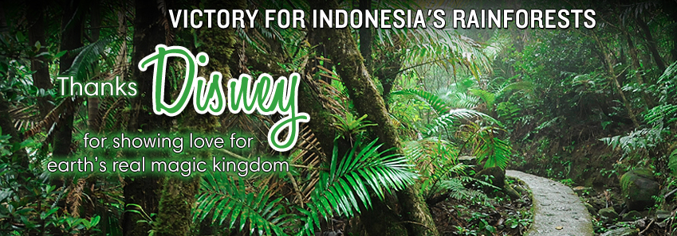
Notes:
2012, Disney adopted what may be one of the most far-reaching paper policies ever, including groundbreaking safeguards for climate and human rights.
Disney's commitment will have a particularly important impact in Indonesia, maximizes its use of environmentally superior papers like recycled and eliminates controversial sources like those connected to rainforest destruction. This policy applies to the company’s entire international operations, including thousands of licensees of Disney characters and nearly 25,000 factories in more than 100 countires.

Slide 8
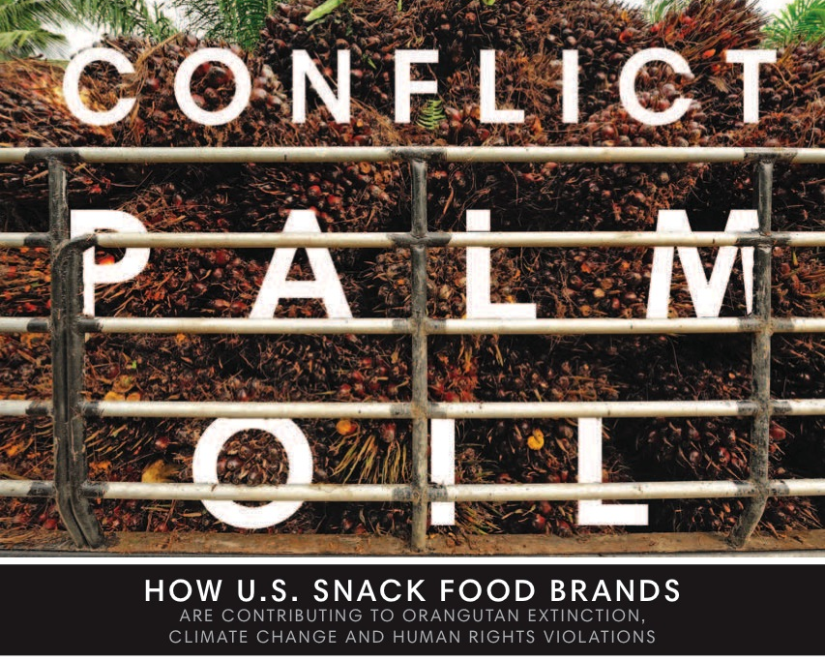
Palm Campaign

Slide 9
responsible palm oil is oil that has been produced without causing deforestation, expansion on peatlands and human rights violations and is traceable from the plantation to the final product.

Slide 10
