Slide 1

Rainforest Foundation Norway‘s NORAD/CFI program:
Building REDD+ from the bottom up: Civil society as agent for change towards a transformative and sustainable REDD+
Ane Schjolden,
Senior policy adviser

Slide 2


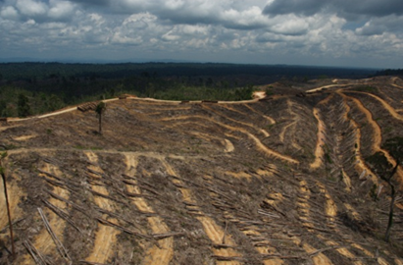
Thematic category 3:
“Analysis, concept and methodology development that contribute to planning and implementation of REDD+ “
Focus on three thematic issues:
i) benefit sharing
ii) spatial planning and land tenure
iii) safeguards
Notes:
Focus on three thematic issues which RFN and partners identify to be essential for making REDD+ transformative and sustainable: i) benefit sharing, ii) spatial planning and land tenure, and iii) safeguards. These are key issues within which RFN and partners have specialized competence and expertise as a result of long term engagement in rights-based forest protection

Slide 3

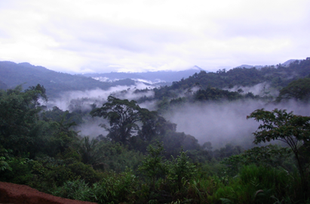
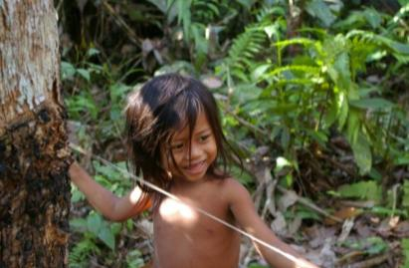
Program design
4 program components:
international policy + three target countries: Indonesia, Ecuador and DR Congo
Target group:
Primary: decision makers with power to influence forest management and land use policies in rainforest countries, at the global, national and local levels.
Secondary: civil society organizations in general and RFN’s partners in particular
Notes:
Decision makers on the national, regional and local levels need to understand and accept the importance of broad and effective participation in the planning and implementation of REDD+, and the importance of broad ownership and support from stakeholders. They also need to be aware that REDD + will not succeed without proper attention to benefit sharing, comprehensive and coherent spatial planning, and social and environmental safeguards.

Slide 4
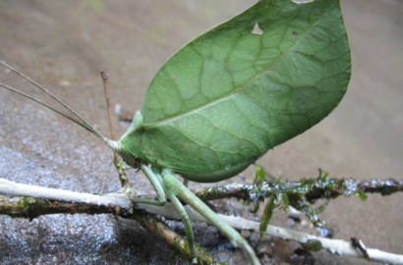
Program objectives
Main impact:
Rainforests are sustainably managed and the rights of indigenous peoples and other forest-dependent groups are respected.
3 outcomes:
National and multilateral REDD+ policies include mechanisms that ensure fair and effective benefit sharing.
Rainforest countries have adopted comprehensive and coherent land use plans, taking into account all relevant drivers of deforestation as well as customary land claims and rights of forest peoples.
Environmental and social safeguards for REDD+ are implemented in target countries and participatory monitoring systems are established.
Notes:
Indicators main impact:
- Deforestation and forest degradation rates in the three target countries have slowed down in the project period.
- Indigenous peoples’ and forest peoples’ rights to freely exercise their culture and to full and effective participation, including free, prior and informed consent, in all matters that affect them are recognized in national and multilateral REDD+ policy documents.
- The loss of biological diversity as a result of deforestation and forest degradation is reduced in the three target countries.
Indigenous peoples’ and forest peoples’ rights to ownership or usage rights over their ancestral territories and natural resources are recognized in national and multilateral REDD+ policy documents.
Indicators Outcome
1: National and multilateral REDD+ policies include mechanisms that ensure fair and effective benefit sharing;
Global:
Main multilateral REDD+ initiatives include requirements for a national mechanism for fair and effective benefit sharing in relevant policies, standards and guidelines.
Indonesia:
In Indonesia, the REDD+ agency includes operational guidelines for fair and effective benefit sharing in the national strategy and financing mechanism.
Ecuador:
Indigenous and afro-Ecuadorian communities and their organizations implement models of fair and effective benefit sharing as part of the Socio Bosque Project and the country’s National REDD + Program.
Democratic Republic of Congo:
In DRC, The National REDD+ plan includes operational guidelines for fair and effective benefit sharing mechanism with special mention of benefits to local communities
2: Rainforest countries have adopted comprehensive and coherent land use plans, taking into account all relevant drivers of deforestation as well as customary land claims and rights of forest peoples
Global:
Main multilateral REDD+ initiatives require measures to strengthen land tenure reforms and forest governance on the national level in REDD+ partner countries.
Indonesia:
In Indonesia, the provincial spatial plans in at least 3 of the 11 REDD+ pilot provinces have been revised based on participatory environmental assessments
In Indonesia, indigenous territories and community based forest management schemes are recognized by the national land agency and are reflected in the government’s One Map Policy
Ecuador:
In Ecuador, local authorities and indigenous peoples address land titling and the underlying causes of deforestation in their annual plans, actions and programs.
Democratic Republic of Congo:
In DRC, indigenous peoples’ and local communities’ land tenure is recognized and integrated as a cross-cutting fundament in DRC’s forest land-use planning and the National REDD Plan.
3: Environmental and social safeguards for REDD+ are implemented in target countries and participatory monitoring systems are established
Global:
The policies, standards and guidelines of the main multilateral REDD+ initiatives require implementation and monitoring of the UNFCCC agreed safeguards on the national level in REDD+ partner countries.
Indonesia:
In Indonesia, the safeguards described in the National REDD+ Strategy have been operationalized and are reflected in provincial REDD+ strategies in at least 3 of the 11 REDD+ pilot provinces
Ecuador:
In Ecuador, the National REDD+ Program has a transparent system providing information about the implementation of social and environmental safeguards
Democratic Republic of Congo:
In DRC, the safeguards described in the National REDD Plan fully reflect social and environmental components as agreed under the UNFCCC COP16 Cancún agreements.

Slide 5
Thank you!
ane@rainforest.no

