Slide 1
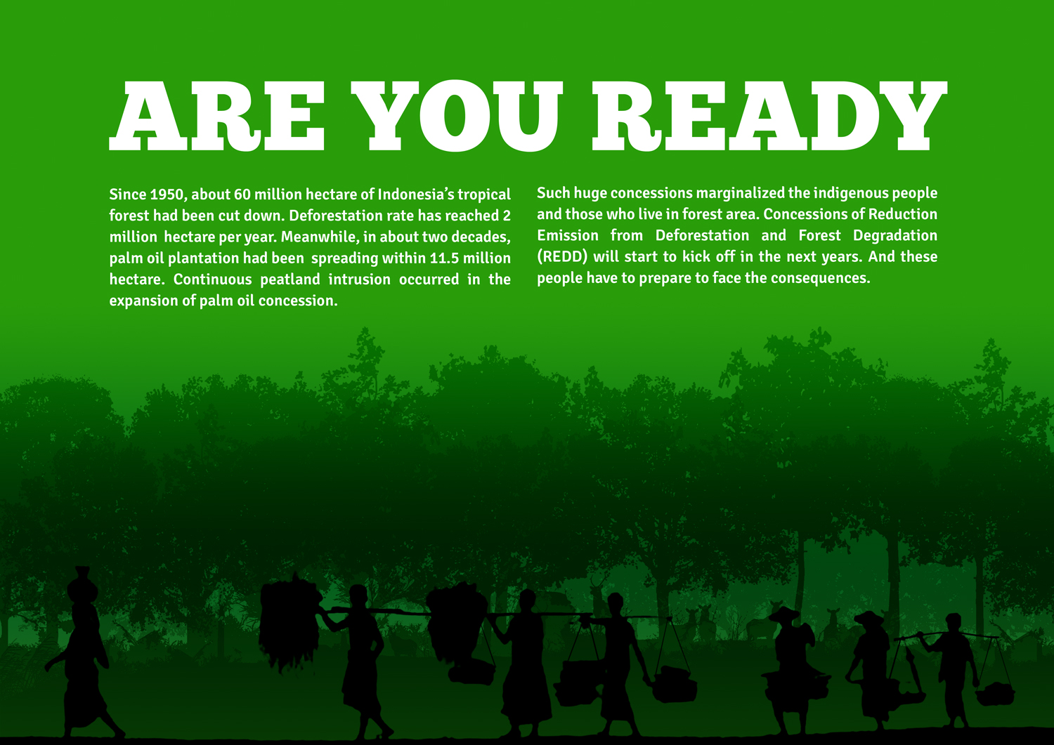
COMMUNITY ENGAGEMENT
IN LOW EMISSIONS DEVELOPMENT
2013-2015

Slide 2
2013-2015 → the new grants from Norad, to continue and up-levelling the results from the previous grants → expanding target areas, to Myanmar
Thematic Category → Analysis, concept and methodology development that contribute to planning and implementation of REDD+; Sustainable Landscapes: Promoting integrated sustainable land use planning

Slide 3
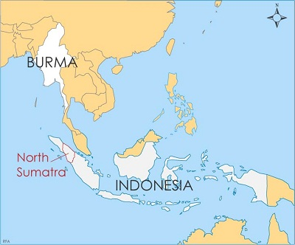
Goals
Assist Indonesia and Myanmar meet their emission reduction targets from deforestation while also addressing chronic rural poverty and securing tenure for rural communities.
greater involvement of community to a low emissions development pathway and security of tenure over their natural resources

Slide 4
Expected Outcome
1. Increased community involvement with Government: Land use change planning & with large scale plantation licensing
2. Increased community involvement with Forestry and plantation license holders: to ensure that private sector efforts to reduce carbon emissions include agreements with affected communities on the use of community lands.
3. Communities secure rights over and manage their landscapes to avoid or reduce carbon emissions.

Slide 5
Indicators
Outcome 1.
Indicator :
Land use change plans and licenses identify and maintain high carbon landscapes and include agreements with affected communities
Outcome 2.
Indicator :
1. License holders have plans, resources and mechanisms in place to ensure that negotiated agreements with communities are respected and land is managed to minimize carbon emissions.
2. Assessments show that communities understand and are involved in implementation of agreed activities and are broadly satisfied with licensee performance
Outcome 3.
Indicator :
communities have sufficient legal rights over their land and resources, and the
institutions and resources to manage their land to minimize emissions.

Slide 6
Expected main changes/developments
Greater emphasis on incorporating the results of Indonesian local communities and NGO actors on rights and defense of territory, including maps, community forest management action plans and policy propositions into District, Provincial and National policy and land use planning processes to provide ‘pathways’ for land rights recognition and low emissions development;
Expanding, deepening and applying lessons on conflict resolution, mediation and arbitration and related legal actions to engage with private sector actors and government policy processes on community-private sector agreements and;
Regional cross-learning and expansion into Myanmar, where Samdhana partnerships with local actors exist.

Slide 7
Partners

