Slide 1
Smallholder Acceleration REDD+ Programme
Introduction into the Programme
28th October 2013

Slide 2
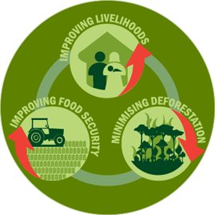
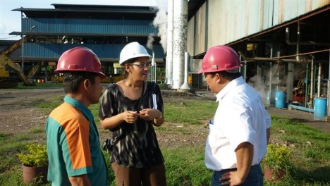
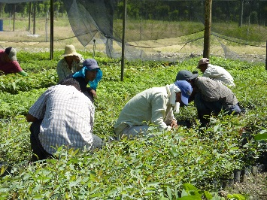
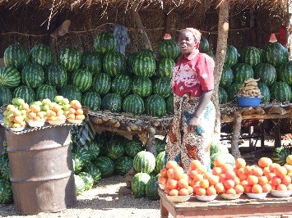
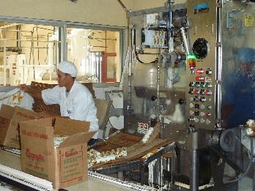
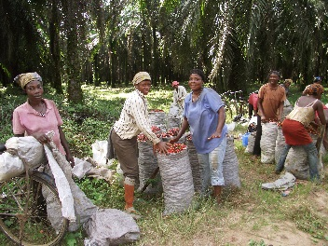
SHARP Objective
To support and accelerate responsible smallholder development in commodity crop production, through collaboration with the private sector

Slide 3
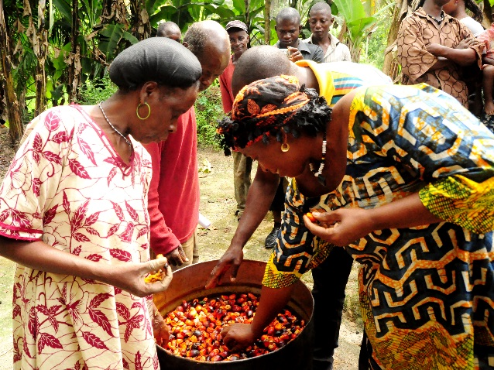
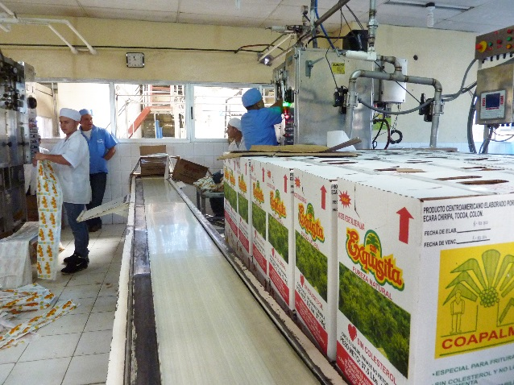
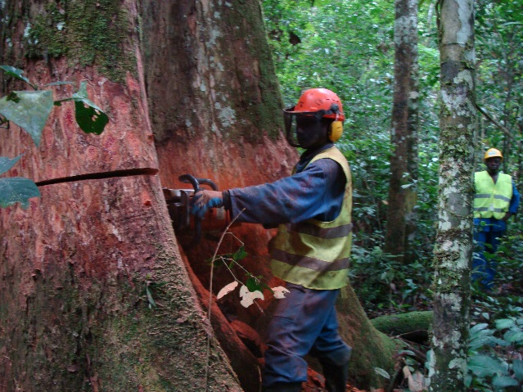
3 Main Programmes of SHARP
SHARP consists of 3 main programmes:
  Successful models for sustainable smallholder development
  Responsible Supply chains
  Practical approaches for minimising deforestation

Slide 4
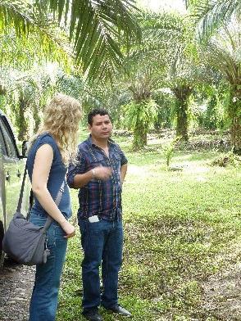
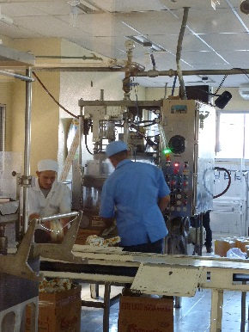
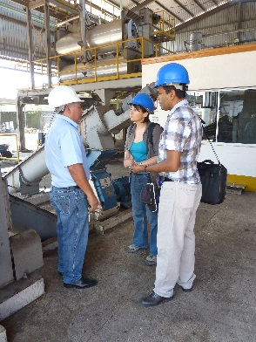
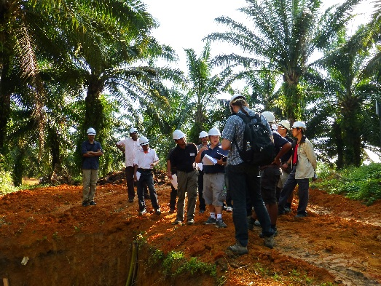
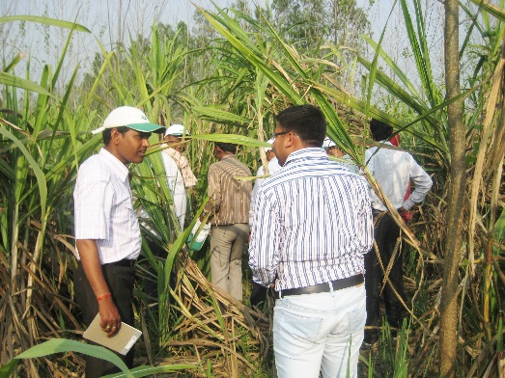
Why SHARP? – how is it different from other initiatives?
Unique in that it focuses on working with and through producer and supply chain companies
Aims to provide a platform to share lessons learned and to convene stakeholders to find solutions for common problems to avoid exclusion of smallholders from the sustainable supply chain

Slide 5
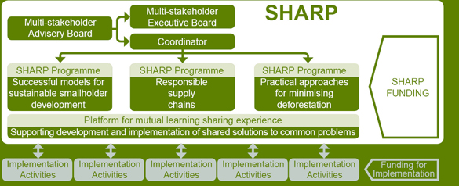
Organisation of SHARP
SHARP is governed by the EB
Secretariat and coordination by Proforest
Cross-cutting so not limited to any specific commodity but starting with focus on palm
SHARP covers 3 regions
  Latin America, South-East Asia and West-and Central Africa

Slide 6
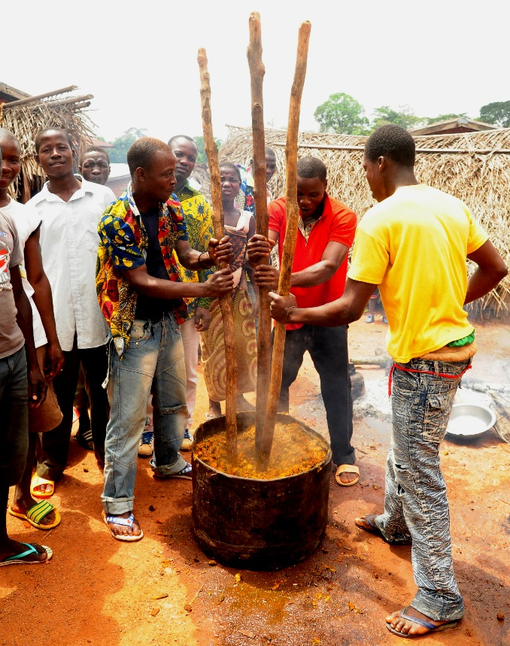
Programme 1:
Successful models for smallholder development
Develop guidance for companies on best practices for smallholder development
Scale up company support to responsible, low-deforestation smallholder development
  Support companies in testing best practices
  Share common solutions through central database and learning platform
Improve access to finance for smallholders

Slide 7
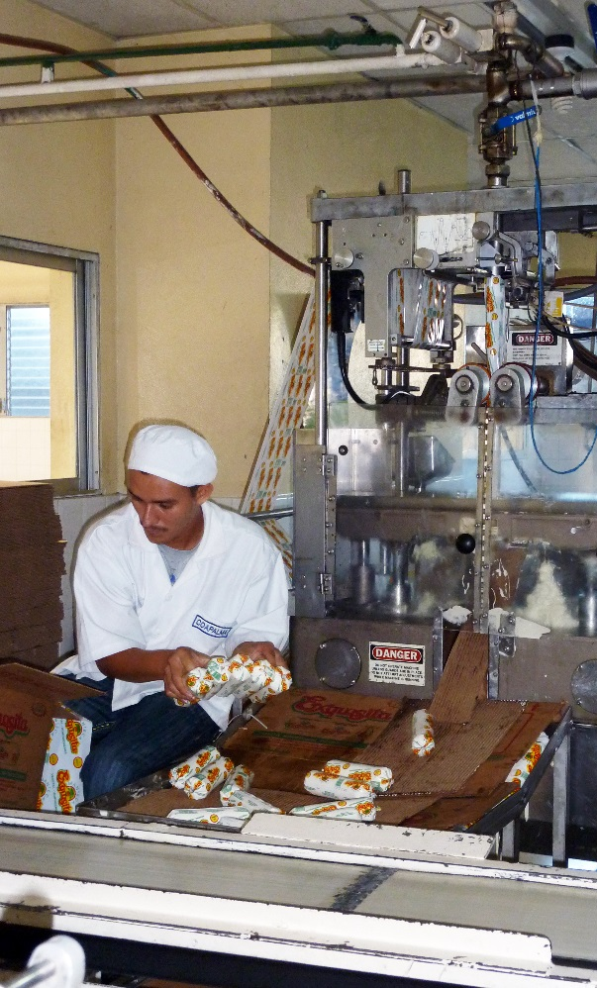
Programme 2:
Responsible supply chain
Key objective: avoid exclusion of smallholders from the sustainable supply chain
How to achieve this?
  Assist smallholders to overcome barriers in meeting certification requirements of international standards
  Development of an alternative Controlled Supply from Smallholder approach
  Increase demand for products meeting the alternative approach for smallholders

Slide 8
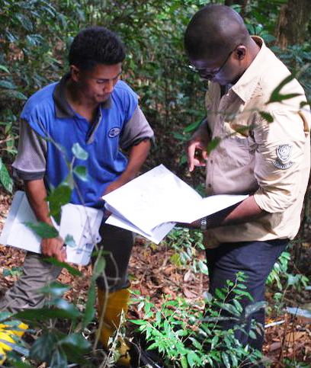
Programme 3:
Practical approaches for minimising deforestation
Three key components
  Development of practical tools and guidance for companies to assist smallholders in managing HCVs and high carbon areas
  Awareness raising with smallholders about maintaining forests and biodiversity
  Linking conservation of forests to direct incentives for smallholders

Slide 9
Any questions?

Slide 10
For more information - www.sharppartnership.org
Or contact veronique@proforest.net

