Slide 1

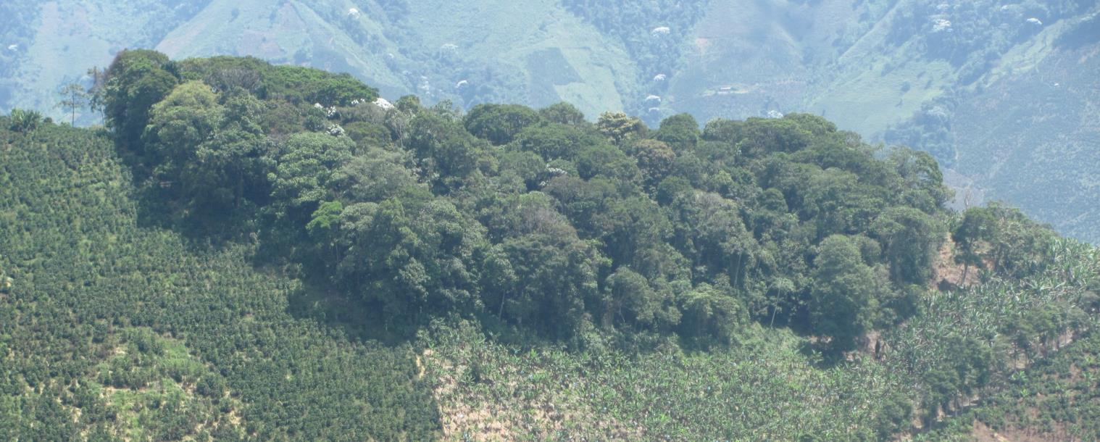
Bringing Agricultural Capacity, Carbon and Knowledge to REDD+
Yvette Faber

Slide 2

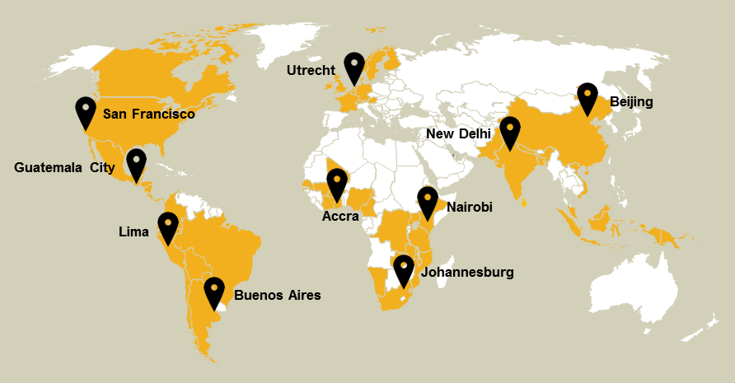
Solidaridad
Since 1969
Co-founder Max Havelaar
Accelerating the transition towards a more sustainable economy
  through 12 key supply chains
World Wide Network
  10 regional offices
190 staff members
23 M Euro in 2012

Slide 3
Revenue streams
B2R
Higher income because of higher yields and reduced costs
Sustainability certification for access to markets
Improved productivity and yield
Carbon bundling
Public funds used to incubate revenue streams for CSA
Climate Smart Agriculture
Carbon credits
Improved Carbon performance
Public support
Enhanced climate resilience
Payment for Adaptation
Constant income (and food security) through constant production
Yellow: current Solidaridad portfolio
Blue: new CSA streams

Slide 4
Objectives BACk to REDD+
Overall the project will demonstrate how farming can shift from being part of the problem to part of the solution to deforestation and climate change.
Increased revenue streams
Increased technical assistance on Climate Smart Agriculture (CSA)
Increased uptake of Climate Smart Agriculture leading to:
  reduced GHG emissions in coffee farms and reduced expansion into forests
  Improved productivity of coffee smallholder systems, resulting in higher incomes, reduced poverty and increased food security
  Increased resilience of farming systems to climate change, resulting in adaptation.

Slide 5
Main outcomes back to redd+
Building carbon stocks
85 000 MT of CO² avoided emission, 135 000 MT of CO² sequestered and 180 hectares of avoided deforestation per year
Building capacity
8000 smallholders adopt climate smart agricultural practices and 180 technical assistance providers receive training on climate smart agriculture
Building knowledge
Feed results to inform the development of CSA tools, carbon credit standards, agricultural certification schemes and national REDD+ and development strategies with a view to bring CSA practices to scale.

Slide 6
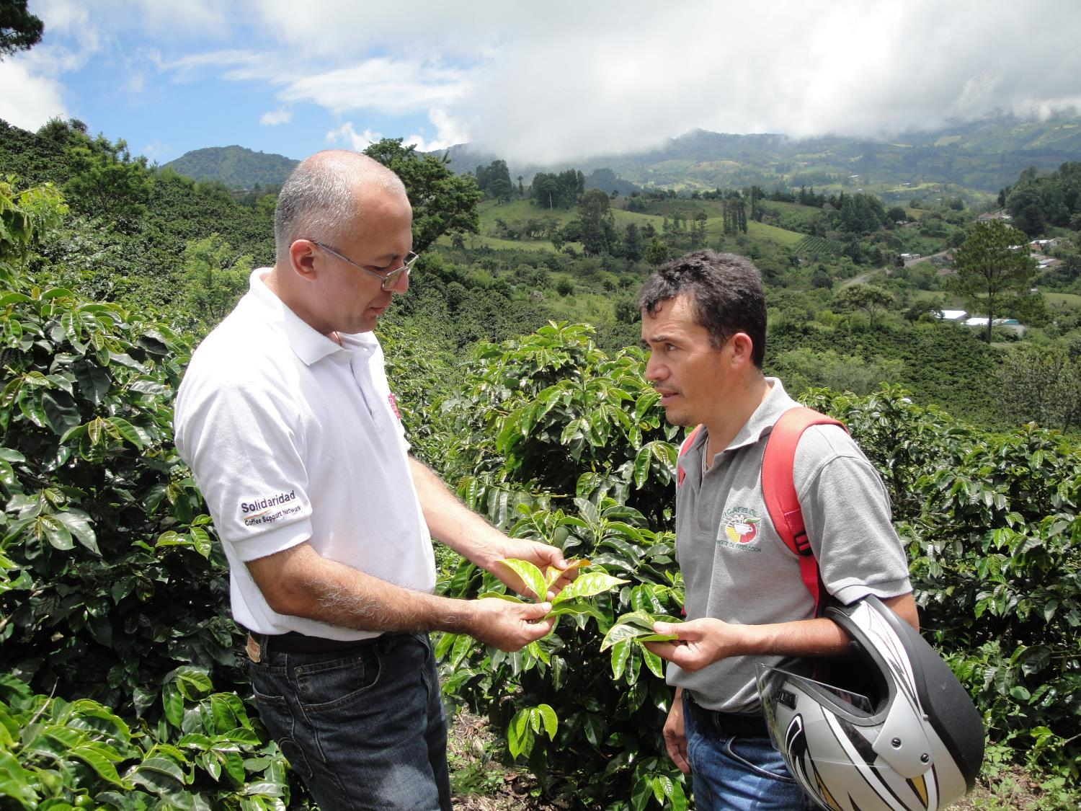
Climate Smart Coffee in Mexico, Colombia and Peru

Slide 7
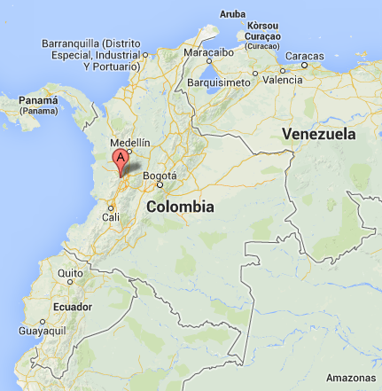
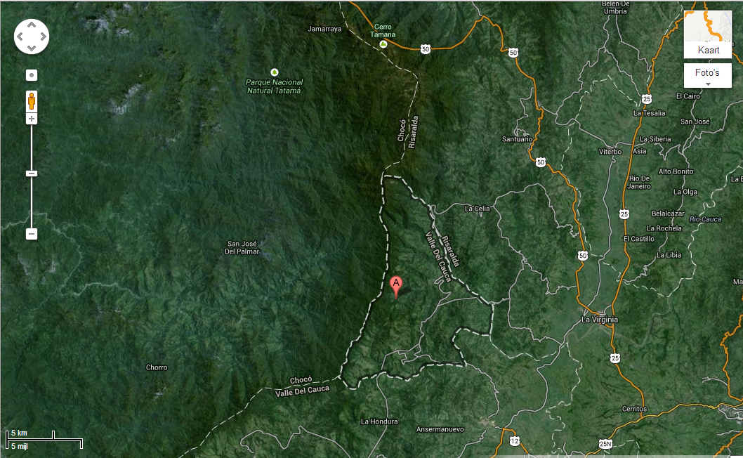
Project site colombia
Risaralda

Slide 8
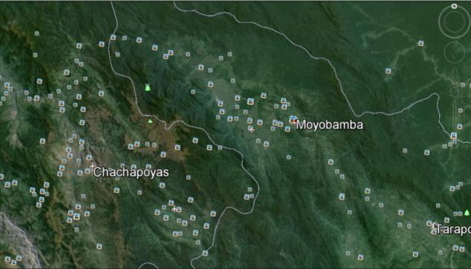
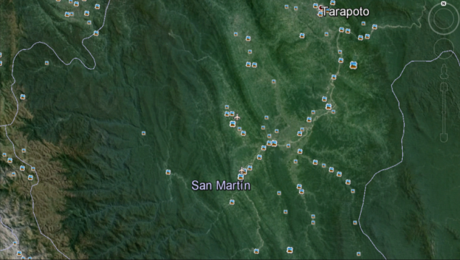
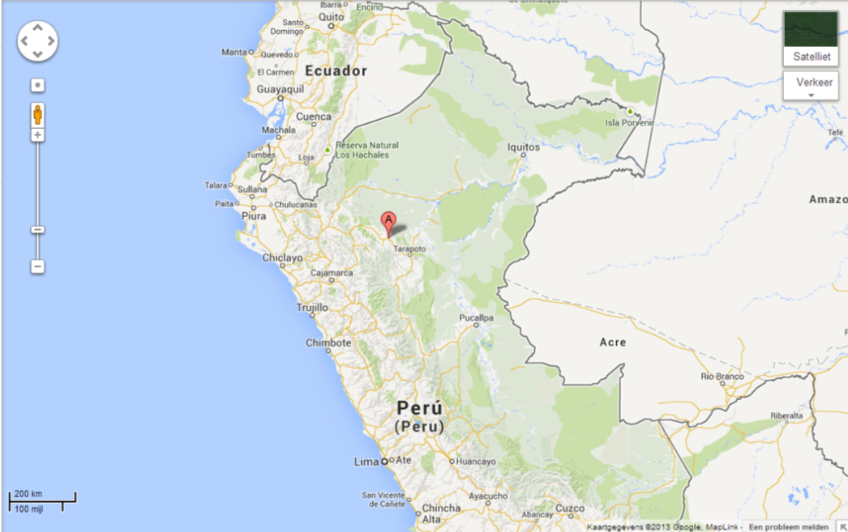
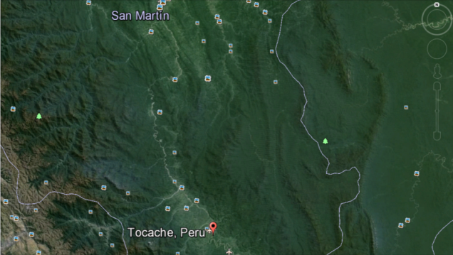
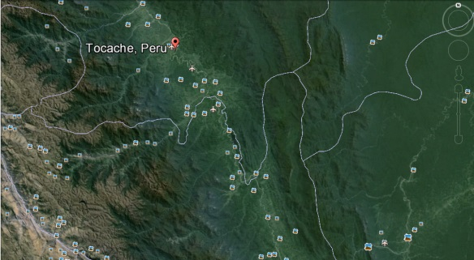
Peru
San
Martin

Slide 9
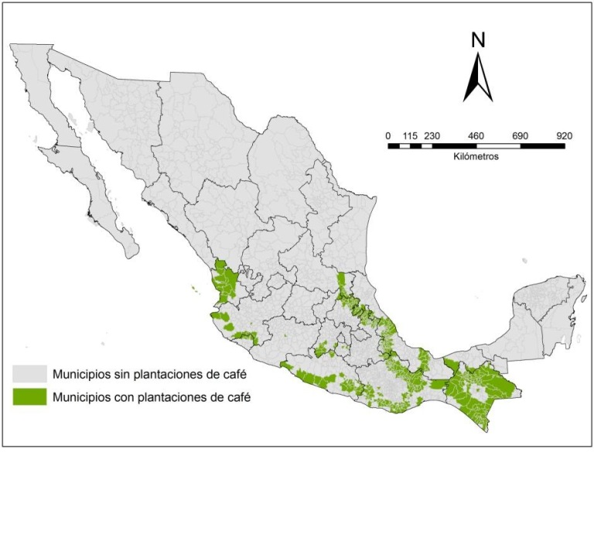
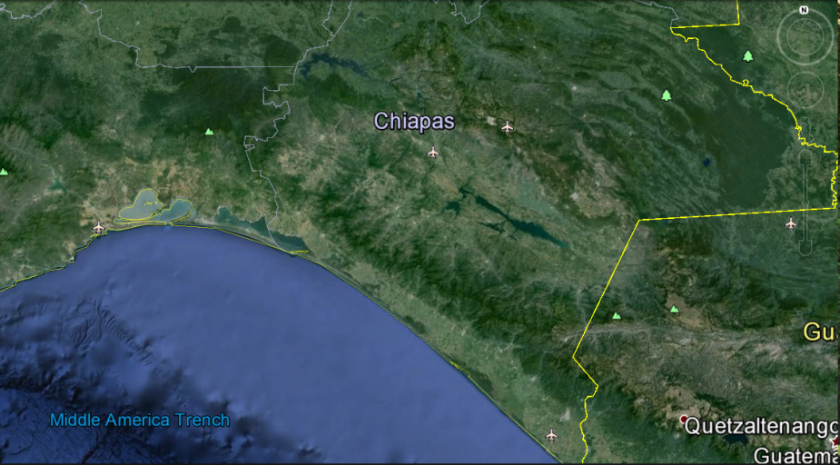
Project site Mexico
Chiapas

Slide 10
Yvette Faber
yvette.faber@solidaridad.nl

