Slide 1

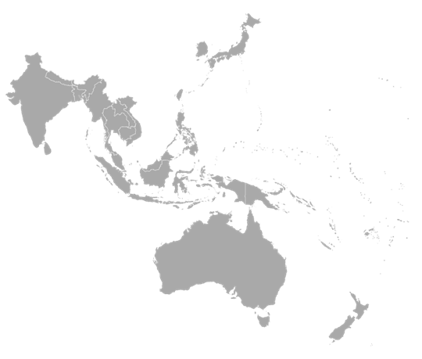
Transparency International is
working to prevent corruption
from undermining REDD+
objectives in:
Indonesia
Papua New Guinea
Vietnam
We are doing this by…..

Slide 2
Research and Diagnostics:
Corruption Risks Assessments in REDD+
Capacity Building and Raising Awareness for multi-stakeholders: citizens, companies, government
Advocacy: National and Global Level Policy Engagement for better transparency, accountability and anti-corruption
Monitoring Decision-making and Project Implementation for
corruption, information disclosure, accountability….

Slide 3
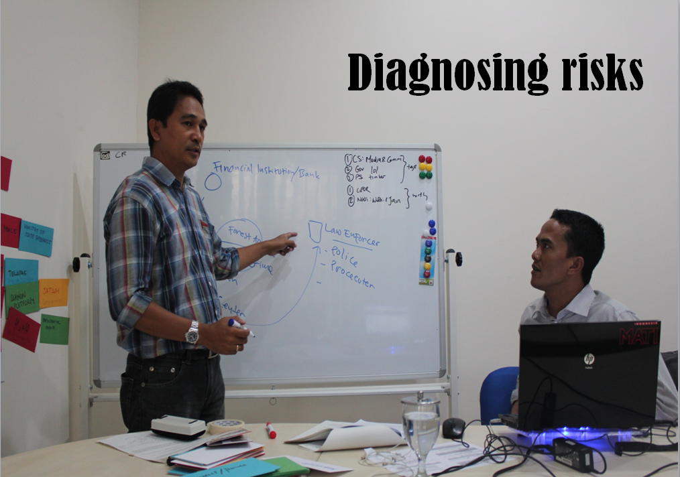
Building on TI’s Forest Sector Corruption Risk Assessment methodology, TI developed a tool for REDD. A Manual helps users with a step by step guide to diagnose corruption risks in their countries or communities.

Slide 4
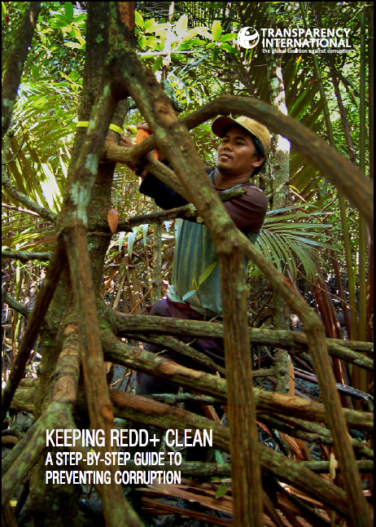
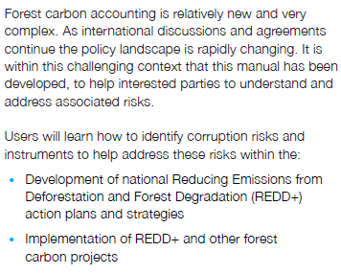






Slide 5
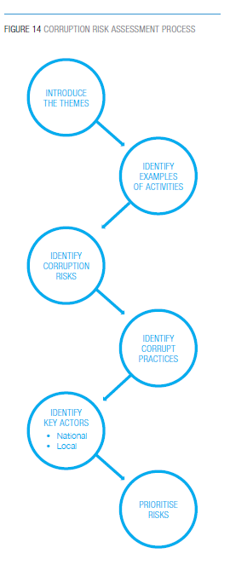
The Corruption risk assessment process involving multi-stakeholders

Slide 6
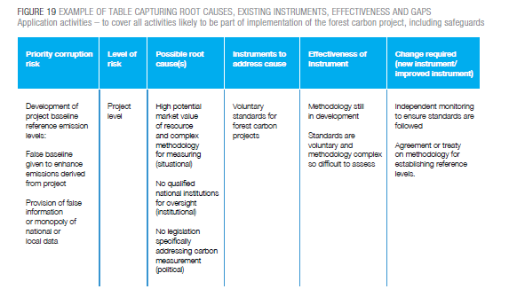

Slide 7
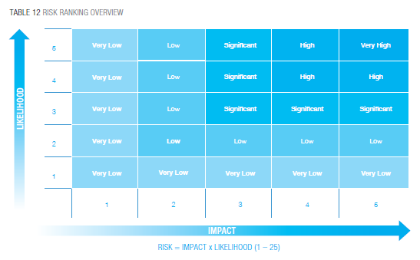
Often numerous risks for corruption and fraud may be perceived.
To prioritise the most serious threats, the following chart demonstrates how stakeholders take into consideration both likelihood and impacts in order to pinpoint risks which require attention immediately.

Slide 8
Where are some of the most important corruption challenges?

Slide 9
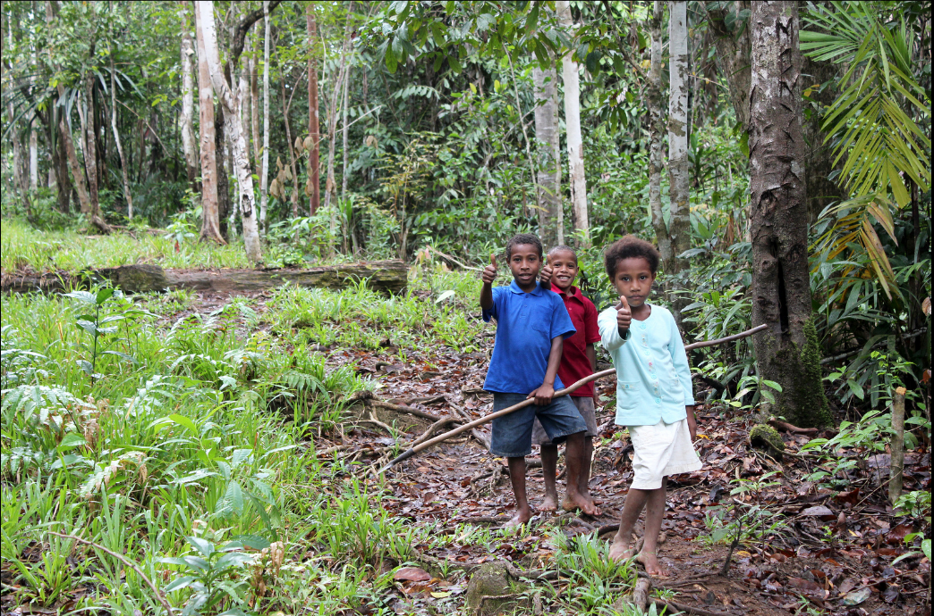
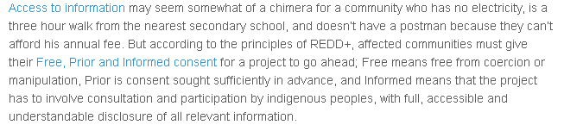

Slide 10
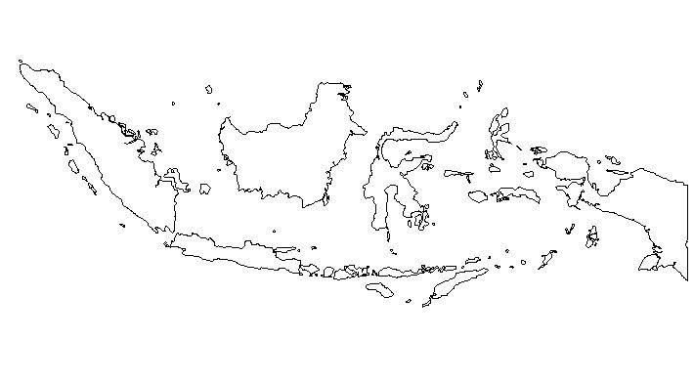
Indonesia

Slide 11
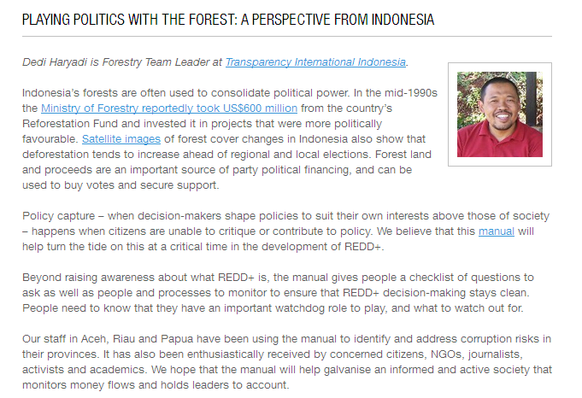

Slide 12
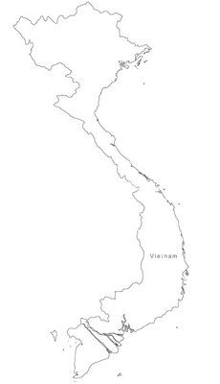
Vietnam

Slide 13
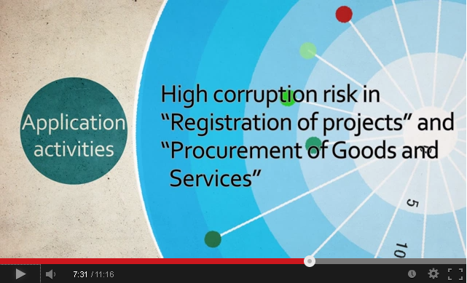

Slide 14
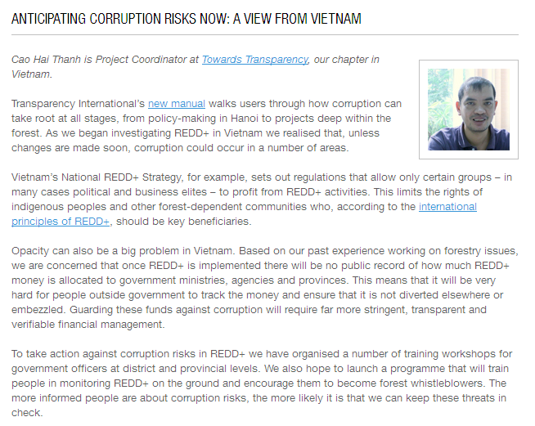

Slide 15
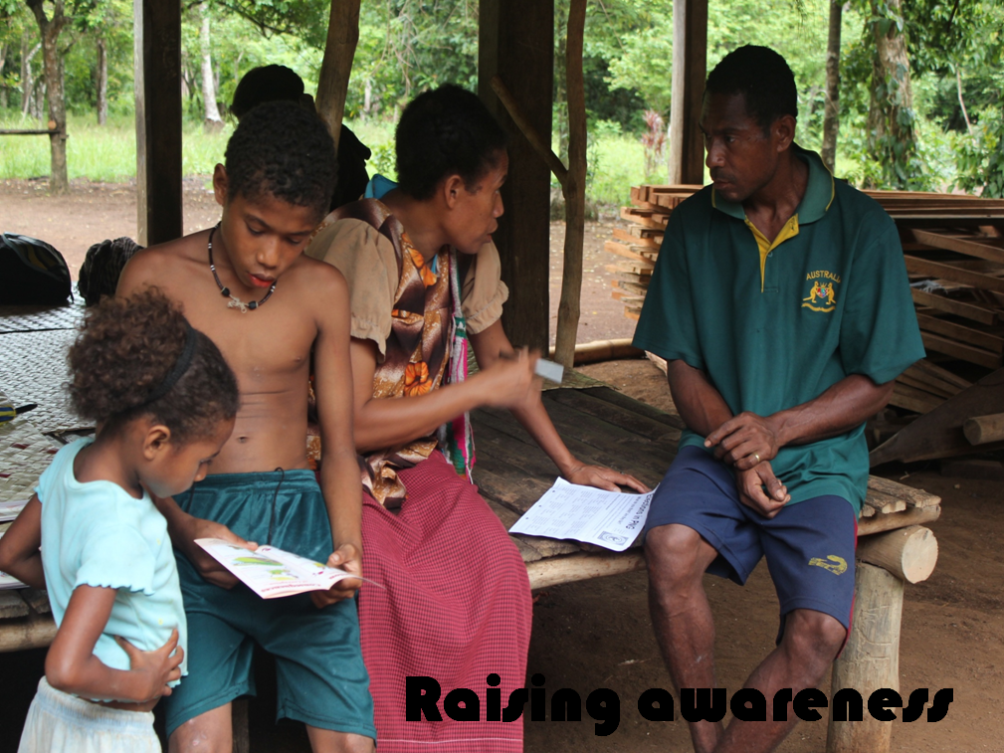

Slide 16
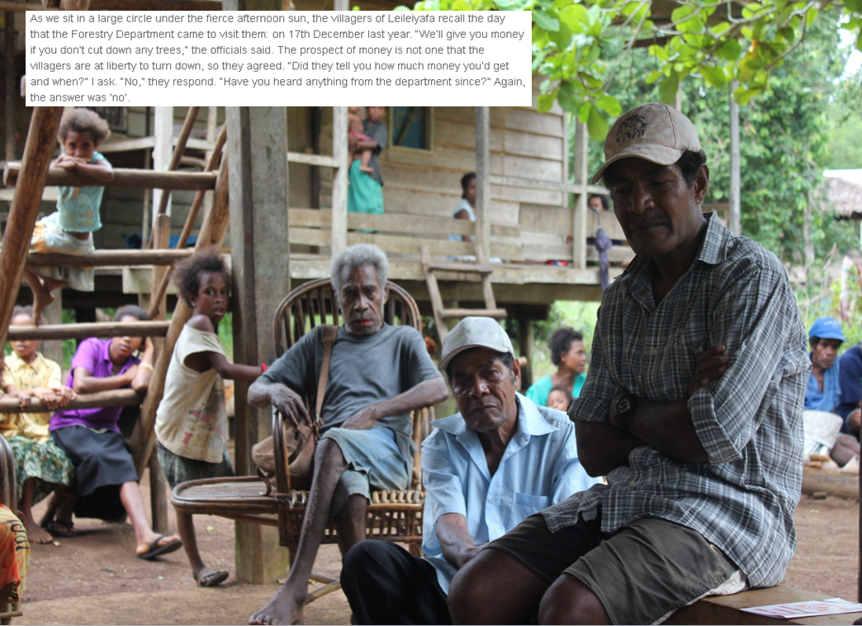

Slide 17
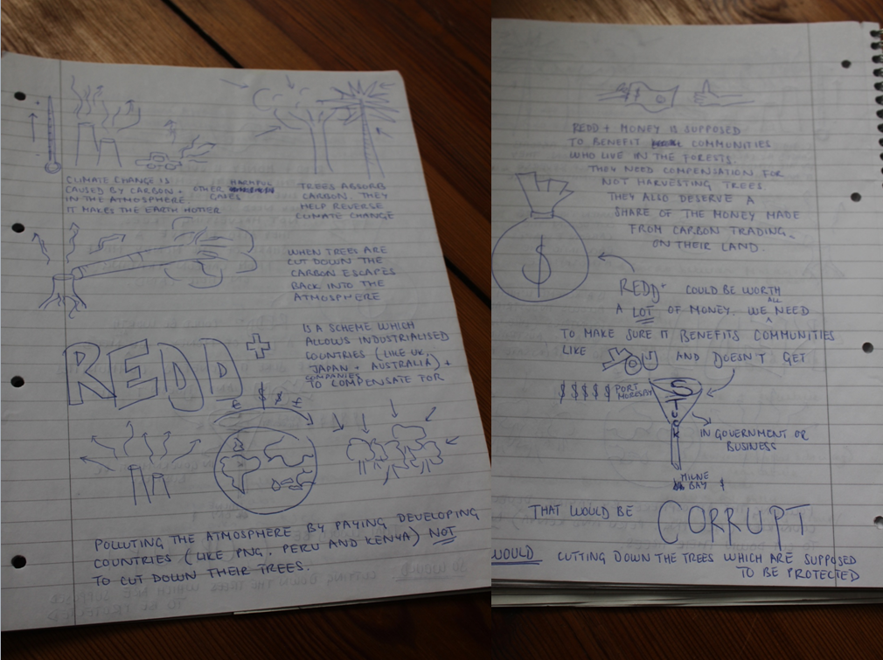

Slide 18

Advocating for change

Slide 19

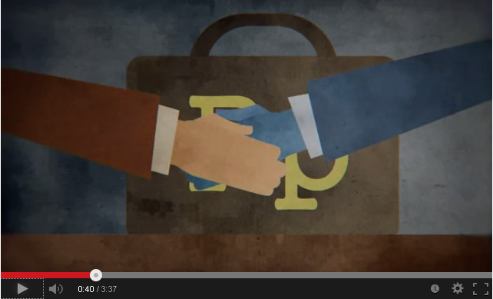
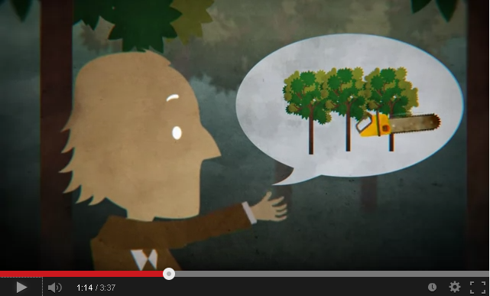
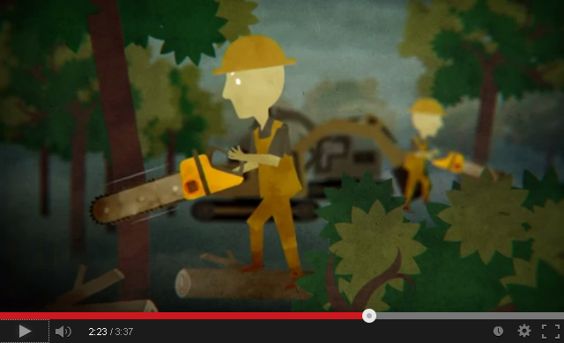
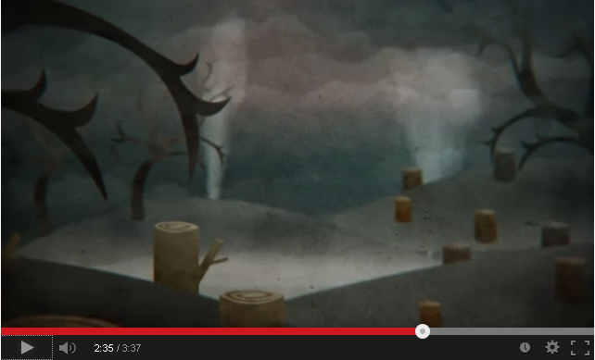


Slide 20

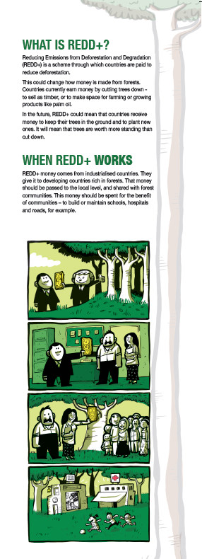

Slide 21
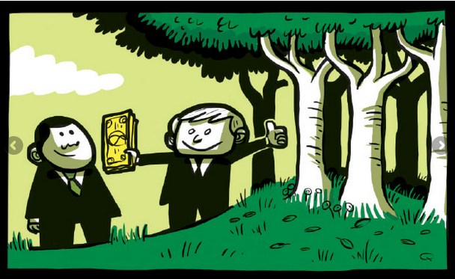
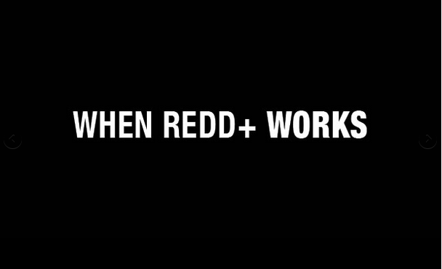
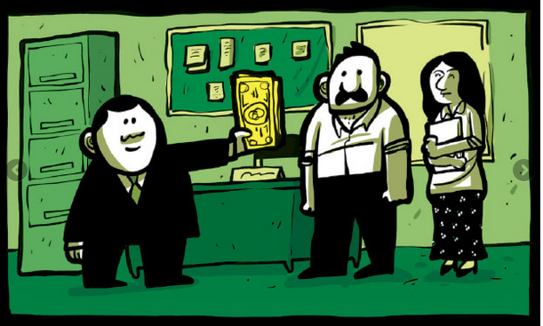
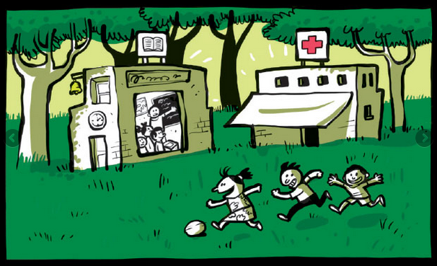
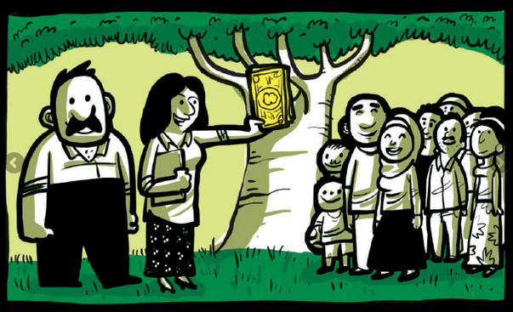

Slide 22

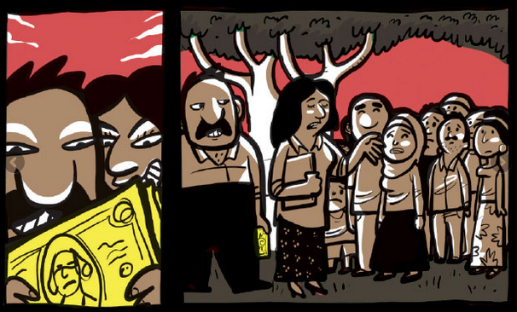
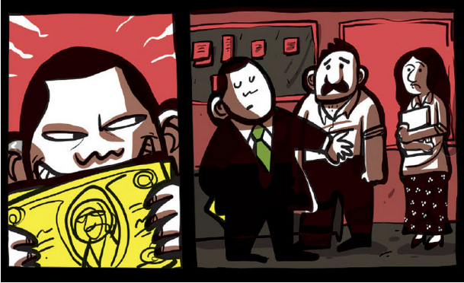
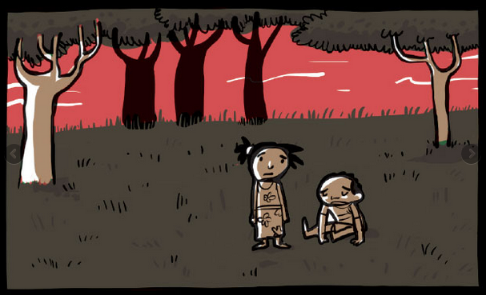

Slide 23
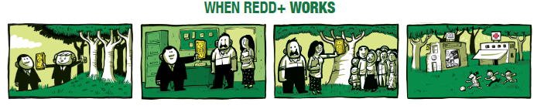
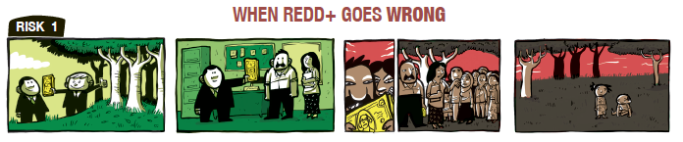
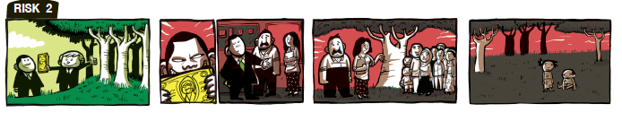
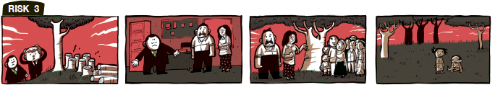
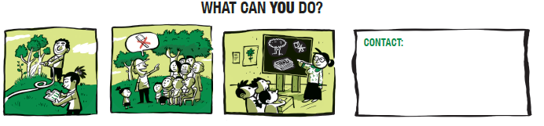

Slide 24
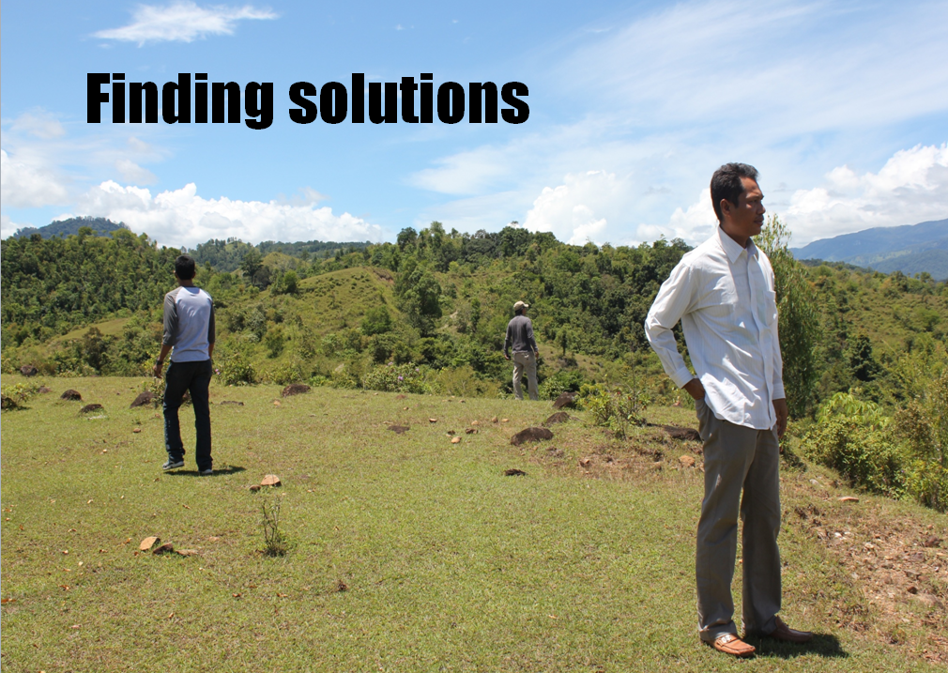

Slide 25
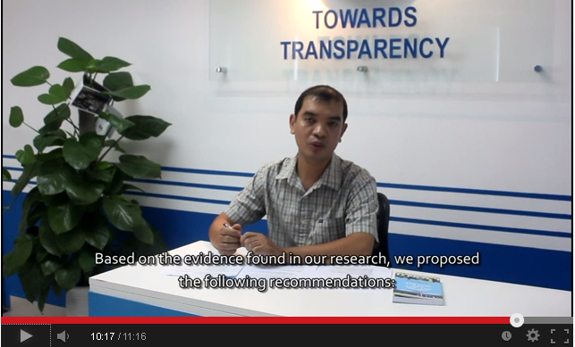

Slide 26
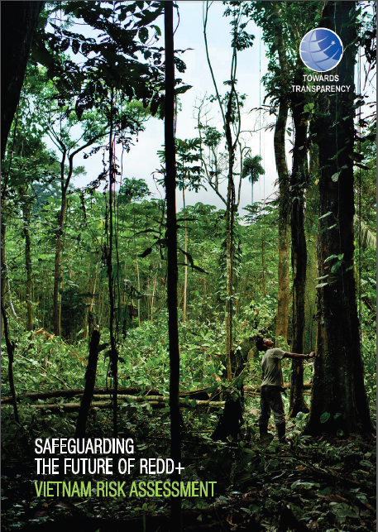
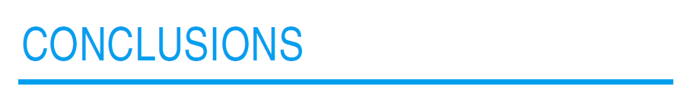
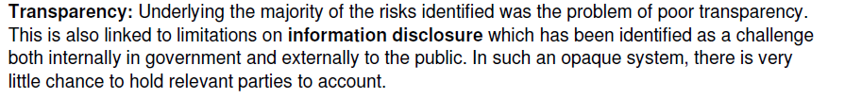
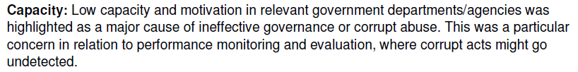

Slide 27
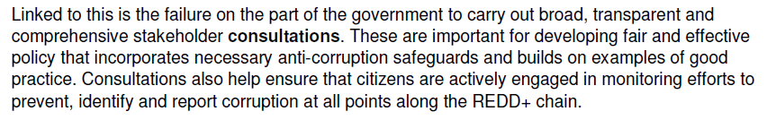

Slide 28
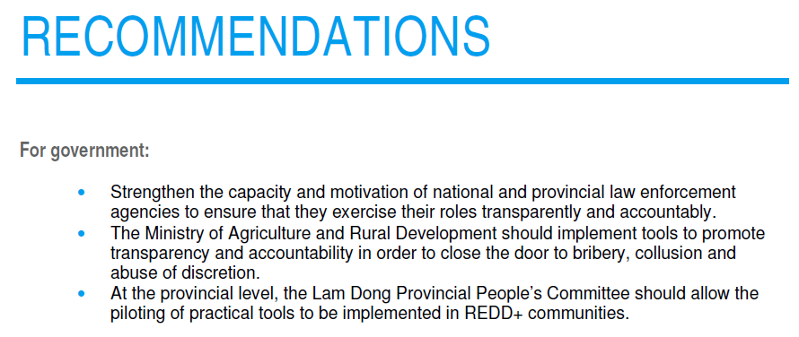
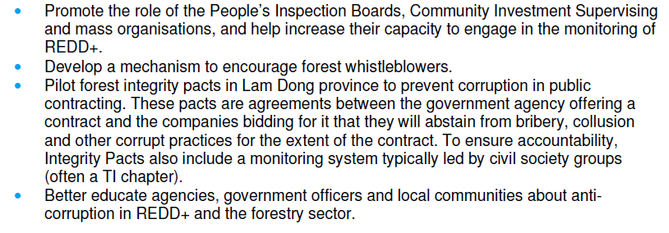

Slide 29
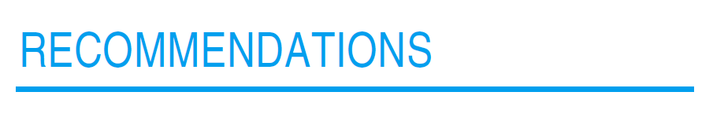
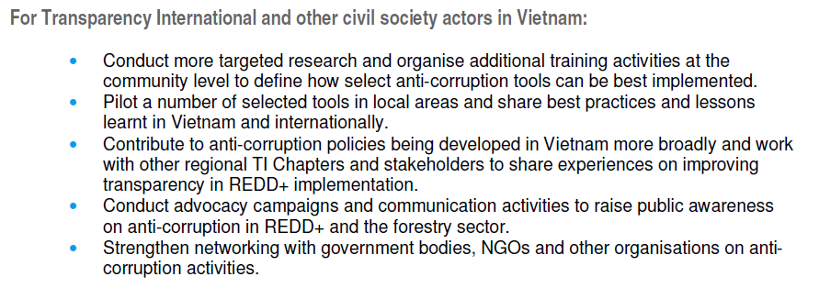

Slide 30
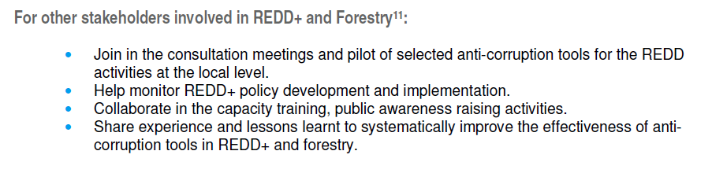

Slide 31

Applying Transparency International’s anti-corruption tools
Applying our anti-corruption tools to REDD+

Slide 32
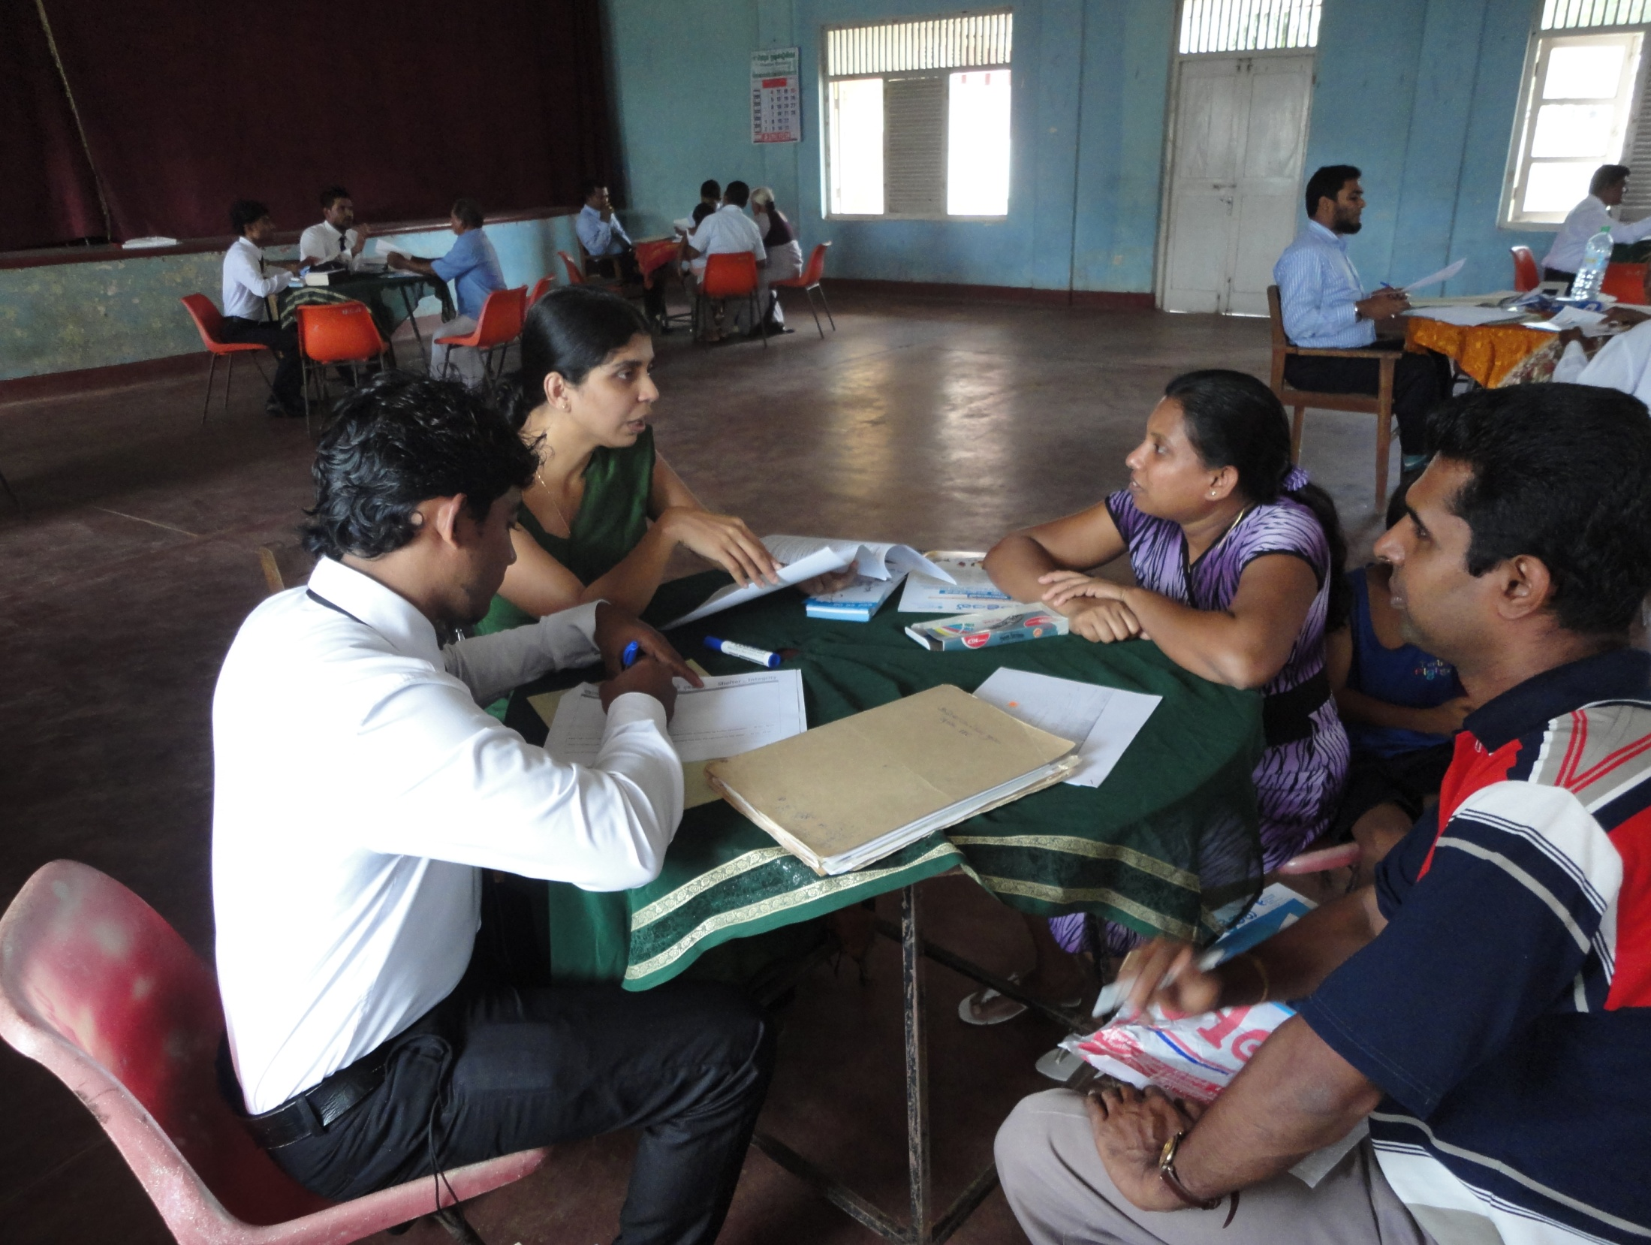
Our Advocacy and Legal Advice Centres provide free and confidential legal advice to victims and witnesses of corruption. The information gained from hundreds of corruption cases generates solid statistics enabling TI to identify corruption hotspots that demand reform or official action.

Slide 33
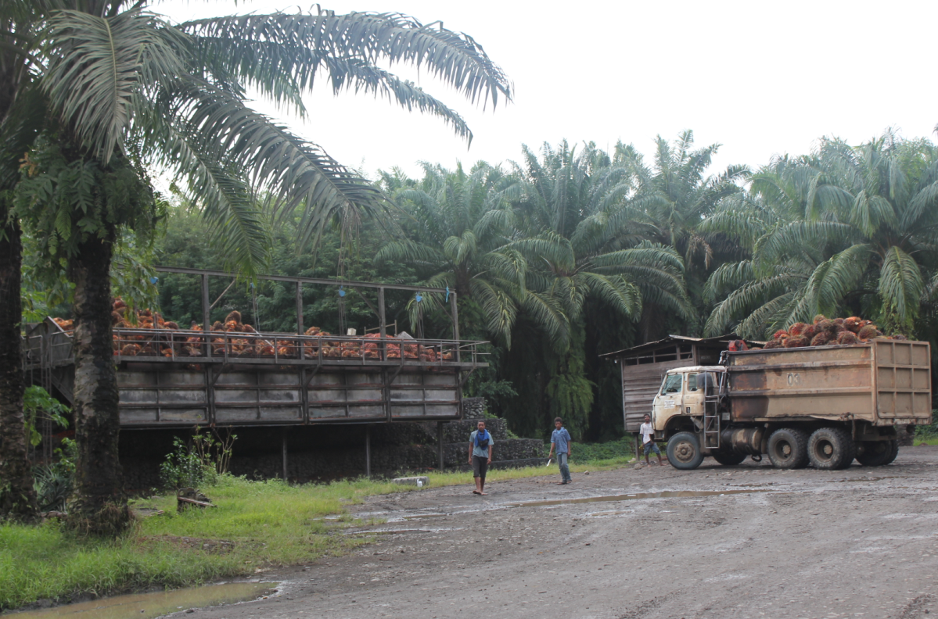
Integrity Pacts are a tool for preventing corruption in public contracting. They are essentially an agreement between the government agency offering a contract and the companies bidding for it that they will abstain from bribery, collusion and other corrupt practices for the extent of the contract. To ensure accountability, Integrity Pacts also include a monitoring system, typically led by civil society groups.

Slide 34
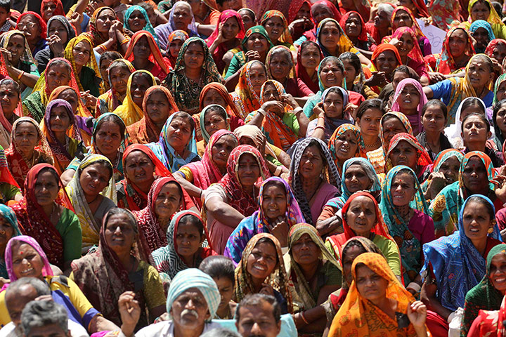
Public hearings can help raise awareness about REDD+ and allow citizens to hold duty-bearers to account.

Slide 35
For more information and contact….
Transparency International PNG
Jerry Bagita: opmtipng@gmail.com
Programme Manager
Address: 2nd Floor|IPA Haus|Konedobu,
P.O Box 591|Port Moresby|NCD
Website: www.transparencypng.org
Transparency International Indonesia
Rivan Prahasya: rprahasya@ti.or.id
Program Coordinator - Forestry Governance
Address: Jl. Senayan Bawah No.17 Jakarta 12180
Phone : (62-21) 720-8515 Fax
Website: http://www.ti.or.id/en/
Vietnam: Towards Transparency
Cao Hai Thanh:
haithanh@towardstransparency.vn
National Project Coordinator
Address: Floor 12 B, MACHINCO,
444 Hoang Hoa Tham, Tay Ho, Hanoi
Phone: +84 (04) 3715 3443
TI Secretariat
Claire Martin: cmartin@transparency.org
Climate Finance Integrity Programme
http://www.transparency.org
Address: Alt-Moabit 96, 10559 Berlin, Germany
Phone: + 49 30 3438 20 410

