Slide 1
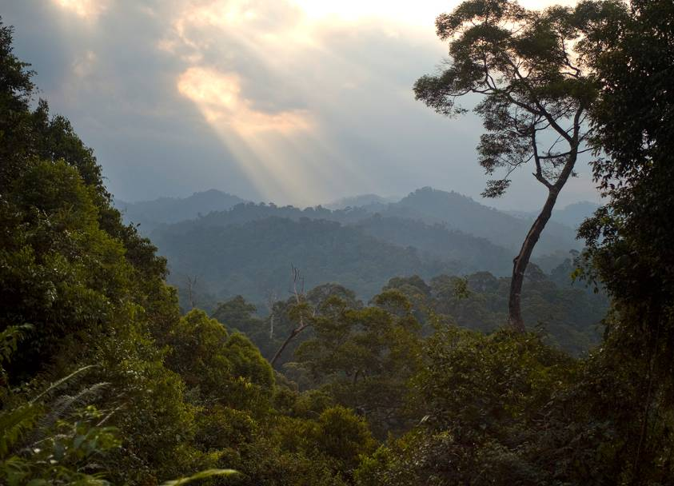
SUSTAINABLE LANDSCAPES IN BRAZIL AND INDONESIA
2013-2015
Herlina Hartanto
Indonesia Terrestrial Program

Slide 2
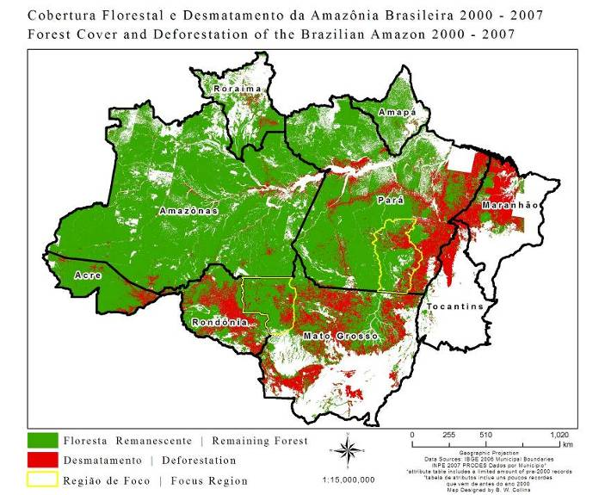
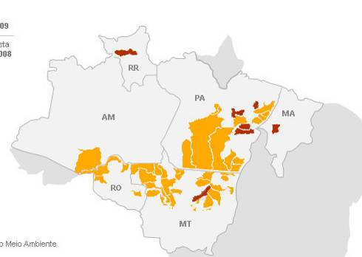
São Felix do Xingu Green Economy
São Félix do Xingu, Para, Brazil, 8.4 million ha
Notes:
2

Slide 3
São Felix do Xingu Green Economy
Strategies
Increase responsibility along beef production chain
Restoration of degraded areas
Cocoa production
Agroforestry
Implement Territorial and Environmental Management Plans in Indigenous Lands
Long term, large scale financial mechanism: São Felix do Xingu Green Fund
Notes:
3

Slide 4
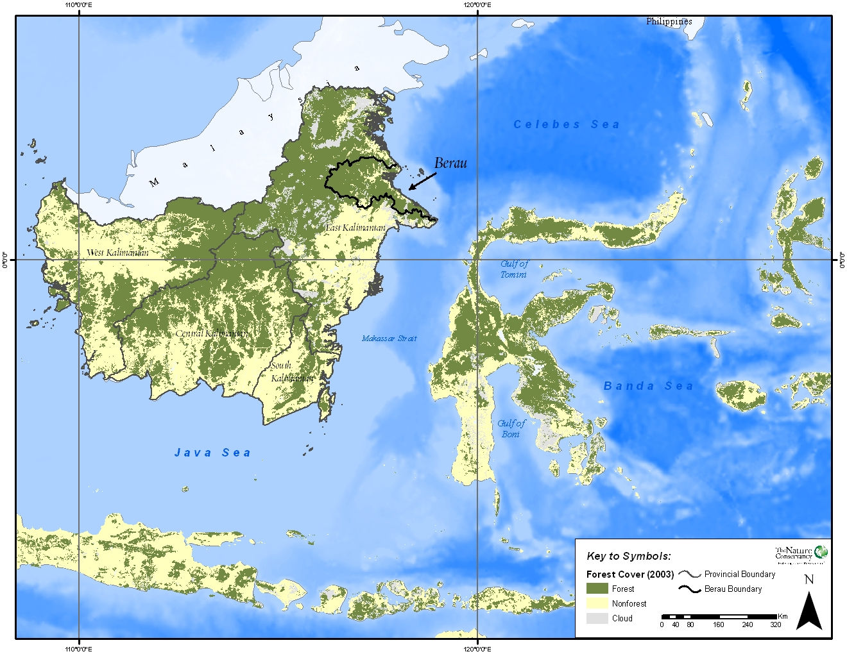
BERAU FOREST CARBON PROGRAM Berau district, East Kalimantan Province, Indonesia
2.2 million ha

Slide 5
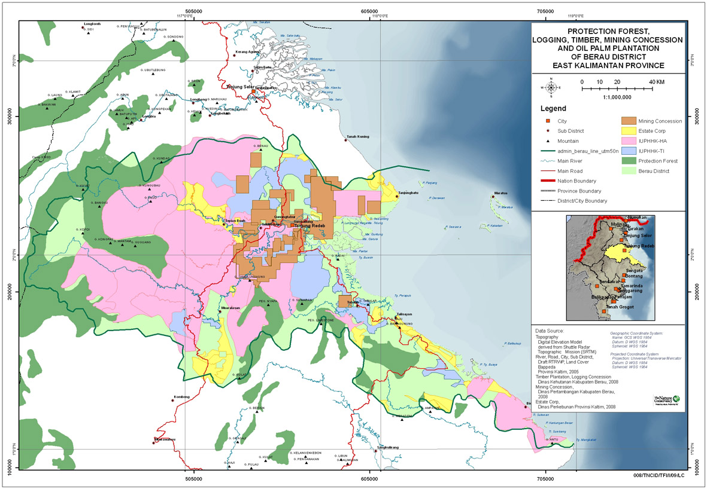
BFCP STRATEGIES
Cross-Cutting:
Improved spatial planning
Improved governance (capacity building, policy and legal framework)
Community empowerment and engagement, improved livelihood
Production Forests: RIL, HCVF, certification
Oil Palm Plantations: better siting, land swap, HCVF, best practices
REL
Protection Forests: better management, incentives
Strategy 1
Strategy 2
Strategy 3
Historic
Performance
Period 1
Notes:
Again focus on better land management yet improved community livelihood
Switch emission red with communities??
5

Slide 6
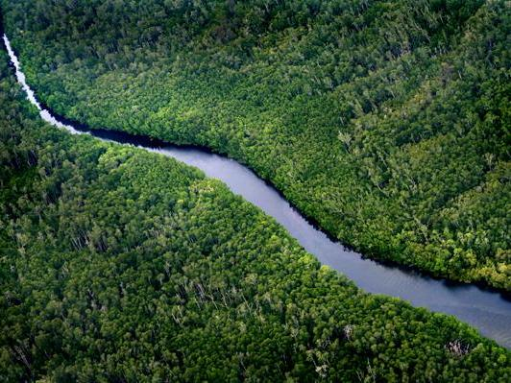
PROJECT GOAL
To increase economic development and human well-being while minimizing carbon emissions and habitat loss in two important sub-national demonstration landscapes, and at the State, Province and National levels.

Slide 7
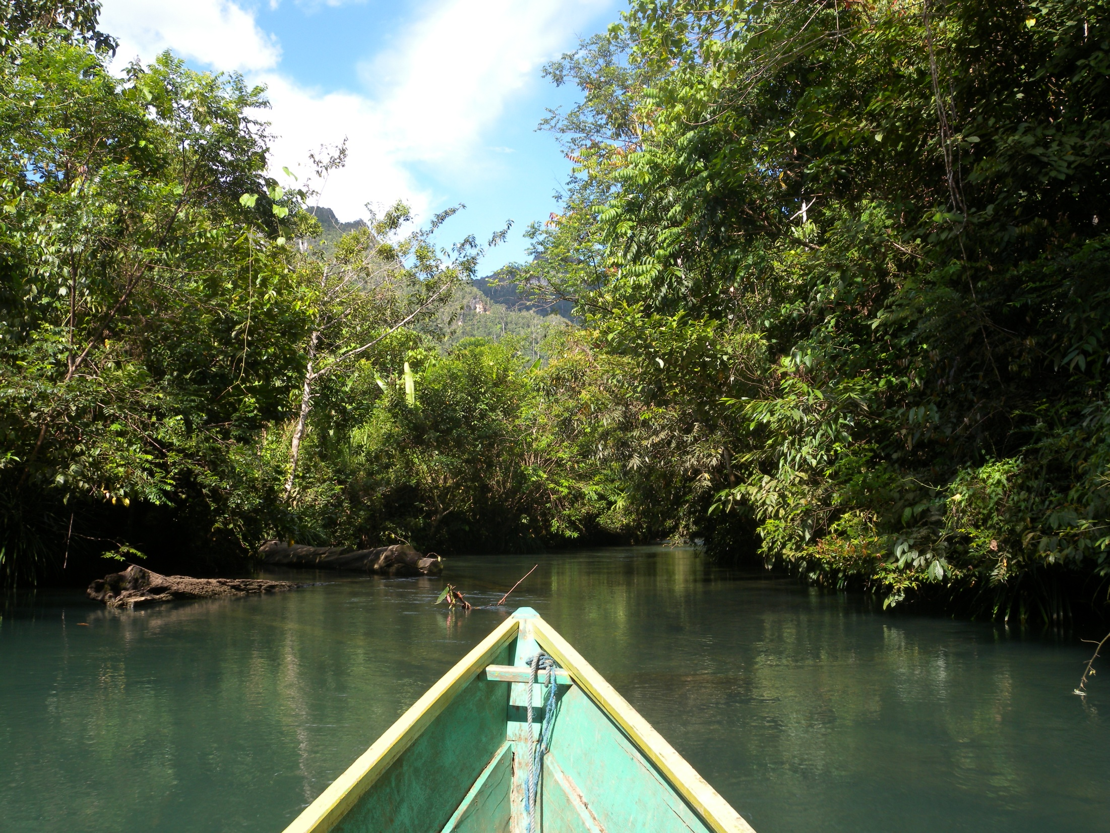
BRAZIL
Indicators for the five-year (2013-2017) demonstration phase of the Central Xingu REDD+ Pilot Program:
Tons of emission reductions (target: 41 million)
% of total expected area of legal reserves and riparian zones with forest, under restoration or compensated (target: legal reserves: 60%; riparian zones: 50%)
% farms/ranches associated with local union adopting improved practices (target: 50%)
# territorial management/municipal land-use plans created (target: 3 in indigenous territories, 1 in protected areas, 2 municipal-level)
# of Municipal, State, and National REDD+ programs that incorporate significant learnings from the Central Xingu program (target: municipal: 5; state: 1; national: 2)

Slide 8
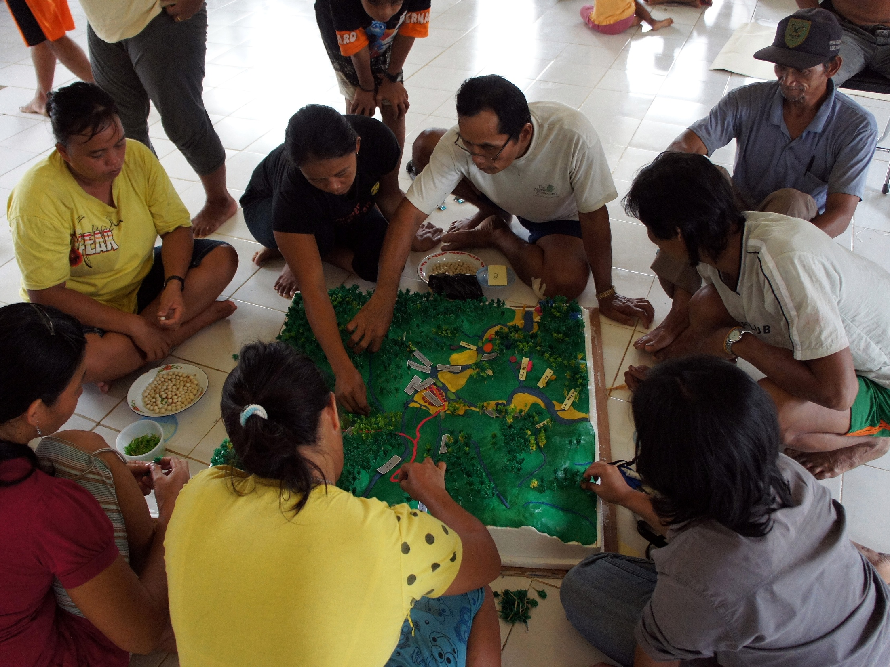
INDONESIA
Indicators for the five-year (2011-2015) demonstration phase of the BFCP:
Tons of emission reductions in Berau from 2011-2015 based on district-level carbon methods agreed between Berau and National MRV authority (target: 10 million)
# hectares of land in Berau independently assessed to be under sustainable effective management (target: 800,000)
% of households in participating villages with increased income, livelihood opportunities, or improved access to basic services as a result of engaging in BFCP (target: 50%)
# of District, Province, and National REDD+ programs that incorporate significant learnings from the Berau program by 2015 (target: 5 Districts, 3 Provinces, 3 National programs)
VISIONING

