Slide 1
Addressing Large-scale Drivers of Deforestation in the Mekong Region
Wildlife Conservation Society (WCS)
NICFI Grantees’ meeting, Oslo, 28 Oct. 2013
Thematic areas
Sustainable landscapes
REDD+ relevant commodity supply chains
Planning and implementation of REDD+

Slide 2
Goal
Understand, plan and demonstrate appropriate policy and landscape-level responses that…
..address large-scale drivers of deforestation..
…in particular the expansion of poorly planned and quasi-legal industrial agriculture and extractive industries, in the Mekong region

Slide 3
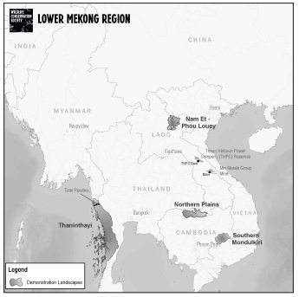
Partners
Regional
- Forest Trends
- Global Environment Institute
Lao
- Land Issues Working Group
- Village Focus International
Cambodia
- Vishnu Law Group
- Sansom Mlup Prey
5 focal landscapes across
3 countries – Lao, Cambodia, Myanmar
The work builds on well-established WCS field programs and country offices

Slide 4
Outcome 1: Improved understanding of large-scale drivers of deforestation in the Mekong region and their impacts by governments, development partners, private sector actors and civil society.
Output 1.1: Country-specific studies of the large-scale drivers of deforestation and regional linkages
Output 1.2: Analyses of the commodity chains for key commodities (e.g. oil palm and rubber in particular)
Output 1.3: Increased availability of information on planned and existing development activities
Output 1.4: Profiles of companies that are causing large-scale deforestation in the region

Slide 5
Outcome 2: Formulation of policies to reduce the impact of large-scale drivers of deforestation by government and private sector actors and pilot implementation
Output 2.1: Improvements in policies across the region to regulate concessions and land-use planning
Output 2.2: Development of the new Environmental and Social Impact Assessment (ESIA) law for Cambodia
Output 2.3: Stronger sustainability policies for Chinese State-Owned Enterprises
Output 2.4: Examples of best practice in forest conservation offsets used to inform sectoral policies

Slide 6
Outcome (3) Implementation of multi-stakeholder land-use plans to meet economic development and forest conservation goals across four critical landscapes covering 2.0 million hectares of forests in the region
Output 3.1: Development or revision of government land-use plans for each landscape
Output 3.2: Effective implementation systems for landscape level plans
Output 3.3: Establishment of partnerships with major private sector entities in and around the landscapes
Output 3.4: Long-term monitoring of drivers of deforestation and the impacts of project activities

Slide 7
Outcome (4) Established models and policy guidance for site-level multi-stakeholder approaches to protecting forests and reducing rural poverty, benefiting at least 80 villages and 5000 households
Output 4.1: Villages develop land-use plans and obtain land titles and tenure over natural resources
Output 4.2: Established conflict resolution mechanisms to resolve land and forest disputes
Output 4.3: Implementation and scaling-up of incentive-based schemes, such as PES
Output 4.4: Monitoring of site-level impacts and documentation of lessons learned

Slide 8
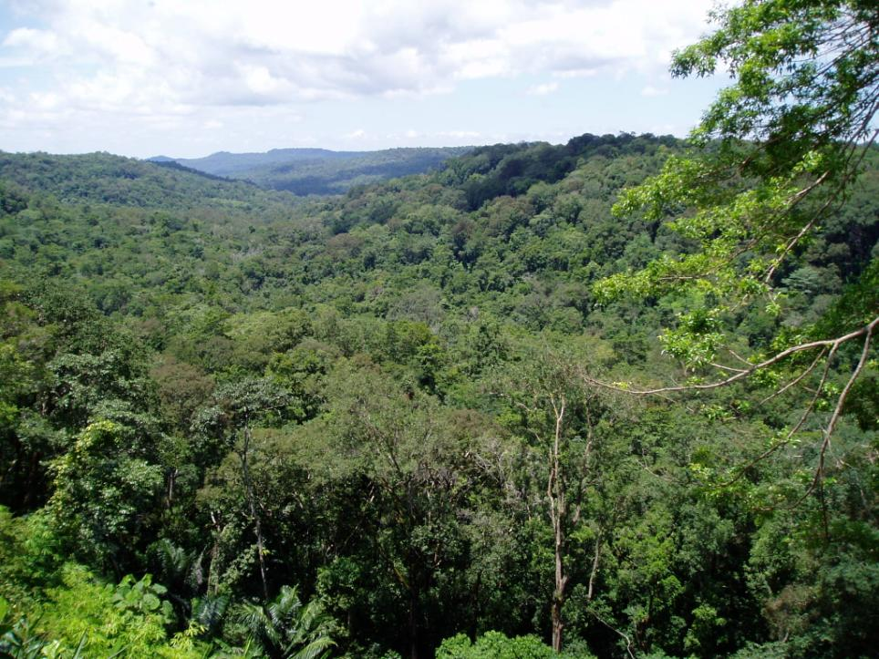
Thank you

