Slide 1
Gender, health and development: underlying paradigms and their implications for interventions
Rachel Tolhurst,
Department of International Public Health

Slide 2
Underlying paradigms
Integrationist vs. agenda setting paradigms
Integrationist: incorporates gender perspective into existing (disciplinary/sectoral/development) paradigms without challenging them
Agenda setting: fundamental rethinking of goals, policy, change processes from a gender perspective
Notes:
Link to women’s condition and position

Slide 3
Women’s health needs or gender and health
Women’s health needs approaches
  (Women’s and girls’) health and rights (agenda setting)
  Gender efficiency – cost effectiveness of targeting women (instrumental to children’s health) (integrationist)
Gender equity approaches
  Social determinants of health (agenda setting)
  Epidemiological approach (integrationist)

Slide 4
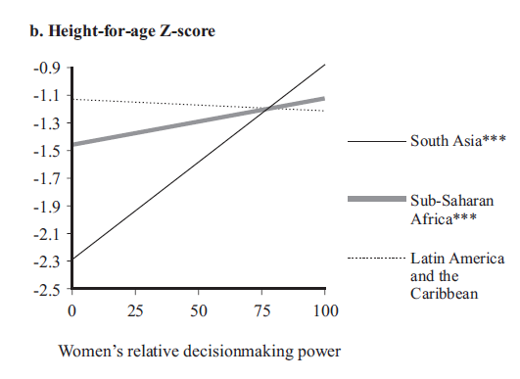
(Source: Smith et al, 2003, using National Demographic and Health Surveys 1990-1998; sample of 117,242 from 36 countries)

Slide 5
Improving gender sensitivity of child-health and nutrition programming (integrationist approaches)
Provide (financially and geographically) accessible, acceptable and good quality maternal and child health services (e.g. close to community services)
Increase women’s participation in health planning (e.g. strengthening women’s involvement in community accountability structures)
Involve senior women and fathers in health promotion activities (e.g. work with grandmothers in Senegal)
Improve women’s capacity to analyse, plan and act collectively (e.g. participatory work with women’s groups in India and Nepal)

Slide 6
Structural interventions for health and social change (agenda setting approaches)
Target cash to women (e.g. PROGRESA, Mexico)
Improve livelihood opportunities poor women – e.g. collectivisation, training, micro-credit
Legal and institutional change, including rights to abortion, legislation against violence, inheritance law
Social change including support to women’s organisations and men’s organisations that challenge gender inequalities (e.g. Sonke gender justice network)
Health promotion approaches that enable women and men to reflect on gender norms, stereotypes and relations (e.g. World Neighbours work)
Provide comprehensive sexual and reproductive health services

Slide 7
Implications for policy and research
Policy goals need to be framed within agenda setting paradigms with a commitment to women’s rights and gender equity
Policy needs to move beyond integrationist approaches to ‘structural interventions’ and to link health and social interventions
More evidence and exploration is needed regarding:
    The roles of context and interactions between gender and other axes of social disadvantage
    The health outcomes of interventions to increase women’s decision making power in the household and community
    Gender equity outcomes of improved health service provision

