Slide 1
Evaluation of UNDP support to Conflict affected countries in the context of integrated peace operations
Evaluation Office of UNDP
May 2013

Slide 2
Objectives
Assess how UNDP programming and policies support peacebuilding within the framework of large international operations, and how UNDP supports a country’s transition from immediate post-conflict to development
Evaluate how UNDP response mechanisms function at headquarters and operational levels during periods of transition in conflict-affected countries

Slide 3
Peacebuilding Context
Integrated missions introduced in 1997, and further defined in the 2000 Brahimi report
Since 2000 there has been a steady rise in the use of Security Council-mandated UN political, peacekeeping and/or peacebuilding missions with multidimensional mandates

Slide 4
UNDP Context
Fighting poverty
Building democratic societies
Protecting the environment
Halting and reversing HIV/AIDS
Empowering women
Growing national capacity
Preventing crisis, enabling recovery

Slide 5
From Key Findings to Recommended Actions
Comparative Advantage
Conflict analysis
Government capacity building
Electoral systems
Empowering Women
Peacebuilding partnerships

Slide 6
UNDP comparative advantages
on the ground presence
close partner to government
humanitarian, peacebuilding and development bridge
Governance and institutional change agent
Ad hoc and overly ambitious support programmes
Slow delivery
Reputational risk

Slide 7
Conflict Analysis
UNDP is often caught off guard and unprepared when conflict erupts, despite its in-country position and close contacts with government and civil society.
Even though UNDP recognizes the importance of conflict analysis and has developed its own conflict analysis tools, the organization has no standard operating procedure for when and how to conduct conflict analysis. As a result, the conduct of such analysis in both substantive and procedural terms remains varied across UNDP.

Slide 8
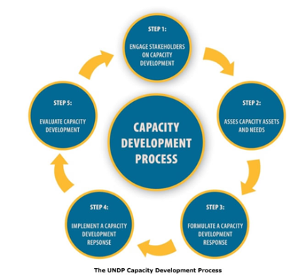
Expanding post-crisis government capacity
The sustainability of UNDP support to conflict-affected countries depends not only on how national capacities are developed but also on the organization’s ability to advocate for and maintain international support for longer term peacebuilding activities once the initial crisis has passed

Slide 9
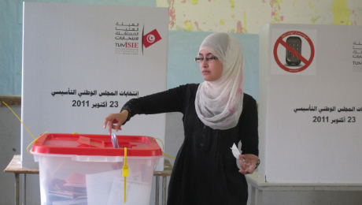
Electoral System Reform
Extensive experience
Generally viewed as effective and impartial
Often difficult to balance political imperatives and social contract obligations

Slide 10
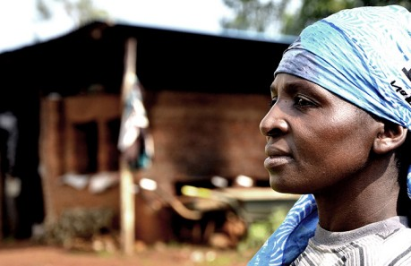
Empowering Women in Conflict Settings
UNDP has supported opportunities for women to participate more fully in the emerging political and legal landscape of post-conflict countries.
Recommendation:
Increase efforts to prepare and place female staff in conflict settings and set tighter benchmarks for country offices to meet gender targets

Slide 11
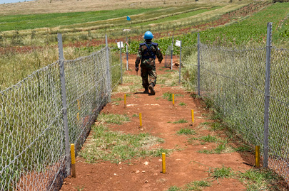
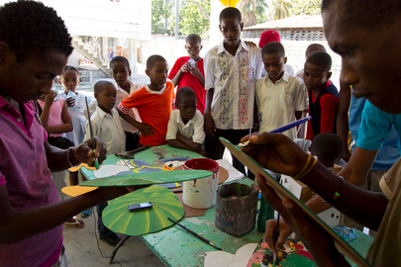
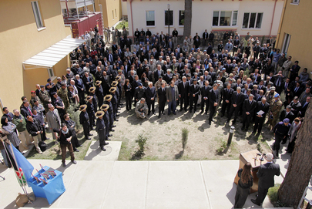
Partnerships
Further UNDP engagement is needed with DPKO, DPA, OCHA and other participants at the start of integrated missions – in order to smooth the transition to peacebuilding

Slide 12
Thank you
Alan Fox
Evaluation Advisor
alan.fox@undp.org
http://web.undp.org/evaluation

