Slide 1
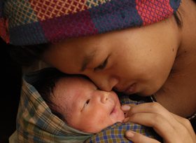


The theoretical perspective and argument for UNICEF’s focus on Equity
Christian Salazar Volkmann
UNICEF
Programme Division
May 10, 2012
Oslo

Slide 2
EAP Economies doing very well … but income inequality has increased a lot!
Source: ADB (2007), except for Thailand (TDRI, 2007)
Notes:
EAP Econs doing well, but inequality increasing.
Gini mostly going up.
Trend unlikely to change soon.
So, where are the poor?
Source: ADB, 2010b - except Thailand (TDRI, 2007).
Note: Years of computation: Cambodia (1994–2007); People’s Republic of China (1993–2004); Indonesia (1993–2002); Republic of Korea (1993–2004); Lao PDR (1992–2002); Malaysia (1993–2004); Philippines (1994–2006); Thailand (1990–2007); and Viet Nam (1993–2004).

Slide 4
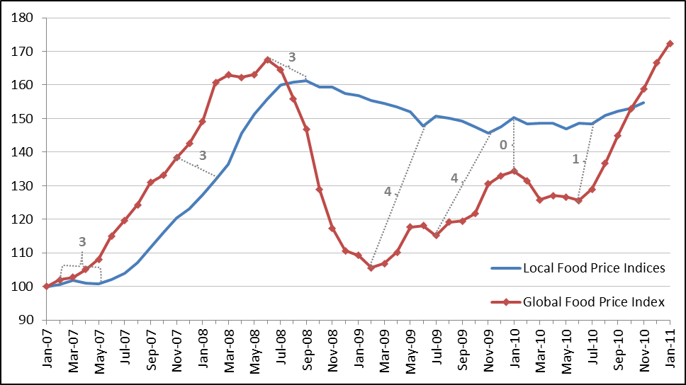

Food Prices
Source: Ortiz, Chai and Cummins (2011) UNICEF

Slide 6
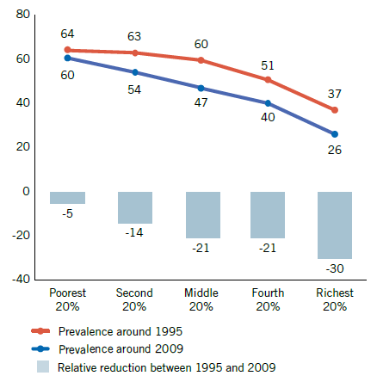
In Southern Asia, progress in combating child undernutrition is bypassing the poorest
Proportion of under-five children who are underweight in Southern Asia, by household wealth, around 1995 and 2009 (%)
Source: UNICEF global databases, Statistics and Monitoring Section/ Division of Policy and Practice.
Published in: The Millennium Development Goals Report, 2011.

Slide 8
Multiple Deprivations, Severe deprivation and Income Poverty, 2006

Slide 10
Child Vulnerability:
Dimensions and Thresholds
Dimension | Severe Deprivation | Less Severe Deprivation
Food | Children whose height and weight were more than 3 SDs below the median of the international reference population. | Children whose height and weight were more than 2 SDs below the median of the international reference population.
Shelter | Children in dwellings with 5 or more people per room or with no flooring material . | Children in dwellings with 3 or more people per room or living in a house with no flooring or inadequate roofing.
Water | … | …
Sanitation | … | …
Health | … | …
Education | … | …
Information | … | …

Slide 12
Levels and trends in under-five mortality
2010
Under-five mortality rate in 2010 (per 1,000 live births)
Global average:
57 per 1,000
Observed rate of U5MR reduction (ARR, 2000-2010)
Notes:
Size of bubble: Number of deaths in 2010
All countries at or below 180 per 1000
Countries with high burden of deaths have relatively higher mortality

Slide 13
8 of the 10 countries with the highest under five child mortality rates are affected by violence or in ‘fragile situations’
1) Somalia (180 per 1000 live births)
2) Mali
3) Burkina Faso
4) Sierra Leone
5) Chad
6) Democratic Republic of the Congo
7) Haiti
8) Angola
9) Central African Republic
10) Guinea-Bissau
11) Afghanistan
12) Niger and Nigeria
13) Burundi
14) Cameroon
15) Mozambique
16) Guinea
17) Côte d’Ivoire
18) Equatorial Guinea
19) Benin
20) Zambia and Mauritania (both111 per 1000 live births)
Source for mortality rank: UN Inter-agency Group for Child Mortality Estimation 2011; Fragile Situation countries are shown in red (source: World Bank 2011)
Notes:
No low-income fragile or conflict-affected state has yet achieved a single Millennium Development Goal.
More than 1.5 billion people live in countries affected by fragility, violence, or conflict. The World Bank’s recent analysis (The World Development Report 2011: Conflict, Security, and Development http://wdr2011.worldbank.org/fulltext shows that while countries currently affected by or recovering from violence and fragility account for 47% of the total population of developing countries (excluding Brazil, China, India, and Russian Federation) but they account for:
64% of unattended births, 71% of child (under 5) deaths, 60% of undernourished, 65% of people without access to safe water, and 54% of people without access to improved sanitation
The World Bank defines a fragile situation as having either: a) a composite World Bank, African Development Bank and Asian Development Bank Country Policy and Institutional Assessment rating of 3.2 or less; or b) the presence of a United Nations and/or regional peace-keeping or peace-building mission (e.g. African Union, European Union, NATO), with the exclusion of border monitoring operations, during the past three years.

Slide 15
Disparity of Incidence of Severe Deprivation, ca. 2006

Slide 17
Context specific indicators for key determinants to identify barriers & bottlenecks
 | Determinants | Description
Enabling Environment | Social Norms | Widely followed social rules of behaviour
 | Legislation/Policy | Adequacy of laws and policies
 | Budget/expenditure | Allocation & disbursement of required resources
 | Management /Coordination | Roles and Accountability/ Coordination/ Partnership
Supply | Availability of essential commodities/inputs | Essential commodities/ inputs required to deliver a service or adopt a practice
 | Access to adequately staffed services, facilities and information | Physical access (services, facilities/information)
Demand | Financial access | Direct and indirect costs for services/ practices
 | Social and cultural practices and beliefs | Individual/ community beliefs, awareness, behaviors, practices, attitudes
 | Timing and Continuity of use | Completion/ continuity in service, practice
Qty | Quality of care | Adherence to required quality standards (national or international norms)
Notes:
Enabling environment
Social Norms: This sub-category refers to social rules of behaviours that are widely followed within a society. While these vary according to contexts, it will be essential to identify social norms that result in discrimination or exclusion and that may be common across different contexts. Addressing these social norms is critical to realizing children’s rights, changing behavior and practices that constrain the fulfillment of rights, or creating demand for services.
Legislation/Policy: This refers to the existence and implementation of laws and policies at different levels of society. In each country, we must focus our monitoring on the legal and policy issues that promote or deter our objectives. In some cases, national legislation may be a critical factor; in others, the subnational policy framework may represent a crucial bottleneck.
Budget/Expenditures: The efficient and equitable allocation and utilization of resources is a common constraint to effective coverage. The precise nature of this constraint will vary by context. The bottleneck to be monitored may be the allocation of resources to a specific sector of the system, or the allocation for particular groups (deprived communities), or the actual levels of expenditure.
Governance/Partnerships: While the term “governance” has broad and varied connotations, we are focusing on the bottlenecks that obstruct accountability and transparency, as well the impediments to coordination and partnership.
Supply:
Availability of essential commodities/inputs: Most services, facilities and practices require a certain amount of essential commodities or inputs to function.
Access to adequately staffed services, facilities and information: This refers to the target population’s physical access to the relevant services, facilities and information. Depending on the sector, the most critical determinant for access may relate to infrastructure, the presence of qualified personnel, the information channels, or a combination of these factors.
Demand:
Financial access: Financial barriers often prevent deprived groups from utilizing available services or adopting certain practices. These barriers can be direct (e.g. user fees, purchase of required inputs by households) or indirect (cost of transportation, time, etc.).
Social and cultural practices and associated beliefs: Social and cultural barriers may prevent deprived groups from using services or adopting practices. These factors include social practices that reflect social roles and responsibilities (e.g. children with disabilities are a source of shame and should be hidden) and individual or collective beliefs about cause and effect that support customary practices (e.g. the colostrum will harm the newborn). These factors may affect service access and provision (e.g. language, attitudes of providers regarding different ethnic groups).
Continuity of use: The effectiveness of a service, practice, or other intervention generally depends on the continuity of use over the medium to long term. While many target groups may start using a specific service or facility or adopting a desired behavior, it is often the case that participants drop out after a period or do not complete all the required aspects or steps.
Note that while some financial and socio-cultural barriers can be measured directly, others are measured indirectly by measuring the actual utilization of the service or the adoption of the practice.
Quality:
No sub-components.
While quality is subject to interpretation across contexts, for our purposes, “quality” implies adherence to the minimum required standards, as defined by national or international norms.

