Slide 1

AIDS 2014
Oppsummering fra Aidskonferansen i Melbourne
29. oktober 2014
Notes:
Intro
Norad

Slide 2
Program:
Velkommen v/Helga Fogstad, Seksjonsleder Global Helse, Norad
Trender og highlights fra Melbourne v/Anne Skjelmerud, Norad
Betydningen av primærforebygging v/Bera U. Moseng og Aksel Overskott, Helseutvalget
Tabu og Etikk – et internasjonalt perspektiv v/ Ruth Paintsil (PMV) og Evy Pilskog Stadsvik (Aksept)
Ungdom og hiv v/ Anne May Andersen, Norad
Brukerstyrt medisinsk poliklinikk v/Nye Pluss
Rettigheter v/Bjørg Sandkjær, Norad
Sexarbeidere og rusbrukere v/ Astrid Renland, PION
Oppsummering og avsluttende kommentarer v/Sigrun Møgedal

Slide 3
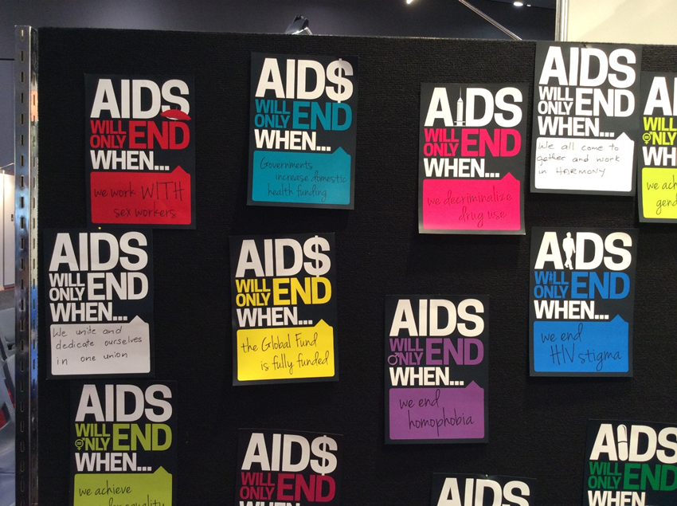
Oversikt presentasjon
Hovedinntrykk
Globalt overblikk
Landinntrykk
Forebygging
Behandling
Hiv og…

Slide 4


Hovedslagord:
Mer samstemt enn før: Ikke nok med vitenskapelige fremskritt, om man ikke får gjort noe med rettigheter og stigma

Slide 5
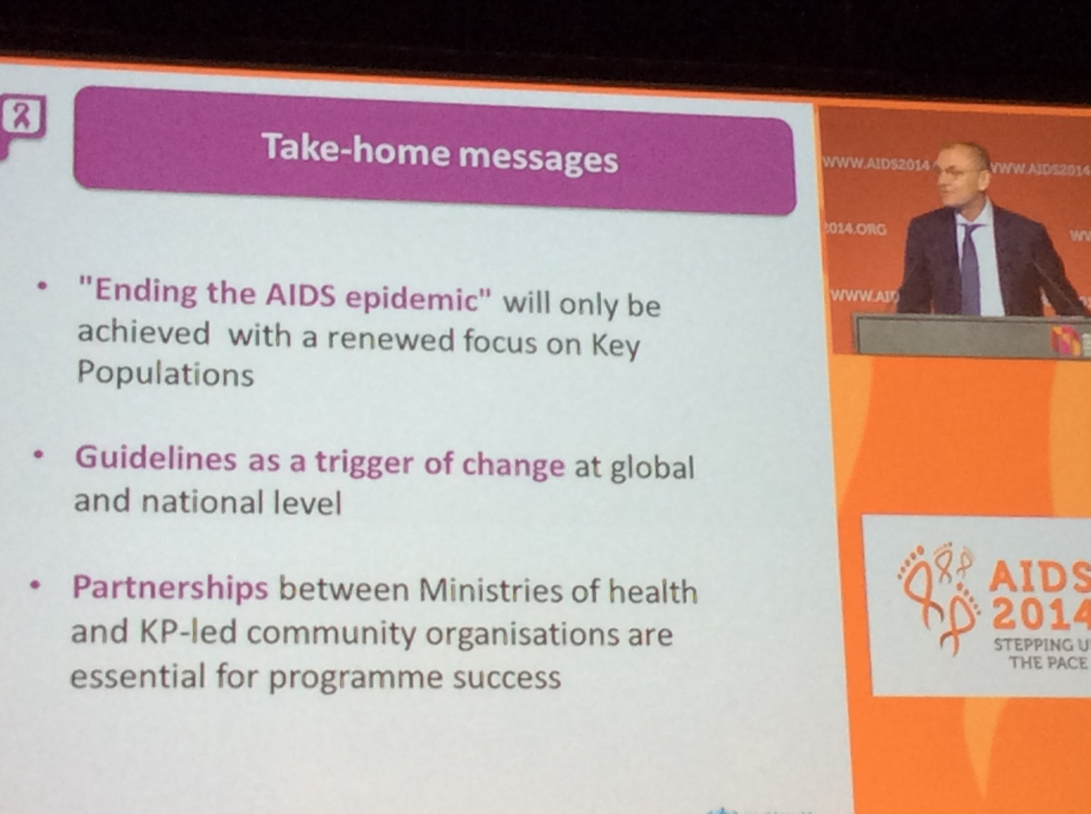

Slide 6
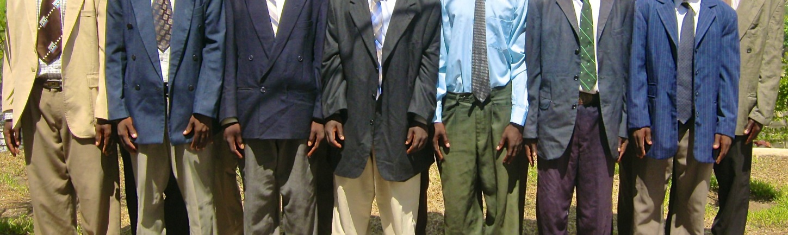
Discriminatory Environments Impede Effective HIV Service Delivery
Characteristic Malawi Namibia Botswana
MSM afraid to seek health services 18% 18% 21%
MSM afraid to walk in community 16% 17% 29%
MSM blackmailed because of sexuality 18% 21% 27%
MSM beat up by govt/police official 8% 22% 2%
Cultural and political environments contributing to stigma and discrimination impede access to life-saving services for many populations
Source: Beyrer et al, 2010
Notes:
819.4980

Slide 7
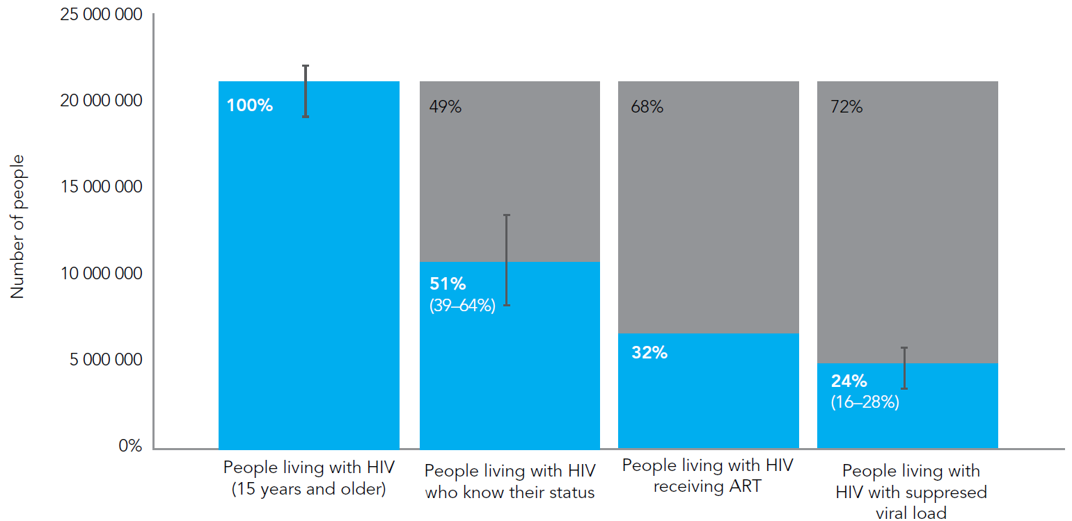
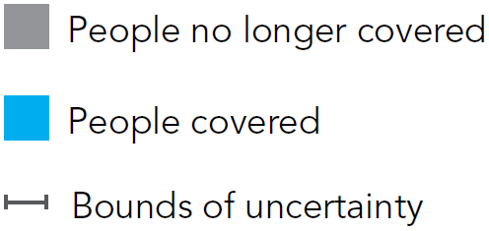
Challenges ahead: treatment cascade
Notes: No systematic data are available for the proportion of people living with HIV who are linked to care, although this is a vital step to ensuring viral suppression in the community.
Sources: 1. UNAIDS 2012 estimates; 2. Demographic and Health Surveys, 2007–2011
(www.measuredhs.com); 3. Kranzer, K., van Schaik, N., et al. (2011), PLoS ONE;
4. GARPR 2012; 5. Barth R E, van der Loeff MR, et al. (2010), Lancet Infect Disease.

Slide 8
By 2020…
90%
of all people living with HIV will know their HIV status
90%
of all people diagnosed with HIV will receive sustained antiretroviral therapy.
90%
of all people receiving antiretroviral therapy will have durable suppression.

Slide 9
The result
72%
3
of all people living with HIV
will be virally suppressed
= a three-fold increase
over current 2014 estimates

Slide 10
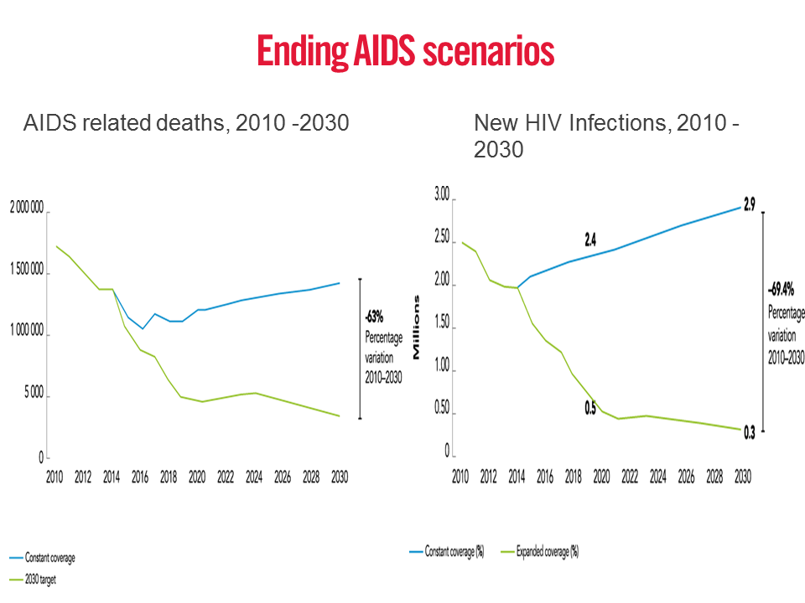

Slide 11
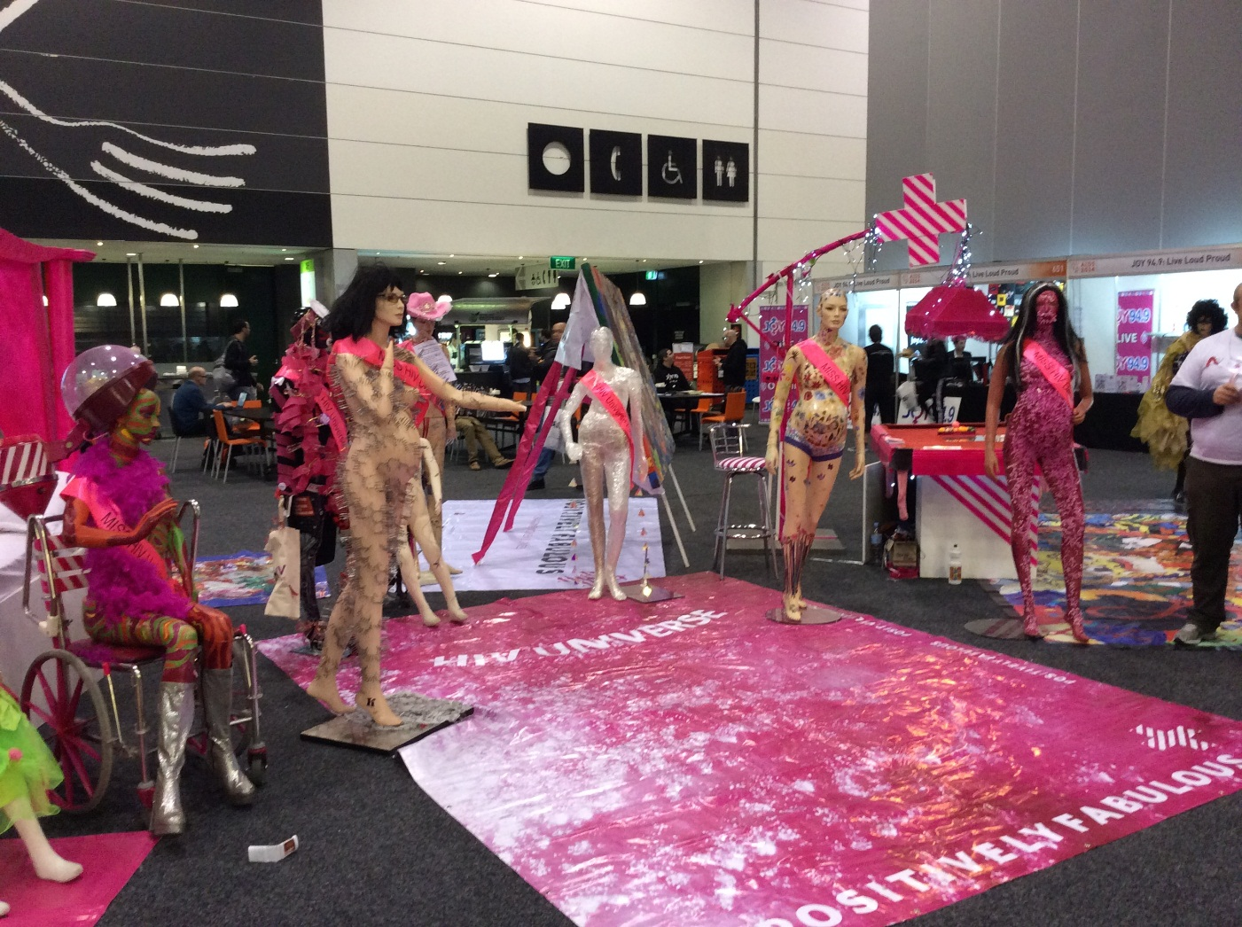
Global overview

Slide 12
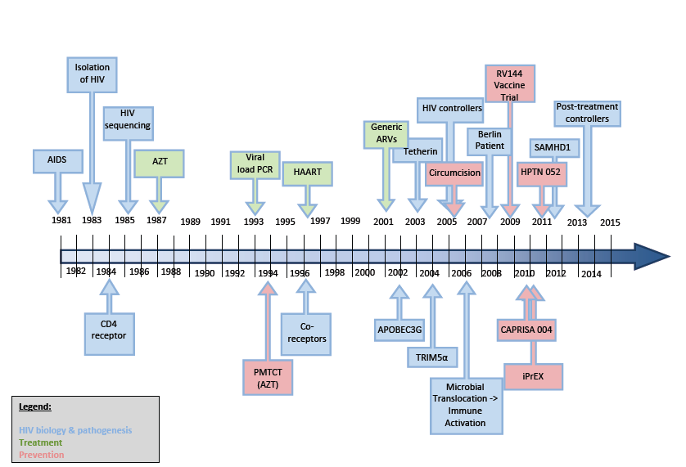
30 years of HIV Science
A good example of translational research
F. Barré-Sinoussi, AL. Ross, JF Delfraissy (2013) Nature Reviews Microbiology

Slide 13
New Infections Halved since Peak of Epidemic
Maintaining momentum is key to achieving epidemic control
Trends in New HIV Infections, 1990-2012
Notes:
But we can’t become complacent now. The road ahead to an AIDS-free generation remains long….. and complicated. And all of you know that because you’re paving the road!

Slide 14
Unequal Decline in New HIV Infections
Source, UNAIDS 2014

Slide 15
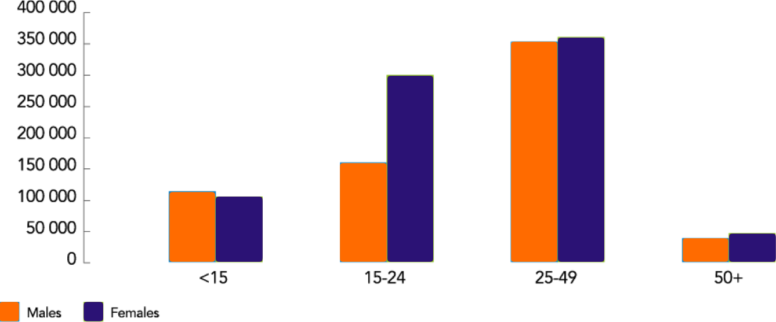
Disparately High HIV Prevalence among Young Women Compared to Young Men
New HIV Infections in Sub-Saharan Africa by Age & Sex, 2013
Source: UNAIDS 2014

Slide 16

Violence Against Children Surveys (VACS)
Reducing Gender Based Violence is a Critical Priority
*Among females reporting sexual debut before age 18
**Data for Tanzania and Swaziland reported by 13-24 year olds
Sources:
UNICEF Swaziland and CDC. Findings from a National Survey on Violence Against Children in Swaziland. CDC, Atlanta. 2007
UNICEF Tanzania, CDC, and Muhimbili University of Health and Allied Sciences. Violence against Children in Tanzania: Findings from a National Survey 2009. Dar es Salaam, Tanzania. 2011
UNICEF Kenya, CDC, and Kenya National Bureau of Statistics. Violence against Children in Kenya: Findings from a 2010 National Survey. Nairobi, Kenya. 2012
Zimbabwe National Statistics Agency. National Baseline Survey on Life Experiences of Adolescents in Zimbabwe 2011. Preliminary Report. 2012
CDC, Interuniversity Institute for Research and Development, Comité de Coordination. Violence against Children in Haiti: Findings from a National Survey, 2012. Port-au-Prince, Haiti: Centers for Disease Control and Prevention, 2013

Slide 17
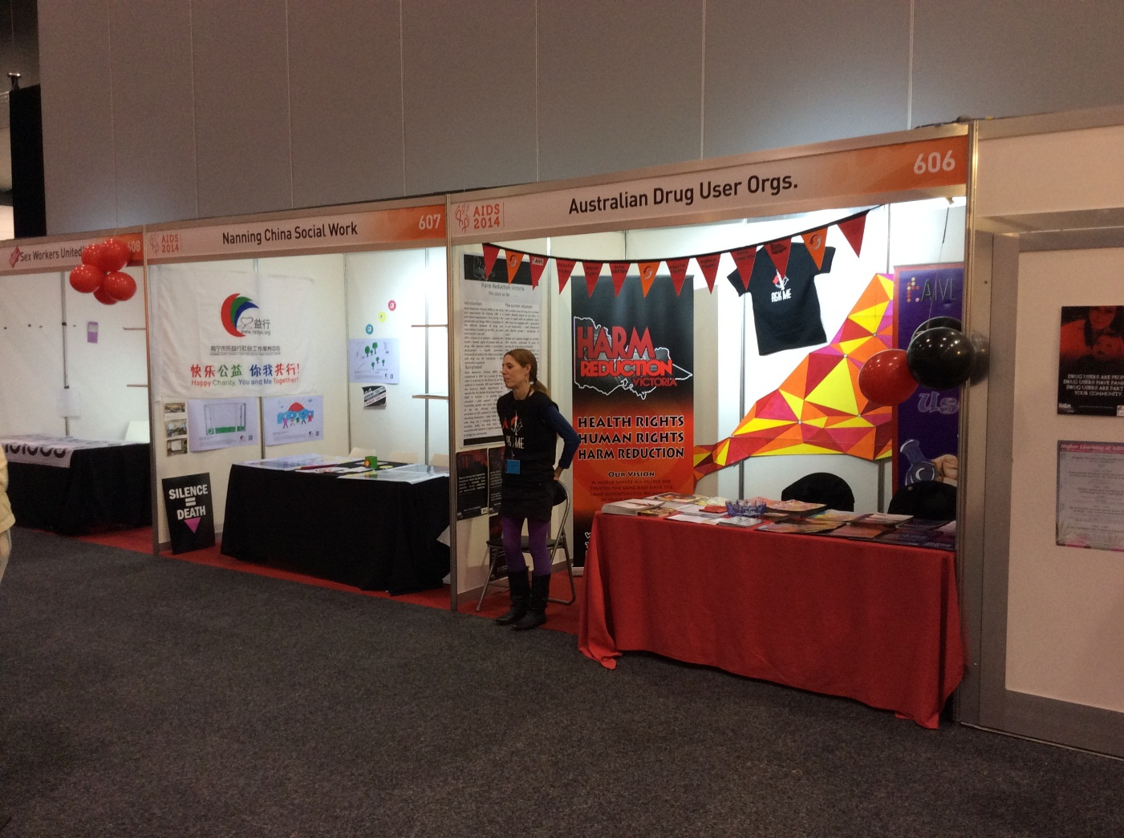
Country snapshots

Slide 18
Swaziland: Childhood Sexual Violence & HIV
Survivors of Childhood Sexual Violence 4 Times More Likely to be HIV Positive
Association between childhood sexual violence and selected health conditions, reported by females 13-24 years old in Swaziland
*Adjusted for age, community setting, SES, and orphan status
Source:
UNICEF Swaziland and CDC. Findings from a National Survey on Violence Against Children in Swaziland. CDC, Atlanta. 2007

Slide 19
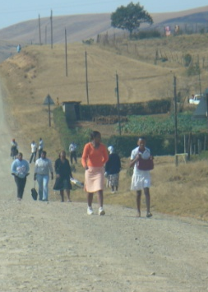
HIV prevalence in pregnant women in rural Vulindlela, South Africa
Age Group (Years) | HIV Prevalence (N=1237)
≤16 | 10.6%
17-18 | 21.3%
19-20 | 33.0%
21-22 | 44.3%
23-24 | 51.1%

Slide 20





Every 2 hrs a Filipino becomes HIV infected…
2000
1
1 new cases in 3 days
2012
9 new cases a day or
1 new case every 3 hours
2013
13 new cases a day
As of June 2013, Philippine HIV Registry – NEC/DOH
Notes:
Philippines is now one of the 9 countries globally experienced a fast growing HIV new infections over the last decade. Since 2013, every 2 hours a Filipino becomes HIV infected…

Slide 21
Malawi- why the decrease?
Declines in both prevalence and incidence
Decline in annual deaths from 99,000 in 2004 to 48,000 in 2013
Sharp decline observed in HIV incidence
Study was therefore initiated to understand reasons for decline in HIV incidence

Slide 22
Malawi - Conclusion
Identified factors contributing to decline in HIV incidence in Malawi include:
Improved coordination of the national response to HIV & AIDS (NAC, policy framework, strategic guiding documents)
Uptake of ART services
Achievements in behavior change+ as demonstrated by increased uptake of HTC and condom use
Evidence of reduced stigma leading to increased uptake of services.
Decline in STI prevalence

Slide 23
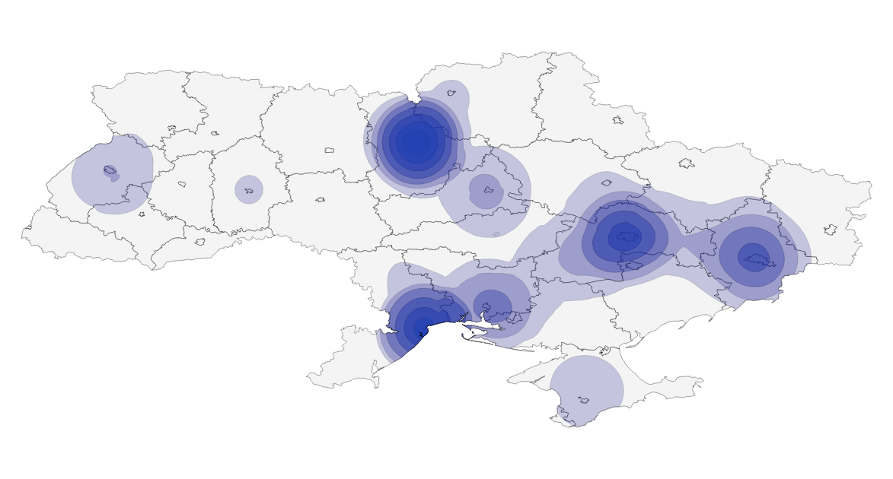
HIV epidemic among PWID in Ukraine
Estimated # of PWID in Ukraine is 310,000
  Main injectable drug of abuse – home-made acetylated poppy straw extract (opioid)
  Home-made methamphetamine-type drugs are also prevalent
HIV epidemic started in 1995 among PWID in southern and eastern regions
Kyiv
Dnipropetrovsk
Donetsk
Lviv
Odesa
Mykolaiv
AR Crimea
Notes:
The main message – the HIV epidemic in Ukraine was fuelled by PWID since the beginning. Now there is a decline in PWID.

Slide 24
Morocco: Epidemiology
Prevalence : 0.15% General Population
Evidence of a concentrated epidemics :
    FSWs : 5.8%
    MSM : 5.6%
    PWID : 11,4-25%
31,000 estimated cases of HIV infection, 30% only identified
Female : 49%

Slide 25
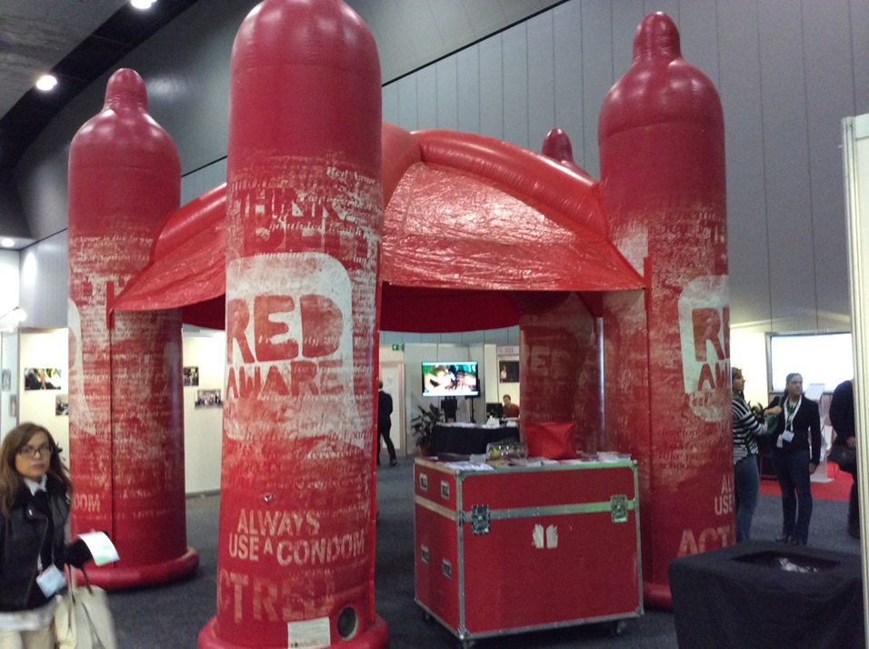
Prevention incl treatment as prevention

Slide 26
Approaches to Reducing
HIV Transmission
HIV+
HIV-
Exposure to HIV
INFECTED
PARTNER
EXPOSED
PARTNER
Reduce infectiousness
Reduce susceptibility
Reduce exposure
Notes:
Most HIV-1 infections globally occur in the context of sexual transmission. Thus, interventions to reduce HIV infection could be divided into those that reduce susceptibility in the exposed partner [click] and those that reduce infectiousness of the transmitting partner. [click]. My focus today is on the latter and specifically the question of [click] what makes an HIV-1 infected partner infectious. Clearly, over the 3 decades of the HIV-1 epidemic, a great deal of information has been generated with regard to approaches to reducing HIV-1 infectiousness.
26

Slide 27
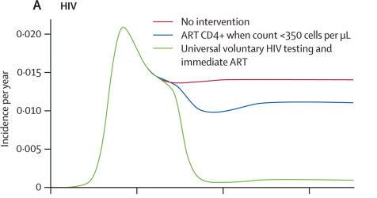
HIV incidence
2020
2040
2000
Granich RM et al, Lancet 2009; 373: 48–57

Slide 28
Male circumcision - VMMC
28
Background – The effect of VMMC on HIV among men
3 RCTs documenting a protective effect of VMMC among men
Recommended by WHO-UNAIDS since 2007
Effect of roll-out demonstrated among men
(Auvert et al, Plos Med 2013)
An effect on HIV among women?
No direct effect observed in epidemiological studies
(Weiss et al, Lancet ID 2009)
An indirect effect through reduced exposure?
Predicted by modelling studies
(Williams et al, Plos Med 2006; Njeuhmeli et al, Plos Med 2011)
VMMC: Voluntary Male Medical Circumcision RCT: Randomized Controlled Trial

Slide 29
Overview of results on VMMC roll-out obtained in Orange Farm (2007-2014)
29
Among men
VMMC uptake can be rapid and large
VMMC is not statistically associated with condom use
Circumcised men have a lower risk of prevalent HIV infection
Circumcised men have a lower risk of incident HIV infection (BED assay)
Among women
Most women are in favor of VMMC
Most women prefer circumcised men
Partner’s circumcision status is not statistically associated with condom use
Women having only circumcised partners have a lower risk of lower risk of prevalent HIV infection
Women having only circumcised partners have a lower risk of incident HIV infection (modelled)
Auvert et al, Plos Med 2013
Auvert et al, CROI 2014; AIDS 2014
VMMC: Voluntary Male Medical Circumcision

Slide 30
Conclusion:
Prevention effectiveness
All data sources confirm inverse correlation between increasing coverage of prevention programs and number of new cases among PWID;
RNPDI, rapid testing in outreach settings, CITI, and other approaches aimed at increasing the service coverage, improving PWID retention in services, and their access to care are key to the success of prevention program in Ukraine
The effectiveness of prevention programs among PWID in reducing HIV incidence could be easily undermined in case of decreasing coverage or limiting the service package for PWID, which are inevitable in case of the anticipated decline in funding of services for PWID in Ukraine

Slide 31
Action: MAT (med.ass.treatment) scale-up in Ukraine
Crimea annexation
Estimated # of injecting opioid users is ~250,000
MAT covers about 3.4% of them
Notes:
The slide is showing rapid scale-up of MAT in Ukraine.
But the coverage is not sufficient. 40% is recommended by WHO.

Slide 32
Effectiveness in HIV Prevention Trials
Study
Effect size (CI)
Prime-Boost vaccine
(Thai RV144, 2009)
31% (1, 51)
1% tenofovir gel
(CAPRISA 004, 2010)
39% (6, 60)
TDF/FTC oral PrEP
(iPrEx, 2010)
44% (15, 63)
TDF oral PrEP
(CDC, IDU, 2013)
49% (10, 72)
Medical male circumcision (x3)
(Orange Farm, 2005; Rakai, Kisumu, 2007)
57% (42, 68)
TDF/FTC oral PrEP
(TDF2, CDC, 2011)
63% (22, 83)
TDF oral PrEP
(Partners PrEP, 2011)
62% (34, 78)
TDF/FTC oral PrEP
(Partners PrEP, 2011)
73% (49, 85)
Immediate ART for HIV-positive partners
(HPTN 052, 2011)
96% (82, 99)
0% 20 40 60 80 100%
Efficacy

Slide 33
Key steps to Test and Treat Effective (Thailand)
Normalize HIV
Media
MSM
Indicators
Spousal Tm
New Diagnosed Cases
With high CD4 count
No. of case
BL CD4 increased
CSWs+
Clients
PWIDs
Getting ART
Time to Dx to ART
% on ART
Retained on ART with good VC
% Drop out
% VL tested
% VL<50
% VF with 2nd Line
Reach Out
Routine Testing
Annual Check up
How to significantly increase testing uptake?
In at least 25 of 76 provinces (contributing to 2/3 of total new infection)
New infection rate monitoring
New infection <1000/y

Slide 34

HIV Transmission According to Sexual Behavior Reported by HIV-Negative Partner
Rate of Couple Transmission
(per 100 Couple-Years Follow-Up)
Heterosexual (Male)
Vaginal sex with ejaculation
(192 CYFU)
Heterosexual (Female)
Vaginal sex (272 CYFU)
MSM
Receptive anal sex:
With ejaculation (93 CYFU)
Without ejaculation (157 CYFU)
Insertive anal sex (262 CYFU)
Overall risk = Zero through condomless sex with a partner on ART (HIV RNA <200 copies/mL
0 1 2 3 4
Rate (95% CI)
Source: Rodger A, et al. 21st CROI. Boston, 2014. Abstract 153LB
Notes:
Slide: HIV Transmission According to Sexual Behavior Reported by HIV-Negative Partner
Although some negative partners became HIV positive during follow-up, no phylogenetically linked transmissions occurred, giving a rate of within-couple HIV transmission during eligible couple-years of zero for both MSMs and heterosexuals.¹
Uncertainty over the upper limit of risk remains, particularly with receptive anal sex with ejaculation.¹
Additional follow-up needed to provide more precise estimates for transmission risk. Duration of prior ART without transmission may have selected for lowest risk discordant couples.¹
Reference
Rodger A, Bruun T, Cambiano V, et al. HIV transmission risk through condomless sex if HIV+ partner on suppressive ART: PARTNER study. Program and abstracts of the 21st Conference on Retroviruses and Opportunistic Infections; March 3-6, 2013; Boston, MA. Abstract 153LB.

Slide 35
Treatment

Slide 36
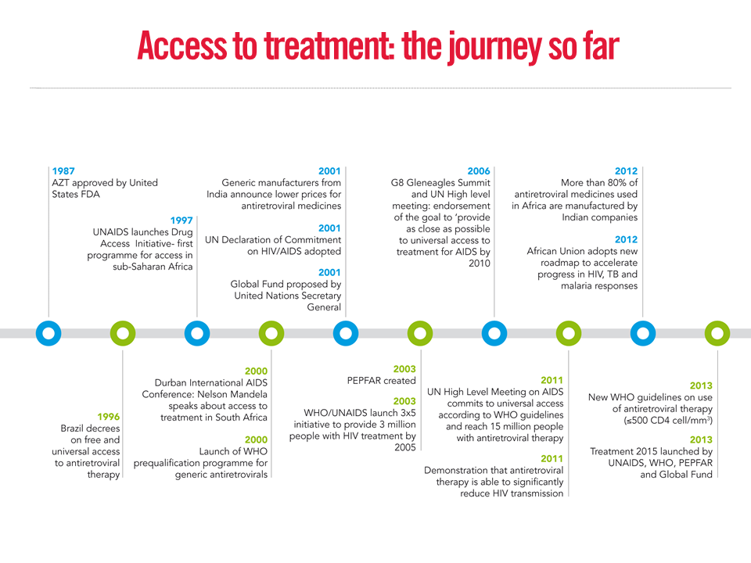

Slide 37
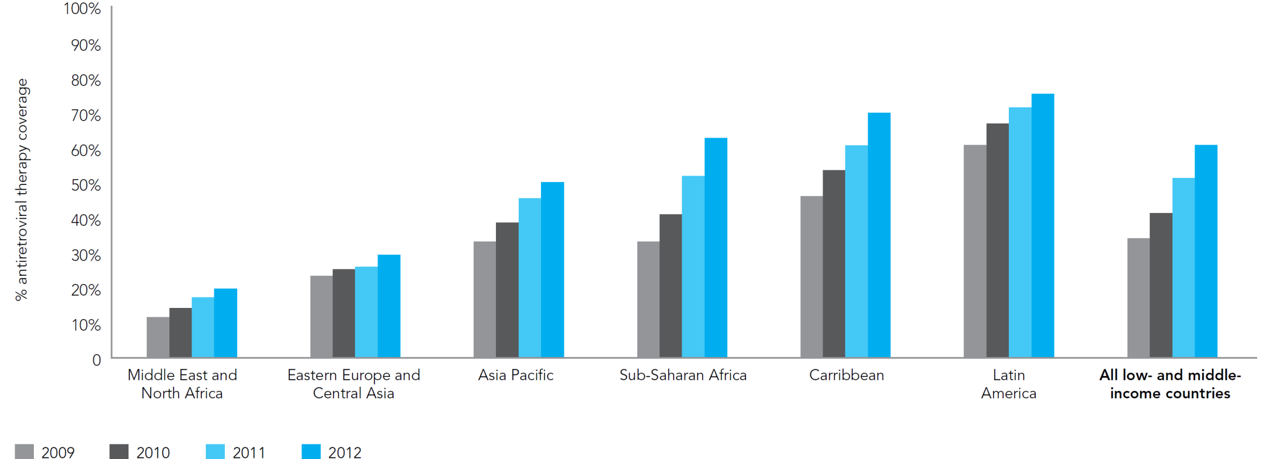
Increasing antiretroviral therapy coverage by region
% ART coverage
Number of people receiving ART increased
from ~2 million in 2005 to ~13 million in 2013
100
80
60
40
20
0
% of people eligible who are receiving ART
(based on 2010 WHO guidelines)
Source: UNAIDS Global report 2013

Slide 38
Treatment cascade of adults living with HIV: United Kingdom, 2012
MPES
SOPHID
Notes:
All numbers are rounded to the nearest 100s.
2. In 2012, an estimated 98,400 people living with HIV in the UK in 2012, 78% were diagnosed.
3. Of 76, 800 adults living with diagnosed HIV 88% (67,600) were receiving antiretroviral therapy in 2012 This number includes both adults initiated ART in 2012 and those initiated in previous years. This does not imply adherence.
4. Where a VL was reported, 78% (54,800/70,615) adults living with diagnosed HIV had achieved virological suppression (VL<50 copies/ml). Applying this proportion on those without a VL reported (8%), we estimate that 59,900 (78%) of diagnosed adults were virally suppressed in 2012. In an intention-to-treat analysis (i.e. assuming that all adults without VL reported have high viral ), this proportion drops to 71% (54,800/76,800). We believe that 78% is in fact more likely correct and with no specific biases in reporting VL

Slide 39
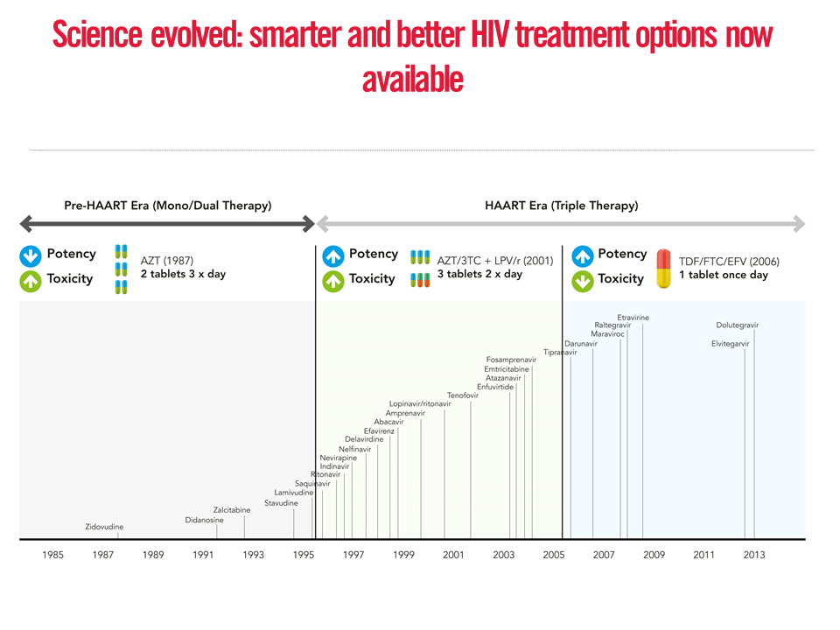

Slide 40

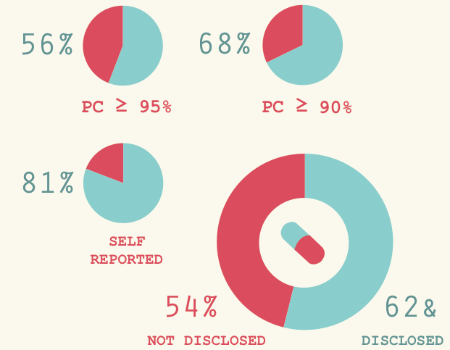
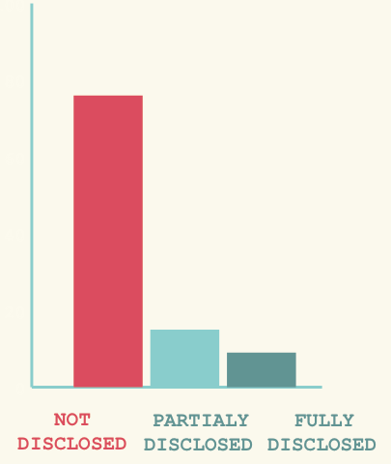
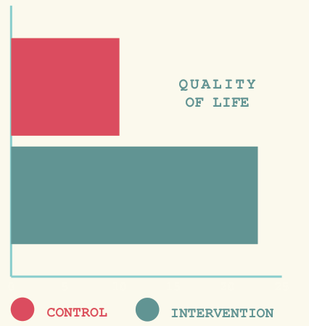
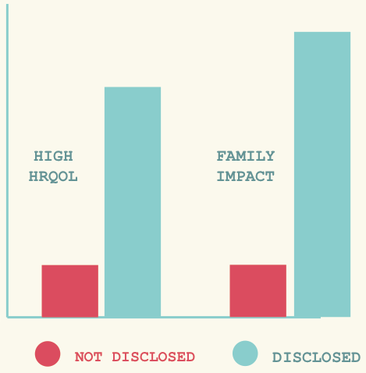
When adolescents are disclosed they are more adherent
Disclosed:
Better adherence
ADHERENCE
DISCLOSURE
Low FI:
Non-adherence
HRQoL & FI
HRQoL

Slide 41
Substance Use Complicates HIV Care
Substance and alcohol use among persons living with HIV is associated with:
  Behavioral health issues (Pence et al.)
  ART non-adherence (Chesney, 2000; Ware et al., 2005)
  Risk for HIV infection (Leigh & Stall, 1993; Semaan et al., 2002)
Alcohol and substance use can DECREASE the efficacy of antiretroviral therapy (Michel, Carrieri, Fugon et al., 2010)
In ROAH Uganda, 30% reported using alcohol; no one reported any other substance use
Notes:
Note that depression is a double-threat – poorer adherence and impedes drug effectiveness

Slide 42
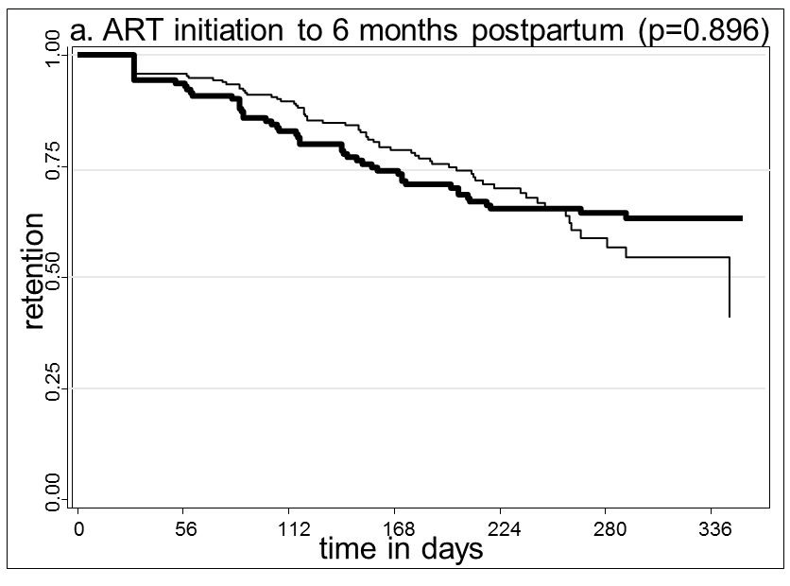
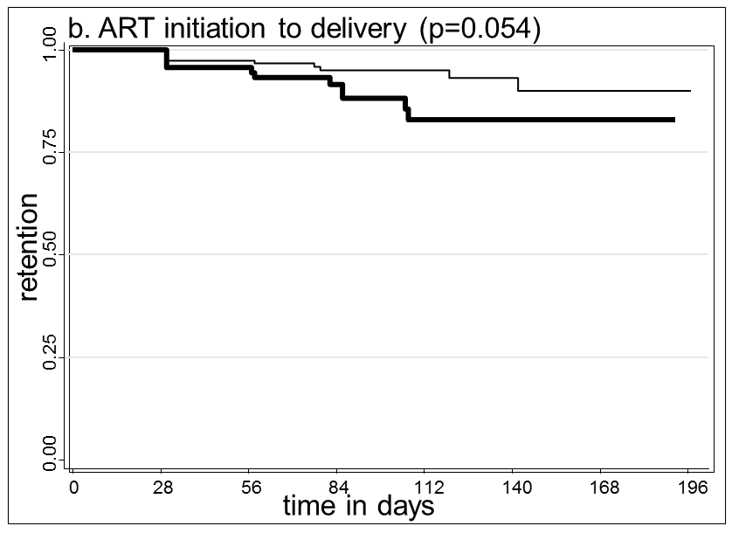
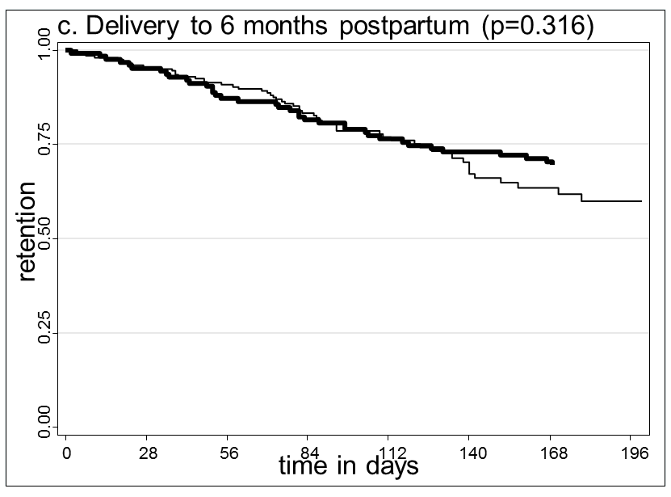
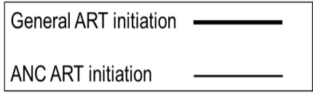
Retention in care during and after pregnancy
is still problematic
32% (n=115) disengaged from care (>56 days late)
Disengagement & missed visits more common post delivery than antenatally (rate of disengagement 6.17 vs. 2.41 per 100 woman months)
Similar rates of disengagement at both ART sites
Kaplan Meier curves of retention by site overall(a), antenatally(b) and postpartum(c)

Slide 43
Other health issues- interlinkage

Slide 44
In 2014… We have
Evidence based prevention for HIV/TB
New TB diagnostics
Ability to cure most TB in 6 months and to reduce mortality with ART
Over 1 million new TB cases in HIV+ persons and 320,000 HIV/TB deaths EVERY YEAR
Notes:
With affordable regimens

Slide 45
Moving forward in 2014: Combination Prevention for HIV/TB
ART: 65% reduction in TB(1)
ART + isoniazid preventive therapy (IPT) additional 35% reduction in TB in high TB transmission areas(2)
  NO TB SKIN TEST NEEDED
Transmission reduction strategies
  Enhanced case finding (3)
  Infection control
ART
IPT
Transmission reduction strategies
Combination Prevention
1. Suthar, PLOS Medicine , 2012; 2. Rangaka, Lancet, 2014 3. Lorent PLOS One, 2014
Notes:
So how do build on this success and step up the pace? Let me start by briefly reviewing what we have NEW in our tool chest

Slide 46
Who is dying from HIV/TB?
TOP 10 COUNTRIES WITH HIV/TB DEATHS
South Africa 88,000
Mozambique 45,000
India 42,000
Nigeria 19,000
Zimbabwe 18,000
Uganda 9,200
Kenya 7,700
Tanzania 7,000
DRC 6,300
Ethiopia 5,600
Global TB report, 2012 data
Notes:
In preparing for this talk, I asked myself what countries have the highest HIV/TB deaths? Where This slide lists the top 10 countries with HIV/TB deaths. Not surprisingly 2 of the top very high HIV prevalence and mining industry. India has much lower HIV prevalence but still an enourmous TB burden and burden o HIV/TB deaths.

Slide 47
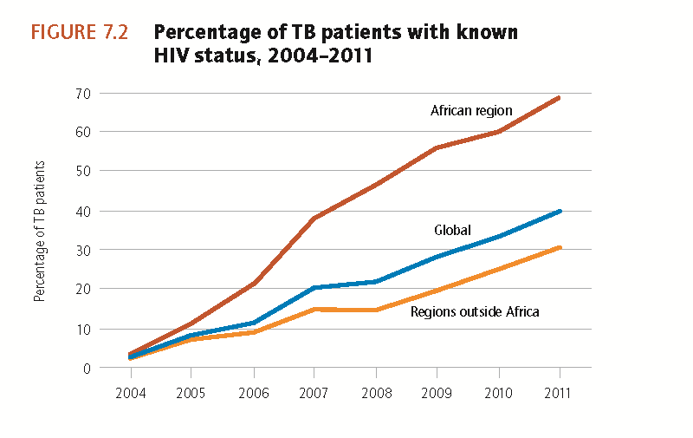
HIV is not diagnosed in TB; ART cannot be started
Globally, Only 40% TB cases HIV status known
Global TB report, 2012

Slide 48
Miners – “a public health catastrophe”
Extraordinary rates of TB 4000-7000/100,000 in miners vs general population in SSA
Second largest driver of TB in South Africa (after HIV) is mining
HIV and mining lethal combination
  Silica exposure– increase risk 3 fold
  HIV + increase risk greater than 10 fold
  HIV + silica- exposure - increased risk 15 fold
  Poor living conditions– increased risk many fold
All forms of TB are a problem
  Latent TB- 89% in miners!
  New TB infections and TB re-infections
  MDRTB 3.6% (miners) vs 1.9% non miners
Dharmadadhikari, Int J Health Services, 2013
Notes:
¾ million miners are in SSA HIV prevalence over 30%.

Slide 49
Children– Some sobering data
High TB Burden and Mortality
Broken care cascade
1713 children presented with cough >2 weeks duration in rural Uganda clinics
Only 17.5% referred for microscopy
Among those found to be AFB smear positive, only approximately half started TB therapy
32% HIV + children enrolled in Malawi cohort 2004-2010 diagnosed with TB
20% with TB died
8.8 fold increase in death in those not starting ART vs those starting ART within 2 months
Buck, IJTLD, 2013
Marquez, submitted
Notes:
Some not starting ART because did not quality, many because child deemed not ready : deaths an underestimate

Slide 50
HIV/HCV coinfected patients are no more a «special population»
3D + RBV Regimen
12-Week Arm
24-Week Arm
31
31
32
32
30
31
31
32
29
31
31
32
29
31
TURQUOISE-I Results: ITT Virologic Response Rates
Notes:
Superiority threshold of 36% for pegIFN/RBV historic control; however, this was not applied as this is an interim analysis
95% CI for 12-week SVR12 is 79.3 to 98.2%.
To date, no subjects in the 24-week treatment arm have experienced post-treatment HCV relapse. 19/20 (95%) have achieved a SVR12 to date.
For the 24-week arm, of the patients with data in the SVR12 window, no patient has experienced relapse.

Slide 51
the HPV vaccine is working
HIV
HC
Month
% SP
[95% CI]
n
% SP
[95% CI]
n
1
3
7
12
18
21
46
47
47
47
44.6
97.8
100
100
100
[34.2, 56.8]
[92.7, 99.5]
[96.9, 100]
[96.0, 100]
[96.0, 100]
27
47
47
47
47
57.4
100
100
100
100
[34.2, 56.8]
[97.2, 99.5]
[97.3, 100]
[97.3, 100]
[97.0, 100]
Anti-HPV IgG titers raised shortly at month 3, peaked at month 7 and slightly decreased at month 12, reaching their steady statue up to 18 months after enrollment both in HIV-infected and uninfected subjects
Antibody levels in HIV+ were slightly lower, although not significantly, compared to HC

Slide 52
Hiv & Cervical cancer - Etiopia
BACKGROUND
PROJECT DESCRIPTION
PERFORMANCE ANALYSIS
RESULTS
WAY FORWARD
In 2012, estimated HIV adult prevalence in Ethiopia was 1.3% (1.8% among women and 0.9% among men); number of PLHIV was approximately 800,000; generalized HIV epidemic
Cervical cancer (CC) is the most frequent form and leading cause of cancer mortality among Ethiopian women (around 4,600 women diagnosed with CC per year)
Cytological screening (e.g., pap smear) available, but not widely practiced and not linked to pre-cancer treatment
No organized national cervical cancer control program, nor national cancer registry
One oncology center with 16 inpatient beds and two radiotherapy machines

Slide 53
Hormonal contraception and HIV
For women at high risk of HIV or living with HIV, WHO recommends no restrictions for:
  Combined hormonal contraceptives or progestogen-only contraceptives
  Women and couples at high risk of HIV infection & using POIs should be informed about (and have access to) HIV preventative measures, including male and female condoms.
  LNG –IUDs can generally be used; however, initiation should be generally avoided if advanced/severe disease
For women taking ART, WHO recommends they are generally eligible to use hormonal contraception:
  Special consideration for efavirenz or neviripine & some protease inhibitors may be warranted.
Consistent and correct use of condoms, male or female, is critical to protect against STIs/HIV and for prevention of HIV transmission

Slide 54

Cancer and co-morbidities are common in LMICs, too
* Non Hodgkin Lymphoma
† Oral cavity, larynx, pharynx
(%)
WEAB0106 A. Jaquet
Most reported cancer types according to HIV status
in participating referral hospitals
(Benin, Côte d’Ivoire, Nigeria and Togo)

Slide 55
ART works even if they are using methadone or buprenorfine
3D: co-formulated ombitasvir/ABT-450/r, 25 mg /150 mg/100 mg QD; dasabuvir, 250 mg BID
RBV: 1000-1200 mg daily according to body weight (<75 kg and ≥75kg, respectively)
37/38 patients (97.4%) achieved each efficacy endpoint
1 patient (2.6%) prematurely discontinued the study at week 2 of treatment due to a serious adverse event unrelated to study drug
97.4%
37/38
37/38
37/38
37/38

Slide 56
Why Depression Among PWHA is Important
Can suppress immune responses (e.g., Tiemeier, van Tuijl, Hofman, Kiliaan, & Breteler, 2003)
Associated with an increased inflammatory response (Kiecolt-Glaser & Glaser, 2002)
Contributes to neuropsychological impairment or exacerbates cognitive deterioration caused by normal aging in HIV-infected adults (Gibbie et al., 2006) :
  Decrements in functional ability
  Difficulty with adherence to HAART and other treatments

Slide 57
Depression
One of the most frequently self-reported comorbid conditions:
  52% in ROAH NYC and 42% in ROAH Uganda
Depression is often related to:
  Prior history of depression
  Comorbidity (i.e., physical illness, psychiatric, substance use)
  Chronic stress
  History of trauma/abuse and PTSD
  HIV stigma, and concomitant loneliness and social Isolation

Slide 58

HIV and ageing: Why is there a need to disentangle these issues?
Many chronic diseases of ageing are more common in those
with HIV, even after adjustment for ART use and lifestyle factors
Schouten J et al. Clin Infect Dis. 2014 (in press)
Deeks SG, et al. BMJ 2009; 338:a3172
Notes:
Why is there a need to try and disentangle these effects (1)
NCD’s more prevalent in HIV

Slide 59
Why is there a need to disentangle these issues?
Chronic disease drivers (known and suspected) act in concert
ART
Toxicity
Clinical
Chronic
Co-morbidity
Host
HIV
Persistent
Immune Dysregulation
& Inflammation
in treated
HIV disease
Lifestyle
(smoking etc)
Genetic
AGING
Deeks SG, et al. BMJ 2009; 338:a3172
Notes:
Why is there a need to try and disentangle these effects (1)
Traditional risk factors often more prevalent amongst those with HIV; mailnly based on data from resource-rich area; data from RLS’s badly needed. Disentangling important when considering opportunities for targeted interventions.

Slide 60
The Host and Lifestyle
As an example: the importance of smoking
“In a setting where HIV care is well organized and antiretroviral therapy is free of charge, HIV-infected smokers loose more life-years to smoking than to HIV.”
>60% of deaths in the HIV cohort
were attributable to factors
associated with smoking
Helleberg M et al. Clin Infect Dis. 2013;56:727-734
Deeks SG, et al. BMJ 2009; 338:a3172
Notes:
Traditional risk factors not only often more prevalent amongst those with HIV, but exert major effects on health

Slide 61
HIV & Ageing: Summary and Conclusions
Burden of various co-morbidities consistently increased in HIV
Traditional risk factors play an important role. Needs to be reflected in our clinical management and care
Independent associations with HIV are observed for some but not all co-morbidities
Longer time spent at low CD4 counts, rather than longer overall exposure to ART, generally contributes to greater co-morbidity risk
Persistent inflammation and innate immune activation generally seem to additionally contribute towards risk
Pathogenic pathways involving effects on the biology of aging need further exploration

