Slide 1
The importance of Education in Emergencies - Reflections from children and youth in eastern DRC

Slide 2
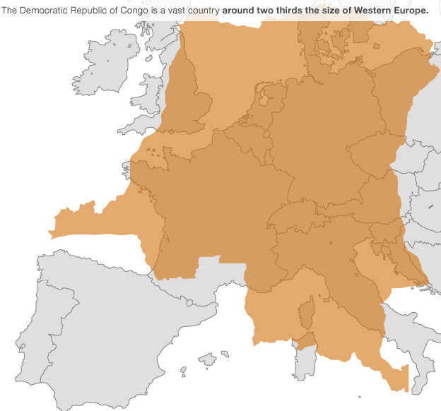
Democratic Republic of Congo
Notes:
Continuing instability since last year 2012. Escalation of violence from September reaching the peak in November 2012.

Slide 3
Need to provide physical access and accountability
Children, families and communities consistently prioritise education
Many communities struggle to provide education themselves – demonstrating need
“So many members of the community gave the little that they had to contribute, then we built the school using local materials and leftover UNHCR sheets. The quality was low, and it was so hard – how can we do this properly on our own? But this is how much we want it!” – community leader
Notes:
Accountability from beneficiaries perspective. Have we asked to them? Or have we used simply the assumption other sector are more important?

Slide 4
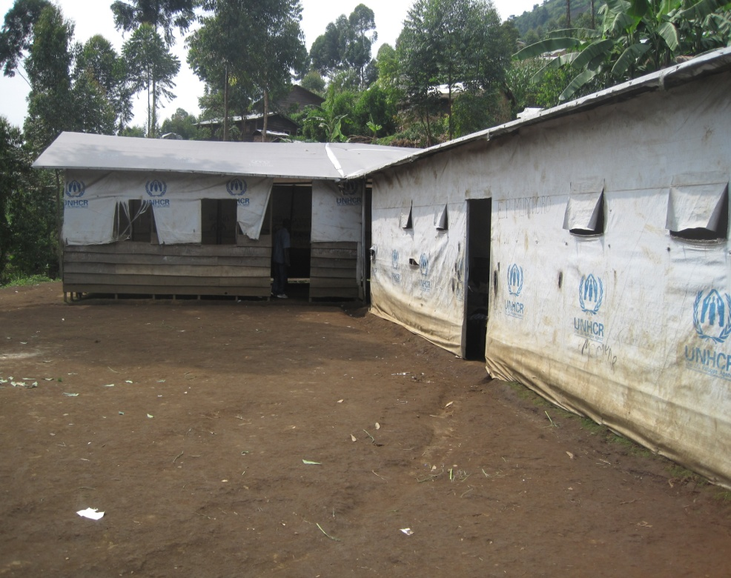
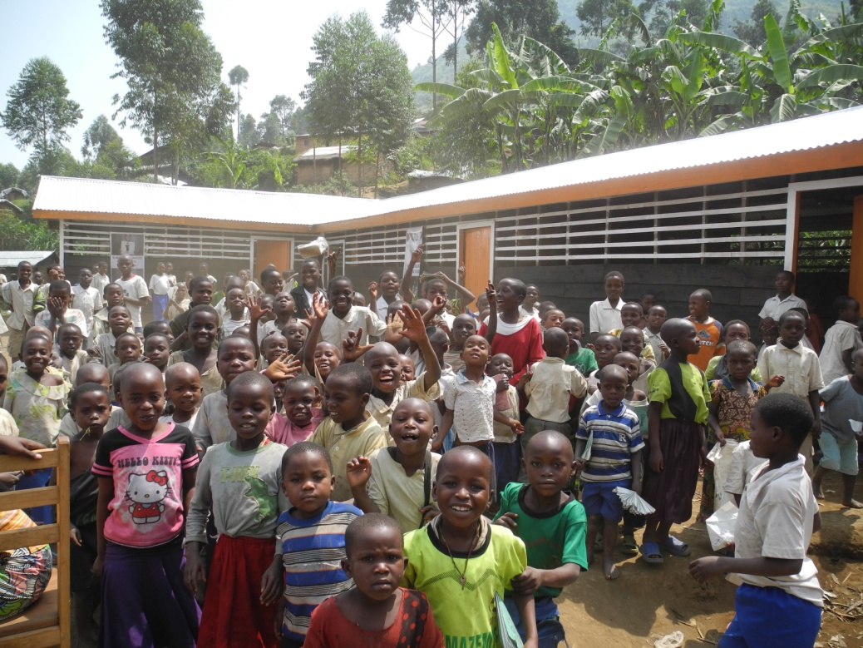
Mudororo Primary School
Notes:
The school quoted by one of the parents in the previous slide, located in Kalinga IDP Camp.

Slide 5
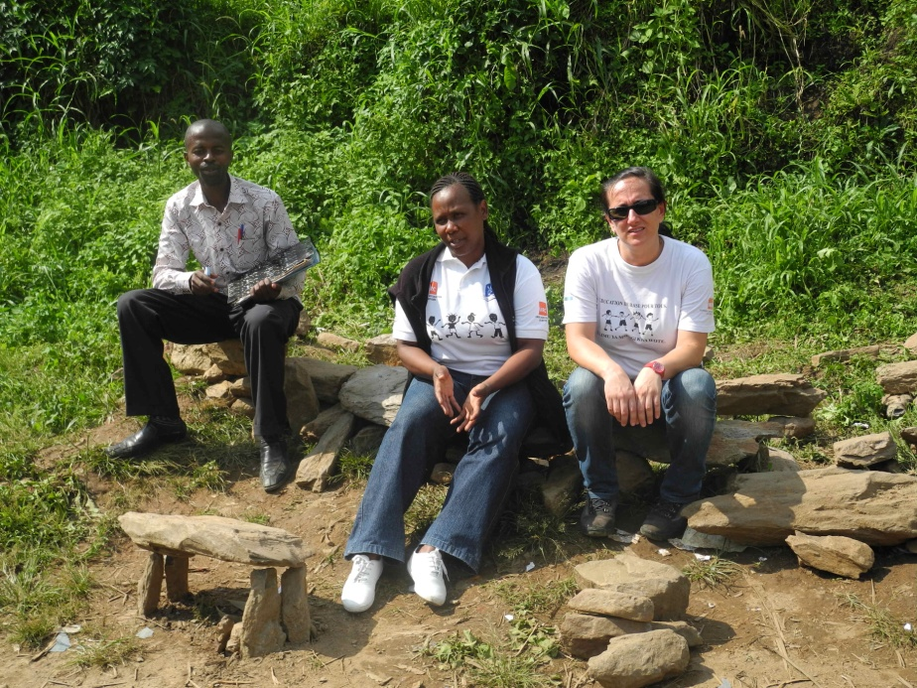
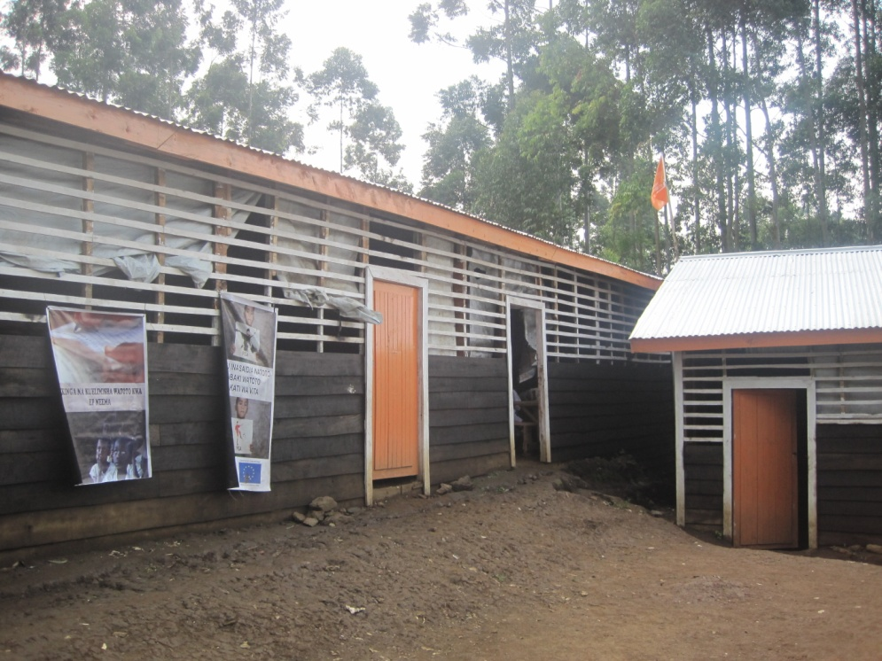
Neema Primary School: the Blessing School

Slide 6
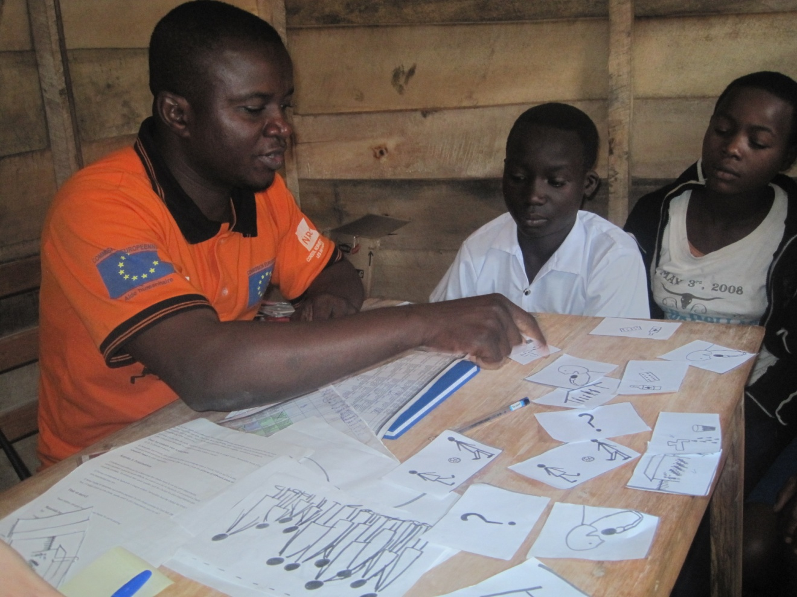
Community Prioritisation

Slide 7
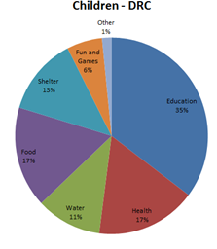
Community Prioritisation
35% of children prioritise education
34% of girls
27% of parents
32% of community leaders
More than any other sector for all groups
“I choose education, because this will give me a future” – 11 year old boy
Notes:
Camp setting problem of food above, children were underlying this as priority too but ‘I need to eat in order to go to school’

Slide 8
Breaking Cycles of Violence & Avoiding Lost Generations
Curricula: Peace-building integrated into teaching
“Those who have studied can help search for solutions to the fighting here” – displaced young boy
Multi-ethnic communities rebuilding around schools
“We see that the school is a stabilizing influence on a community – having the school here has created a more stable settlement with the school at the centre” - community leader
Notes:
Example of EP Neema (tribal issue), pacific cohabitation.
Education as the only way to move forward and avoid lost generation…and build the future for the country, which started to suffer from 1994…20 years of desperation, instability and war.

Slide 9
Breaking Cycles of Violence & Avoiding Lost Generations
Children from different groups and tribes play together
“School teaches us to respect everyone, and that if someone annoys us we should respond calmly – and even if they hit us we shouldn’t get into a fight. This will help me have a longer life in this place” – 15 year old boy
“At school I have learnt that we all have ‘le sang’ [blood] which is life in us, and that this is important in every person and that we should protect that and not let people get killed”- boy at Neema Primary School

Slide 10
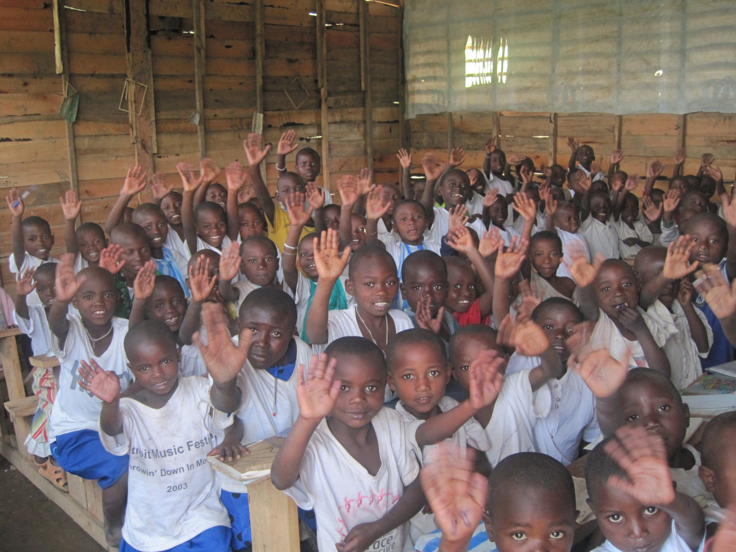

Slide 11
Finding Economic Opportunity for Youth
DRC suffers income loss of 43.3% from under-education (primary school)
Basic skills are transferable
“Because I am learning carpentry, if I have to flee again, I will be better able to survive in the new place and even make a shelter for my family” – Young boy in YEP/CFS Bukombo
Vocational students already making profits
“They need studies and motivation – you can have studies and not be determined, and you will not find work – but if you have both you will be more likely to succeed whatever the future brings” - father
Notes:
43.3% from Burnett. N, Guison-Dowdy. A, Thomas. M. 2013. A Moral Obligation, An Economic Priority: The urgency of enrolling out of school children. Results for Development Institute/Education a Child.

Slide 12
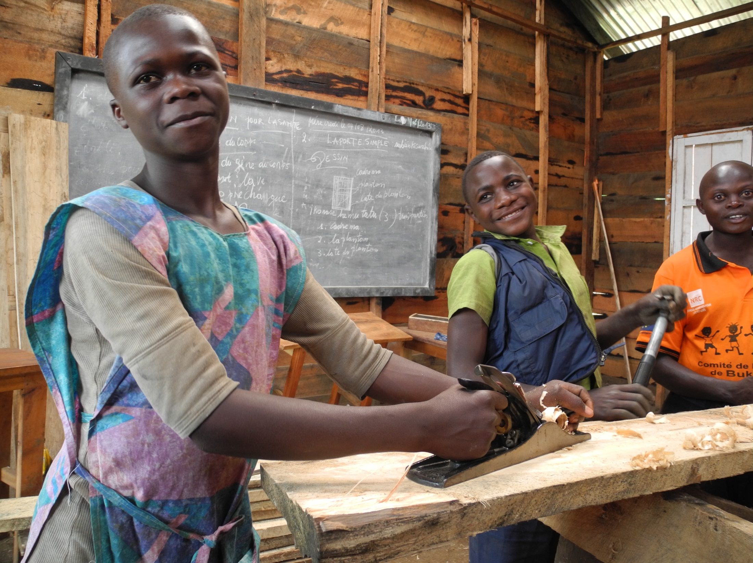

Slide 13
Recovery and Resilience
Recovering from trauma (psychosocial support, games: BE CHILDREN)
“Before I came to school I had the spirit of an assassin because of what they did to me, but here I have started to become like a normal person again. The taste of study made me want to be like I was before. I am so happy to be here” – 15 year old boy
Skills for dealing with future conflict
“Studying helps children face the difficult things in life, and find solutions to the hard times” – father

Slide 14
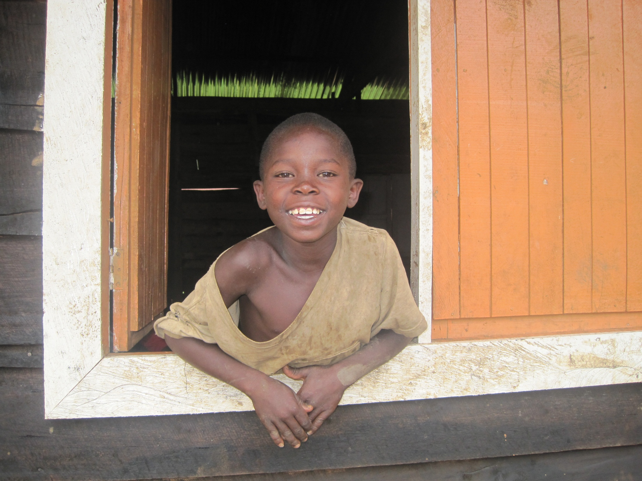

Slide 15
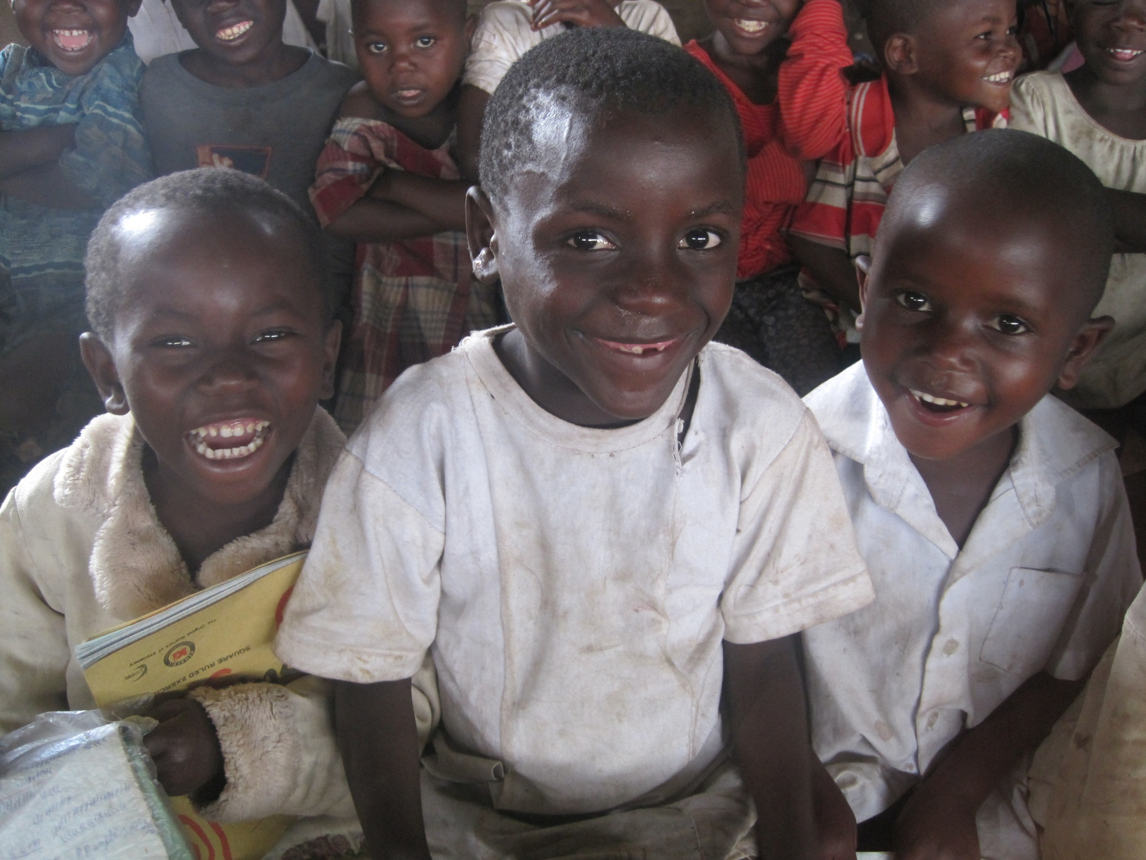

Slide 16
Transferring protective knowledge
Effective in combating and preventing recruitment and re-recruitment
“Now I’ve studied it helps me see when things are dangerous – and if you’ve studied you can express yourself better, and that makes you safer, especially if militia ask you a question” – 15 year old boy
Less risk of Gender Based Violence and other abuse
“Sometimes the militia come to the village and rape girls and take them away by force – one day I was at school and the militia came and took three girls who didn’t go to school away with them. I was safe because I was in school. These girls never came back”
Notes:
Former child soldiers in our program (already demobilized and some of them came to ask to be assisted).

Slide 17
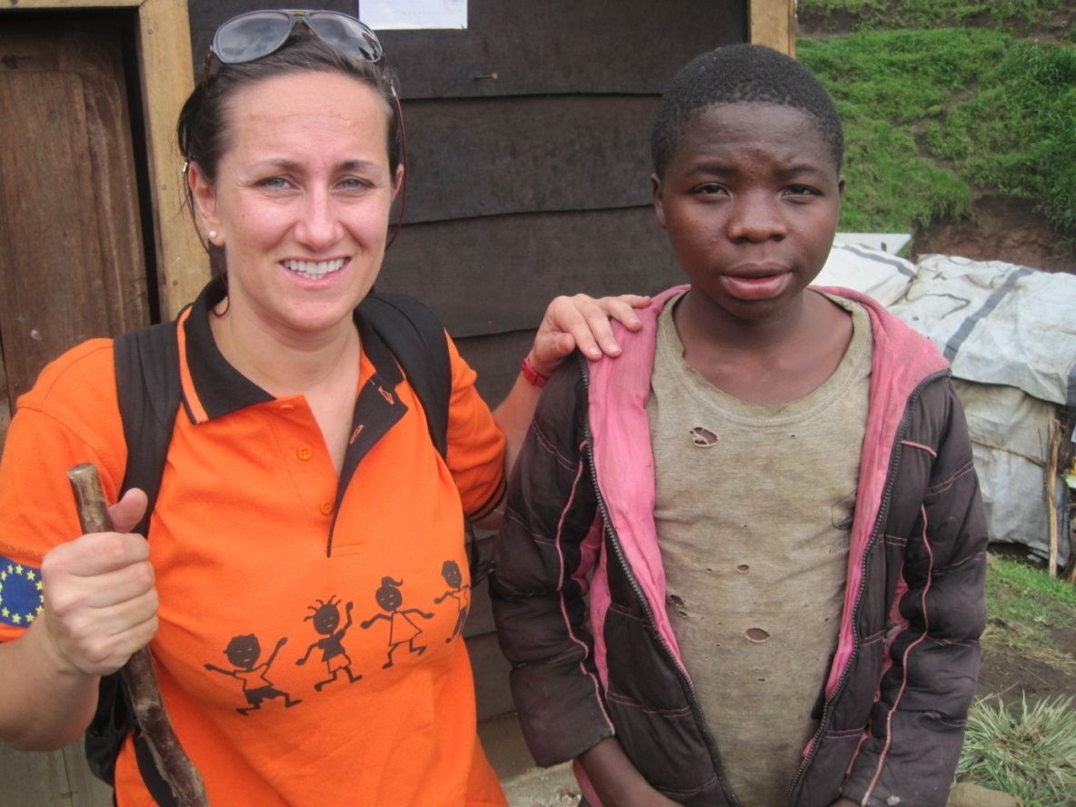
He is Vita
Vita=Life (Italian)
Vita=War (Swahili)
“My colonel respected children staying in school”
Notes:
Vita-vitam (latin)-war. His name is war because was born during the war…and was forcedly recruited.

Slide 18
Protective Potential of Education
Parents and community leaders consider education to be life-saving in Masisi
Classrooms are physically safer during conflict, and provide psychosocial support
Parents can attend to other needs while children are safe in school
Prevents discrimination against children within the community
“If you have a goat, and it falls into a hole, will you wait three days for it to die before you try to help it? No! You will go straight away! It is the same with education – if you wait three months, many of these children will go with the armed forces or face violence, and they too may die, just like the goat” – community leader
Notes:
Classroom safe: example of EP Bukombo…then it depends from armed group too!
Child's discrimination, if you do not go to school and robberies are happening in the village or in the camp…you are guilty

Slide 19
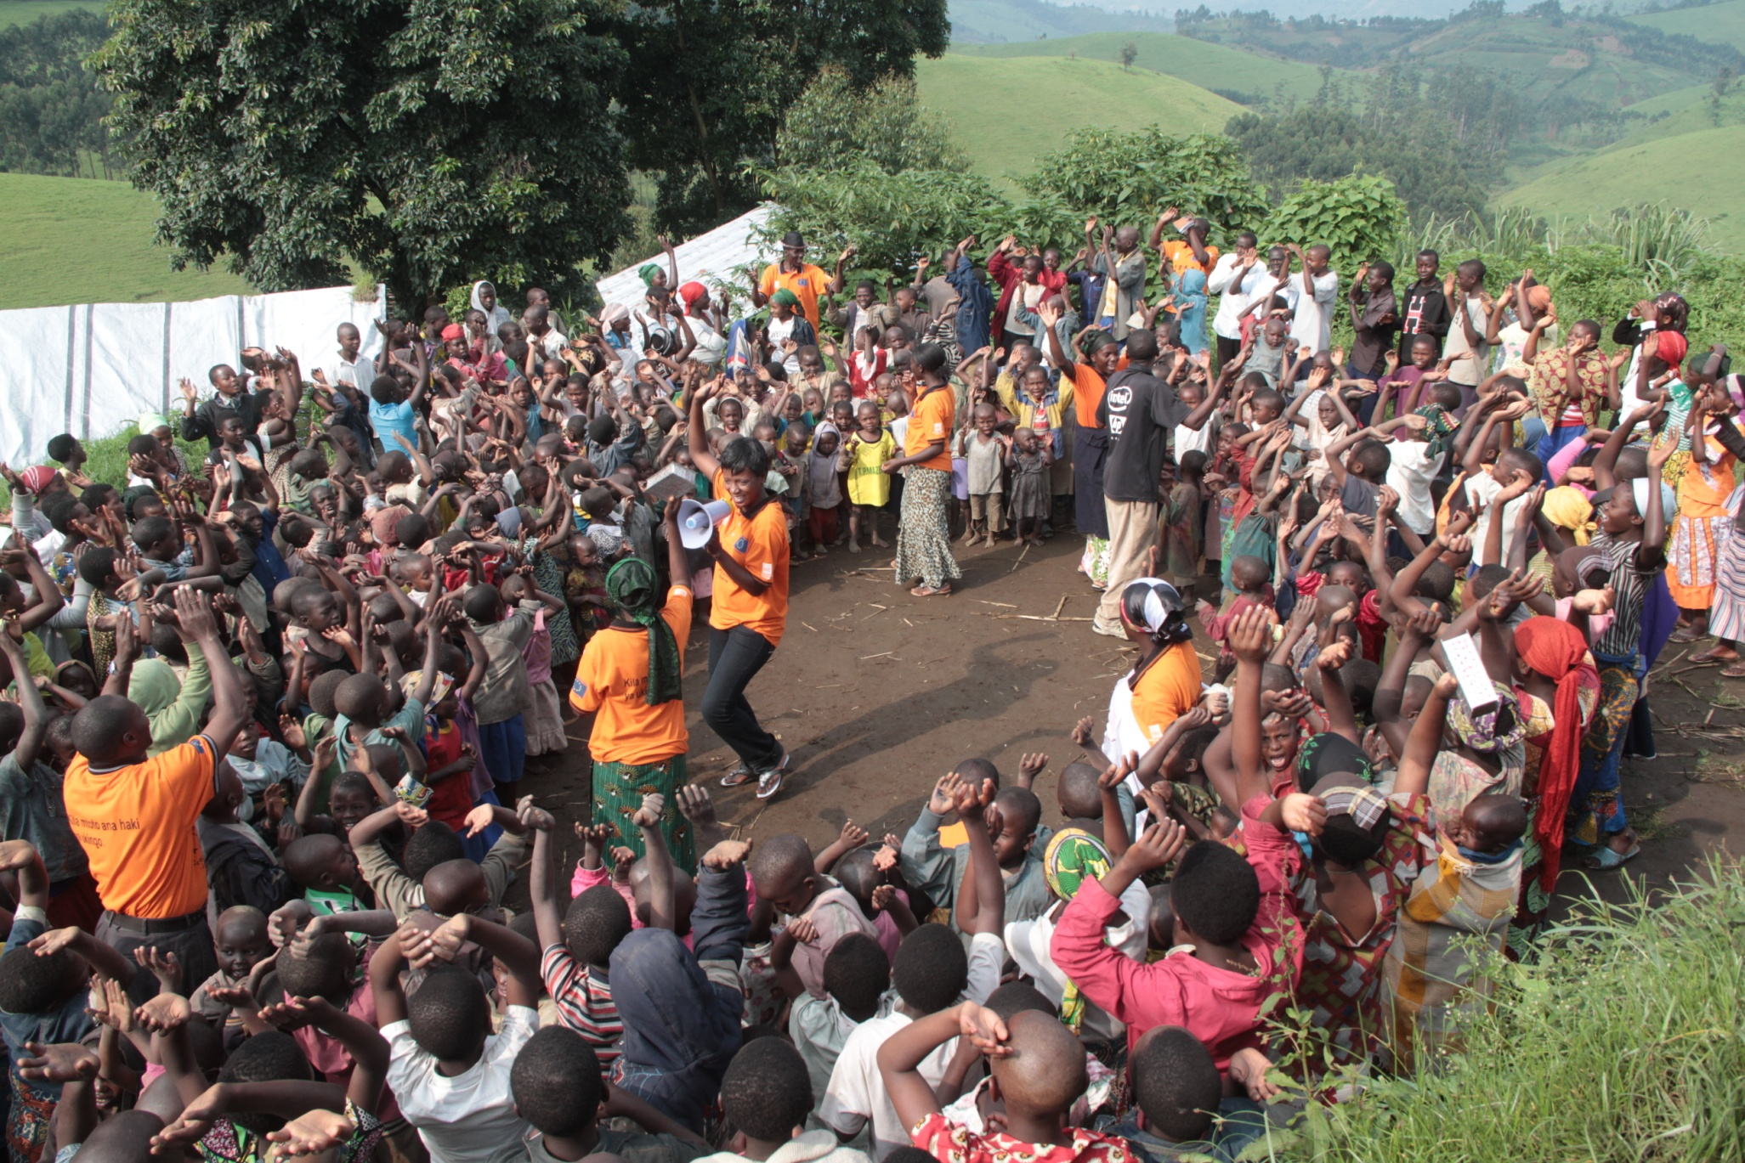

Slide 20
Education Supporting Other Sectors
Important platform for nutrition
Life-saving information on health, hygiene and sanitation
Children are “agents of change”
“Our work is easier in the schools, because in this environment the children are better placed to absorb information – and then they go home and tell their parents or relatives” – NRC Health Specialist in Masisi
Notes:
Almost all children named school or CFS as the place where they had first learnt about hand-washing and toilet hygiene (81% first learnt about this in school), not to drink dirty water (83% first learnt in school), not to eat unsafe food and how to identify it (71% first learnt in school), not to play with mud (68% first learnt in school), to wash regularly with soap (90% first learnt in school), to clean dishes and clothes (67% first learnt in school) and to clean and cut nails and hair (70% first learnt in school)

Slide 21
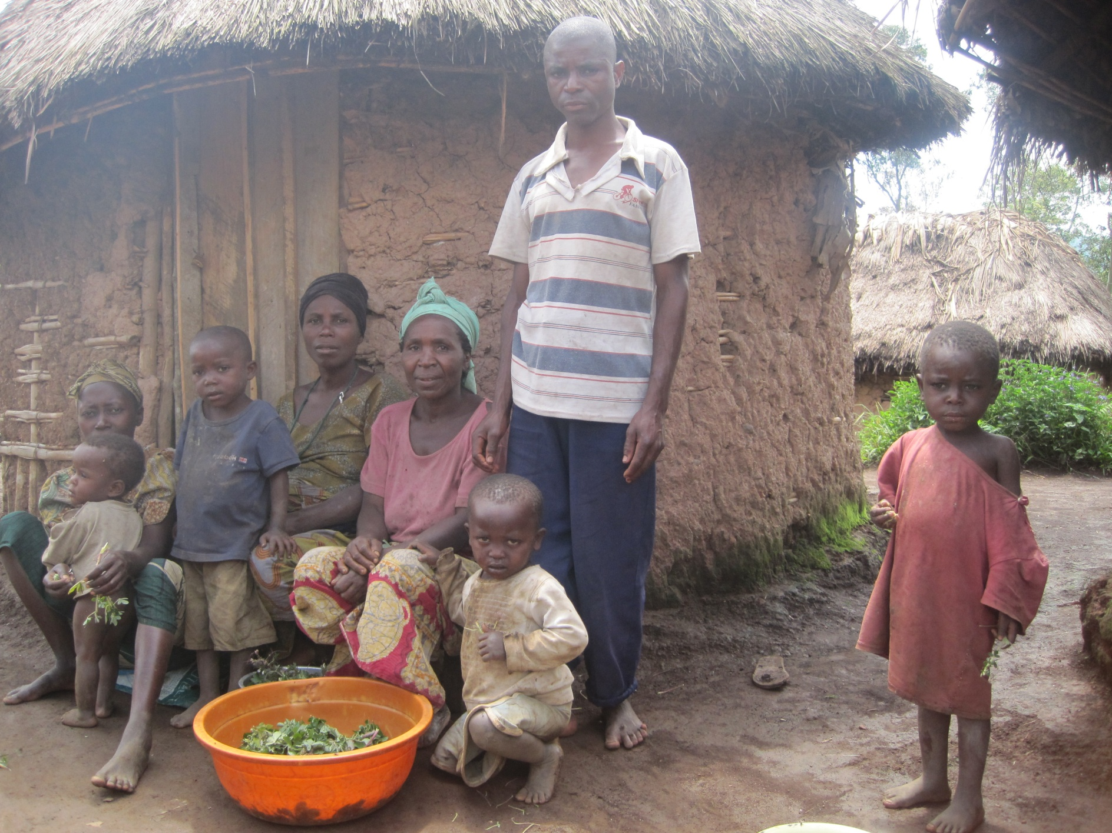

Slide 22
Difficulties
Lack of continuity with development (12 months are not enough!)
Ineffective mechanisms for referral (1612) and effective response
Free Primary Education – MGD (policies, money and Monitoring System)
“Education helps me help others – I try to teach them the things that I learn, and also it makes me know how to care for them better” – 13 year old girl

Slide 23
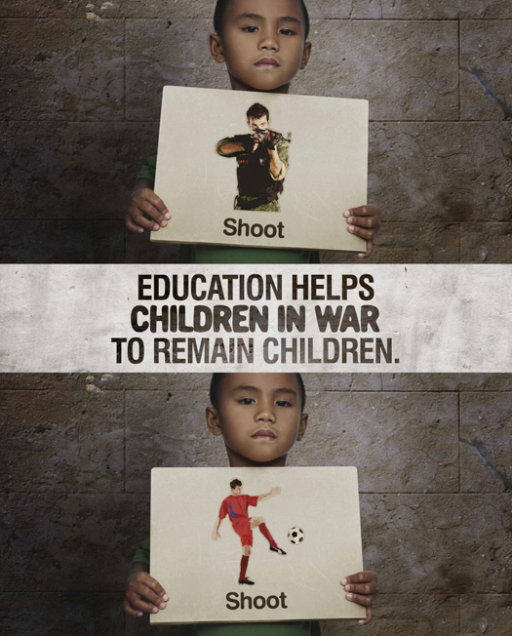
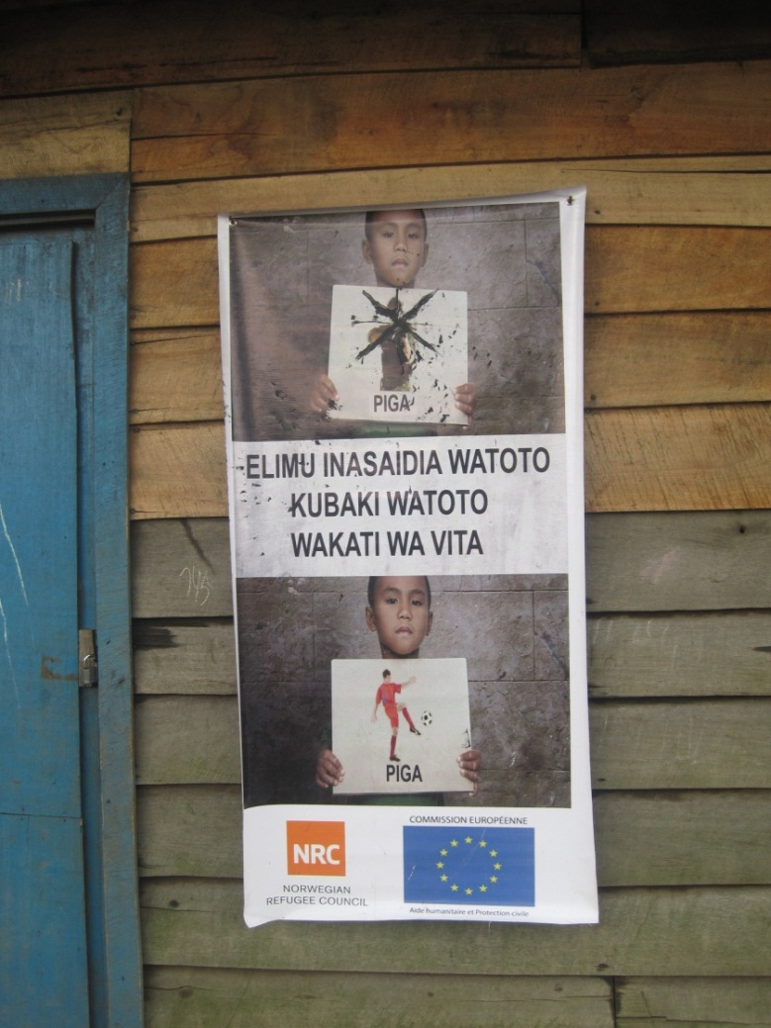
Listen to their perspectives before acting!!!
Notes:
Picture one (our vision-western-grown up) Picture two (child perspective). This is and European and Western Perspective…we think this is good communication. What we (Policy makers, donors, NGOs…) are assuming is the right solution for a country maybe is not. Education is not a NFI, Education is something that will always accompany you.
This is the reality…the children asked to add a cross!!! So a different perspctive. Please reflect on this concrete example!!!

Slide 24
ASANTE SANA

