Slide 1
EWOS IN VIETNAM
Managing Director Rune Vamråk
Bangkok 17 Jan 2013
Notes:
Glede å være førstemann ut på dette seminaret
Vi er glad for et det er stor interesse, og økende interesse for hvert år.

Slide 2
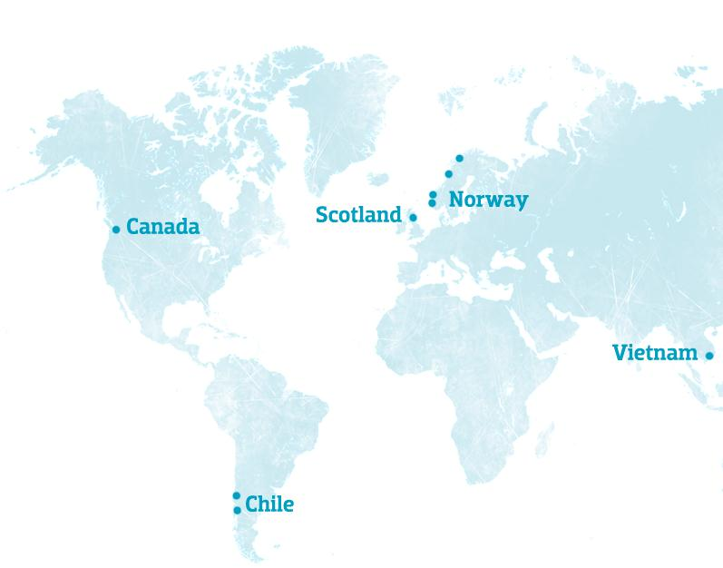

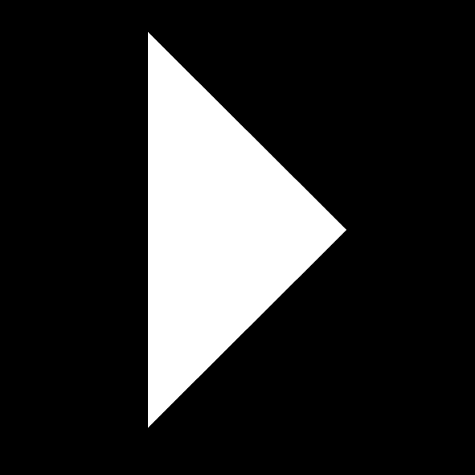
EWOS in a Nutshell
A World Leader in Fish Nutrition
  Operations in Norway, UK, Chile, Canada and Vietnam
  R&D operations in Vietnam, Norway and Chile
  897 employees
  7 factories and 20 feed production lines
  40% share of the world salmon feed market
  1,207,400 tonnes feed sales in 2012
  100% owned by Cermaq ASA (CEQ)

Slide 3
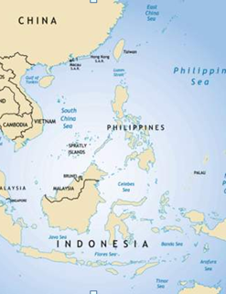
Vietnam – and the region
Best conditions from Nha Trang – and south
  Water temp (>24°C) – 2 seasons
  Good water quantity – both fresh and sea water
  Still potential for more aquaculture
Export – large volumes to EU, USA and Latin-Amerika
EWOS VN

Slide 4
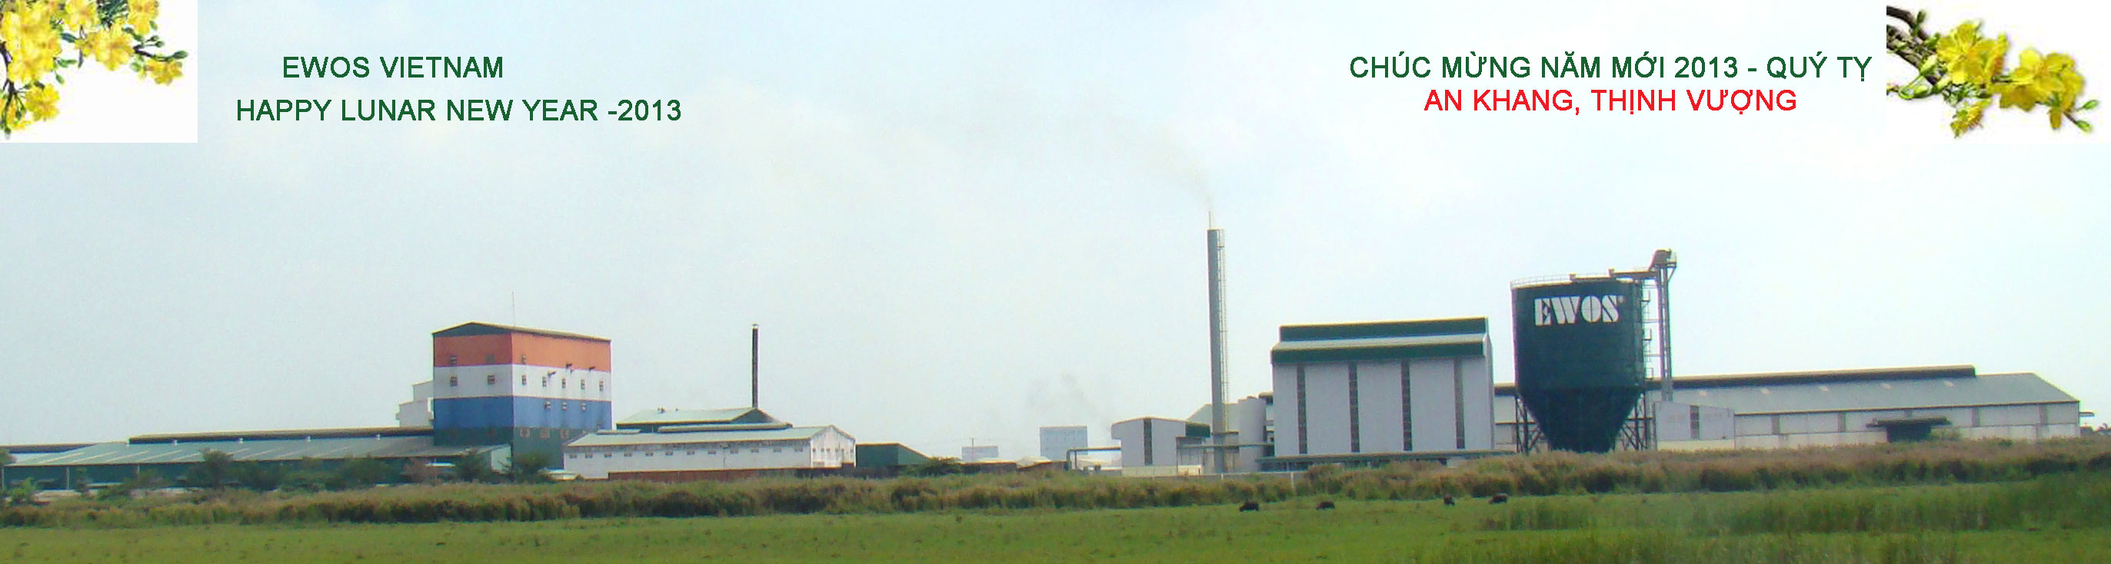
Why Vietnam is important for CERMAQ
Feed for other species is strategically important for CERMAQ – and for Vietnam
We were prepared, but ….
Nevertheless – we have had many surprises
We been operating for 2 years – and many things have been done, but we are not finished
Continuously focus on social responsibility – CSR, sustainable operations – is the only way

Slide 5
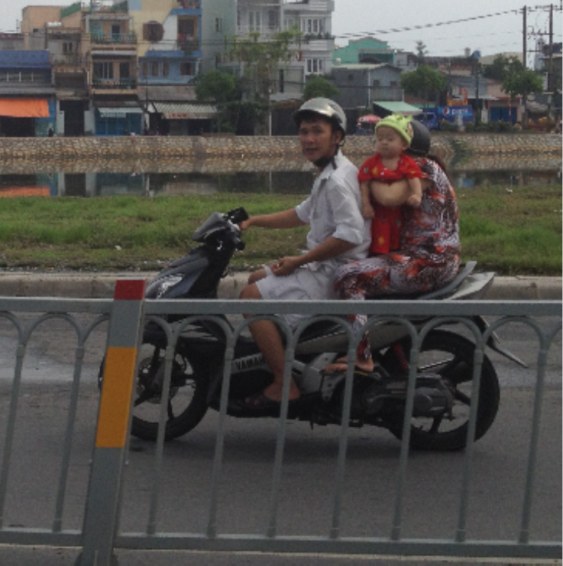
Challenges, and our approach

Slide 6
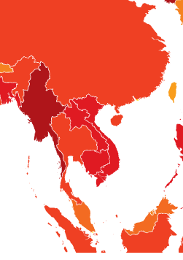
Anti-corruption
ZERO-tolerance
  Not only bribes, but all operations
  Training program for all, incl our partner
  We knew things are taking a bit longer time, but this
  is the only sustainable way

Slide 7
Our approach – Sustainable operations
We wanted to start small and being able to control the company
Thorough investigation and due diligence done by external company, but still …..
The Cermaq Guidelines for social and ethical responsibility is the platform – for the company, our partners and our suppliers
EWOS VIETNAM is following the same reporting structure as all other operating companies in the group (Norway, Scotland, Chile and Canada)
We established an organisation which is able to follow through – and used the CSR and quality focus as an «vehicle» for our program, incl
  EIMS (EWOS Integrated Management Systems (ISO 9000, Global Gap))
  Functional Feed
  Our own R&D facility
  Focus on market & sales organisation
  De-bottlenecking in the factory

Slide 8
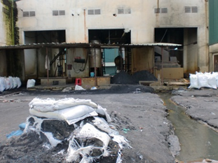
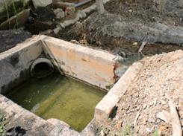
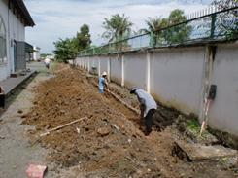
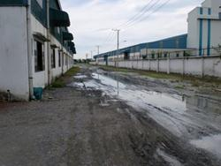
What did we find? - 2011

Slide 9
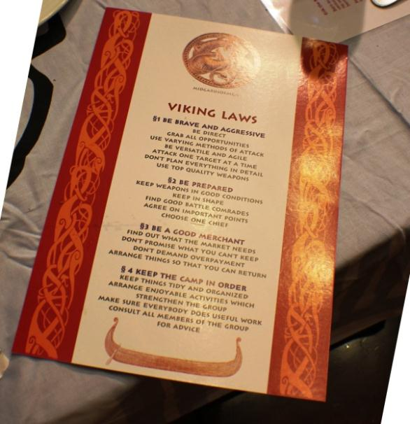
Our Culture
The Norwegian Style
The CERMAQ Culture
The EWOS Way
Reports to CERMAQ
Corporate Governance
Certifications and systems (ISO, Global G.A.P)
Environmental Impact Assessment & Operating licenses
Management & Leadership as we do it!

Slide 10
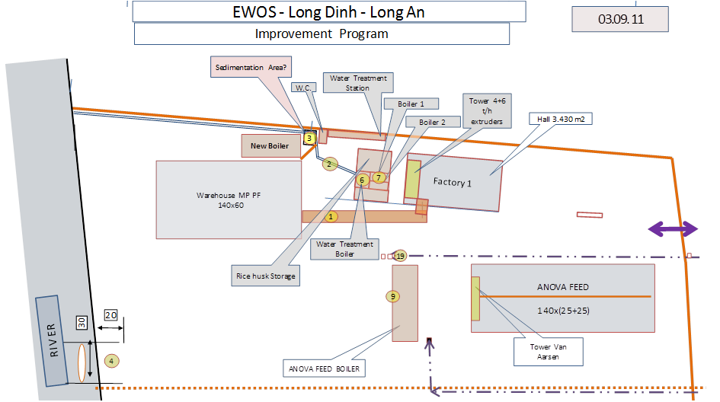
Improvement Program

Slide 11
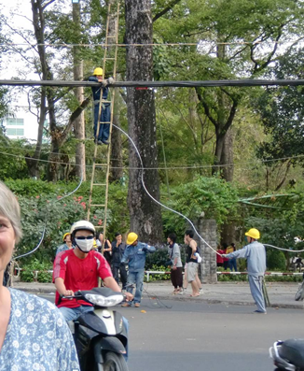
Working conditions
Working conditions – identified as a clear area for improvement and EWOS Vietnam have done this (and more):
All workers got personal protection equipment (PPE)
The bonus system secure use of PPE
3 shift – instead of the 2 shift they had
No Saturday working for the office staff
Increased wages, extra allowances for «un-comfortable working conditions (hot!) and a program to keep experienced staff
Revitalised the Union (Workers Syndicate) to improve the communication’s with our staff
Better food in the canteen

Slide 12
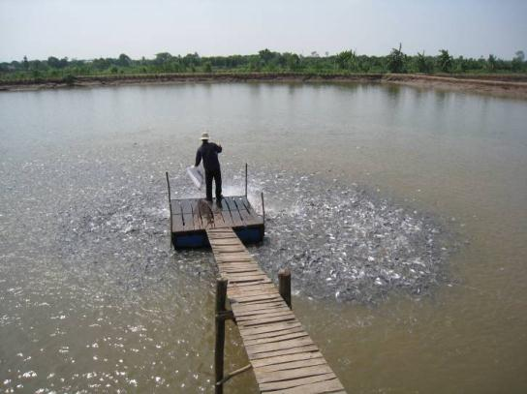
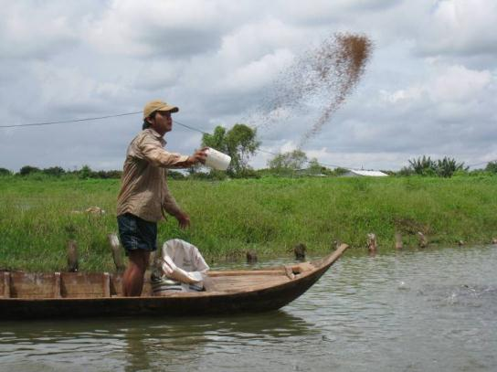
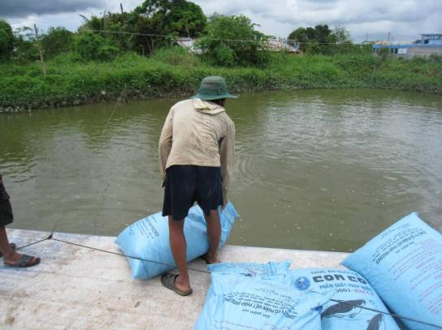
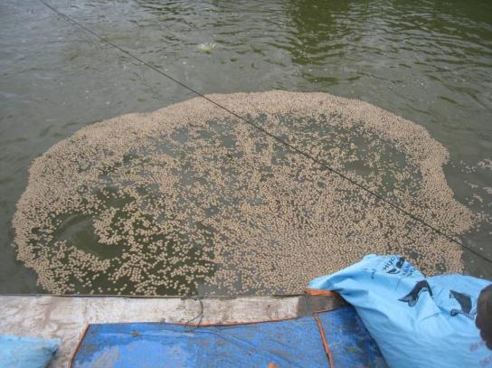
Aquaculture value chain
Feeding
Notes:
Feeding is normally to tables (all feed companies use same recommendations)
Can be from one point (top left) from a boat (top right) or from a barge (bottom left) which moves slowly through the pond
Generally dispersal is poor and so expect many fish not to eat in each meal

Slide 13
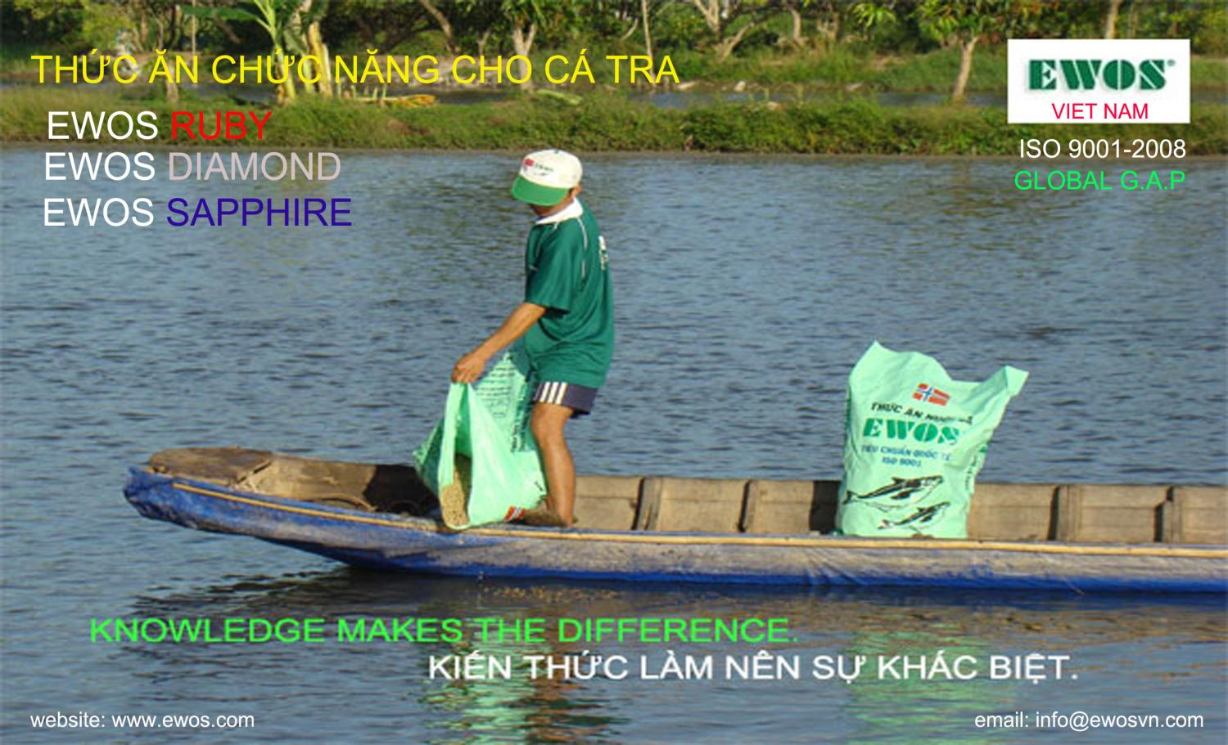
Aquaculture value chain
Functional Feeds

Slide 14
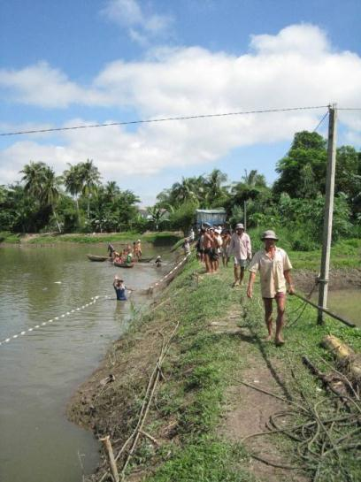
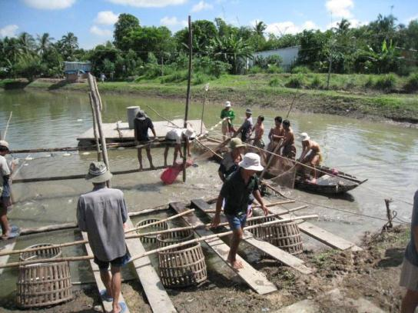
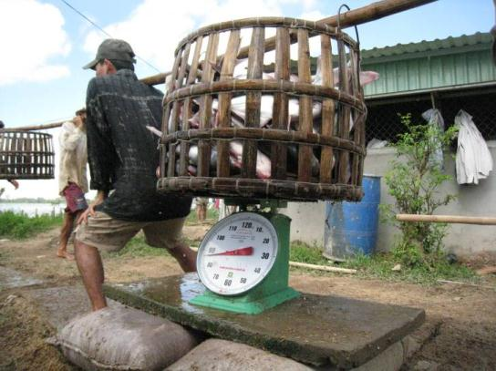
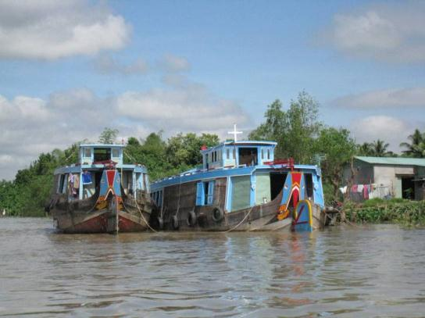
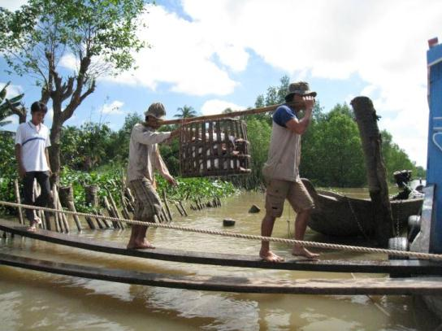
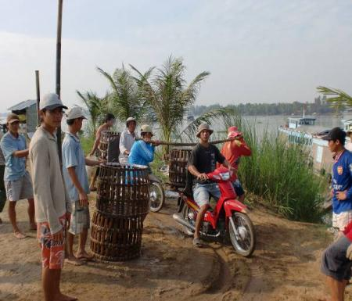
Aquaculture value chain
Harvest
Some potential – here as well

Slide 15
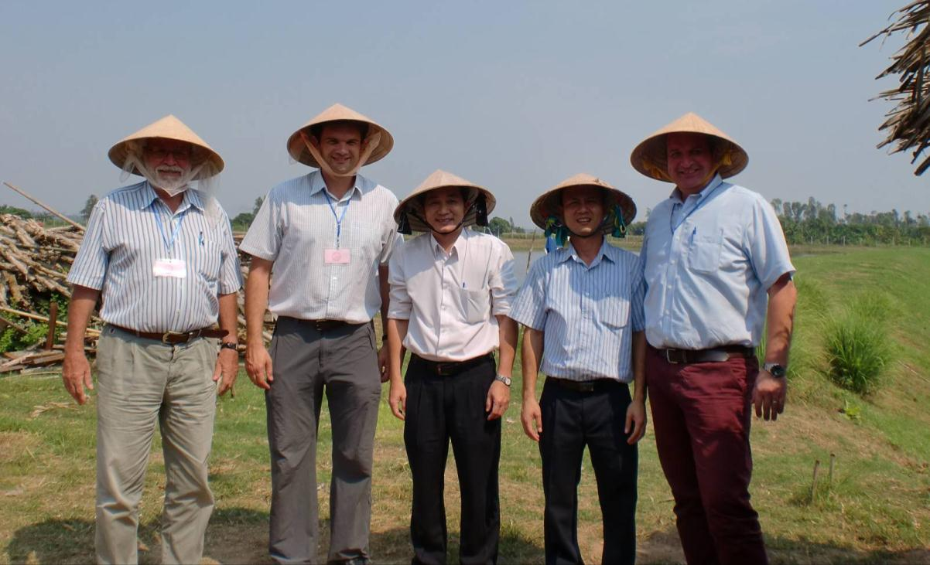
Conclution
This is an important step for us
Lessons learned
We are not finished – but on schedule
Continuously focus on CSR, sustainable operations is KEY!

Slide 16
Thank you

