Slide 1
Challenges and Opportunities to promote
Responsible Aquaculture in
Asia Pacific Region
NACA Presentation

Slide 2
Outline of Presentation
Global Food Fish Production:
  Role of Aquaculture vis-à-vis Capture Fisheries; volume & value; trade; protein supply; livelihoods
Asia Contribution to Global Aquaculture Production
the PR China Factor; top producers; top species;
Diversity of Aquaculture Systems in Asia.. A walk through
Unique Characteristics of Asian Aquaculture System
Demand and Supply of Fish
  Scenarios – Baseline (2007); 2030; 2050
Challenges to Sustain Aquaculture Production in Asia
How will Asia as a whole respond to these challenges
Opportunities for Intervention → Responsible Aquaculture

Slide 3
Discussion to focus on:
  Taking stock of the track record of Aquaculture
  Evaluate how the sector could sustain in the next few decades
  Ascertain how the sector could contribute to the Millennium Development Goals in terms of:
    Food fish production as a primary source of Nutrition of the rural poor
    Rural livelihoods
    Income generation
    Food security
  Suggest Critical Action Points /
  Thematic programs

Slide 4
Supply of Fish:
Capture Fisheries (Hunting and Gathering)
Aquaculture (Farming)
FI department, FAO-UN

Slide 5
Global protein supply
World per capita food fish supply increased from an average of 9.9 kg in the 1960s to an estimated 18.6 kg in 2010.
Fish accounts for about 16.6 percent of the world population’s intake of animal protein and 6.5 percent of all protein consumed.
Globally, fish provides about 3.0 billion people with almost 20 percent of their intake of animal protein, and 4.3 billion people with about 15 percent of such protein.

Slide 6
Global Volume and Value
Overall global capture fisheries production stable (stagnant) at about 90 mmt worth an estimated US$217.5 billion in 2010.
Global aquaculture production has continued to grow, albeit more slowly than in the 1980s and 1990s
World aquaculture production attained an all-time high in 2010 at 60 mmt (excluding aquatic plants and non-food products), with an estimated total value of US$119 billion.
Source: (SOFIA 2010)

Slide 7
Global Trade
The share of total fishery production exported in the form of various food and feed items increased from 25 percent in 1976 to about 38 percent in 2010.
World trade in fish and fishery products grew significantly also in value terms, rising from US$8 billion (1976) to US$102 billion (2010)
Key Drivers
  sustained demand
  trade liberalization policies
  globalization of food systems
  technological innovations.

Slide 8
Global Livelihoods
Fisheries and aquaculture provided livelihoods and income for an estimated 54.8 million people engaged in the primary sector of fish production in 2010.
Apart from the primary production sector, fisheries and aquaculture provide numerous jobs in ancilliary activities.
All of this employment, together with dependents, is estimated to support the livelihoods of 660–820 million people, or about 10–12 percent of the world’s population.

Slide 9
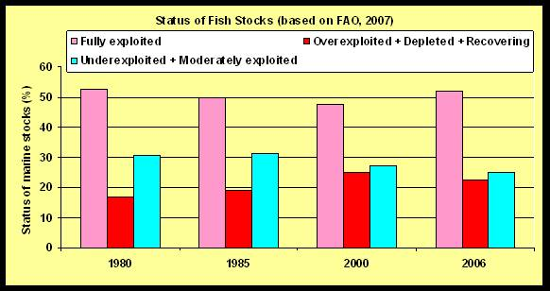
Growing Importance of Aquaculture
Decrease in traditional food fish supplies
Lead to an increasing reliance on aquaculture

Slide 10
Asia Accounts for 90% of
Global Aquaculture Production
Year | Global (t) | A-P (t)
1987 | 13,961,611 | 11,939,706 (85.5%)
1997 | 34,261,739 | 31,075,412 (90.7%)
2007 | 65,190,029 | 59,568,049 (91.4%)

Slide 11

Asia-Pacific
In 2010, almost 90% of world aquaculture production came from the region.
Oceania: 183,516 T (0.3%)
Americas: 2,576,428 T (4.3%)
Europe: 2,523,179 T (4.2%)
Asia-Pacific: 53,301,157 T (89.0%)
Source: FAO, 2012

Slide 12
Growth in last decade
During 2000-2010 average growth 6.7% per year
However, country variation
  Some outstanding growth in production (2000-2010) - 9-24% per year: India, Indonesia, Viet Nam, Myanmar
  Average growth, 6-7 % per year: Bangladesh, Philippines and Thailand
  China 5.5% per year
  Stagnant or negative growth: Japan, RO Korea

Slide 13
Asia-Pacific: Global Leader
Top 10 aquaculture producers in the world in 2010 - 8 in Asia
Rank | Country | Production (T)
1 | China | 36,734,215
2 | India | 4,648,851
3 | Vietnam | 2,671,800
4 | Indonesia | 2,304,828
5 | Bangladesh | 1,308,515
6 | Thailand | 1,286,122
7 | Norway | 1,008,010
8 | Egypt | 919,585
9 | Myanmar | 850,697
10 | Philippines | 744,695

Slide 14
Asia (& PR China) Contribution to Global aquaculture production

Slide 15
PR China is the mainstay in the region (70%)
Rest of Asia - 30%

Slide 16
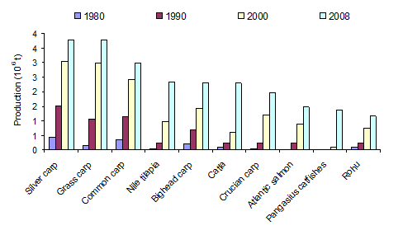
Bulk of Aquaculture Production in Asia is Fin Fish (90%)
Among the top 10 Fin Fish
Cyprinids, feeding low in the trophic chain Contribute nearly 75% to production in the Asia

Slide 17
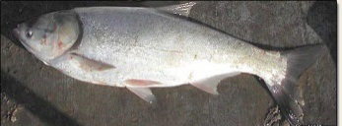
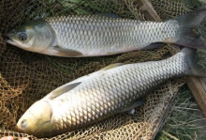
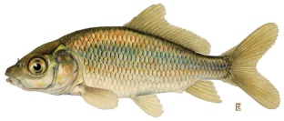
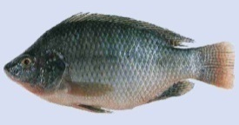
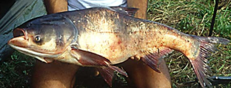
Top 10 finfish species (2009).
Source: FAO, 2011
Rank | Species | Production (T) | Value (x1000 US$)
1 | Grass carp (Ctenopharyngodon idellus) | 4,159,919 | 5,291,468
2 | Silver carp (Hypophthalmichthys molitrix) | 4,075,115 | 5,221,718
3 | Common carp (Cyprinus carpio) | 3,216,203 | 4,186,719
4 | Nile tilapia (Oreochromis niloticus) | 2,542,960 | 3,784,193
5 | Bighead carp (Hypophthalmichthys nobilis) | 2,466,578 | 3,162,138

Slide 18
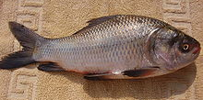
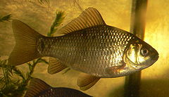
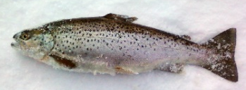
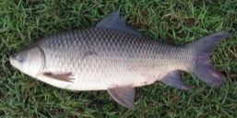
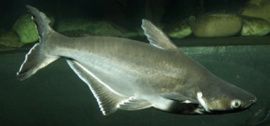
Top 10 finfish species (contd.)
Source: FAO, 2011
Rank | Species | Production (T) | Value (x1000 US$)
6 | Catla (Catla catla) | 2,418,821 | 3,645,519
7 | Crucian carp (Ctenopharyngodon idellus) | 2,057,104 | 2,244,259
8 | Atlantic salmon (Salmo salar) | 1,440,085 | 6,421,910
9 | Rohu (Labeo rohita) | 1,221,828 | 1,475,377
10 | Pangasius catfish (Pangansius/Pangasianodon spp.) | 1,211,833 | 1,846,565

Slide 19
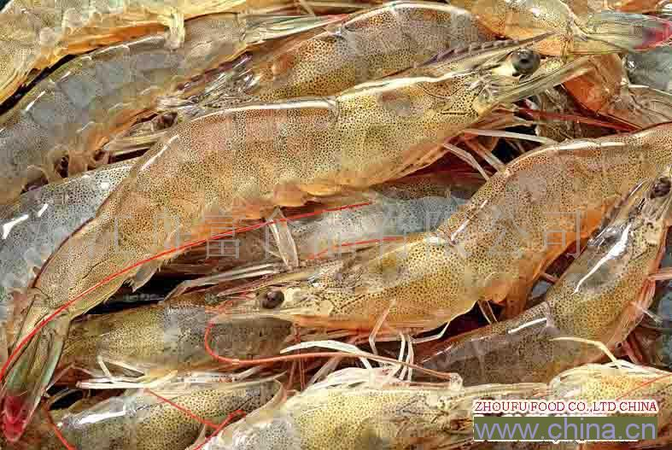
Super performers of the Decade
3 species achieved most outstanding growth
  Catla (20 % per year )
  Whiteleg shrimp (99 % per year)
  Pangas catfishes (29% per year)

Slide 20
Highlights of Aquaculture in Asia

Slide 21
Highlights-Freshwater finfish
Freshwater finfish requiring lower cost feed inputs dominate freshwater finfish production (carps)
  95% (30 million tonnes in 2010)
Rapid growth of high value freshwater finfish.
  Snakehead, eel species, mandarin fish, largemouth black bass
Catfish – fastest growing species group
  2.8 million tonnes in 2010
  rapid growth during 2000 – 2010 , 28 % per year
Tilapia - dominated by Nile tilapia
  2.4 million tonnes, (unit value $ 1.49/kg) in 2010
  4 countries - 91% production: China (57%), Indonesia, Philippines & Thailand

Slide 22
Highlights-Crustaceans
Crustaceans - most valuable species group
Total production- 5.1 million tonnes (2010)
  90% of global production ($ 4.71/kg)
White-leg shrimp dominates production
  2.2 million tonnes in 2010;
Other important species (in the top 20 aquaculture species in the region)
  Giant tiger prawn, Chinese mitten crab, Red swamp crawfish

Slide 23
Highlights-Marine & Brackish water finfish
2.5 million tonnes worth $ 7.9 billion in 2010
  Production growing slowly 3% per year 2009-2010
Major producers:
  China, Indonesia, Philippines, Japan, Viet Nam, RO Korea & Bangladesh
Carnivorous fish species (diverse)
  1.6 million tonnes worth $ 6.7 billion ($ 4.09/kg)
Herbivorous & omnivorous fish
  milkfish dominant 800 000 tonnes worth $ 1.3 billion ($ 1.53/kg)

Slide 24
A Walk Through ……
Diversity of Aquaculture Systems in Asia
From Subsistence Level in marginal environments
To Industrial Scale Enterprises
(Photo Credits – Peter Edwards: unless mentioned otherwise)

Slide 25
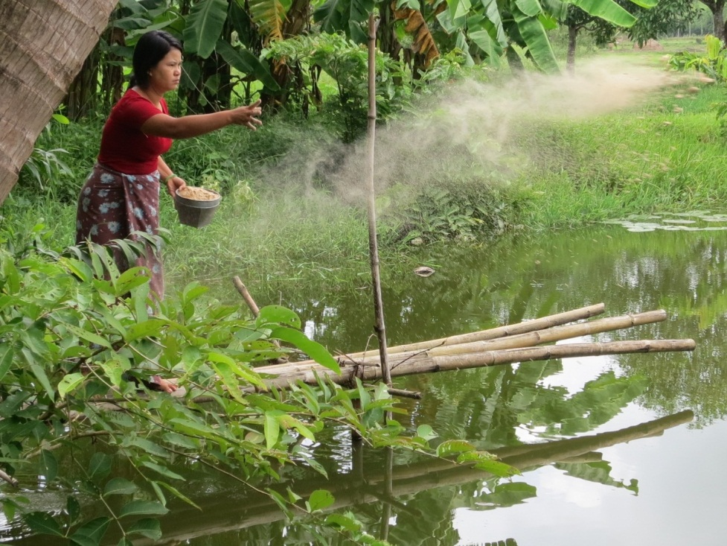
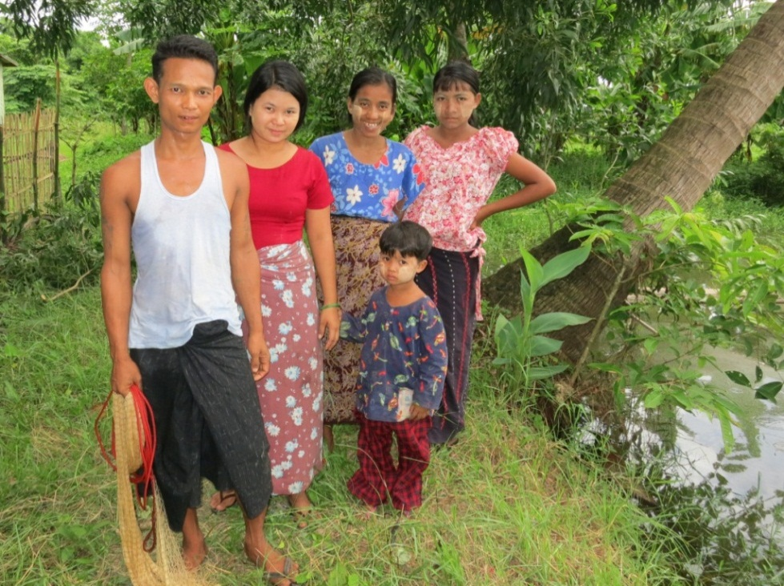
Home stead Ponds in Myanmar

Slide 26
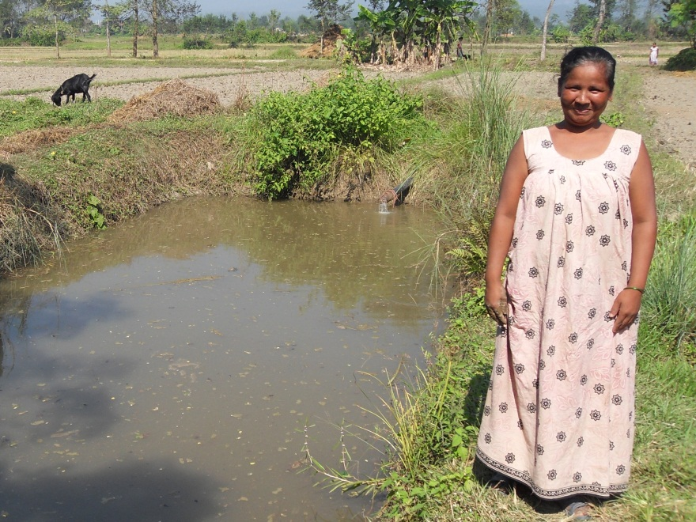
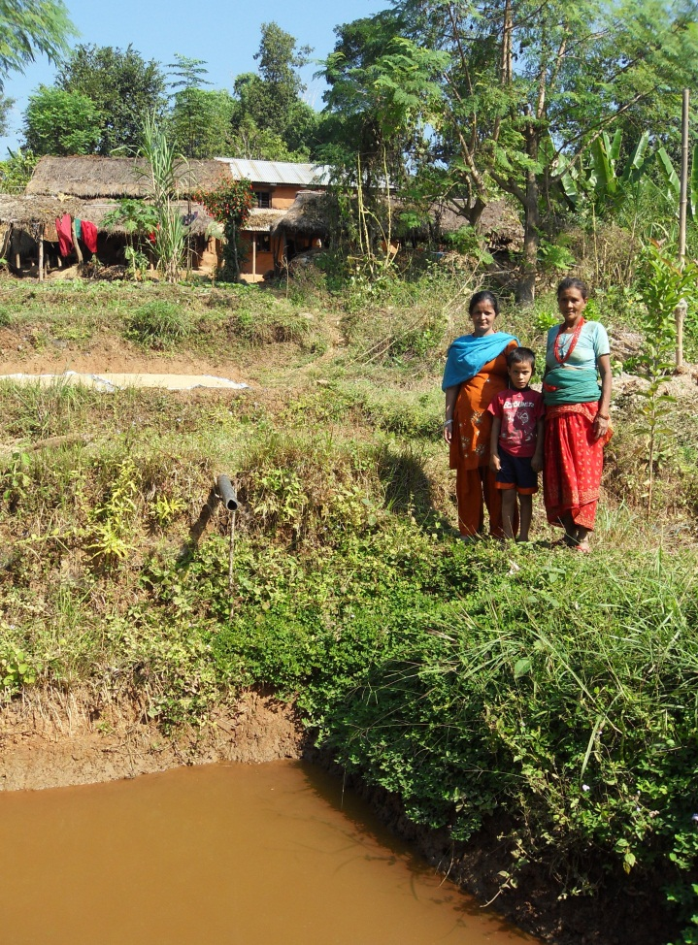
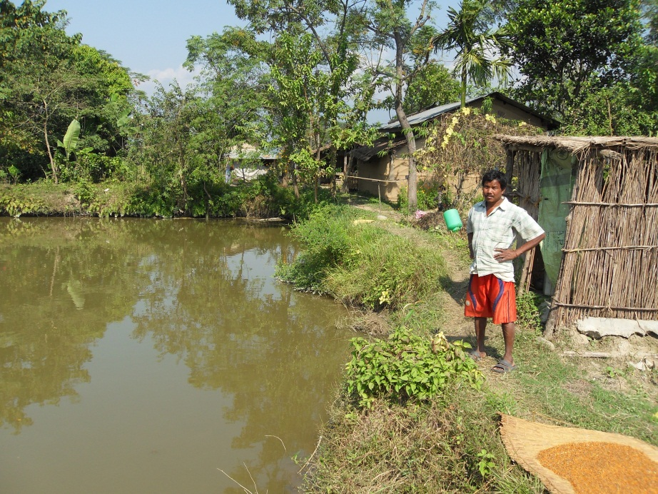
Homestead Ponds in Nepal

Slide 27
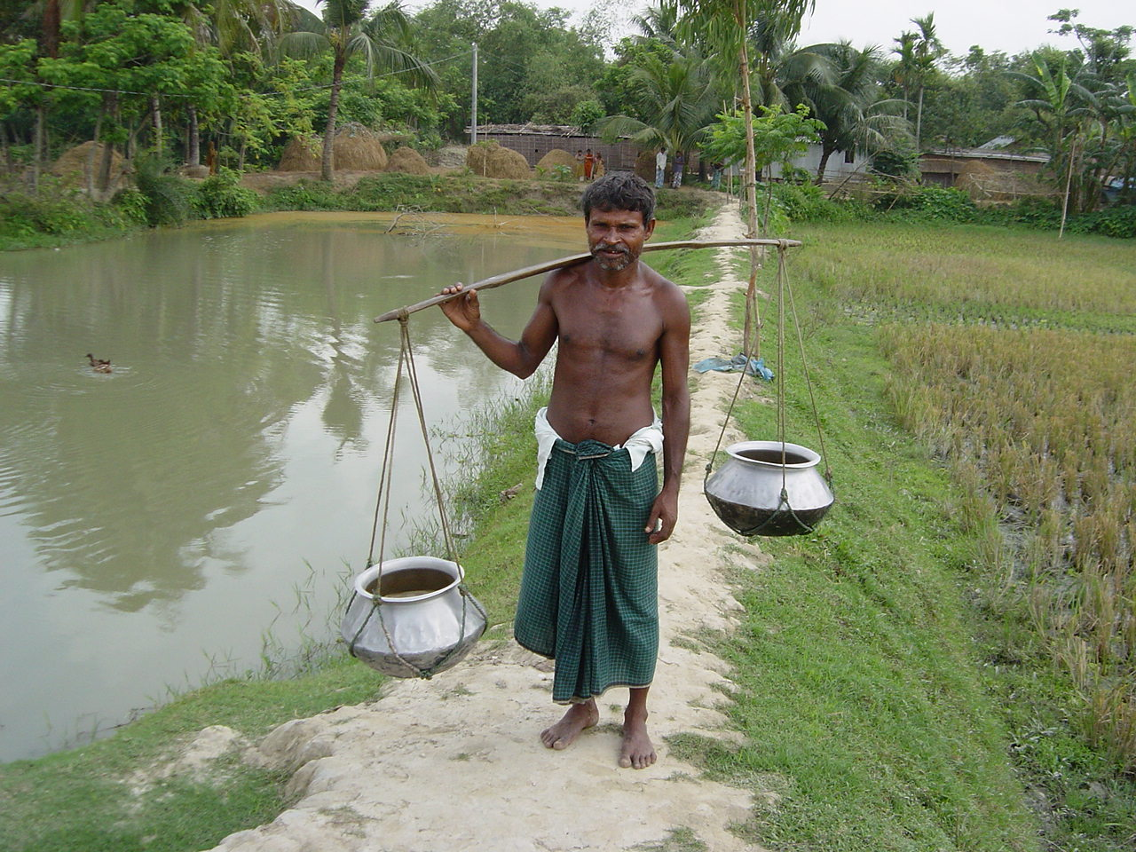
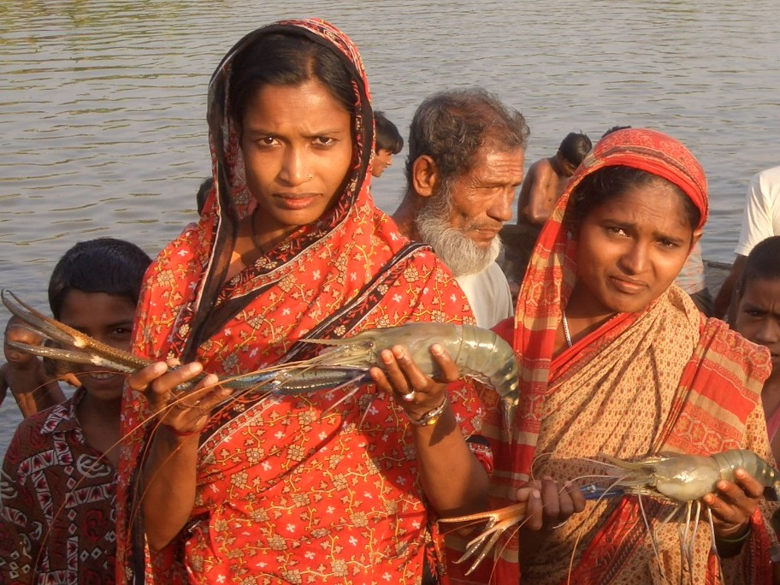

Slide 28
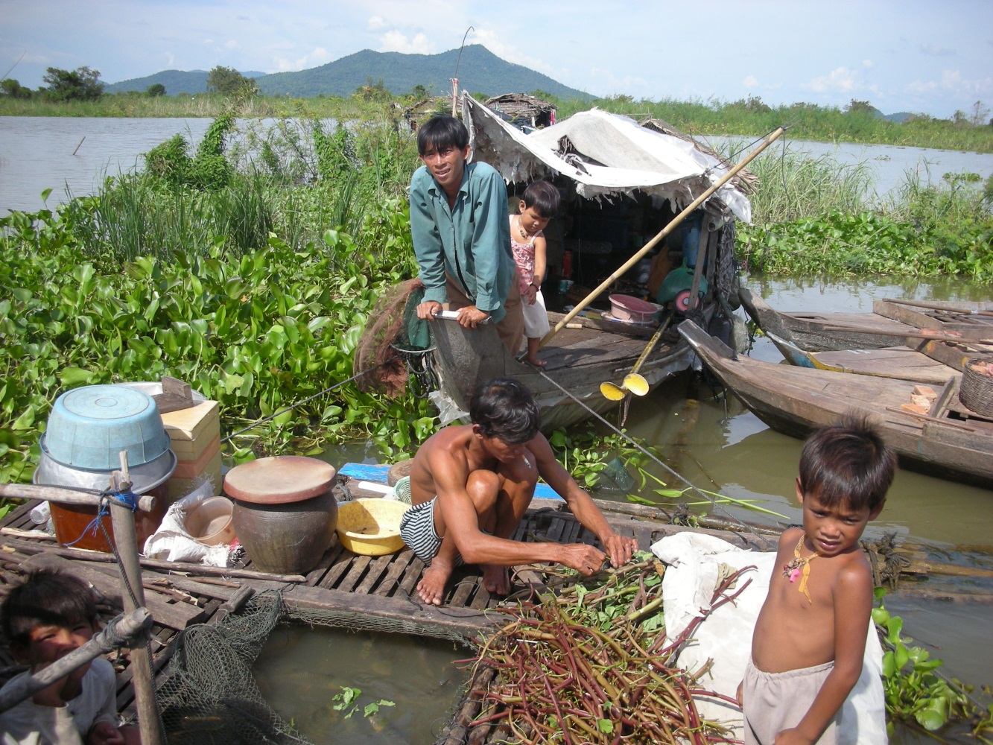

Slide 29
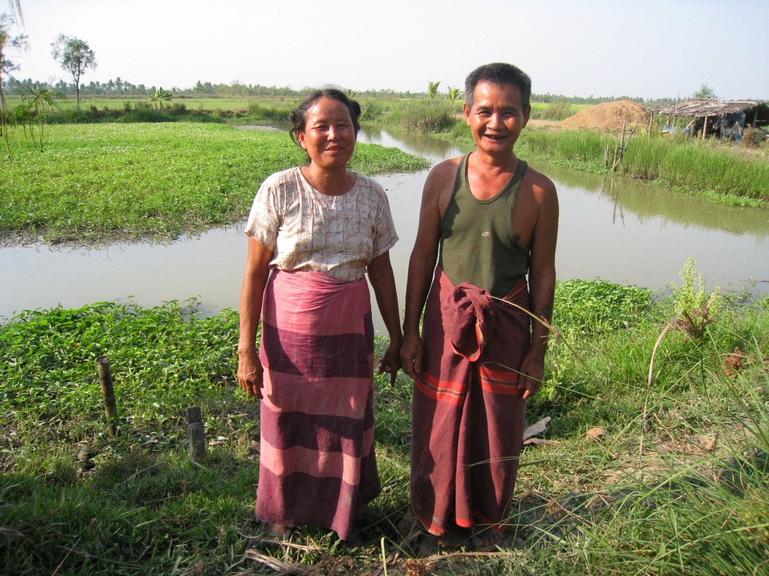

Slide 30
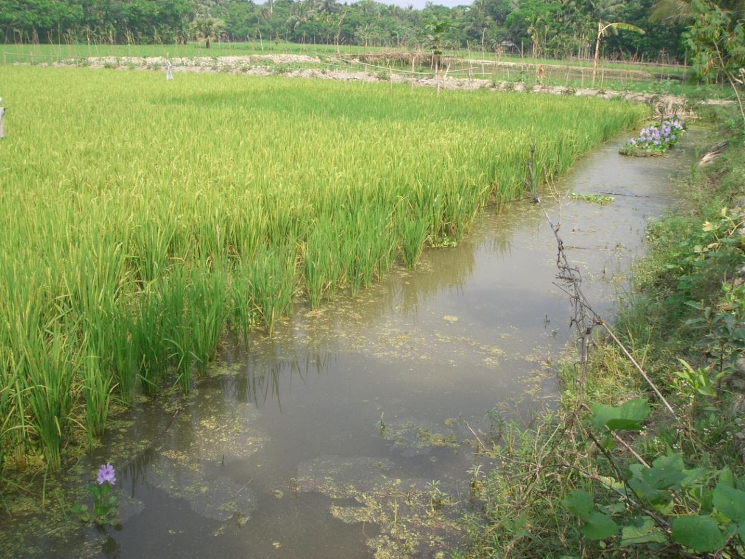
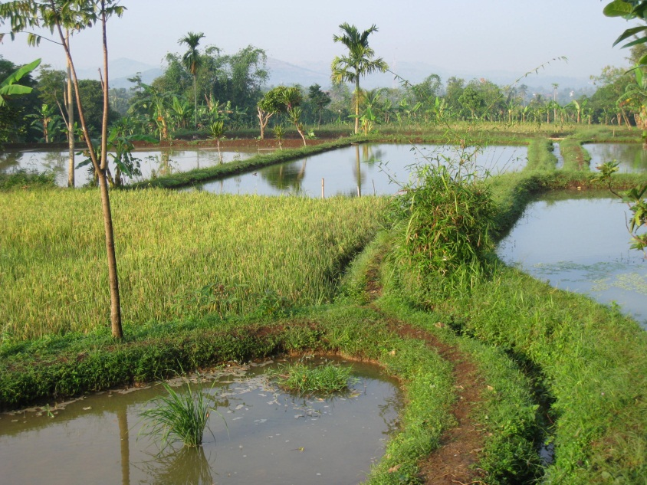
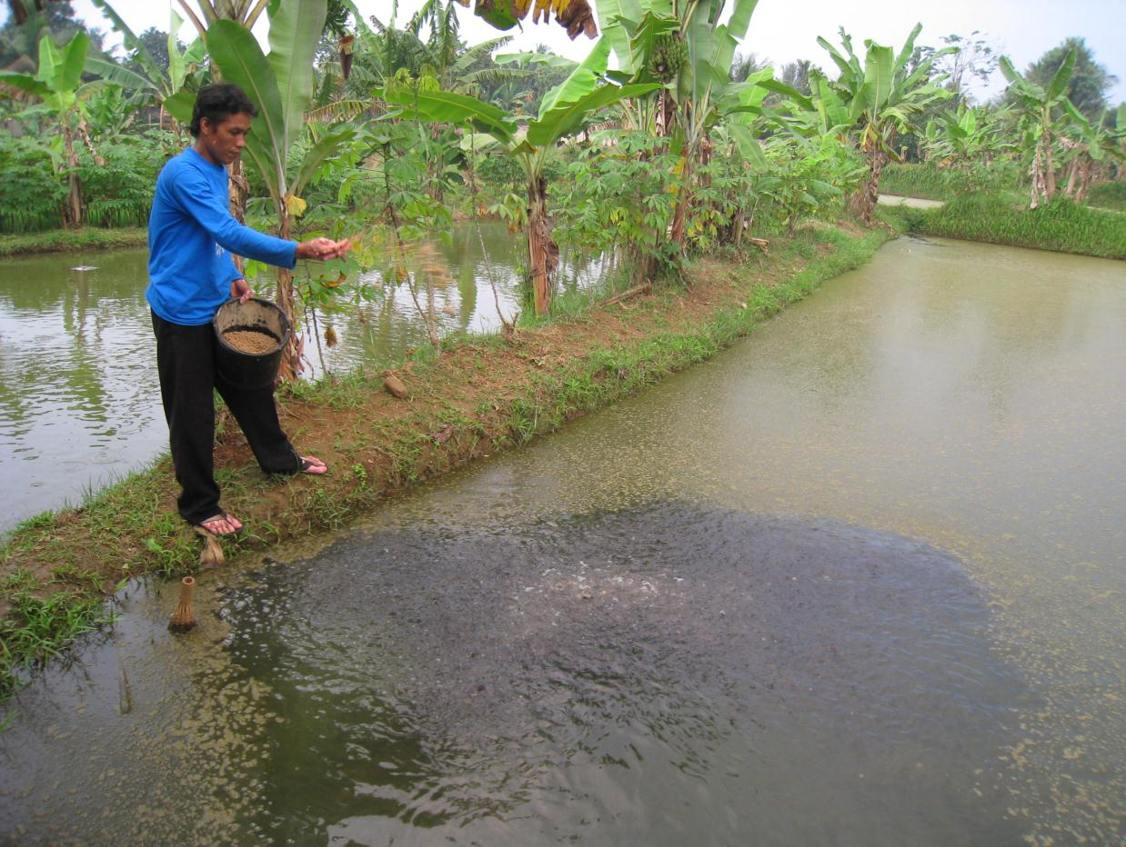
Ponds integrated in paddy fields

Slide 31
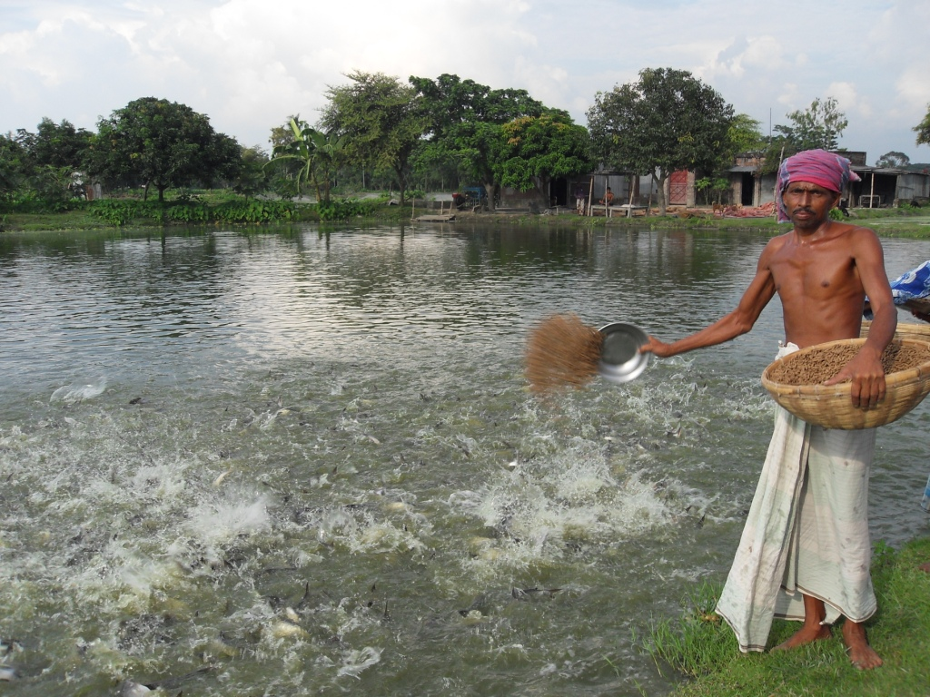
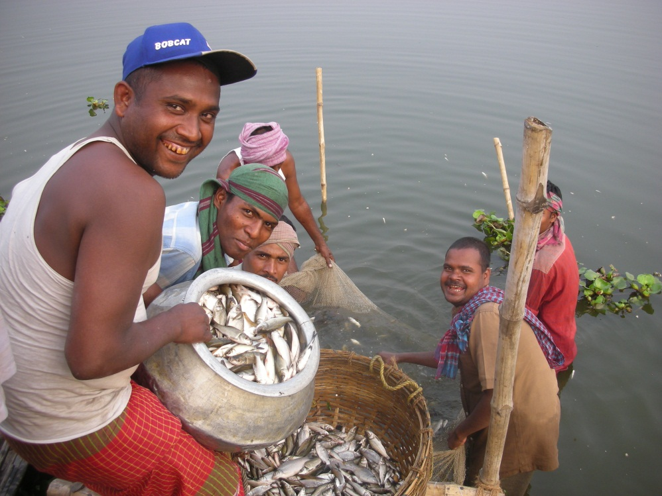

Slide 32
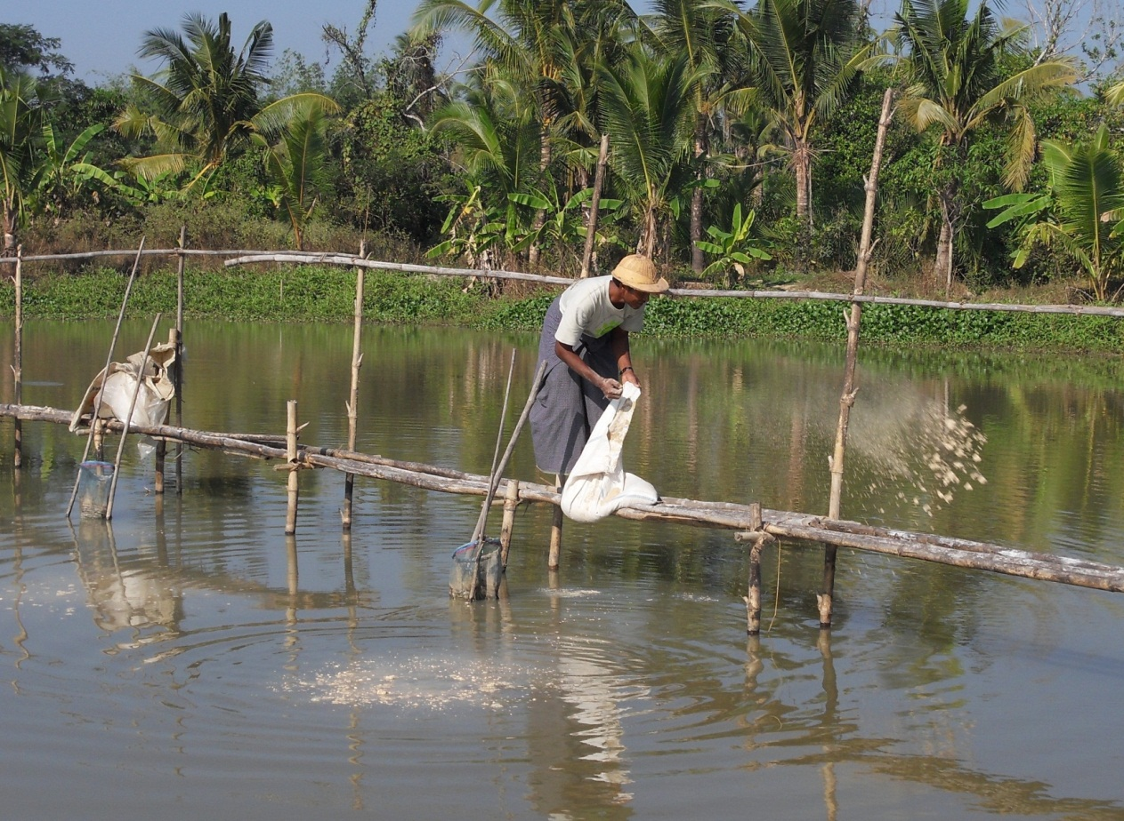

Slide 33
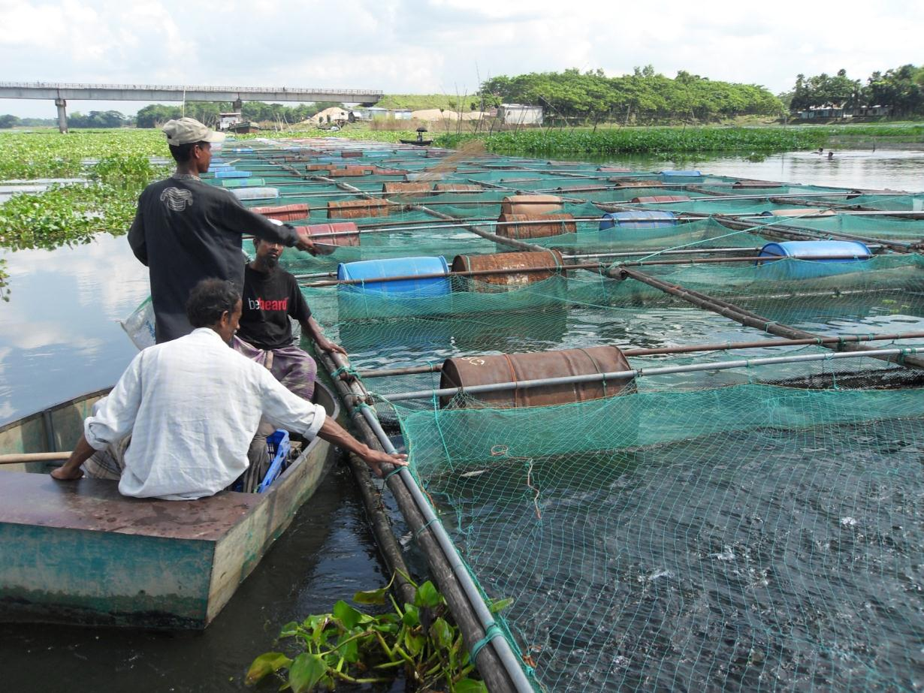

Slide 34
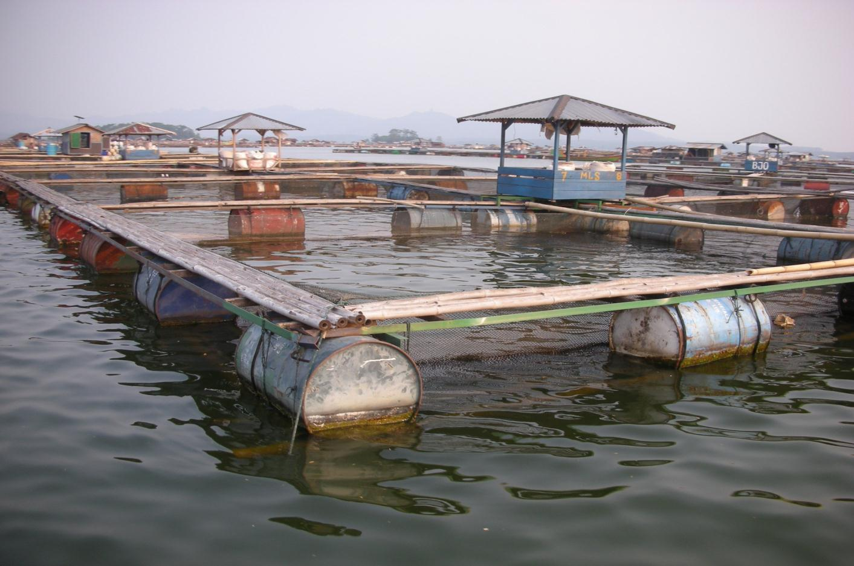

Slide 35
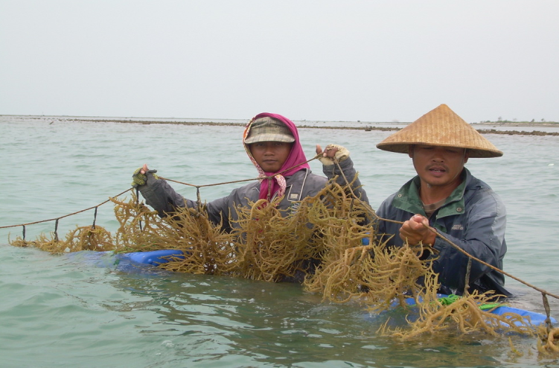
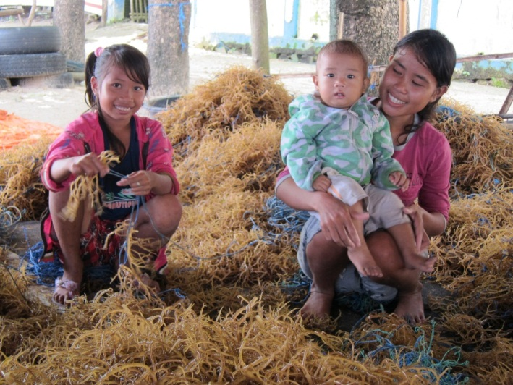
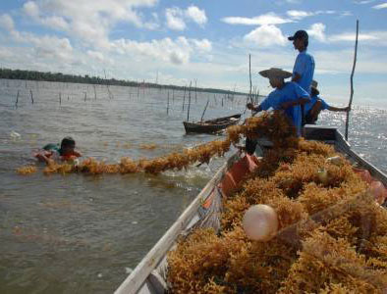
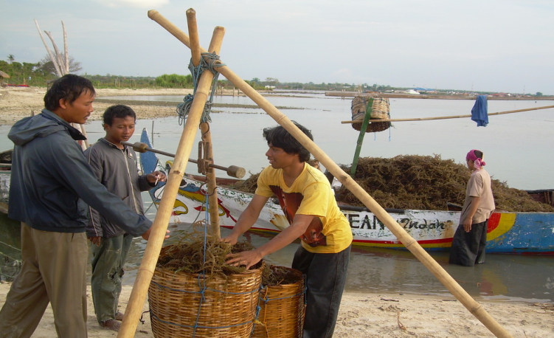
Sea Weed Culture – Indonesia
Directorate General Aquaculture

Slide 36
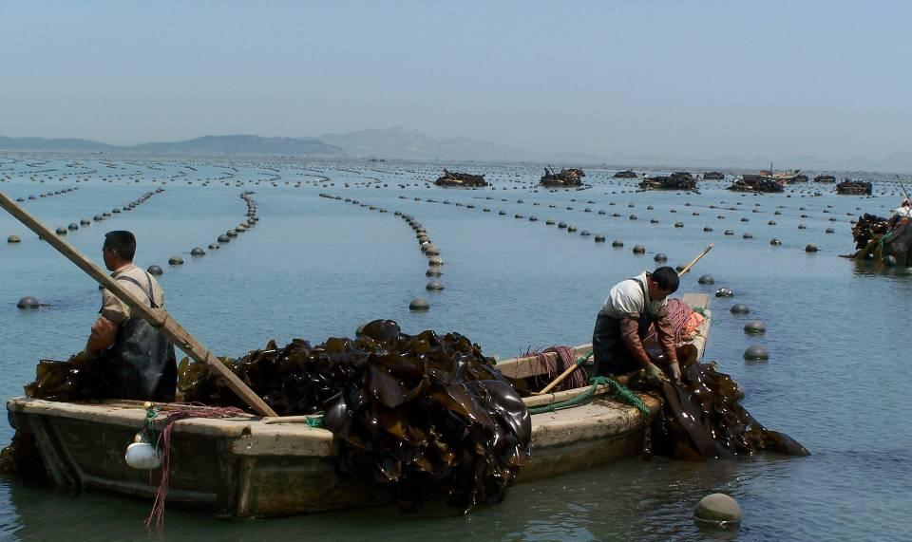

Slide 37
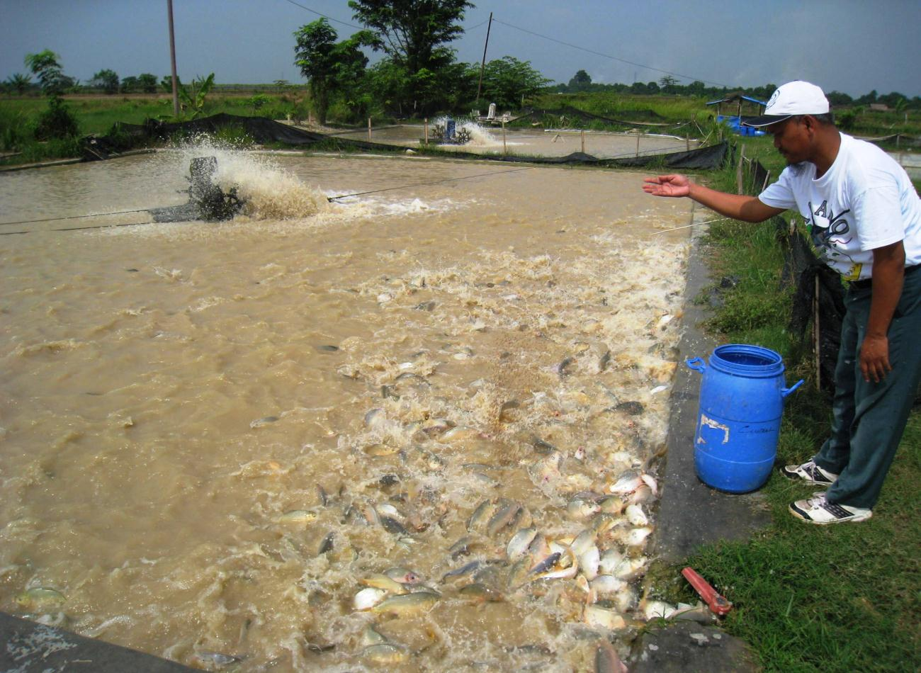

Slide 38
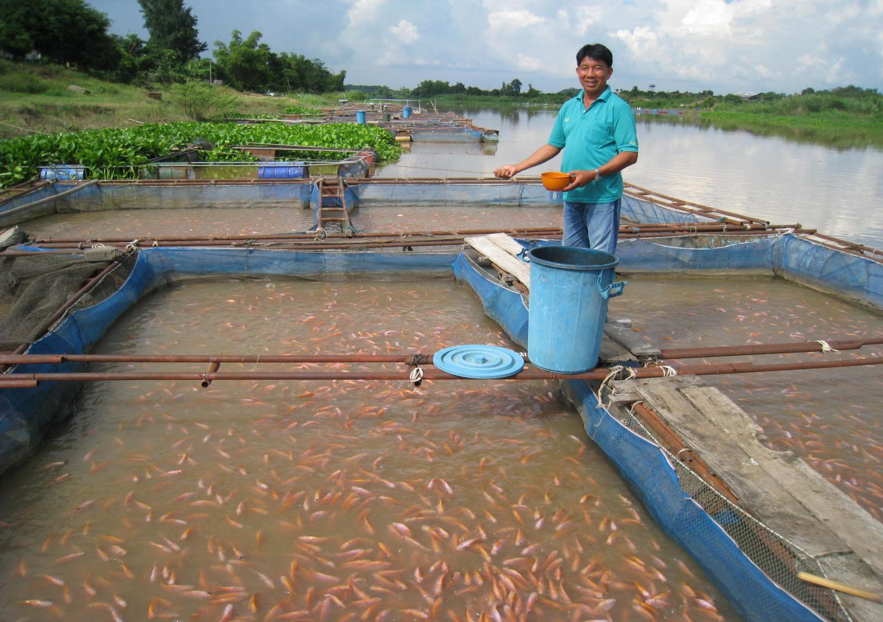

Slide 39
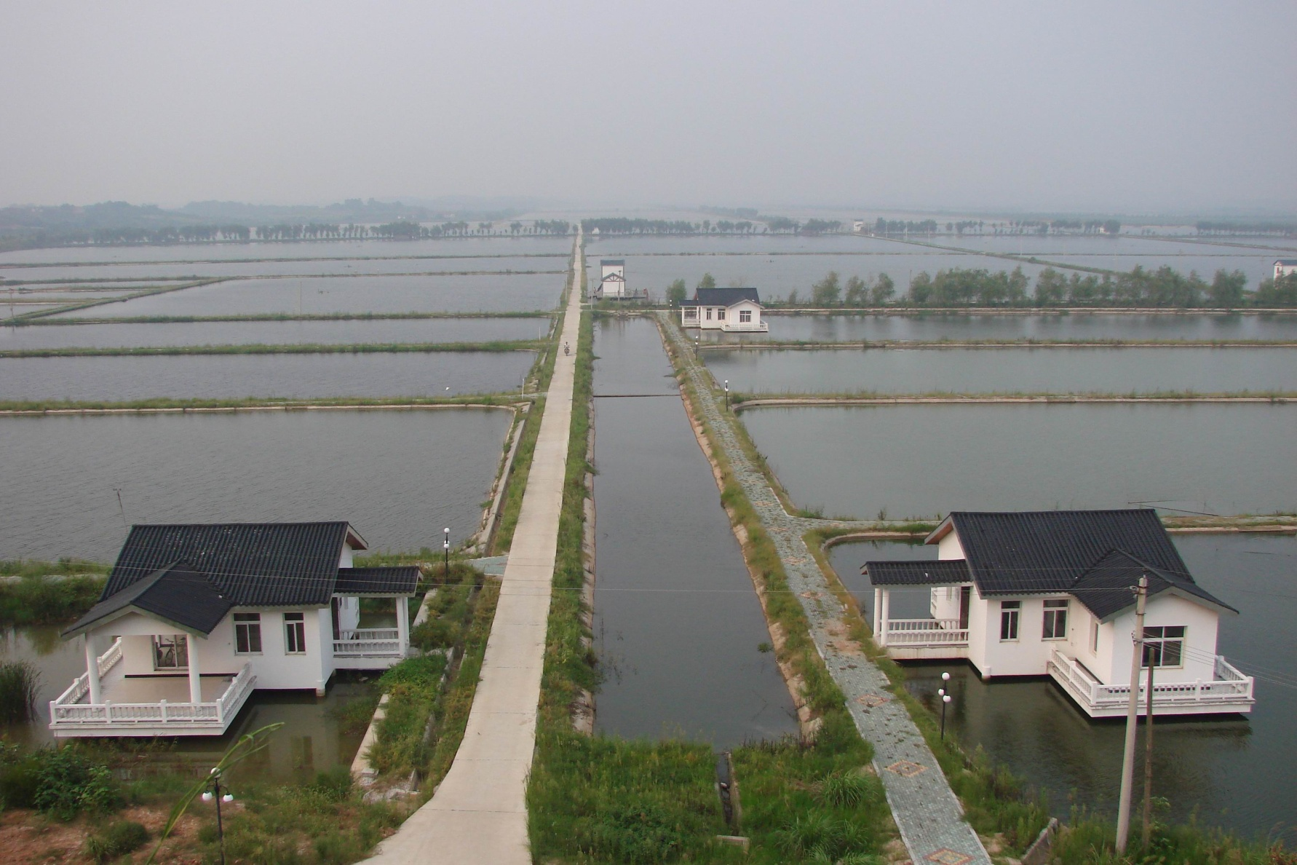
Reconstructed Earthen Ponds in China
(courtesy. Bureau of Fisheries, China)

Slide 40
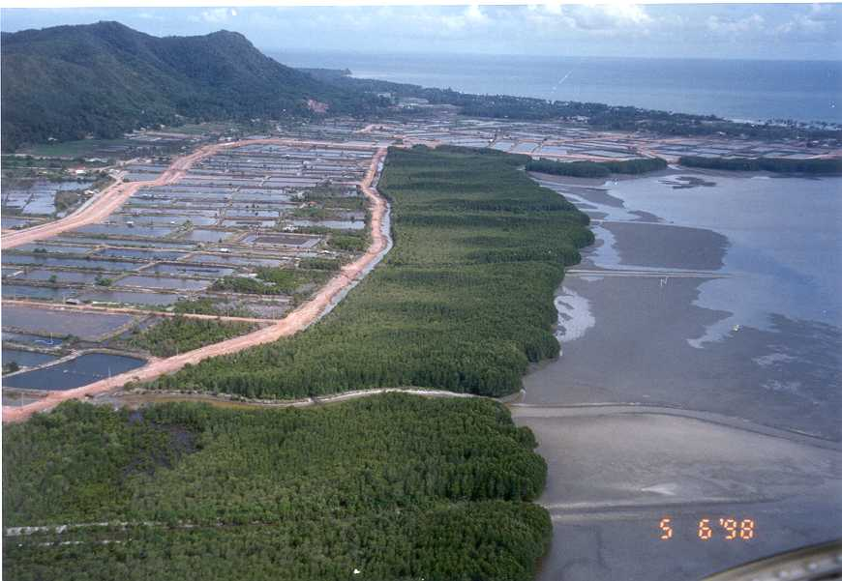

Slide 41
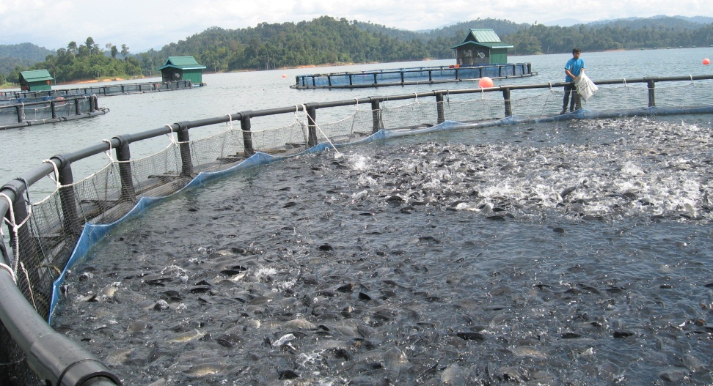
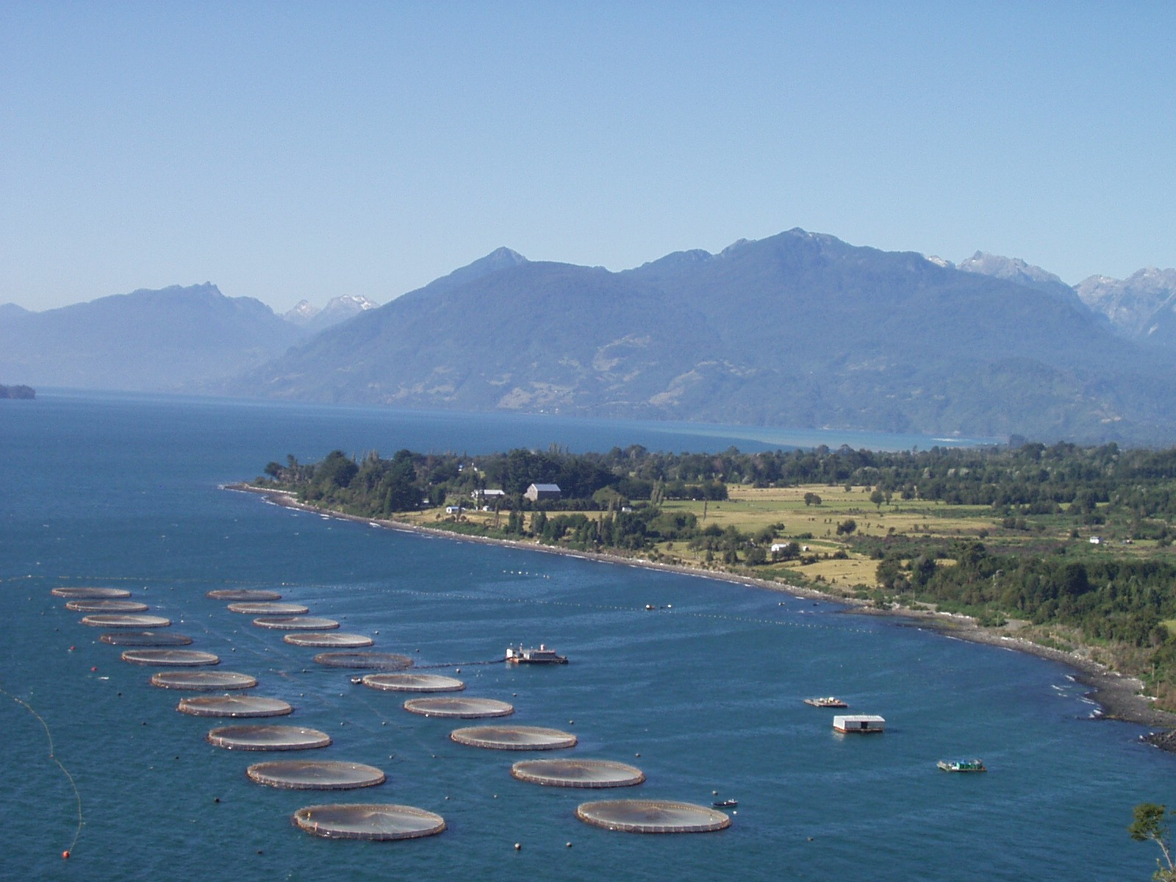

Slide 42
Characteristics of Asian Aquaculture Systems:
Predominantly small – scale; will probably remain small scale in the future – No different from other Agriculture or livestock or Dairy.
  Small-scale farmers make up >80% of the more than 12 million aquaculture farmers in Asia, contributing significantly to global aquaculture production and trade.
  Important for rural development, communities, employment, poverty reduction and environmental sustainability (Objectives of MDG)
  Aquaculture only way out to food security & source of livelihood in most circumstances at Household & community level
  Highly Adaptive and Innovative sector

Slide 43
Characteristics of Asian Aquaculture Systems:
Diversity of Farming Systems & Species
Most rapidly growing industry – “new kid on the block”.
Most Globally Traded Commodity – Producers, Consumers and Traders in Developing countries.
Rapid transformation since birth only three decades ago!
Extremely Vulnerable

Slide 44
Issues and Challenges

Slide 45

The Root Problem / Challenge
World Population to reach 9.2 Billion by 2050
Demography of the future population?
  MDG achieved?
  Present disparities more Magnified?
  Future Population More Affluent?
Can we feed the growing population sustainably?
Farmers’ must produce 70% more food by 2050
  Role of food fish?
  Role of Aquaculture – focus on Asia

Slide 46
Demand and Supply of Fish ….
Now and in the Future

Slide 47
Food Fish Demand and Supply Projections
51 million tones deficit in 2030? Or More??
Fish supply (mt) | 2010 (baseline) | 2030 (projection)
Aquaculture | 59 | 123
Capture fisheries | 88 | 88
Total supply | 147 | 211
% of aquaculture: | 40 | 58
Source: Estimation of FI Department
A
B
Fish Demand (mt) | 2007 (baseline) | 2030 (projection)
Africa | 9.0 | 14.0
Asia | 86.4 | 96.3
Europe | 19.4 | 19.9
L.A. & C. | 15.2 | 16.4
Northern A. | 9.1 | 10.7
Oceania | 1.1 | 1.4
World | 140.3 | 158.8
Source: Estimation of FI Department (Rohana Subasinghe)
2030 (projection)
18.7
186.3
23.4
18.3
12.9
1.8
261.2
Supply 2030
11.7
156.5
18.6
16.2
6.2
1.5
210.7
S-D gap 2030
-7.0
-29.8
-4.8
-2.1
-6.6
-0.3
-50.6

Slide 48
Bridging the supply-demand gaps
Aquaculture growth rate during 2007-2030 | Expected APR (%) | Required APR (%)
World | 4.0 | 5.6
Africa | 7.2 | 11.5
Asia | 4.0 | 5.3
Europe | 3.1 | 4.0
L.A. & C. | 4.4 | 7.6
Northern A. | 0.4 | 9.0
Oceania | 2.6 | 7.9
Source: Estimation of FI Department (Rohana Subasinghe)
If countries aquaculture production follow the recent trend, expected aquaculture growth rate:
  4.0 percent annually.
To feed growing and wealthier world population, required aquaculture growth rate:
  5.6 percent annually.

Slide 49
Can we sustain Aquaculture Production in Asia ……
&…meet the growing demands ???

Slide 50
Top 100 questions of importance to future of global agriculture (Pretty et al., 2010)
Limits on land and water resources
Significant increase in production from technological change to propel sustainable intensification
Not simply to maximize productivity; Cost and energy efficient production systems are essential; Use of renewable energy and low carbon emission systems will become paramount to sector sustainability
Optimize across complex land(water)scape of production, rural development, environment, social justice, and food consumption outcomes

Slide 51
Issues / Challenges in Asian Aquaculture
Overall Negative Image of Aquaculture as a Threat to:
  Biodiversity
  Use of resources (land and water)
  Chemical use
  Habitat Loss
  GHG emissions
  FIFO (Fish Meal / Oil) controversy
Mitigating Environmental impacts:
  Effluents & Eutrophication
  Mangroves

Slide 52
Issues and Challenges…..
Managing Biodiversity
  Diseases
  Alien / invasive species
  GMOs
Ensuring Food Safety
  Traceability
  Certifications
  Market Standards
Optimizing Socio – economic Benefits impacts
Adopt Animal Welfare Measures
Mitigation and Adaptation to Looming Threat of CLIMATE CHANGE

Slide 53
Response to Challenges:
Youngest Food Producing Sector – started only 3 decades ago
Aquaculture is on Steep Learning Curve
Track Record good – More Action Required!

Slide 54

FAO Technical Conference on Aquaculture was held in Kyoto, Japan from 26 May to 2 June 1976.
Kyoto Declaration placed aquaculture in national planning.
Personnel trained
Declaration boosted productivity

Slide 55
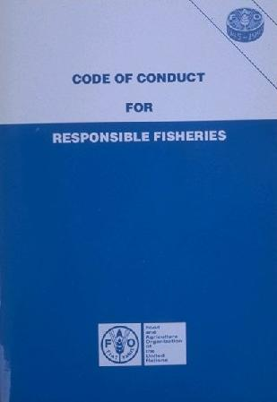
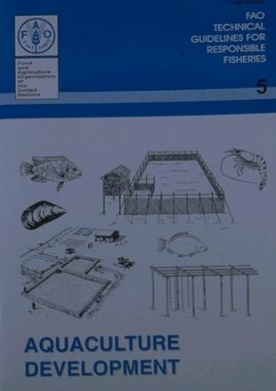
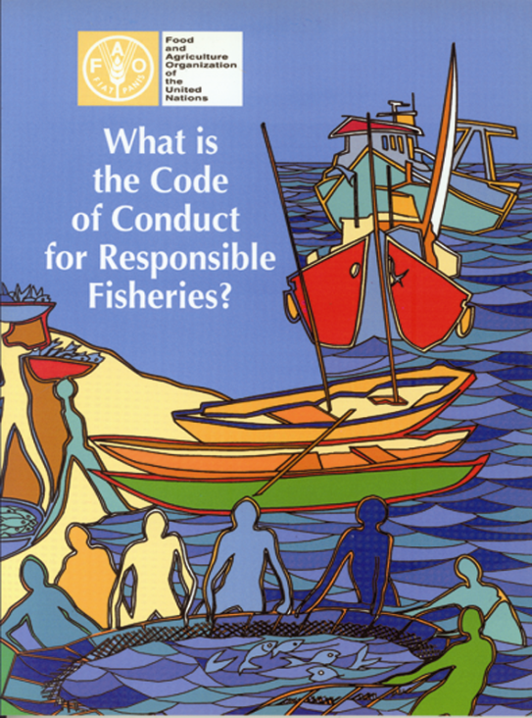
  FAO, in 1995, promulgated the Code of Conduct for Responsible Fisheries & Aquaculture which enshrined the principles of environmental and social responsibility.

Slide 56
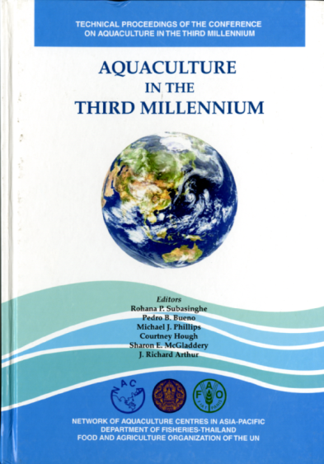
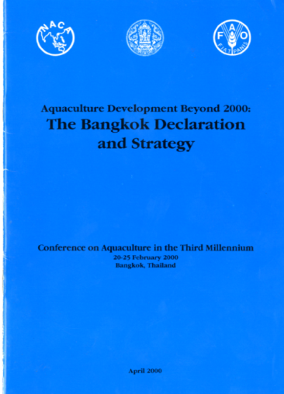

Slide 57
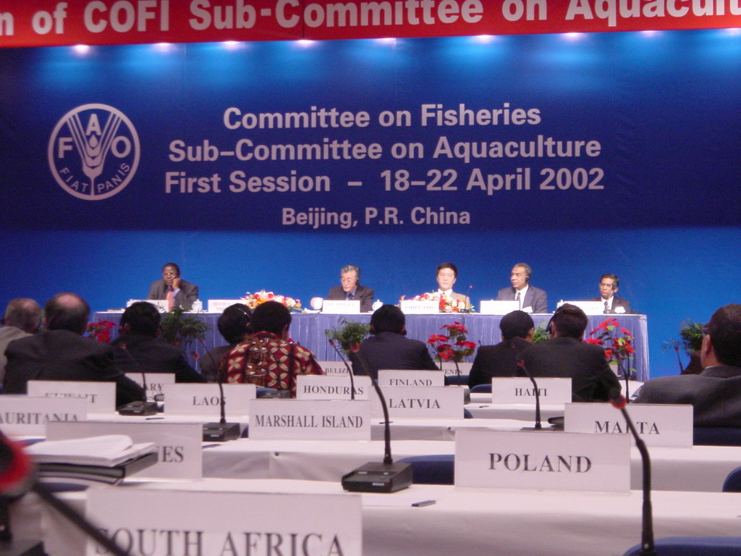
COFI Sub-Committee on Aquaculture

Slide 58
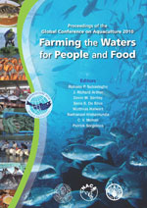

Phuket Consensus:
a re-affirmation of commitment to the
Bangkok Declaration

Slide 59
The Colombo Declaration:
July 2011
Governments agreed on a Regional strategy towards achieving the social, economic and environmental sustainability goals of aquaculture development

Slide 60
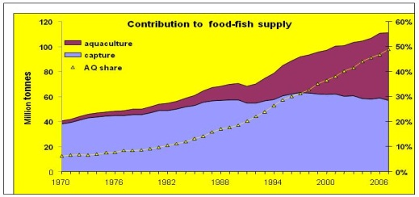
Growth phases of aquaculture
-The sector growth in the modern era can be summarized as-
Phase I
Post 75
Aquaculture development as a science: Recognized as significant potential contributor to animal protein supplies
Blue revolution:
Aqua-plosion???
Phase II
~75-80s
Aquaculture grows unabated; environmental degradation; makes its mark as significant contributor to global food fish supplies
Phase III
1990s
Environmental concerns; all growth need to ensure sustainability: linked to biodiversity - establish CBD
Phase IV
Mid 1990s-2000s
Emergence of food safety issues; banning of use of antibiotics/ growth hormones etc.; HACCP;
eco-labeling; certifications
Aquaculture responds; adoption of BMPs/ GAPs
Phase V
2010 & beyond
Culture practices need to ensure minimal impacts on biodiversity etc.: an ecosystem approach
Shift to low trophic species
Phase V.a
Products to carry extent of GHG emissions

Slide 61
Critical Action Areas /
Intervention opportunities

Slide 62
Intervention opportunities
Over intensification
Promoting sustainable intensification
Mangrove clearance
Effluent discharge
National legislation
Supporting BMPs, compliance to national/international requirements
Use of alien species
Responsible use of alien species
Fish meal/ Fish Oil use of fish meal & fish oil
Regional studies on strategies to reduce dependence
Supporting compliance to public/private certification
Regional study on P.vannamei
Use of planning and management tools

Slide 63
Intervention opportunities
Disease emergence and spread
Regional biosecurity programs with focus on risk analysis, surveillance and contingency planning
Disease prevention
Market access and aquaculture certification
Push for regional vaccination programs and strategies
Small farmer inclusive certification programs
Empowering small farmers
Development and promotion of BMP implementation through farmer groups/cluster management
Seed quality and brood stock management
Benchmarking and equivalence of public and private certification programs

Slide 64
Intervention opportunities
Dependence on wild seed and broodstock | Hatchery and broodstock management programs; Regional domestication programs for key species; New species with better qualities and/or consumer acceptability of GMO fish;
Food Safety New Environments | Responsible use of approved drugs and chemicals BMPs, compliance to Codex, certification Increasing efforts in moving aquaculture further offshore, including further research and adoption of new off-shore aquaculture technology.
Climate Change | Vulnerability assessments, mitigation strategies

Slide 65
Suggested Thematic Programs

Slide 66
Support Least Developed Countries
LDC Criterion
  Low income
  Human resource weakness
  Economic vulnerability
LD Countries in AP
  Bangladesh
  Cambodia
  Lao PDR
  Myanmar
  Nepal
Fisheries and aquaculture important in all the above LDC
Need major push and priority support

Slide 67
Support Aquaculture for poverty alleviation
Previous donor support for small-scale aquaculture (SSA) was mainly for subsistence but farmers seek increased income
Thus SSA needs to provide a significant source of income and be a small and medium enterprise (SME)
Considerable poverty alleviation through large-scale aquaculture through employment:
- large-scale farms
- value chain e.g. input supply, processing and marketing

Slide 68




Support Aquaculture to diversify livelihoods of small-scale farmers and fishers
  Best entry point for poor farmers and fishers to farm fish
  Relatively low cost
  Minimal risk
  First step on ladder of intensification i.e. to gain experience and confidence before intensifying

Slide 69
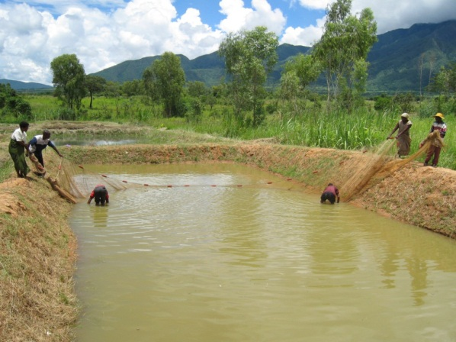


Support South –South cooperation
Within Asia-Pacific region between more developed to least developed countries
- Assess ‘what has worked where’ in more developed countries (a) and ‘where there is a need for similar systems’ in less developed countries (b)
- Transfer from (a) and adapt to local physical and socio-economic conditions in (b)
Similar cooperation between Asia-Pacific region and sub-Saharan Africa has great potential

Slide 70
NACA in Summary
Attributes | Impact
Governance | Intergovernmental organization of 18 governments, works at the aqua-face through participatory approach, commitment to “stronger helping weaker” principle
Networking | Networking to harness the wealth of knowledge and skills that exist in the region
Communication | To share knowledge (what works where) and skills (technical expertise) amongst members
Membership | World’s top aquaculture producers are NACA members
Track Record | 24 years of proven track record of project implementation in support of responsible and sustainable aquaculture
Partnership & Collaboration | Strong partnership with regional and international organization and donors. Strongly believes in partnership and collaboration

Slide 71
Final Word
NACA recognizes the commitment of Norway to support needy governments in Asia Pacific through its donor programs, embassies, national institutions and private sector
NACA with its track record and vast network of regional resources looks forward to partnering and collaborating with Norway to support needy governments in the region in their efforts to promote
Our Common Vision:
Responsible and Sustainable aquaculture.

Slide 72
Thank you

