Slide 1
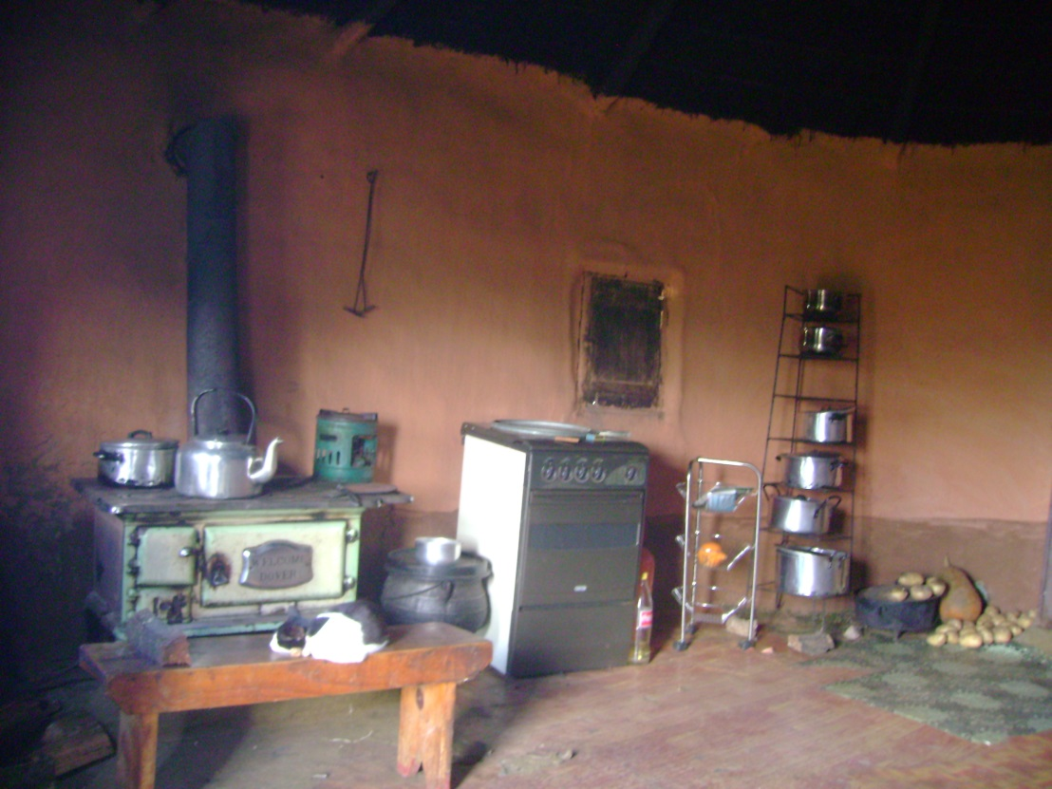
Cultural Aspects of Energy, Health and Gender: The Implications of Current Approaches in the Clean Cooking Sector
Magi Matinga
7th January 2014
Oslo, Norway

Slide 2
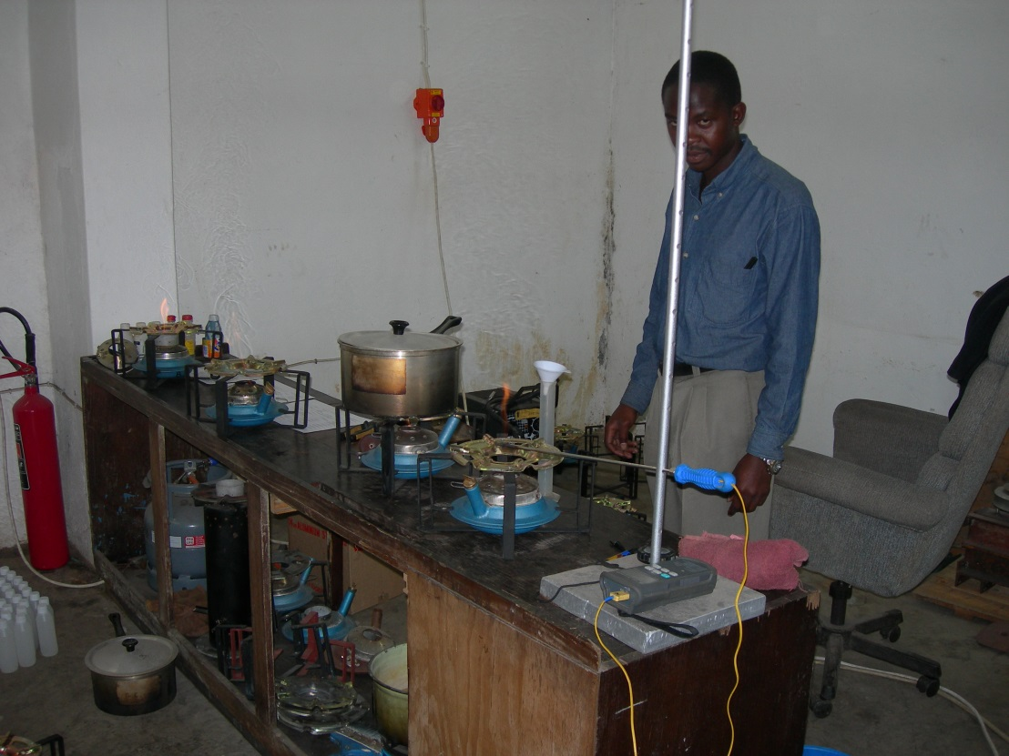
Changing face of energy-health- development
New narratives: Old technology looking for a new problem
Governance of the stove sector at a global level, new institutions and norms
Results-based financing
High value stoves –
  Chargers, radios
Metrics: SUMS, Lab tests
Processed fuels, fuel
processing & kitchen
practices

Slide 3
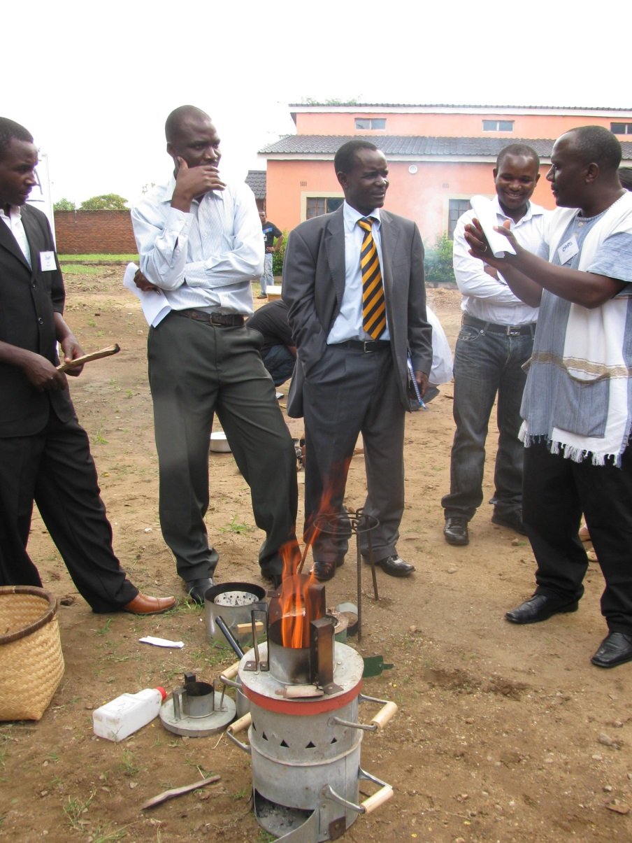
Implications on participation
Tensions between commercial production vs village production
Less production, more distribution jobs? Quality jobs? Where?
What new processes and burdens for women and men?
Which women and men will benefits and who will loose out, who will resist?

Slide 4
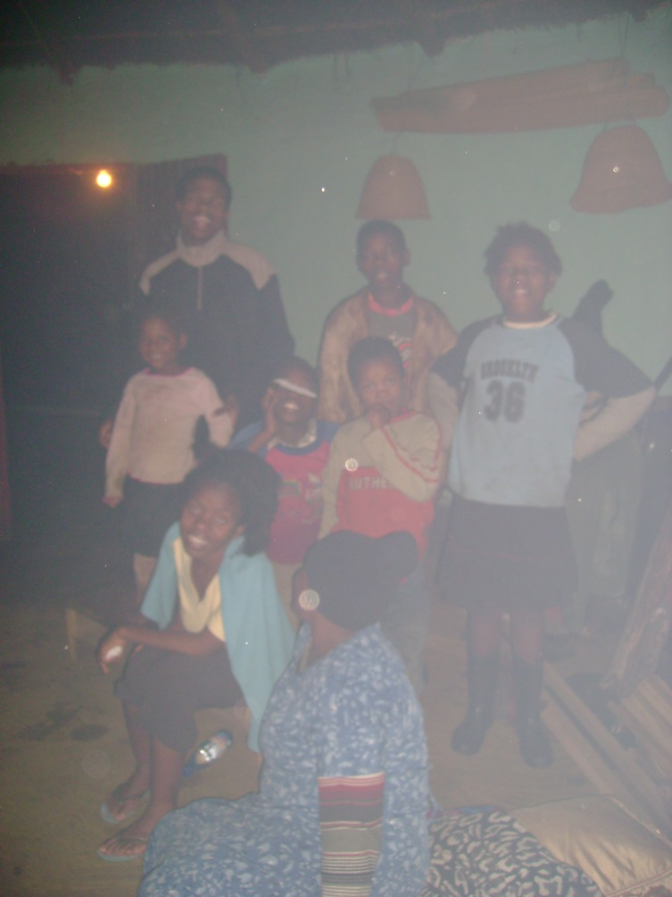
What health? Whose health,
What is health? What is the locus of control?
What happens to the different interpretations of (respiratory) health?
  Ventilation vs respiratory health
  Types of respiratory health issues

Slide 5

Use it for everything, to specifications for all the time

Slide 6
Who likes smoked salmon? Preferences and culture
Meanings of the hearth
Cultural symbols of womanhood associated with energy work and firewood
Preferences for food tests, warmth, non-cooking fires
We (begin to) talk about it, but we don’t seem to know what to do about it!

Slide 7
Technically exciting, practically….?
SUMS – Monitoring stove use (measuring body heat) from the comfort of your ipad!
Who charges the phone? How? When?
What does a stove become when it becomes a multipurpose high value gadget?
ICS are less tolerant of wood conditions e.g. size, wet wood, knots

Slide 8
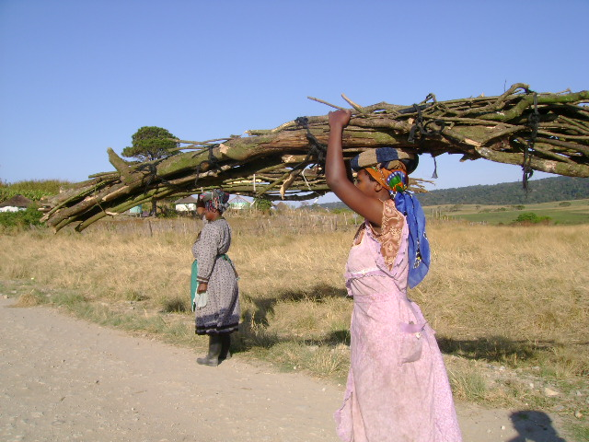
Missing links

Slide 9
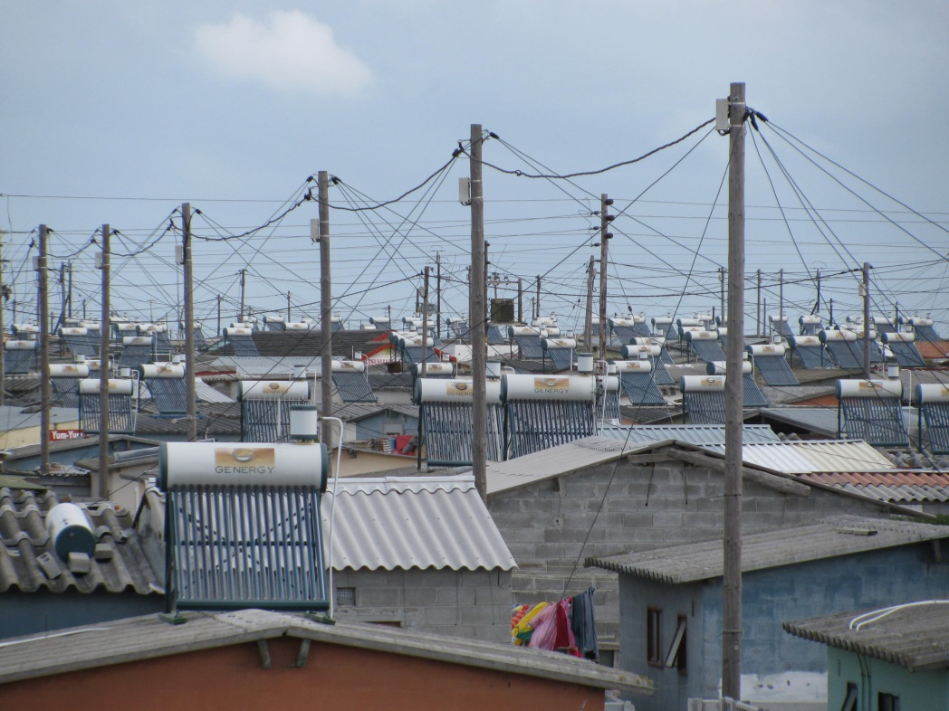
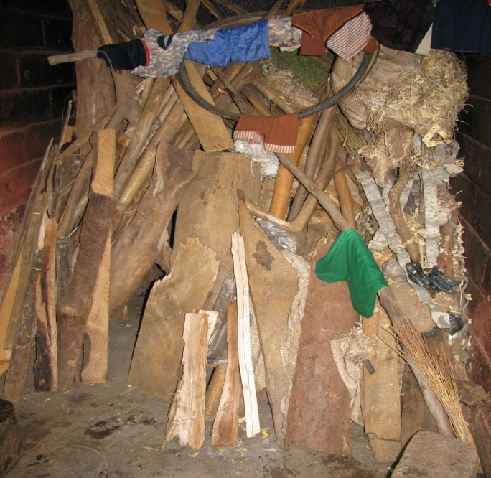
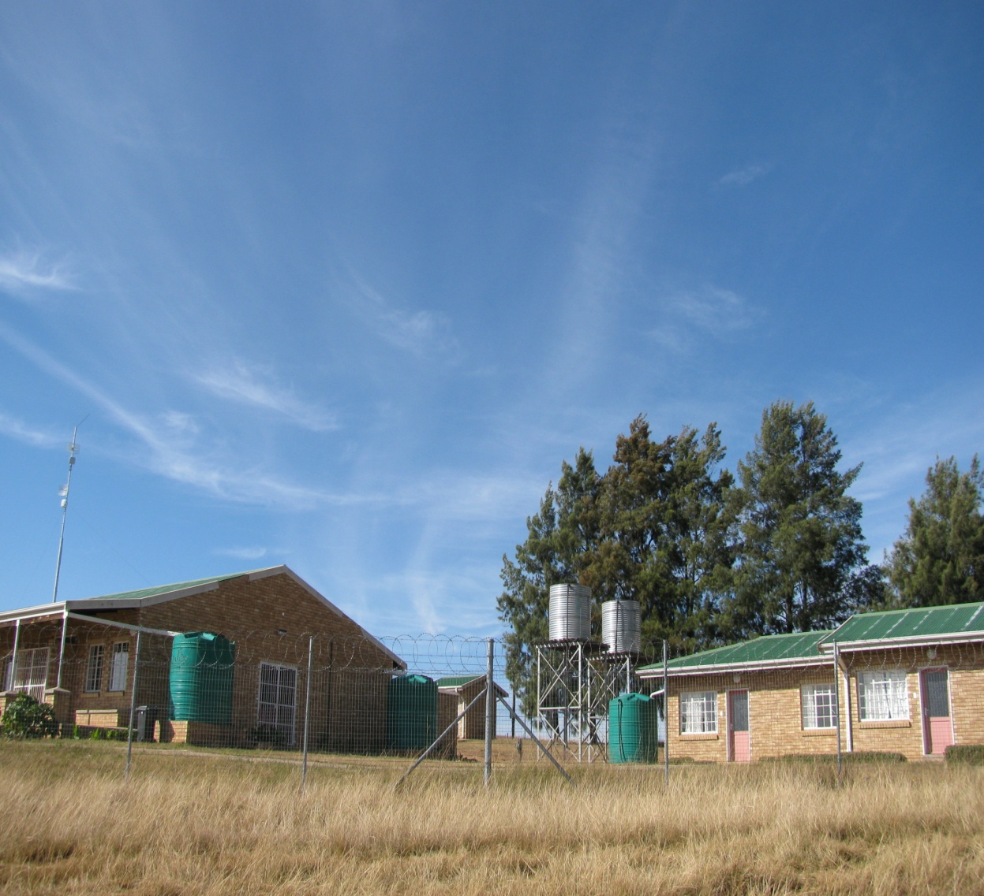
What matters?

