Slide 1
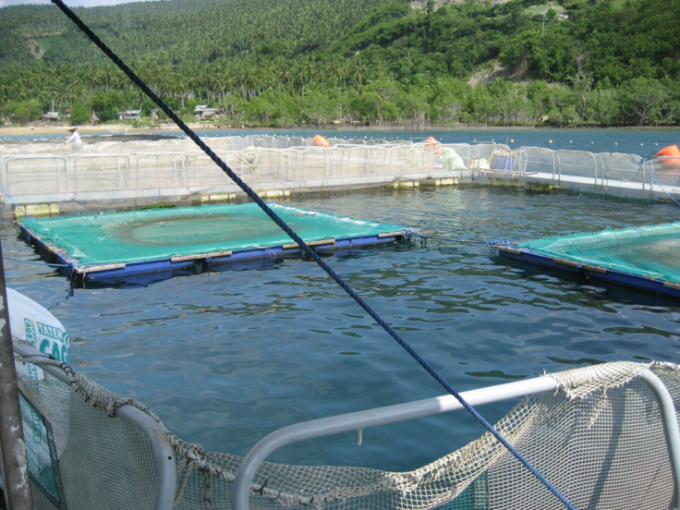
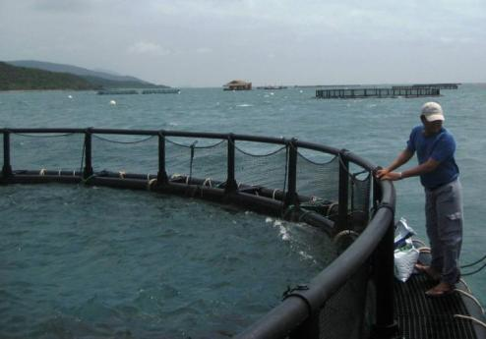
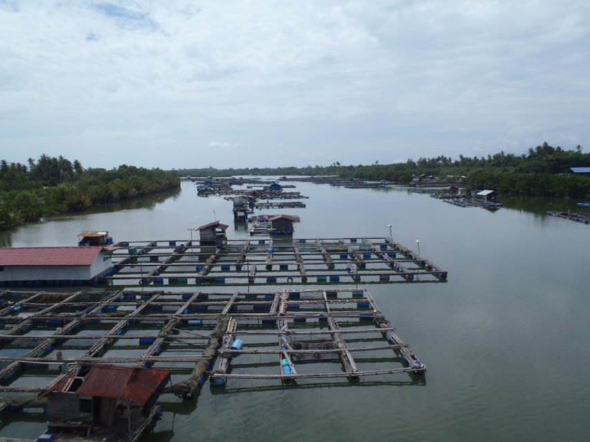
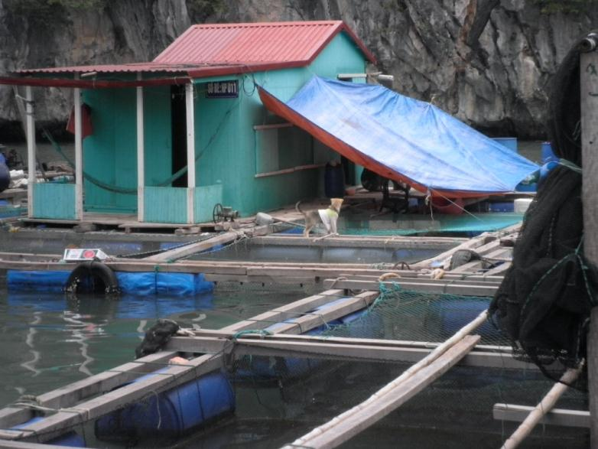
What is required for responsible and productive aquaculture business?
Niels Svennevig
Vietnam
Regional seminar on aquaculture for Norwegian Embassies, Norad and fisheries advisers
Bangkok, January 16th 2013

Slide 2
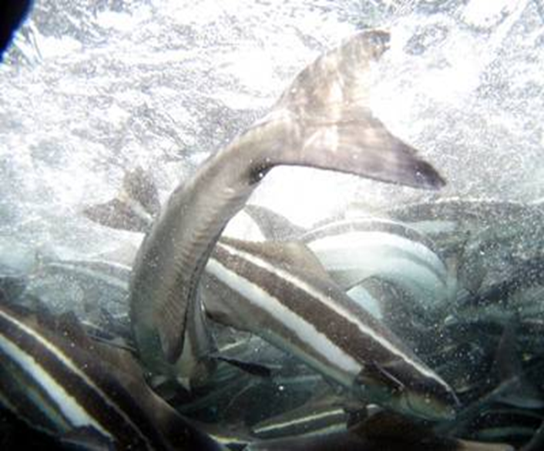
Contents
Context and development perspective
Practises - Risk management
  Role of GAP’s and certification (short)
Picture: Dave Robb, EWOS

Slide 3
Context and development perspective 1
Aquaculture has only been performed for a “few” generations, compared to agriculture
Aquaculture is often considered a risky, unpredictable biological production due to lack of understanding or complying to “its” principles, compared to agriculture
For aquaculture to be successful and sustainable (responsible and productive) there is a need to reduce the risk of loosing the crop/income. This is in common for both the corporate investor and the poor subsistence farmer – as both of them count their money and the latter maybe even more
However risk management has only been applied systematically when corporate large-volume farming was developed because of the large investments in equipment and especially in working capital

Slide 4
Context and development perspective 2
The small-scale farming sector as known especially in SE Asia still needs to appreciate risk management as an approach, which could transform the sector into a more sustainable business, more resource efficient and more productive.
What has been the impact to Asian aquaculture that risk management has not been developed and applied?
  The most obvious development impact is that marine fish farming sector has not developed to the level of its potential – because it is considered too risky

Slide 5
SE Asian farmed marine finfish volumes (FAO 2010)
Asia (from Pakistan to Japan): 2.215.000 tons
  China: 811.000
  Japan: 321.000
  ROK: 80.000
“Tropical Asia” : 1.093.000 tons
i.e. excl. China, ROK and Japan
  of which milkfish is at least 74% 808.000
  but most is farmed in ponds or rivers!
The use of the near shore areas of “Asia” for food production has by far not reached the level of its potential – this can easily appreciated when comparing with Norway, which produces more than 1 000 000 tons of fish/year from farming in the sea

Slide 6
Farmed marine fish (tons) by country (FAO 2010)
Country | 2009 | 2010
Indonesia | 352.999 | 490.716
Philippines | 349.305 | 351.217
Taiwan | 73.831 | 78.239
Bangladesh | 47.839 | 73.825
Malaysia | 33.420 | 40.934
India | 127.779 | 28.420
Thailand | 17.851 | 16.270
Viet Nam | 6.000 | 7.100
Singapore | 1.939 | 2.764
China, Hong Kong SAR | 2.105 | 2.323
Cambodia | 340 | 420
Myanmar | 105 | 225
Brunei Darussalam | 65 | 132
Sri Lanka | 9 | 12
Total | 1.013.588 | 1.092.598

Slide 7
Business structures in marine fish farming
Small-scale approach
  Traditional/easy to copy; small investment; family based; very segmented business structure
  Target is the domestic and regional, high-value, live fish market segment. Larger productions achieved by ‘duplication’ rather than ‘efficiency of scale’
  Production increase constrained by lack of protected sites; diseases/environmental impact; small live fish market volume; difficulty to manage by authorities
Large-volume approach
  Modern/emerging; investment intensive; corporate based; vertically integrated business structure from ‘egg to shelve’
  Target fresh/frozen white fish market segment (regional and Global) through large productions of medium-value fish by ‘efficiency of scale’

Slide 8
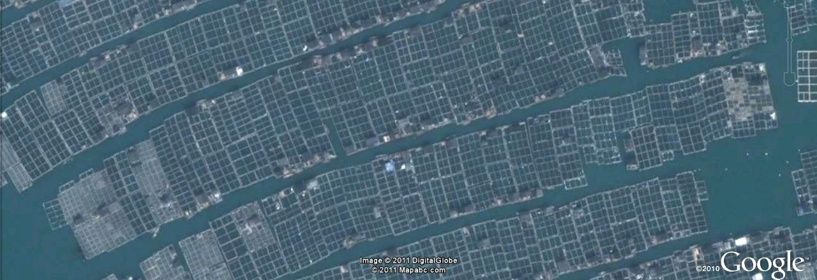
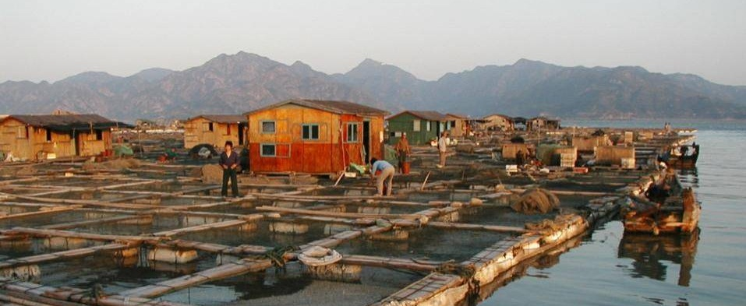
Small-scale farming
Volume by duplication
Fujian, China

Slide 9
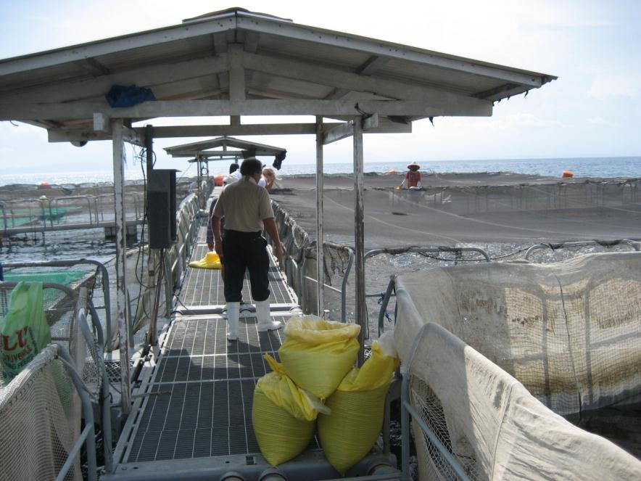

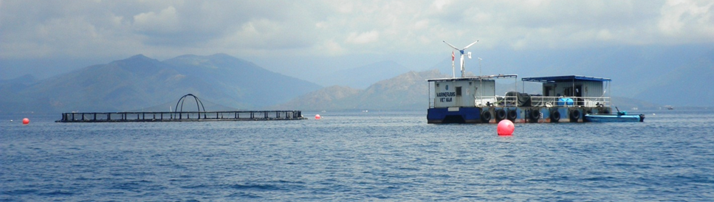
Large-volume farming
Sarangani Bay, Philippines
Marine Farms Vietnam

Slide 10
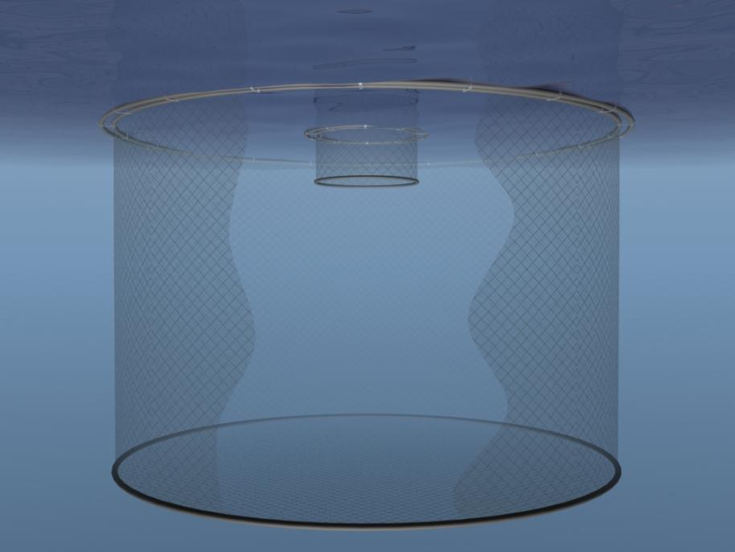
The ‘extreme’ development trend in cage size in salmon farming
Volume increased 100 times compared to pioneer days in Norway:
40m circumference cage with 4 m deep net = 550 m³
157m circumference cage with 30 m deep net = 60 000 m³
^{Picture: Aqualine}
If maximum biomass is 16kg fish/m³
ONE large cage would hold 1 000 tons of fish
(in SE Asia still only 100m circumference and 100 tons)

Slide 11
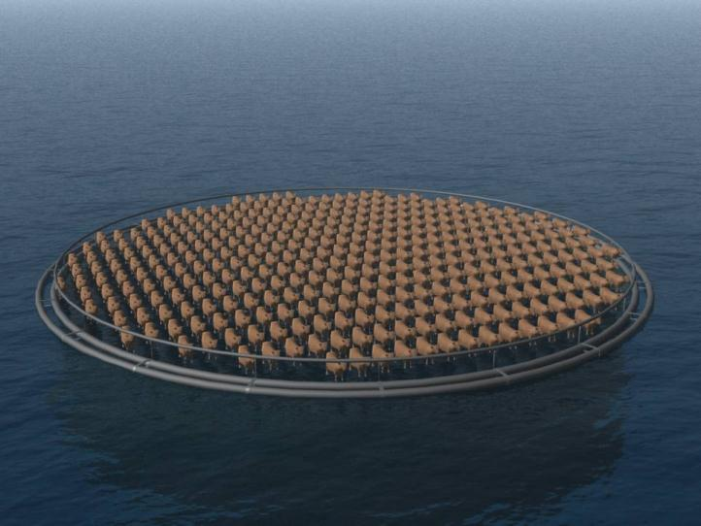
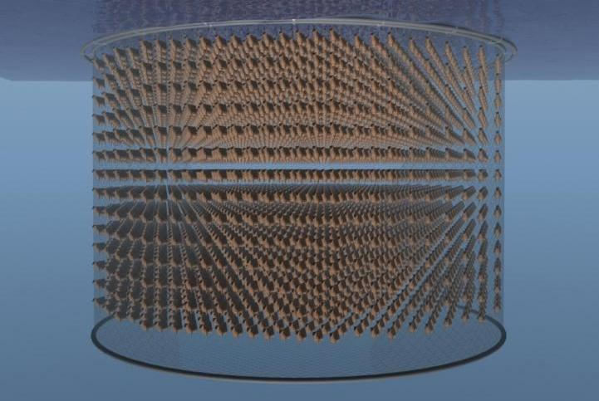
1 000 tons of fish biomass in one cage
If turning this fish biomass into ’cow units’ of 500 kg/cow:
It equals taking care of 2 000 cows; but the challenge is in addition to the large number that you cannot see them!
^{Pictures: Aqualine}
That’s why!!! it takes a skilled ‘shepherd’ plus ‘something more’ to tend one cage

Slide 12
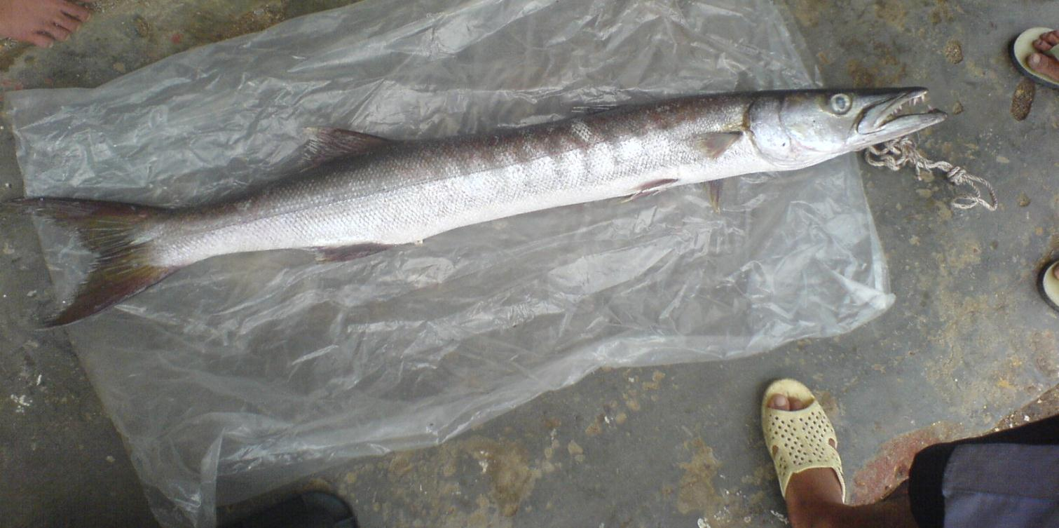
Large-volume farming - large financial risk
  Large investments in equipment and working capital
  1 000 tons of salmon = 3 mill.USD in production costs
Risk management therefore has become a key focus:
Through vertically integrated setup; having control from own hatchery to direct sales to distributors
Through planning, appropriate hardware and skilled operational management and workers, biosecurity etc.

Slide 13
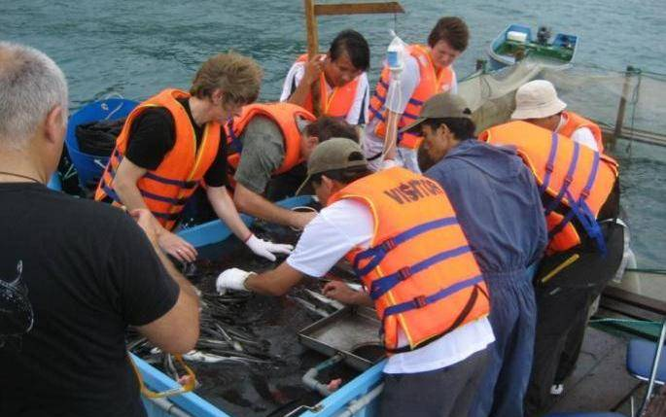
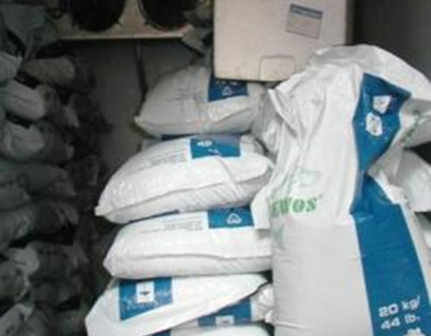
Elements of risk management in practise
  Localities/site selection: Wave/current analyses etc.
  Infrastructure /equipment: Mooring design/dimensioning; proven cage structures; nets; predator nets; feeders; work boats etc.
  Bio-security: Traceable, disease-screened, vaccinated fingerlings; pellet feed; low stocking density; clean nets; environmental impact monitoring; blood water and mort removal; separated generations; fallowing etc.
  Staff: Trained, skilled and educated; production planning – feeding management
  Insurance: If available
  Government: Regulations in place and enforced!; Institutional support

Slide 14
Localities/Site selection: Wave and current
Significant wave height
A Hs <0.5m
B 0.5m < Hs < 1.0m
C 1.0m < Hs < 3.0m
D Hs > 3.0m
i.e. the average height of the tallest
33% of the waves.
Current velocity
a u<0.25m/s
b 0.25m/s < u <0.5m/s
c 0.5m/s < u < 1.0m/s
d u>1.0m/s
Optimal current conditions crucial for oxygen supply and good biological performance at the farm
Site selection includes many other factors

Slide 15
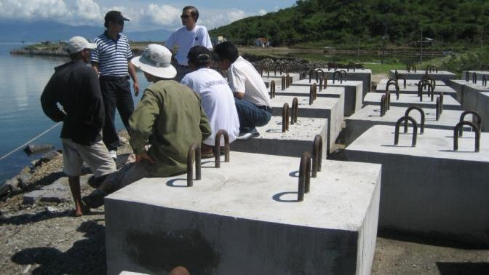
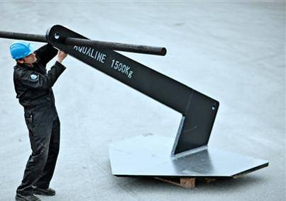
Equipment: Mooring designs and anchors
Often the only available ‘insurance’
‘Individual’ mooring
Frame or grid mooring
Picture Aqualine

Slide 16
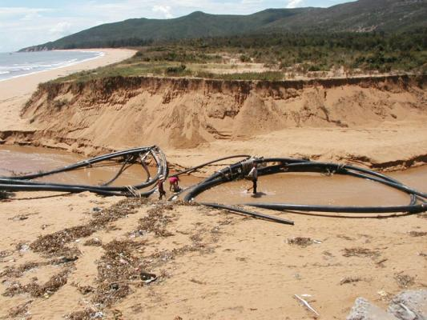
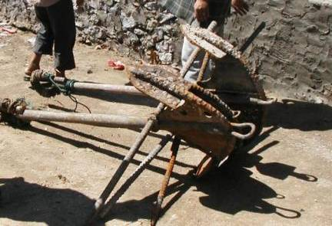
Equipment: Example of failed mooring
After typhoon
Fishing boat anchors

Slide 17
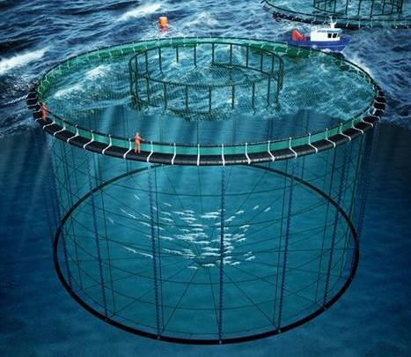
Equipment: Proven cage design
Some ‘rules of thumb’ for a (first time) investor:
Only choose sites which can be operated by proven cage designs.
The circle cage was launched commercially in 1974. At least 70 000 units installed
Let ‘scientific/pilot test farms’ or ‘veterans’ be pioneers in using new cage designs
Appreciate that depreciation (equipment) only contributes 3-5% of production costs. Get things right from the start. Remember also to spend time on important budget lines.
Simplicity: Few but correct dimensioned
components are easier to inspect
Aqualine

Slide 18
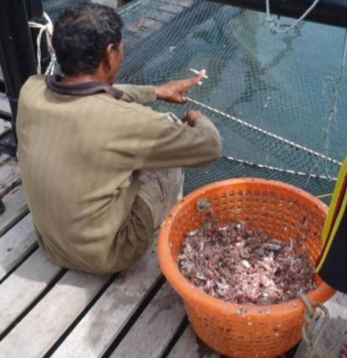
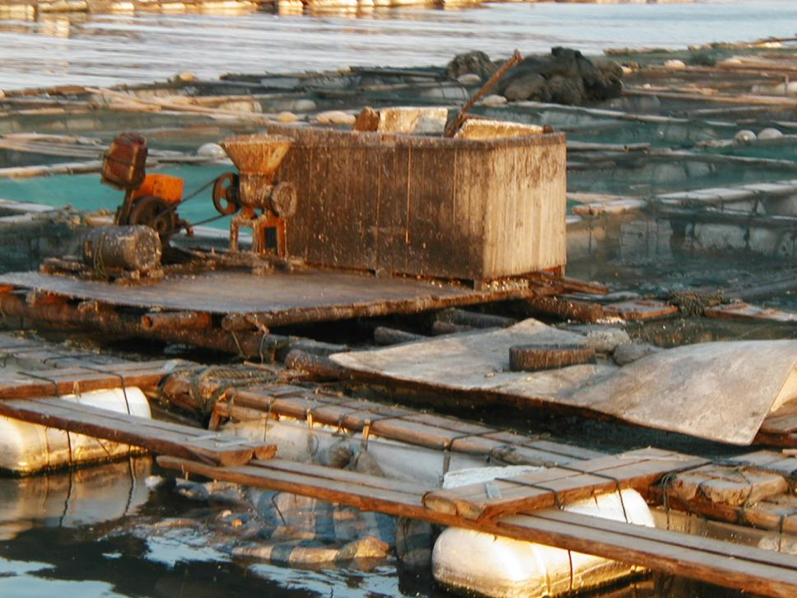
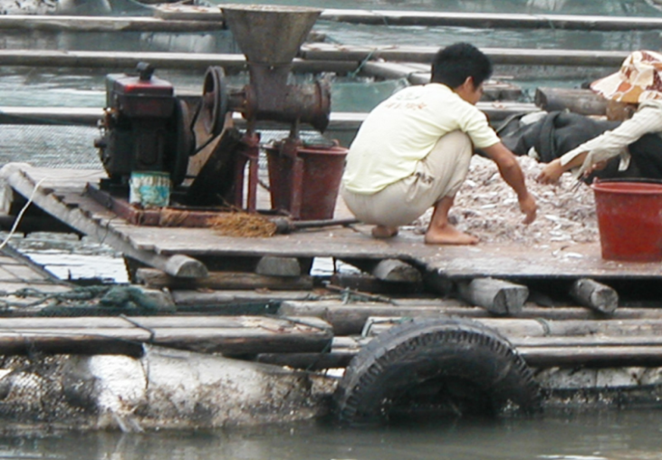
Biosecurity: Small-scale feeding approach
Fujian, China and Langkawi, Malaysia

Slide 19
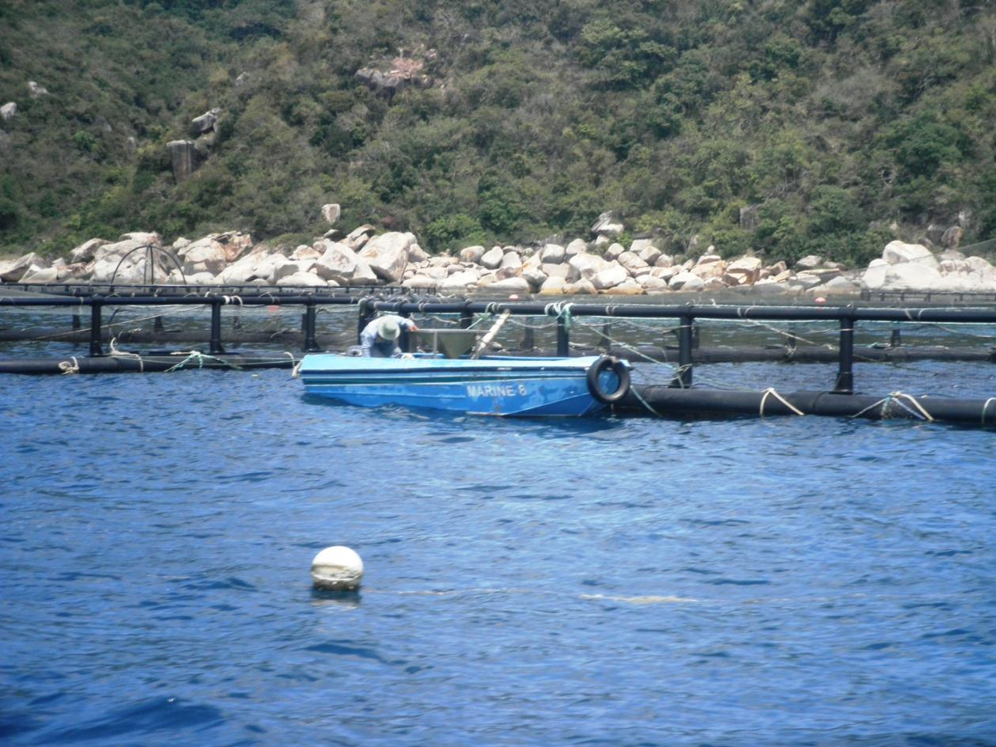
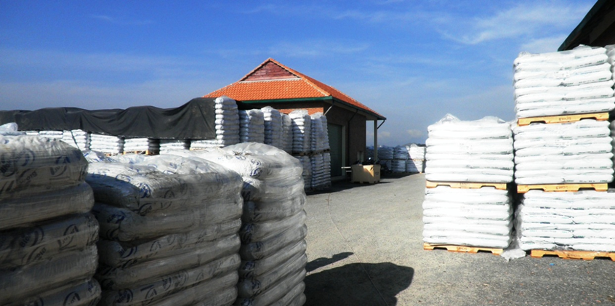
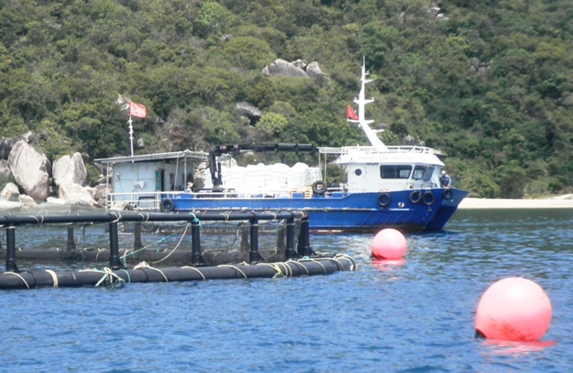
Biosecurity: Large-volume feeding approach
Feed blower, up to 10-14 tons pellets/day (15-25.000USD)
Marine Farms Vietnam

Slide 20
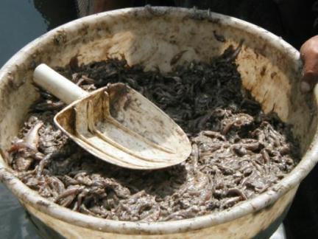
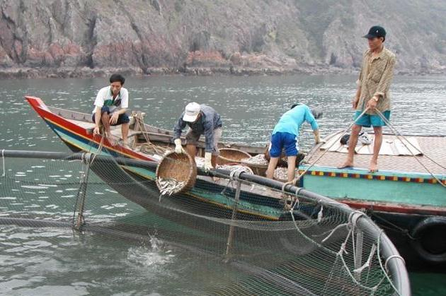
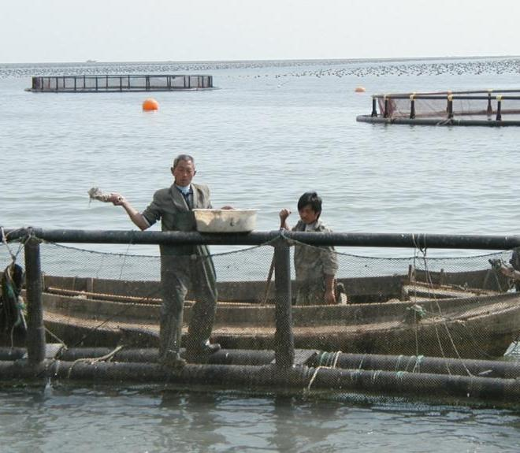
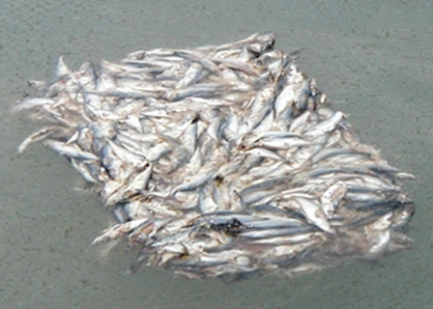
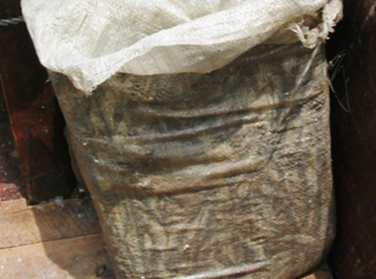
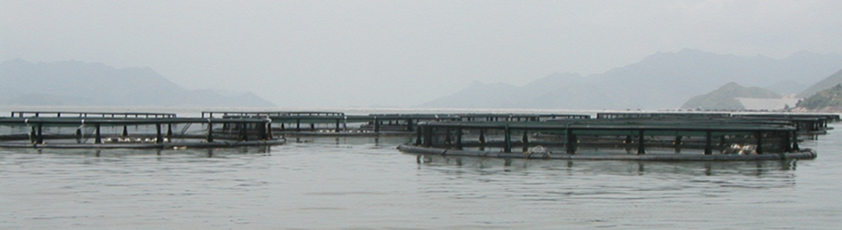
Biosecurity: Failed large-volume feeding
Nghe an, Vietnam and Qingdao and Fujian, China

Slide 21
Biosecurity: Trial-vaccination of cobia

Slide 22
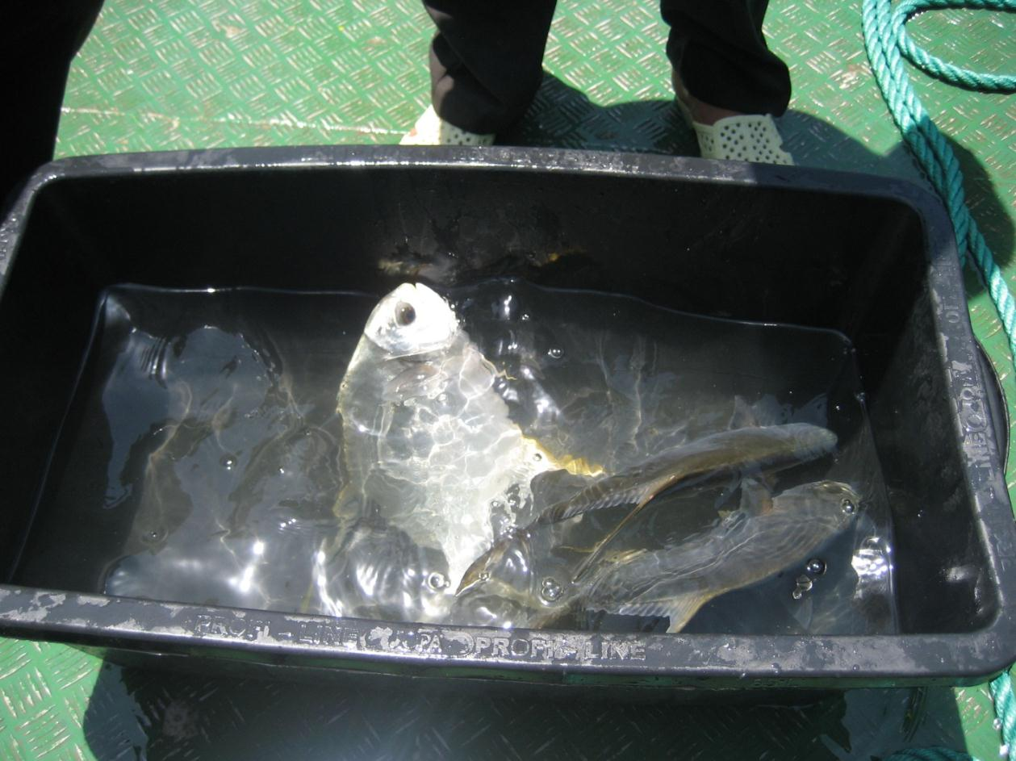
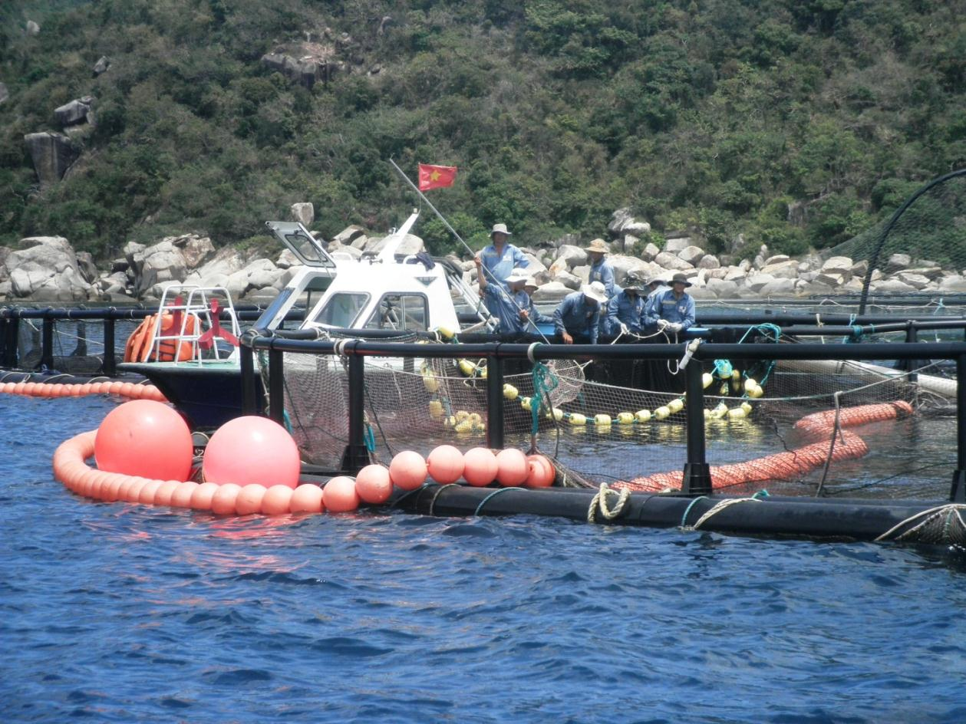
Biosecurity: Parasite check of pompano; corralling fish for freshwater bath

Slide 23
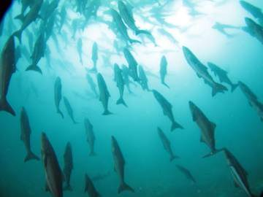
Processing/Quality/Market access
Increasing Global demand for fish, which capture fisheries cannot supply.
Food security. Demand for medium to low-valued fish, which can enter the fresh/chilled/frozen and value added market segments. For regional or WW distribution
Through “efficiency of scale” large-volume farming can supply:
  Traceable and consistent large volumes; utilising more exposed sites with good water quality
  Resulting in production costs low enough to farm species, which can enter processing
Picture: Dave Robb, EWOS

Slide 24
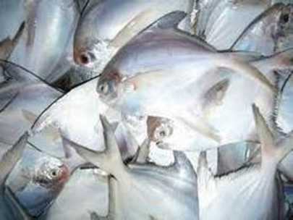
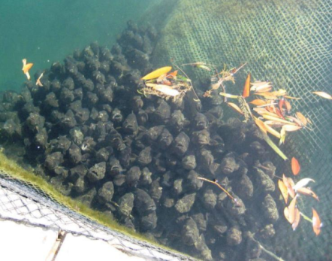
Species selection: Properties of marine fish suitable for food security production?
Large volume market
  Not damaged if supplied 50 tons
  White fish, especially regional market
  If can enter the sashimi segment,
  chances are good in the Global market
Suitable for fresh/frozen/processing
  Medium-value fish
Suitable biology i.e. growth and schooling behaviour
Availability of juveniles
  In large, consistent numbers
Which species in Asia?
  Pompano, snappers, sea bass,
  breams, croakers, cobia, yellowtails (and tuna)
  Not silver pomfret and groupers
Notes:
Silver pomfret is not feasible to farm: growth data from Kuwait: after 20 mths males average 139 g, and females 254 g

Slide 25
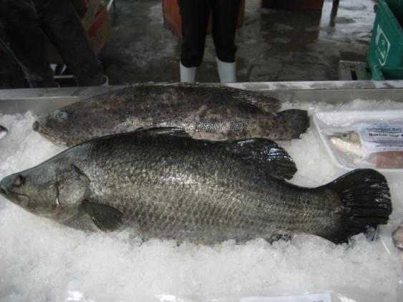
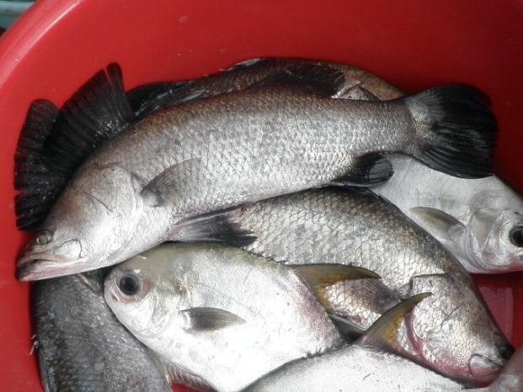
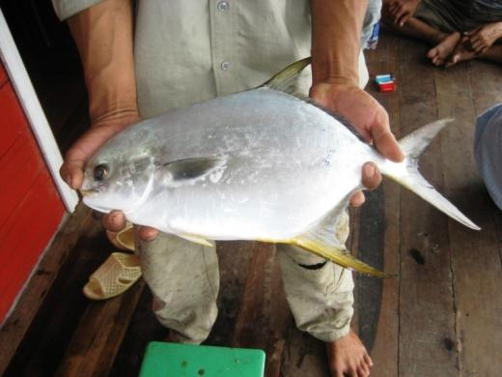
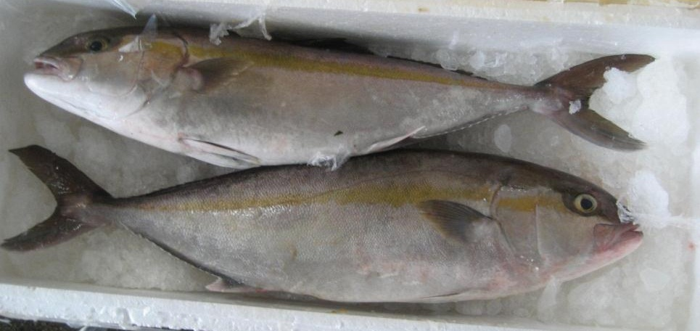
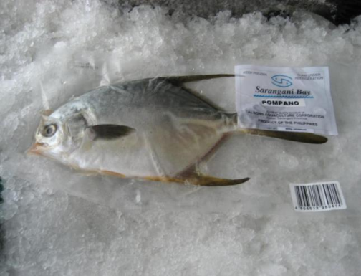
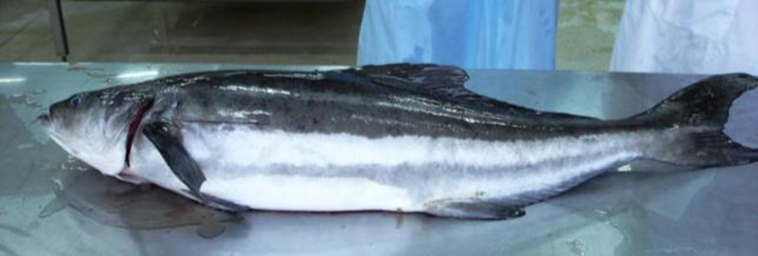
Species selection: Some candidates

Slide 26
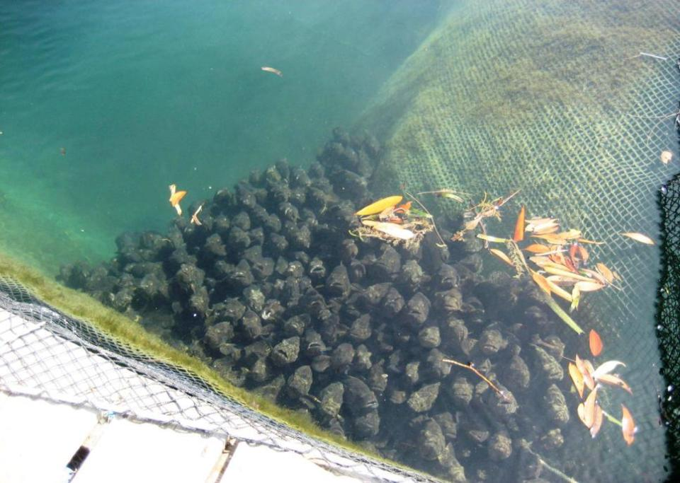
How can Norway contribute to increased aquaculture production in Asia?
  Assist in technology transfer of approach from large-volume farming – through private sector or capacity building of institutions for the benefit of food security and job creation
  Small-scale farming, which has an important social dimension in Asia, could be assisted to become a better sustainable business, more resource efficient and more productive if organised in clusters, achieving large-volume benefits such as efficiency of scale
  Challenges in implementing risk management?
    To a multispecies environment
    To an insufficient regulated farming environment
  \

Slide 27
Are GAP’s and certifications conducive for developing responsible and productive aquaculture business??
GAP in its Asian format is a method to introduce risk management to the small-scale farmers
But confusing certificate/consumer labels have emerged
  Scope unclear, inconsistent criteria between species, unscientific methodology -escapees when no genetic selection issue, nothing re. carbon footprint, animal welfare
  Strong commercial interest by the NGO’s themselves – a ‘consultant’ driven development; targeting producers and retailers for financing and not caring about the consumers they claim to represent.
  COOP – largest supermarket chain in Scandinavia - found that consumers cared most about food safety and price and only 2% knew the MSC brand.
Labels can be used in market distortion against Asia!

Slide 28
Market distortion against Asia
Monterey Bay Aquarium’s Seafood WATCH:
Table of sustainability ranks for cobia
Sustainability Criteria | Conservation concern
 | Low | Moderate | High | Critical
Use of marine resources |  | Recirculation (USA) | Ocean cages (Belize, Asia)
Risk of escaped fish to wild stocks | Recirculation (USA) Ocean cages (Belize) | Ocean cages (Asia)
Risk of disease and parasite transfer to wild stock | Recirculation (USA) |  | Ocean cages (Belize, Asia)
Risk of pollution and habitat effects | Recirculation (USA) | Ocean cages (Belize) | Ocean cages (Asia)
Management effectiveness | Recirculation (USA) | Ocean cages (Belize) | Ocean cages (Asia)

Slide 29
Market distortion against Asia
Recommendation for Cobia sourcing by Seafood WATCH
Overall seafood recommendation
Closed recirculation (USA): | Best Choice | Good Alternative | Avoid
Ocean cages (Belize): | Best Choice | Good Alternative | Avoid
Ocean cages (Asia): | Best Choice | Good Alternative | Avoid
The ONE promoted USA company produced 10 tons cobia in 2009 – i.e. 0.03% of the Global production
Will this attitude contribute to world’s food security??

Slide 30
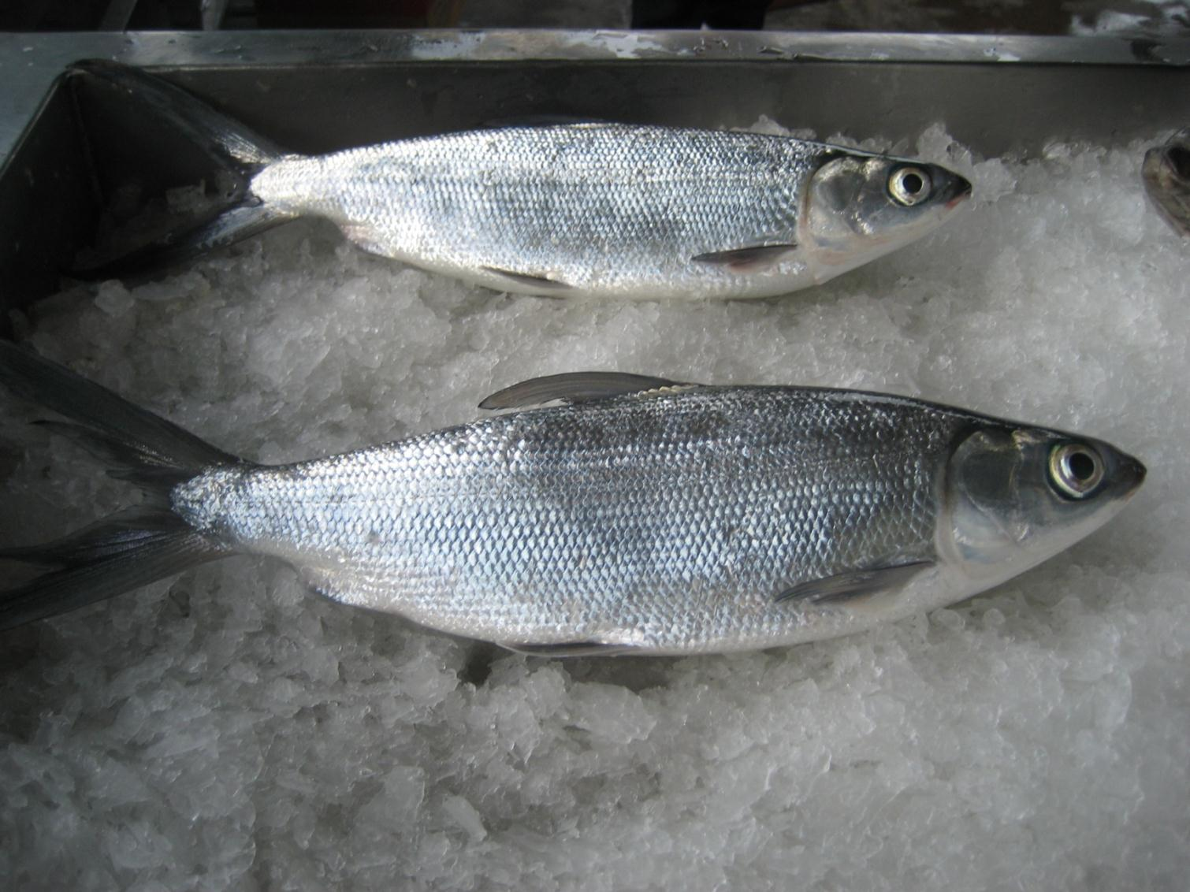
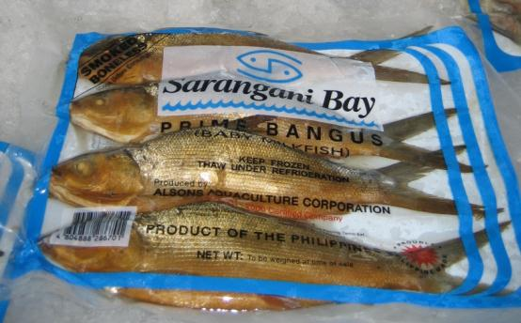
THANK YOU
The most farmed marine fish Milkfish >800 000 tons/year
One of the few farmed, omnivore marine fish, Indonesia, Philippines and Taiwan
Mainly regional/domestic and ethnic-expat markets

