Slide 1
International regulations, guidelines & market requirements
Simon Funge-Smith
Senior Fishery Officer
FAO Regional Office for Asia and the Pacific
Asia-Pacific Fishery Commission (APFIC)

Slide 2
FAO Food & Agriculture Organization of the United Nations
FAO Global body for food and agriculture
Global status and trends, technical understanding, advice, policy development , capacity building
FAO Committee on Fisheries (COFI)
Meets every two years
FAO members meet to discuss issues
Request FAO attention on helping to address them
Build global consensus
Sub-committee on aquaculture focusses on the sub-sector
In 1995 FAO members endorsed the Code of Conduct for Responsible Fisheries (CCRF)

Slide 3
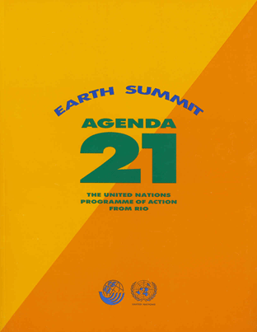
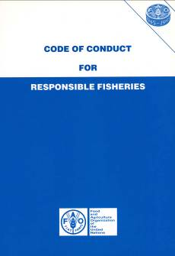
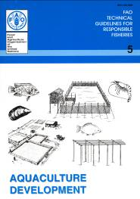
Sustainable Development
1992 UNCED, 2002 World Summit on Sustainable Development (WSSD-Johannesburg)
outlined the need for sustainable development
emphasized use of ecosystem approach
1995 FAO Code of Conduct for Responsible Fisheries (CCRF)
voluntary instrument
set out the guidance for responsible fisheries
FAO Technical guidelines progressively developed to further refine specific technical guidance
Some of these are internationally negotiated
e.g. Aquaculture certification guidelines, eco-labelling guidelines

Slide 4
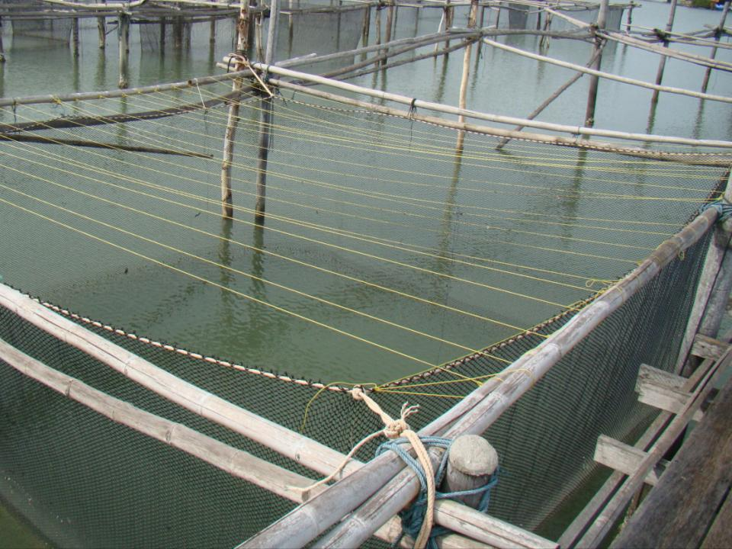
Responsible fisheries & aquaculture

Slide 5
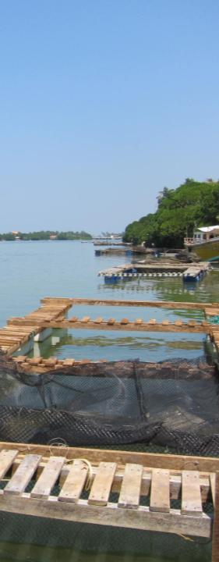
The CCRF is a code
The CCRF does not have explicit implementation details
It sets principles and describes the nature of responsible actions
Voluntary
Note that aquaculture is rarely managed across national borders
Rather difficult to actually implement?
The CCRF Technical Guidelines have more technical details
Enter the Ecosystem Approach to Fisheries (and aquaculture)…

Slide 6
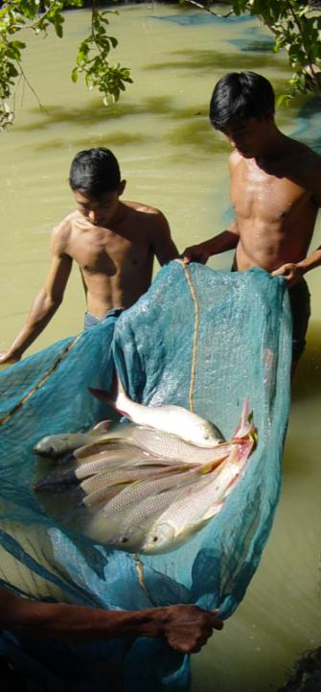
Ecosystem Approach to Aquaculture
When trying to manage fisheries or aquaculture
How do you balance the human dimensions, the ecological dimensions and the governance framework ?
How to trade off between:
loss of pristine environmental integrity, with economic development?
Short term versus long term?
Economic efficiency versus human livelihoods

Slide 7
Components of Ecosystem Approach
Sustainable Development
“Development which meets the needs of the present without compromising the ability of future generations to meet their own needs”
Ecological Well-being
Human
Well-being (social + economic)
Ability to achieve/ Governance

Slide 8
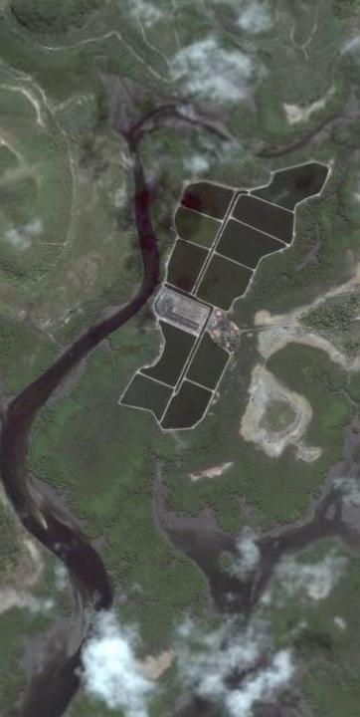
Take home message
EAF/EAA is a planning framework
It aims to balance human well-being, ecological well-being
uses stakeholder dialogue to identify issues,
prioritize them using risk analysis and
develop consensus around how to resolve them.
It is also a direct way to implement sustainable development

Slide 9
A few facts about the regions aquaculture

Slide 10
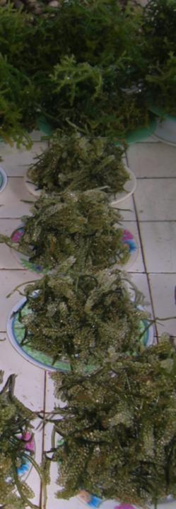
Regional contribution to world aquaculture in 2010
Asia-Pacific region produced 53.1 million tonnes of aquaculture products
(excluding aquatic plants)
6.5% annual growth over decade 2000-2010
89% of global aquaculture production
Total value of aquaculture products from the region was $95.2 billion
10.6% annual growth over decade 2000-2010
80 % of the global total
If aquatic plants are included
91% global total quantity
81% of global total value

Slide 11
Production of low value/trash fish species in the South China Sea region
Estimated at >8.3 million tonnes.
Proportion varies according to area
Consistently more than 20% of overall catch
Considerably higher for the trawl fisheries
typically 40% - 60%
Demand onshore for this is booming
aquaculture demand
Keeps fishing operations profitable
despite impact on fishery

Slide 12
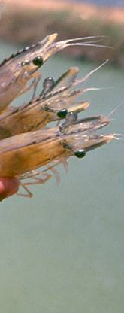
Key points
~6.5 million tonnes capture fishery fish direct feeding to aquaculture
Marine fish, crabs, lobster
~1.94 million tonnes directed to fishmeal
1.1 million tonnes produced in Asia
~56% from trimmings
2.18 million tonnes imported
3.2 million tonnes fish meal available
Current fishmeal demand for aquaculture is ~ 2.0 – 3.0 million tonnes

Slide 13
All of this production comes at some cost…..
Aquaculture feed remains a key constraint
Availability of quality feed for certain countries and commodities
High costs due to soaring prices of feed ingredient
Aquatic animal health problems for important species
EMS in shrimp culture
Large scale outbreak of disease in crucian carp in China
Low economic return to aquaculture farmers
Increasing cost s (fuel, labour)
Slack prices, typically shrimp, striped catfish

Slide 14
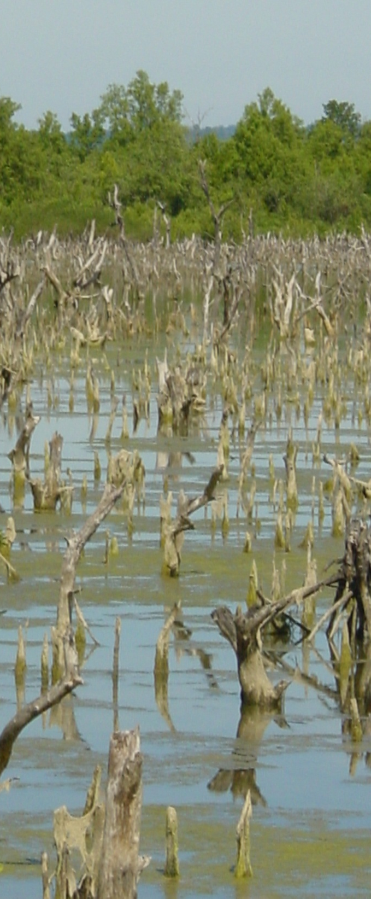
All of this production comes at some cost…..
Aquaculture seed quality remains a key constraint
Effective regulatory system and mechanism
Genetic degradation
Vulnerable to heavy losses due to extreme climate events
Especially flooding, coastal sea surges/storms
Loss of quality labour in aquaculture
in some countries due to urbanization and other social-cultural change

Slide 15
Food safety, eco-labelling & certification

Slide 16
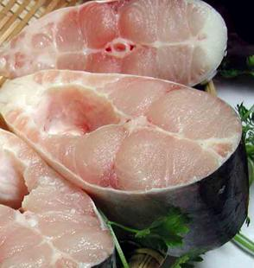
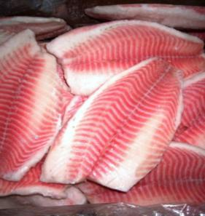
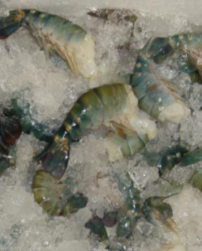
We started with food safety concerns
Export products were initially only scrutinized for food safety
Introduction of HACCP
and efforts to ensure hygiene in processing for export
Region rose to the challenge
Lingering concerns
irresponsible use of antibiotics and chemicals on intensive farms
Poor hygiene, contamination from industry and agriculture

Slide 17
The failure to address environmental sustainability, social impacts
Growing concerns over uncontrolled spread of aquaculture and its impacts (especially in coastal areas)
Aquaculture has grown at a pace that governance cannot hope to keep pace with
In fact, its rapid growth reflects the lack of regulatory constraints
This has led to over crowding, environmental impacts, social conflicts
Resulted in:
Trade barriers
Consumer concern
NGO advocacy

Slide 18
Rise of aquaculture certification
In response to these failures to manage
And the desire for consumer reassurance
Aquaculture certification has arrived to take the place of government regulation
It does not replace food safety - which on the whole is excellent in most export aquaculture products
But it does address farm level environmental impact and social impact to some extent.
Doesn’t really account for aggregated sector level impacts
These are where government regulation and/or assurance fails

Slide 19
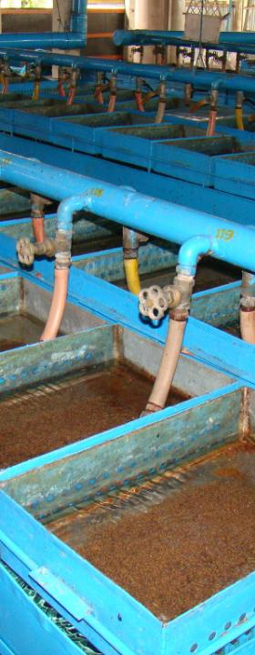
Is aquaculture certification a passing fashion?
Possibly…………..
commodities that can demonstrate good regulation may not need this
may remain an issue for pangassius & shrimp
Increasing interest in business to business
Problem at the moment is no way to differentiate between responsible and irresponsible producers
This opens the door to “sell” certification schemes
Tendency to choose schemes that lower the bar…..
Certification is a non-issue for products not targeted for export, or those traded within region

Slide 20
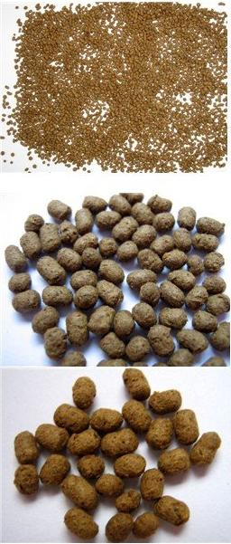
Certification that is too rigorous will be ignored
Rigorous criteria for some commodities
May be difficult to meet the standard
Meeting the fishmeal challenge will undermine all the schemes
all have commitments to reduce fishmeal or ensure it comes from responsible fishing
Region produces a lot of fishmeal from trimmings…but need to boost protein
Cost of the label and auditing deters farmers
End of the day
certification is not really doing farmers a favour
as all costs are passed on to farmers

Slide 21
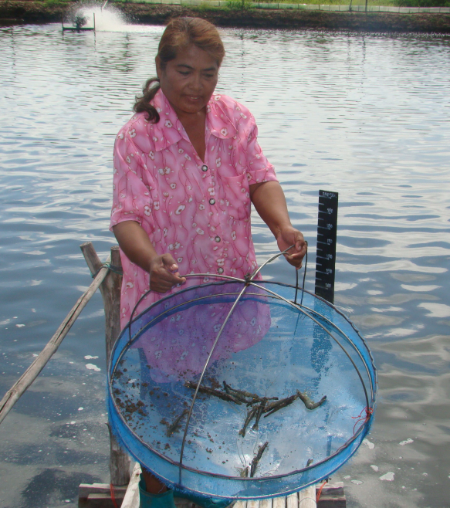
Good Aquaculture Practice (GAP)
Good aquaculture practice
Builds on the (Global )GAP for agriculture products
Arose from supermarket concerns
mainly food safety in the supply chain from developing countries
hygiene, pesticide residues etc
Focusses on minimum standards, principally for food safety
May have an environmental dimension
Rarely that rigourous.
Does not primarily address sustainability concerns

Slide 22
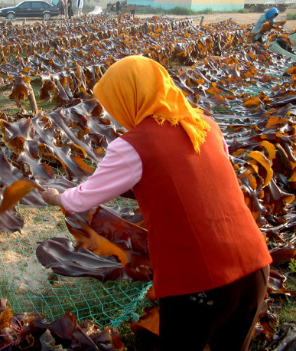
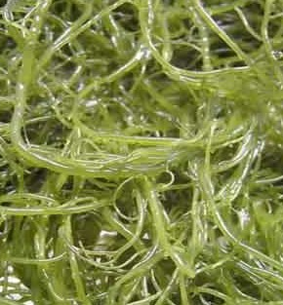
Technical Barriers to Trade (1)
Several key issues in the past 20 years
EU requirements for food safety, product quality, traceability…. shifting goalposts
Antibiotic detection
Contamination (malachite green)
USA anti dumping (turtle excluders, environmental cost, esp. shrimp)
US issue on labelling of pangassius as catfish (protection)
Australia (risk assessment of Asian shrimp - disease import)

Slide 23
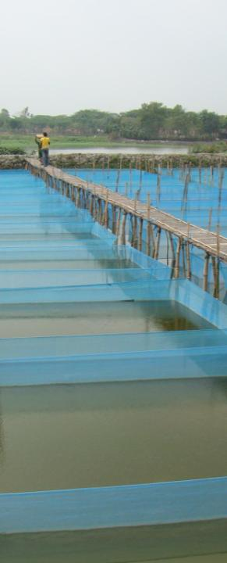
Technical Barriers to Trade (2)
Deliberately used?
Food safety
Detection sensitivity
100% testing
Until a country can develop mutual recognition agreement
Support countries to develop their capacity to monitor
Use of environmental costs
Non-accounting for wastes to environment
May not reflect differences between temperate and tropical systems
Environmental monitoring of systems producing key commodities

Slide 24
Technical Barriers to Trade (3)
Biosecurity
Used to try to limit import of cheap Asian products
Risk analysis, better aquaculture health monitoring
Traceability , documentation of origin etc.
Relatively easy to sort out species, country
Difficult for small farm production (each pond?)
Information/traceability systems, zoning, licensing
Note that few, if any of these are effectively resolved by aquaculture certification!

Slide 25
Next steps to support countries?
Focus on improving credibility of Government regulation of the sector:
Zoning
Health management
Environmental impact
Human rights
Food safety
Feed quality/certification
“mutual recognition” is a goal
food safety first,
but eventually on sector management
Emergence of government certification schemes
Cheaper
Only useful if credible standard
Supermarket B2B

