Slide 1



AIDS 2014 – Ending the adolescent AIDS epidemic
Ungdom og hiv
29.10.2014
Anne May Andersen, Norad

Slide 2
Unacceptable inequality: AIDS deaths rising among adolescents
Source: UNAIDS 2012 HIV and AIDS estimates

Slide 3
HIV and AIDS Among Adolescents
One in five people are aged between 10 and 19
2.1 million adolescents live with HIV - 1.7 million (82%) in Sub-Saharan Africa
In all other regions: HIV concentrated in key populations
HIV is now the second leading cause of death among adolescents, 300 deaths every day

Slide 4
A Tale of Two Epidemics
New HIV Infections in Adolescents in 20 Countries with Highest Number of New HIV Infections, 2012

Slide 5
Results: M:F Annual AIDS Mortality Risk Ratio
Source: UNICEF analysis of UNAIDS, 2012 HIV and AIDS estimates

Slide 6
Results: Annual AIDS Mortality Risk
Source: UNICEF analysis of UNAIDS, 2012 HIV and AIDS estimates

Slide 7
4
What is needed?
Invest more and invest smarter in adolescents
Deliver what works and strengthen Data on adolescents
Empower and Engage adolescents
Accelerate our response

Slide 8

Investment Framework (IF)
Reduce Risk
Reduce the likelihood of transmission
Reduce mortality and morbidity
Basic Programme Activities
PMTCT
Condom promotion and distribution
Key populations
Treatment care and support to PLWH
Male Circumcision
Behavior Change programmes
Critical Enablers
Social Protection, Education, Legal Reform, Gender Equality, Poverty Reduction, Gender-Based Violence, Health Systems (inc. STI treatment & blood safety), Community Systems, Employer Practices
SYNERGIES WITH DEVELOPMENT SECTORS

Slide 9
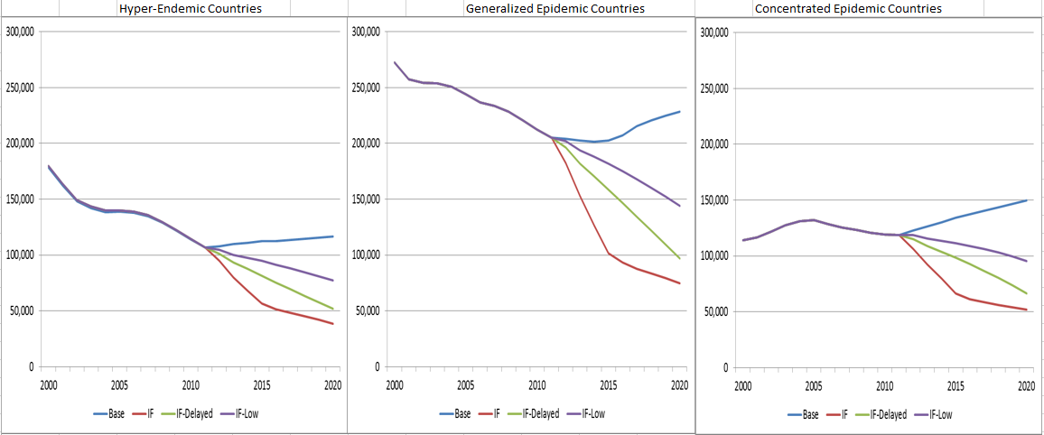
Smarter investments can
decrease new infections
New HIV Infections
Generalized epidemic settings
Source: Stover, J. et al., JAIDS. (66) Jul, 1, 2014

Slide 10

Effective combination prevention:
Cash, care and HIV-risk for adolescents in South Africa
L Cluver, M Orkin, M Boyes, L Sherr
IAS, July 2014

Slide 11
Poverty & family AIDS predict adolescent HIV-risks: how?
2011
Structural deprivation
2012
HIV-risk behavior incidence
Hunger
Transactional sex
Age-disparate sex
Sex using substances
Multiple partners
Unprotected sex
Pregnancy
Community violence
Parental HIV/AIDS
all p<.001
Informal settlement
controlling for: baseline HIV-risk, age, gender

Slide 12
South Africa: Child grant reduces incidence & prevalence of transactional sex and age-disparate sex for girls
No cash transfer
Child cash transfer
Cluver, Boyes, Orkin, Pantelic, Molwena, Sherr (2013). The Lancet Global Health.

Slide 13
Estimated Resource Needs for Adolescents: Modeling Results
Sector Synergies
40%
Enablers
25%
Programs
33%
Source: Stover, J. et al., JAIDS. (66) Jul, 1, 2014

Slide 14

Tailored DELIVERY
Informed by DATA

Slide 15
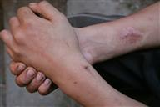
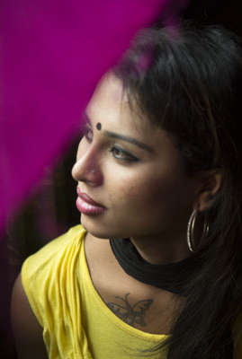
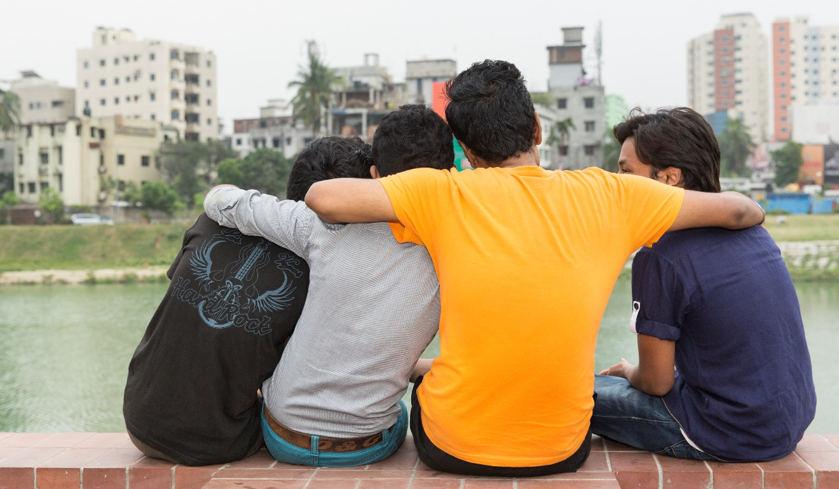
Adolescent Key Populations

Slide 16
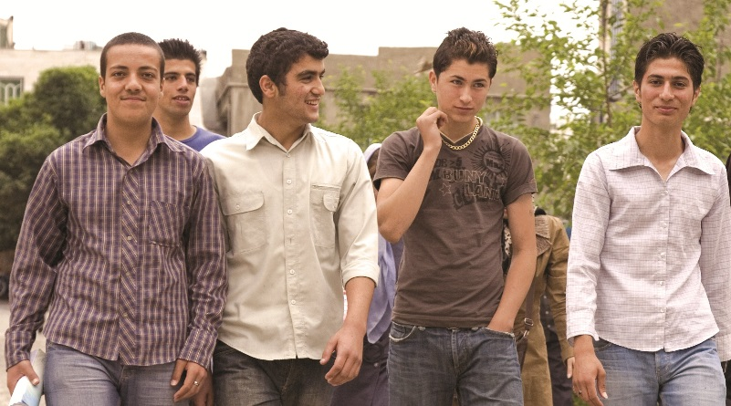

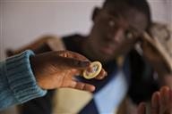


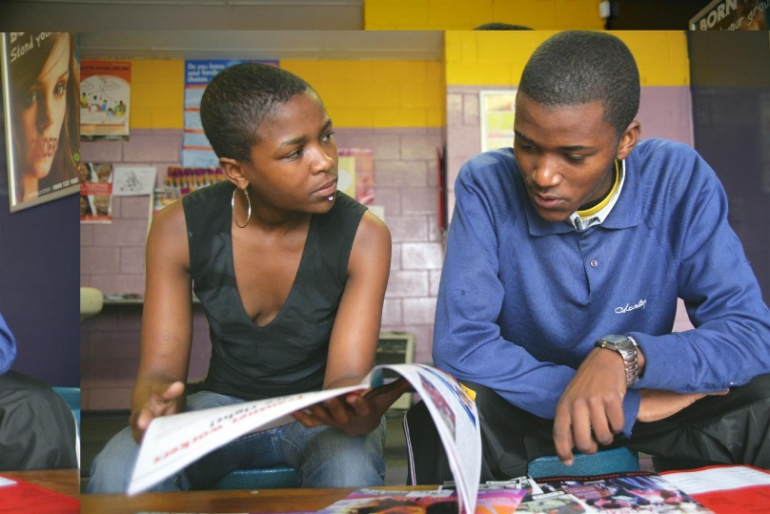
EMPOWER & ENGAGE Adolescents

