Slide 1
Asia Regional Seminar on Aquaculture for Embassies, Norad and fisheries advisers - Bangkok 16-17 January 2013 -
Johán H Williams, Specialist Director
President North East Atlantic Fisheries Commission (NEAFC)
Chair FAO Fisheries Committee (COFI) 2012 - 2014

Slide 2
Norwegian Aquaculture Policies, Management, Institutions, Knowledge and Future Development Cooperation - highlites -
Johán H Williams, Specialist Director
President North East Atlantic Fisheries Commission (NEAFC)
Chair FAO Fisheries Committee (COFI) 2012 - 2014

Slide 3
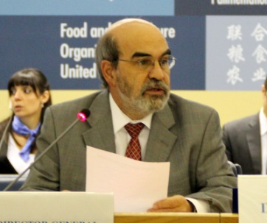
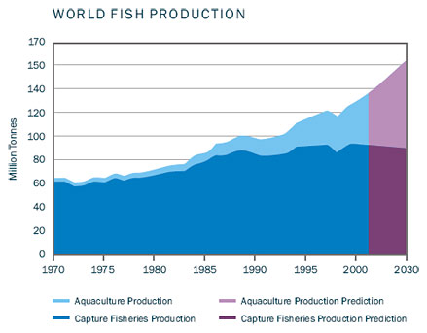
FAO, Norway and Aquaculture - I
Asia Regional Seminar
Norwegian initiative to establish the Sub-Com
Until recently Norway has not been very active
Change;
Norway recognize FAOs role as the normative global organization on aquaculture (as well)
Norway has therefore participated very active in FAOs work on Aquaculture Certification
Norway’s positions have been;
Guidelines will fast influence trade, and therefore terminology has to be consistent with WTO, CODEX, OIE, ISO
Consistency, as far as applicable, with Guidelines for marine capture fisheries

Slide 4
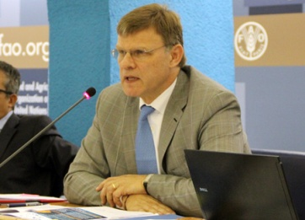
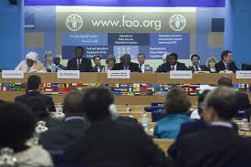
FAO, Norway and Aquaculture - II
Asia Regional Seminar
The scope might be to broad – if encompassing animal welfare, social responsibility, food safety, product quality in addition to environmental
Norway have taken a middle position – leave animal welfare and social responsibility out in Guidelines ”generation 1” – but protocol that this will be included in future – ”generation 2”
Danger with to many aspects included in Guidelines that it becomes a ”pick-and-choose-menu”- Norway supported that minimum requeirments need to be fullfilled at all areas included in the Guidelines
Special softer requierments for Small Scale Farmers shall not include less on food safety and animal welfare
FAO shall not certify
FAO shall not benchmark

Slide 5
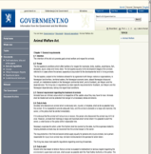
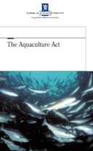
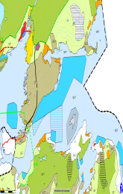
What are the success-factors in Norwegian Aquaculture Development ?
Asia Regional Seminar
Conserted action I/R/A
Tradition for regulations
Controlled growth
Strong ’public eye’
Managed / Controlled by several independent authorities under several laws
Focus on One Sustainable Pillar
Spatial Planning / Carrying Capacity
Still much unsolved
Green Growth

Slide 6
Asia Regional Seminar
Norwegian Aquaculture Governance structure – law enforcement agencies
Maritime safety
Fish health risk
Ministry of Fisheries
and Coastal Affairs
Pollution
Ministry of the
Environment
Operational risk
The Norwegian
Coastal
Administration
Norwegian Food
Safety Authority
Norwegian Pollution
Control Authority
Directorate
of fisheries
Regional offices
Freshwater management
Technical risk
Ministry of Trade
and Industry
Ministry of Petroleum
and Energy
County
Governor
Norwegian Water
Resources and
Energy Directorate
(Private)
Inspection Bodies
Regional
office
Industry
Aquaculture
industry
Regulatory body
Control authority
Operational control
authority
Operational control
authority
Control authority
Regulatory body

Slide 7
Government controlled Growth rate
Asia Regional Seminar

Slide 8
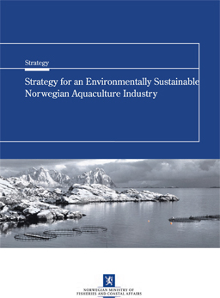
The Norwegian Strategy for environmental sustainable Aquaculture
Asia Regional Seminar
Significant growth over the past 20 years
Experienced challenges
The strategy identifies 5 focus areas, where aquaculture have impact on the environment
Genetic interaction
Pollution
Diseases
Spatial planning
Feed resources
Future Growth = Green Concessions = Group of Experts decide = Beauty Contest

Slide 9
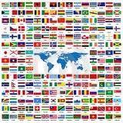
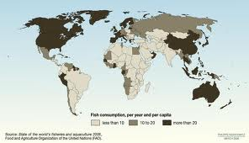
Let us leave Norway – and take a look at Global challenges
Asia Regional Seminar

Slide 10
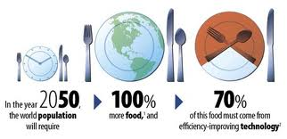
Rio+20 ”The Future We Want” Declaration
Asia Regional Seminar
1 The three dimensions of sustainability
2 Humanity freed from poverty and hunger
21 9 billion people by 2050
32 Country specific challenges
52 Farmers and fishers important
113
“We also stress the crucial role of healthy marine ecosystems, sustainable fisheries, and sustainable aquaculture for food security and nutrition, and in providing for the livelihoods of millions of people”

Slide 11
The Fish as Food Decade ?
Asia Regional Seminar
2010 – 2020 Challenges;
World Population increase
World’s food production systems are unsustainable
Managing the contribution of the food system to the mitigation of climatechange;
Maintaining biodiversity and ecosystem services while feeding the world
The Global Paradox;
1 Billion People Worldwide are starving
1 Billion People Worldwide are obese
Fish/Seafood is the answer to both
challenges due to its nutritional values

Slide 12
Aquaculture Development in Asia – any relevant Norwegian Contribution ?
Asia Regional Seminar
NOK NOK NOK NOK
and …………………………………………..
Legislation
Organization of Authorities
Inatitutional Support / Training
Managing the Production Systems /HACCP
Value Chain organization – Quality assurance
How to mobilize all relevant ”knowledge-full” bodies
to join forces to contribute to the common good ?

Slide 13
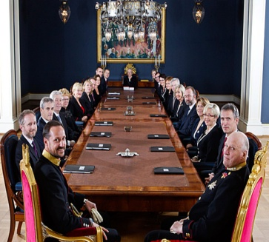
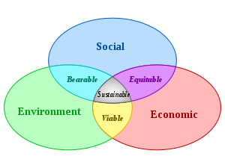
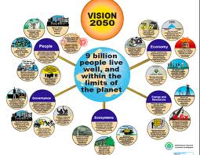
Norwegian Government Development Cooperation Policy Paper Focus Areas
Asia Regional Seminar
Cabinet Decision 22. August 2012
2013 Budget Tematic Profile :
1 Climate/Forest
2 Renewable Energy
3 Fair
4 Health
5 Education
Food Security; including Agriculture, Fisheries and Aquaculture (explicitly)

Slide 14
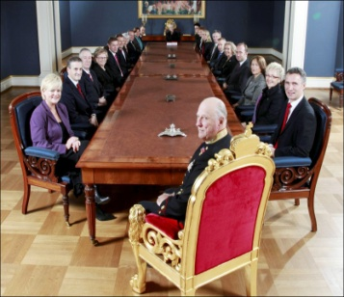
Joint Cabinet Document. Minister for Development Cooperation & Minister for Fisheries and Coast - I
Asia Regional Seminar
White Paper to be presented to Parliament Spring 2013 – ”Norway The World number One Seafood Nation” – Chapter 9 ”Development Cooperation”
Ministry of Foreign Affairs is the Responsible Ministry
Stresses the importance that Ministry of Fisheries and its subordinate bodies to a larger extent are engaged in the implementation of the development policy
The reason; Norway have outstanding (very good) (special) knowledge in fisheries, in aquaculture and in general in marine resource management

Slide 15
Joint Cabinet Document - II
Asia Regional Seminar
It is found of importance that this knowledge, in a more structured way than so far, is used to secure the best quality possible on Norwegian development activities in these areas
Therefore :
The Ministry of Foreign Affairs and the Ministry of Fisheries and Coastal Affairs will establish an Advisory Group that shall;
advice in general on
undertake Quality assessment of
future activities in fisheries, marine resources and aquaculture supported by Norwegian development cooperation funds

Slide 16
Ministry of Fisheries (and aquaculture) and Coastal Affairs respons ;
Asia Regional Seminar
Defining Development Cooperation as a Core Task
Reorganize (Department for Fisheries and Aquaculture Management)
Establish a Unit for Development Cooperation (small but very effective :-)
Annual Budget Allocation Letter to Sub-Ordinate Institutions will include Development Cooperation at same Priority Level as National Obligations

Slide 17
Asia Regional Seminar
Ministry of Fisheries and Coastal Affairs -
Subordinate agencies and institutions
Ministry of Fisheries
and Coastal Affairs
The Fishery
and
Aquaculture
Industry
Research
Fund
NIFES¹
Institute
of Marine
Research
National
Coastal
Administration
Directorate
of Fisheries
Norwegian
Food Safety
Authority²
National
Veterinary
Institute³
The Guarantee
Fund for
Fishermen
Innovation
Norway
5 district offices
7 regional offices
8 regional offices
The Research
Council of Norway
63 district offices
Nofima
The Norwegian
Seafood Export
Council
¹ The National Institute of Nutrition and Seafood Research
² Affiliated institution
³ Affiliated institution
SECORA AS

Slide 18
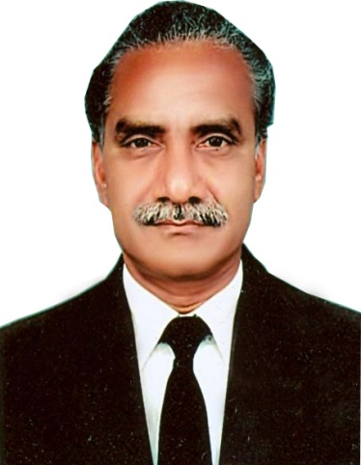
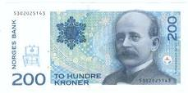
Asia Regional Seminar

Slide 19
Asia Regional Seminar

