Slide 1
Chasing Moby Dick…
Contextual Choices in Fighting Corruption
Alina Mungiu-Pippidi
Hertie School of Governance
pippidi@hertie-school.org
www.againstcorruption.eu

Slide 2
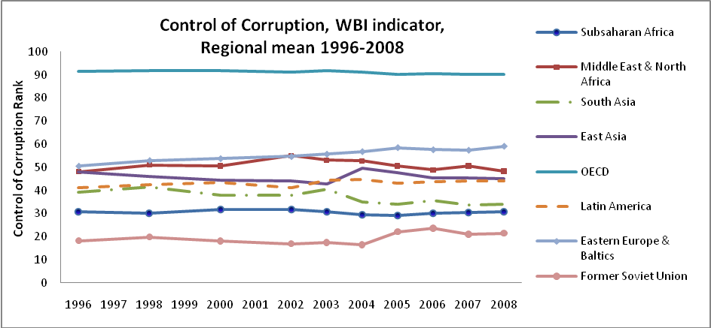
Elusive progress

Slide 3
Few performers…
Historical achievers | Early achievers | Contemporary achievers | Partly free or not free achievers | Borderline
Belgium | Australia | Estonia | United Arab Emirates | Ghana
Austria | Canada | Spain | Hong Kong | Georgia
France | New Zealand | Slovenia | Singapore | San Salvador
Denmark | Ireland | Portugal | Bhutan | Czech Republic
Finland | Japan | St Kitts and Nevis |  | .etc…
Luxemburg | Iceland | Uruguay |  | Cape Verde
Liechtenstein |  | St Lucia |  | Mauritius
Netherlands |  | Barbados |  | Poland
Norway |  | Antigua and Barbuda
Sweden |  | Bahamas
Switzerland |  | Chile
UK |  | St Vincent and the Grenadines
USA |  | Botswana
Andorra |  | Taiwan
Bavaria |  | S. Korea
Prussia |  | Malta West Germany

Slide 4
Why so little progress?
1. Confusion about objectives: we try to change whole governance regimes, not just fight illegal corruption
2. Indicators insensitive to change
and
3. Instruments are therefore not quite up to the task

Slide 5
Theoretical critique
Corruption always defined at the individual level, as deviation from norm of integrity/universalism, with societal context marginalized
Governance= formal and informal institutions determining who gets what in a polity
Governance regime = salient and stable rule of the game
Norm-infringing instruments versus norm building

Slide 6
Main categories Weber/Talcott Parsons
Particularism - a social mode of organization in collectivistic societies, where standards for the way a person is treated (including by the state, but not only) depend of the group the person belongs to; includes vertical favoritism (patronages, clientelism), horizontal (networks), kinship and ethnic based favoritism, bribe
Universalism - the practice of individualistic societies, in which persons are treated similarly regardless the group they belong to
Which one is the rule of the game (majority of transactions carried in this particular way?)

Slide 7
Governance regimes
 | Limited access order |  |  | Open access order
 | (Neo) Patrimonialism | Competitive particularism | Borderline
Power distribution | Hierarchical with monopoly of central power | Stratified with power disputed competitively | Competitive with less stratification | Citizenship. Equality
State autonomy | State captured by ruler | State captured in turn by winners of elections | Archipelago of autonomy and captured ‘islands’ | State autonomous from private interest (legal lobby , etc)
Public allocation (services, goods) | Particular and predicable | Particular but unpredictable | Particular and universal | Ethical universalism
Separation private-public | No | No | Poor | Sharp

Slide 8
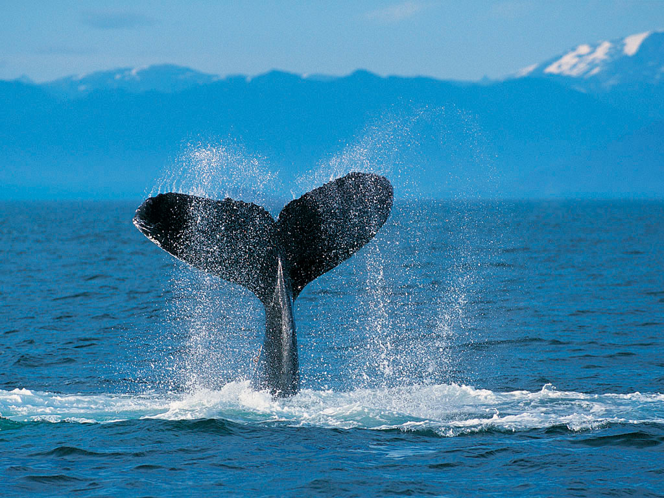
Particularism– the warning….
The duty officer on the Titanic noticed the upper tip.
But it was the iceberg’s part under the water which hit and sunk the ship.

Slide 9
The problem with instruments
Very few instruments allow discerning the 2 key policy features we need for policy design:
1. What is the exception and what the norm in a particular category of transactions?
2. Is this changing?
All aggregate and subjective indicators fail to do this

Slide 10
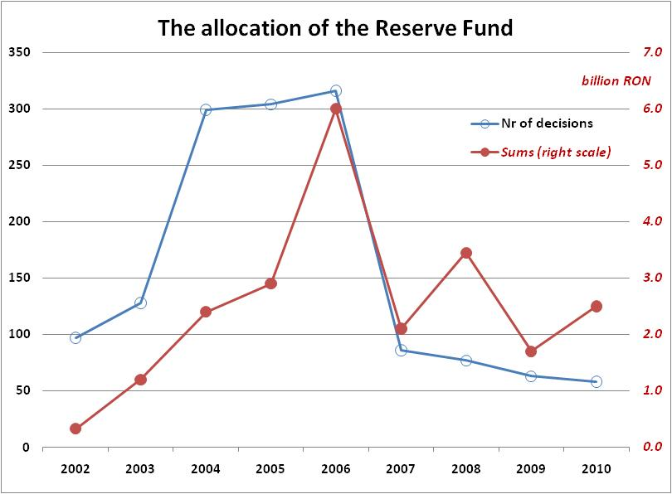
Policy indicators 1: measuring favoritism in allocation of public funds
ROMANIA’S NATIURAL EMERGENCIES FUND ALLOCATION | 2004 (SDP) | 2008 (Liberals) | 2010 (Democrat Liberals)
Share of funds for main govt party % | 49 | 45 | 62
Share of vote in local elections of govt party % | 36 | 16 | 29

Slide 11
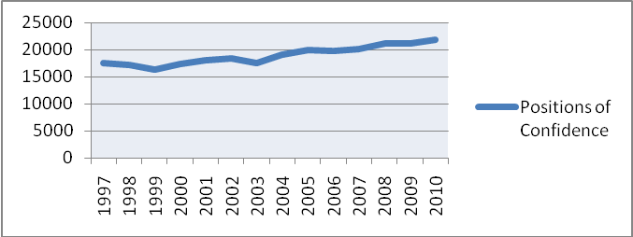
Policy indicators 1: measuring favoritism in allocation of public jobs
Evolution of ‘Confidence’ and Gratification Positions in
the Brazilian Executive Federal Government, December 2010

Slide 12
Klitgaard 1978
Corruption = Monopoly + Discretion– Accountability
Governance regimes= equilibria
Mungiu-Pippidi 2010
Corruption/control of corruption
=
Resources (Power + Material resources)
–
Constraints (Legal + Normative))

Slide 13
Understanding governance regimes
Resources > Constraints = Particularism/Neo-P
Constraints>Resources= Universalism/Good governance/control of corruption
Good question: How can we change from particularism to universalism?
How far can we manipulate resources or constraints by policy, as external agents?

Slide 14
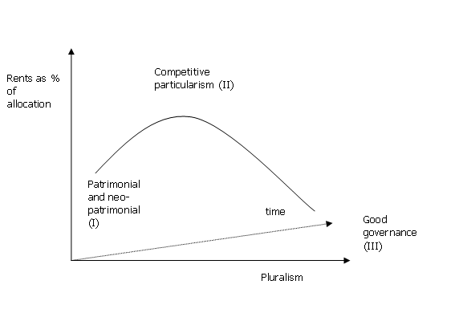
Evolution in time for corruption and democracy

Slide 15
MODE;L EXPLAINING CONTROL OF CORRUPTION
MATERIAL RESOURCES
Informal Economy (% of GDP) | -0.017***
 | (-0.004)
Ease of Doing Business (1-183; 1 is best environment) | -0.004**
 | (-0.001)
Fuel Exports (% of merchandise exports) | 0.001
 | (-0.002)
POWER RESOURCES
Number of Years Ranked 'Free' (0-38; 38 is most ‘Free’ years) | -0.006
 | (-0.006)
NORMATIVE CONSTRAINTS
Internet Users (per 100 inhabitants) | 0.013***
 | (-0.003)
Protestant Religion (% of population in 1980) | 0.004
 | (-0.002)
Civil Society Organizations (per 100.000 inhabitants) | 0.007*
 | (-0.003)
Personal Autonomy and Ind. Rights (0-16; 16 is most autonomy) | 0.073**
 | (-0.027)
LEGAL CONSTRAINTS
Independent Judiciary (0-2; 2 is most independent) | 0.188*
 | (-0.077)
CONTROL
HDI (0-1; 1 is most developed) | -0.39
 | (-0.568)
Constant | -0.091
 | (-0.397)
N | 114
R2 | 0.839
Also tested, insignificant
UNCAC
-ACA
-Ombudsman
-Presidentialism
Unicamerailism
Electoral system-----Constitutional Courts
Tested, sign in diff versions:
FOIA
- Media freedom
-Ethnicity
Mineral resources

Slide 16
The impact of FOIAs

Slide 17
The impact of UNCAC

Slide 18
The impact of ACAs

Slide 19
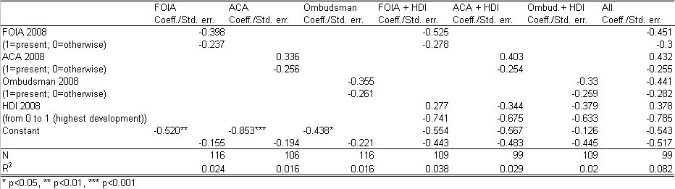
Institutional transfers - ICRG Change in Corruption 1988/2008

Slide 20
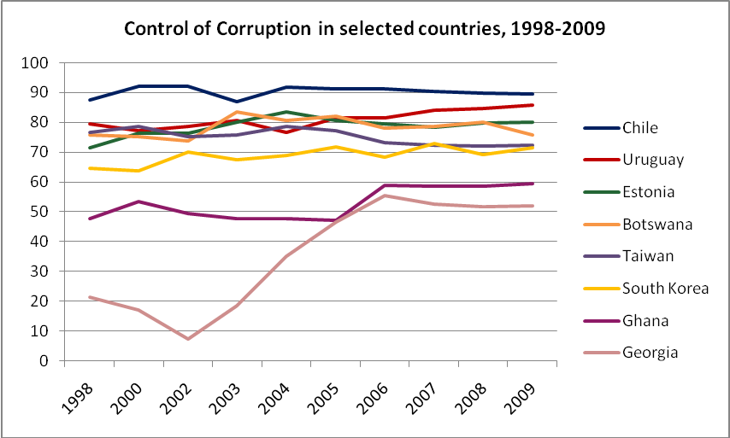
Tipping points? Or any tips?

Slide 21
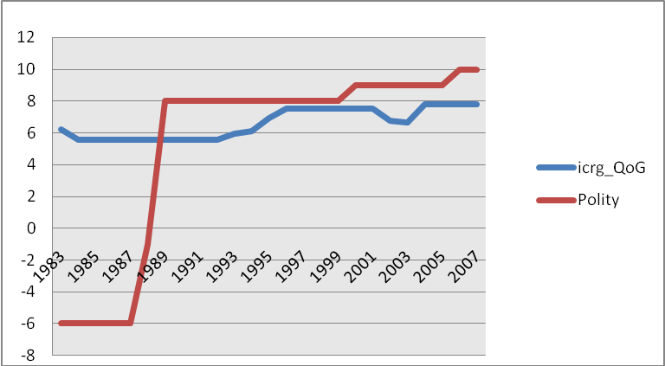
Chile – GG first

Slide 22
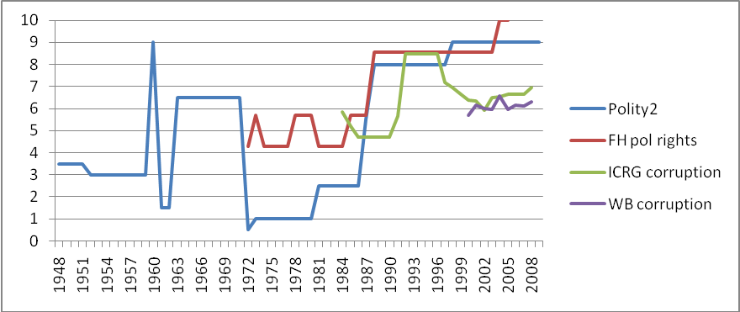
S Korea
Paths are disputed all the way….

Slide 23
And not linear…
Eastern Europe…

Slide 24
Poland – the democracy/governance gap…

Slide 25
Explaining contemporary achievers – main lessons
Not one single institution explains achievers cases, which present great variation across the group
None evolved on behalf of legal constraints alone; reducing resources and increasing normative constraints was the main element (except Botswana)
Emulation worked better than conditionality

Slide 26
Explaining historical achievers – main lessons
Two European paths:
- less complex and numerous communities reached good governance already in medieval times on the basis of community participation – good designs
- complex larger European countries evolved thru enlightened monarchies which developed bureaucracies against challengers and reached GG prior to introduction of universal franchise; independence of judiciary was last. Models hard to reproduce, as democracy and modernization multiply resources of corruption

Slide 27
 | Neo-patrimonialism | Competitive particularism | Borderline | Requirements as to govt participation
Power resources | Support for groups challenging power monopoly, civil society | Cash on delivery for adoption of FOIA and second generation FOIA legislation, domestic conflict of interest laws, red tape cuts |  | Minimal; requires just adoption, not implementation; maximal in NeoP
Material resources | cash for delivery against privatization of natural resources, budget transparency | cash for delivery against privatization of natural resources, budget transparency Formalization programs when income > 3000 | cash for delivery against privatization of natural resources, budget transparency | Medium; requires implementation in good will
Normative constraints | Internet infrastructure support community level Media and civil society watchdogs support | Internet infrastructure support community level Media watchdogs support | Internet infrastructure support community level Media and civil society watchdogs support | None
Legal constraints | Political pressure for judicial independence | Cash on delivery/cash for delivery against judiciary political and material autonomy; support for legal education | Technical support for judiciary | Large

Slide 28
Steps and sequences…
1. Diagnose and find indicators allowing measuring rules of game in time
2. Lay the grounds waiting for windows of opportunity
3. Search for ‘losers’ and help them build drivers of change coalitions
4. Cash on delivery for adoption of institutional weapons in a functional state; drying resources
5. Internet and support for watchdog media
6. UNCAC national review boards inclusive of significant NGOs, media

Slide 29
Some successful designs, more models and all case studies on
www.againstcorruption.eu

Slide 30
