Slide 1

Long Term Perspectives on the Response to the Indian Ocean Tsunami, 2004
Joint Evaluation Findings
Public Presentation
Oslo, 19 October 2009

Slide 2
The Tsunami:
Catastrophic and unique in scope
225,000 lives lost in a few hours across the ocean
Billions in damages, unprecedented efforts, some 10 billion € in donations
A remarkable demonstration of solidarity, along with processes of political change and development.
Four years after the disaster is a good time to take stock of the response.

Slide 3
This is an evaluation of LRRD: Linking Relief, Rehabilitation and Development – the focus is management.
Has there been relevant and effective interaction between actors and types of aid, judged from the results achieved?

Slide 4
This evaluation is on a key weakness repeating itself: the absence of linkages .
We conclude that this considerable effort achieved only a ‘ripple’ of impact – set against the massive destruction of the tsunami, and the force of pre-existing conditions.

Slide 5
Evaluation, particularly « joint » evaluation, seeks to link assistance and change…
Thanks to relief actors?
Suffering is alleviated
The challenge of LRRD evaluation:
only part of the picture
LRRD
Poverty patterns change
Communities adapt
to change
Thanks to rehabilitation investments?
Because of poverty reduction?

Slide 6
Evaluation Methodology
7,775 documents
reviewed, 800
analysed in depth.
Bodies of knowledge
were mapped.
Documents
Mobilisation
& Planning
659 respondents
Interviewed over
one month in three
countries (incl.
Villages) and at HQ
Qualitative Inquiry
Case Study & Preparation
Documents
Interviews
2,143 respondents
from the tsunami
affected areas interv.
on their perceptions
Quantitative Survey

Slide 7
Three steps to the conclusions:
Seven Months
A large Steering Group
From Six Gov: Sida, Netherlands, Danida, Norad + Indonesia & Sri Lanka
A team of 14 consultants (60% Asian) + local teams
Seven months in total

Slide 8
Three steps to the conclusions:
Seven Months
Seven deliverables
A large Steering Group
From Six Gov: Sida, Netherlands, Danida, Norad + Indonesia & Sri Lanka
A team of 14 consultants (60% Asian) + local teams
Seven months in total
3 printed reports in 3 languages
Report on survey results
4 presentations in Europe and 4 in countries in the region
A report on learning on the implementation of joint evaluations

Slide 9
Findings about Joint Evaluations:
4 Key Findings:
Still a need for actors that engage capacity in a long term framework
The crucial need for the presence of a strong local state
Integrated, geographically based, not sectoral approaches, work best
Contextual assessment is key to more linkages
Seven Months
Seven deliverables
A large Steering Group:
From Six Gov: Sida, Netherlands, Danida, Norad + Indonesia & Sri Lanka
A team of 14 consultants (60% Asian) + local teams
Seven months in total
3 printed reports in 3 languages
Report on survey results
4 presentations in Europe and 4 in countries in the region
A report on learning on the implementation of joint evaluations

Slide 10
The five themes proposed in the ToR cover Quality of Life:
1. State & Civil Society
Who was the dominant actor in disaster recovery?
How did they relate together?

Slide 11
The five themes proposed in the ToR cover Quality of Life:
1. State & Civil Society
Who was the dominant actor in disaster recovery?
How did they relate together?
2. Poverty & Livelihoods
The effect of the response on poverty alleviation
Recognition of different livelihoods strategies

Slide 12
The five themes proposed in the ToR cover Quality of Life:
1. State & Civil Society
Who was the dominant actor in disaster recovery?
How did they relate together?
2. Poverty & Livelihoods
The effect of the response on poverty alleviation
Recognition of different livelihoods strategies
3. Social Fabric and community development
The degree to which communities have pulled together to recover
The significance of the contribution which assistance made to that effort

Slide 13
The five themes proposed in the ToR cover Quality of Life:
1. State & Civil Society
Who was the dominant actor in disaster recovery?
How did they relate together?
2. Poverty & Livelihoods
The effect of the response on poverty alleviation
Recognition of different livelihoods strategies
3. Social Fabric and community development
The degree to which communities have pulled together to recover
The significance of the contribution which assistance made to that effort
4. Disaster & Conflict Risk
The capacity in the three countries to identify and mitigate disaster risks.
Some consideration of the link to conflict.

Slide 14
The five themes proposed in the ToR cover Quality of Life:
1. State & Civil Society
Who was the dominant actor in disaster recovery?
How did they relate together?
2. Poverty & Livelihoods
The effect of the response on poverty alleviation
Recognition of different livelihoods strategies
5. Capacity Development
Local capacity to respond to and recover from crises
The handover of sustainable assets and links to existing bodies
3. Social Fabric and community development
The degree to which communities have pulled together to recover
The significance of the contribution which assistance made to that effort
4. Disaster & Conflict Risk
The capacity in the three countries to identify and mitigate disaster risks.
Some consideration of the link to conflict.

Slide 15
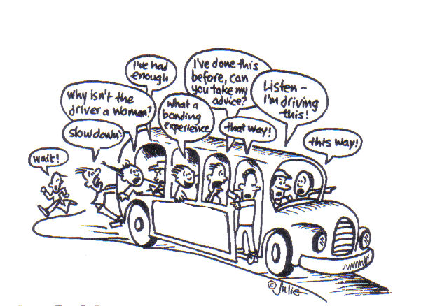
Thematic Area 1:
The State and Governance
State authorities, local in some cases, central in others, have once again become the centre of expectations

Slide 16
Thematic Area 1:
The State and Governance
State authorities, local in some cases, central in others, have once again become the centre of expectations
Linkages between relief and development worked best where the state created a strong local coordination presence

Slide 17
Thematic Area 1:
The State and Governance
State authorities, local in some cases, central in others, have once again become the centre of expectations
Linkages between relief and development worked best where the state created a strong local coordination presence
« Recovery » is a part of development, not something to consider separately from national development plans, nor to ‘forget’ together with emergency aid

Slide 18
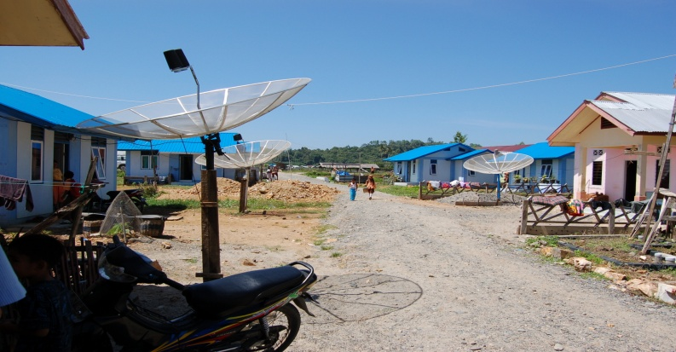
Thematic Area 2:
Livelihoods and Poverty Reduction
Replacement of lost assets

Slide 19
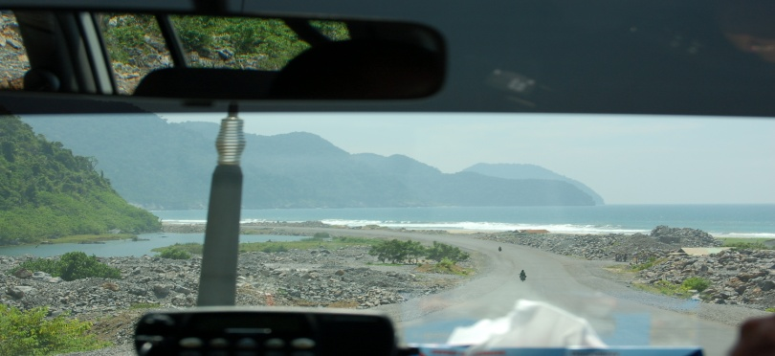
Thematic Area 2:
Livelihoods and Poverty Reduction
Replacement of lost assets
Poor alignment to markets

Slide 20
Thematic Area 2:
Livelihoods and Poverty Reduction
Replacement of lost assets
Good at addressing internal
disparities - but poor at
tackling macro level disparities
Poor alignment to markets

Slide 21
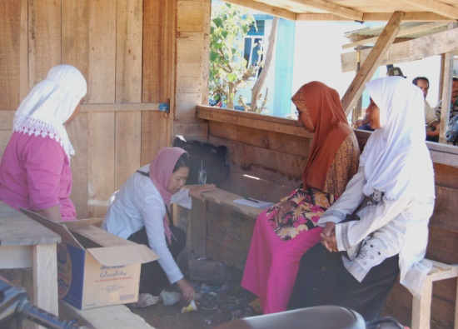
Thematic Area 3:
Social Fabric and Community Development
Gender
More integrated approaches
Psycho.
Owner
A reconstituted social fabric (as regards the tsunami) and a positive attitude
Informat.
Rapid improvements in community consultation
Presence
Duration
… although entitlements and “conflict” are issue
Land
Targeting
Conflict

Slide 22

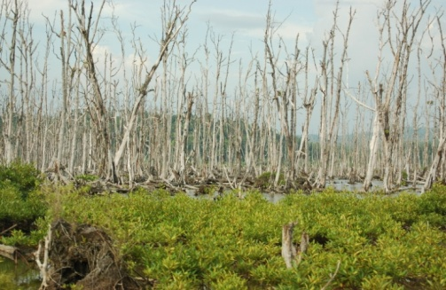
Thematic Area 4:
Hazard Risk Reduction
Increased investment in:
Institutions and laws: 5
Disaster knowledge: 4
Changed impact of future disasters
Positive or negative impact on development
Disaster awareness: 3
Risk reduction measures: 2
Preparedness: 2

Slide 23
Thematic Area 4:
Hazard Risk Reduction
Increased investment in:
Institutions and laws: 5
Disaster knowledge: 4
Changed impact of future disasters
Positive or negative impact on development
Disaster awareness: 3
Risk reduction measures: 2
Preparedness: 2
Changes in vulnerability

Slide 24
Thematic Area 4:
Hazard Risk Reduction
Increased investment in:
Institutions and laws: 5
Changes in Hazards
Disaster knowledge: 4
Changed impact of future disasters
Positive or negative impact on development
Disaster awareness: 3
Risk reduction measures: 2
Preparedness: 2
Changes in vulnerability

Slide 25
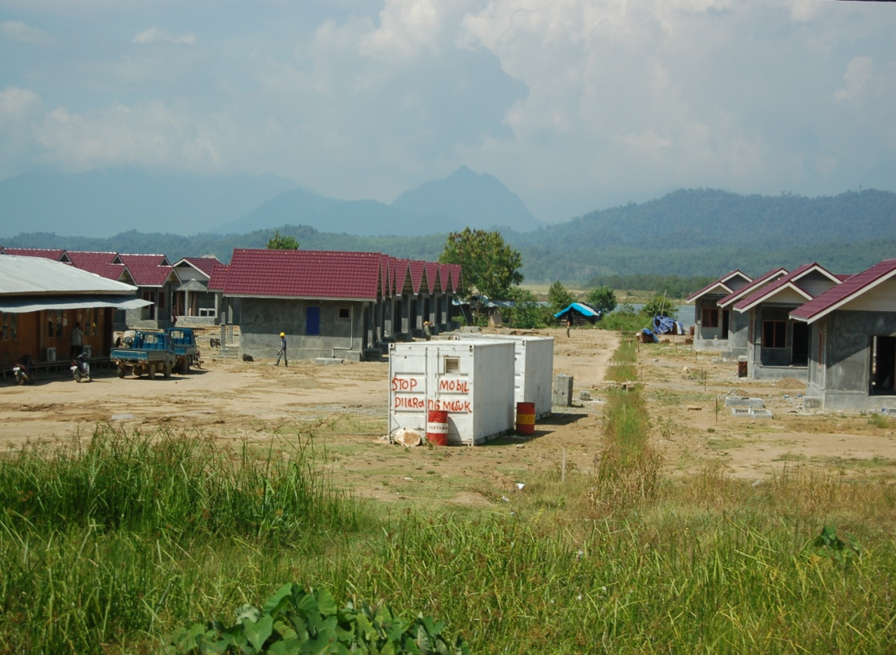
Thematic Area 5:
Capacity Building
Priority issues
Single most significant factor of success
Absence of guidelines and indicators
Externalisation of the notion of capacity building

Slide 26
Thematic Area 5:
Capacity Building
Priority issues
Single most significant factor of success
Absence of guidelines and indicators
Externalisation of the notion of capacity building
A severe weakness:
Resources not shared
Project planning timeframes
Service delivery approach to partners
No academics
Performance
a
d
Continuity
Capacity Building
c
b
Personnel Management

Slide 27
Key Lessons to be Drawn
Capacity building
not physical assets
Risk reduction not
“multi” enough
Integrated assessments
$$
Consultation
in time
?
Conflict sensitive
inclusiveness
States: be local,
not central
Linkages in assistance do not only depend on abundant resources and rapid deployment.

Slide 28
Conclusion
The main loss of linkage is the low priority given to:
The project approach: necessary but insufficient
The aim must be continuity on the ground. Let the actors decide based on local assessment and capacity.
Unifying frames (early recovery, disaster risk reduction, or poverty reduction) are still conceived, and implemented, separately.

Slide 29
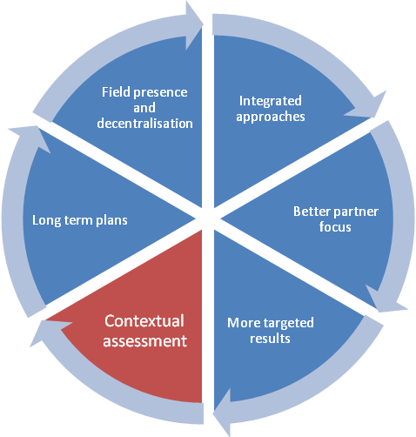
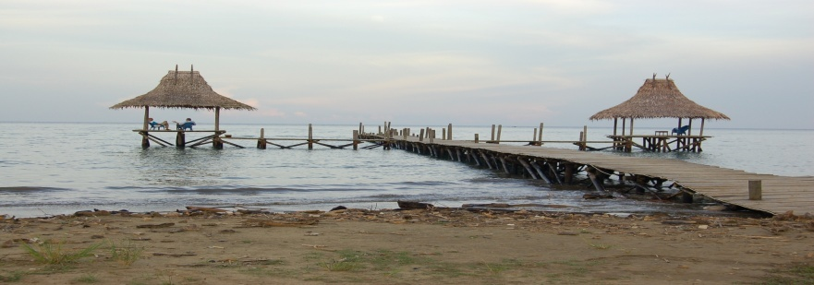
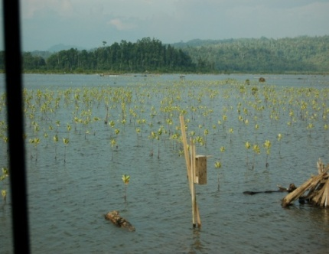
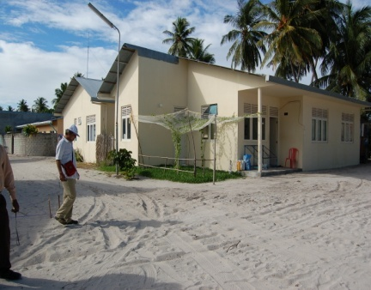
The Way Forward

Slide 30
Recommendations:
Overall country conditions remain the key to the success of different intervention strategies, and can only be properly addressed by a well inter-linked response.
Agencies, organisations and states should be less experimental in their Linkages between Relief Rehabilitation and Development.

Slide 31
Recommendations:
Specific areas of improvement, detailed by actors:
    Strengthen local state effectiveness
    More long range analysis
    More grounded livelihoods strategies
    A more comprehensive risk reduction model
    Better notions of capacity development

Slide 32
For Donor Governments
Strengthen local level state effectiveness
Donor agencies should actively pursue ‘development diplomacy’, including the deployment of technical assistance in the field, identification of risks and bottlenecks in delivery, supplementing pooled funding with targeted bilateral initiatives where required.
More long range analysis
Donors and Governments should continue to review procedures for multi-donor trust funds in recovery and proposals should include conflict sensitivity analysis

Slide 33
For Donor Governments
Less restrictive risk reduction
UN agencies, the Red Cross Movement, and NGOs should implement their DRR projects with a multi-hazard focus.
All agencies, in particular the Red Cross Movement, and NGOs, should attempt to design DRR projects that bring short-term as well as long-term benefits to make participation in DRR more attractive for affected communities.

Slide 34
For Donor Governments
Better notions of capacity building
Donors should consider funding personnel support programmes designed to improve the skills of specialists, assist in placement, and conversion.
Donors should be sensitive to the time needed to accomplish effective and sustainable recovery programmes

Slide 35
For the United Nations, Red Cross and Red Crescent Movement, and NGOs
Better targeted livelihoods recovery
Market analyses should form part of UN and NGO funding flows aiming to restore livelihoods.
UN agencies should examine how the early recovery sector leads or cluster approaches should enable a rapid transition to an area based approach.

Slide 36
For the United Nations, Red Cross and Red Crescent Movement, and NGOs
Better notions of capacity building
International agencies, which are affected by a high turnover of staff, should strengthen human resource mechanisms
NGOs and UN agencies, as well as donors should develop operationally verifiable indicators and concepts that can guide agency programming.
NGOs and UN agencies should seek to create more linkages to academic institutions

Slide 37
For the United Nations, Red Cross and Red Crescent Movement, and NGOs
More long range analysis
NGOs should encourage local presence by their personnel, and monitor public perceptions and expectations.
Strengthen local level state effectiveness
NGOs should continue to refine participatory approaches, including public consultation and grievance mechanisms.

Slide 38
In conclusion
Good linkages have occurred, but disasters are still considered to be exceptional events outside proper planning.
Instead disasters should become a mainstream concept and trigger specific adjustments.
Projects in fragile environments: here to stay – BUT should be allowed to be home-grown.
    This should lead to more effective linkages and stronger effect s.

