Slide 1


IIEP’s conflict-sensitive approach to education sector planning
Suzanne Grant Lewis, Deputy Director
UNESCO International Institute for Educational Planning (IIEP)
Education and Conflict:
Past, Present and Future Role of Norway’s Engagement
Oslo, 31 October 2013

Slide 2

IIEP, a UNESCO institute
IIEP strengthens
the capacities of Member States to plan and manage their education systems in order to help them achieve national and education goals
A capacity development Institute

Slide 3
What IIEP does
IIEP supports policy makers with evidence
IIEP trains educational planners and technicians, who support policy makers
IIEP accompanies countries in formulating and implementing policies and sector plans

Slide 4
Why conflict-sensitive education planning?
Impact
Armed conflict cost lives and jeopardize social service delivery
Right
Convention of the Rights of the Child
Protect
Prevent
$1 spent on disaster risk reduction = $7 saved
Donors
28.5m = ½ of world’s out-of-school children live in conflict-affected countries
Dakar Framework for Action
Education increases tolerance
Donors increasingly require all credible plans to be conflict-sensitive
Ex: GPE Operational framework, USAID Education Strategy

Slide 5
A conflict-sensitive planning process
Regular process
Conflict sensitive aspect
Education Sector Diagnosis
Policy formulation
Conflict analysis (security, political, economic, social) – conflict’s impact on education and vice versa – see next slide
Policies on e.g.: Schools as safe and child-friendly spaces (zones of peace), equity policies, curriculum policy, …
Plan preparation
Priority programmes : Curriculum review, teacher training; school-based emergency preparedness plans; relocate, retrofit schools
M&E framework
Cost & financing framework
Ensuring adequate financing, including from humanitarian sources
Conflict indicators integrated into data collection, maps, EMIS review e.g. attacks on schools

Slide 6
Educ Sector Diagnosis - Analytical framework
Education Sector Diagnosis
Analysis of Context
Analysis of Policy
Analysis of Education system performance
Analysis of Management capacity
Analysis of Costs & financing
  Conflict and natural hazards
  Population movements, including IDPs and/or refugees
Equitable resource distribution
Funding for C/DRR programmes
Contingency funding
  National Disaster Management Policy
  Curriculum policy
  Impacts of hazards on:
Access & Equity
Quality
Internal efficiency
External efficiency
Impact on management capacity
Rapid response mechanisms

Slide 7
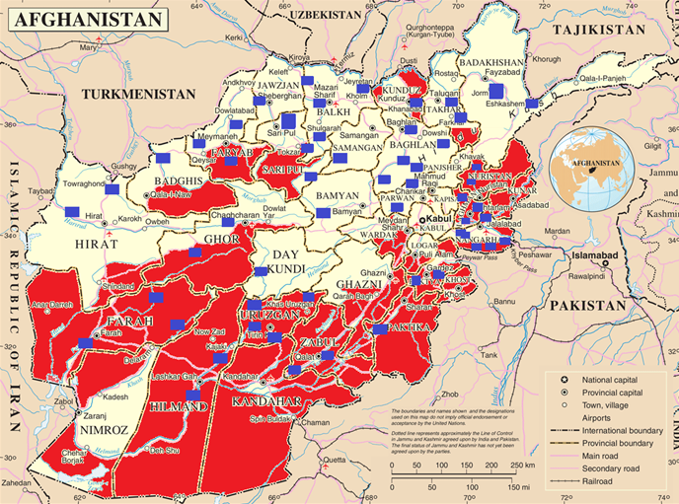
Example – preparing a hazard map
Conflict
Flooding
Prepared by Afghan ministry officials in IIEP Distance Course 2012

Slide 8
Key aspects to pay attention to
School management policies for conflict
Infrastructure and equipment
Teacher training
Curricula
Planning for educational continuity
Community involvement
Contingency plans, school disaster and emergency management plans
Monitoring and Evaluation
Financing

Slide 9
Contributions of conflict-sensitive planning to peacebuilding
By analyzing education system performance, possible grievances connected to education are identified
By reviewing the curriculum and pedagogy, stereotyping and intolerance can be reduced
By identifying conflict-related hazards and strategies to mitigate them, children can be protected from the impact of conflict

Slide 10
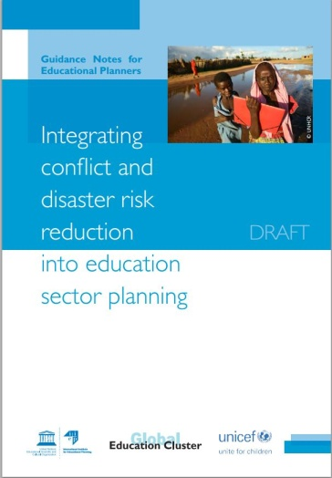

Tools & guidance must be made operational
Plethora of tools & guidance...
  IIEP’s Guidance Notes for Education Planners
  EAA’s Conflict-Sensitive Education Policy
  INEE’s Conflict Sensitive Education Pack
  UNICEF’s conflict analyses, as part of PBEA programme
  USAID/GPE methodology for analysis of sector plans, etc
…but few are operational:
  tools focus on the analysis and/or school levels (or emergencies only),
  and not specifically on developing programmes, indicators, costing and financing at a sector-wide systems level.

Slide 11
IIEP’s upcoming conflict-sensitive work
Product: Resource packages for education ministries and technical assistance
Greater emphasis on the planning process areas not traditionally covered by other agencies, e.g. data collection; projection modeling to reduce crisis impacts

Slide 12
Consolidate and build on existing materials
in a partnership with like-minded agencies (e.g. INEE WGEF, Ed Cluster members). Includes:
Revise guidance notes on planning for conflict and disaster risk reduction
Revise distance course: roll-out in April – July 2014 in French
Integrate conflict-sensitive approaches into IIEP’s Advanced Training Programme and its technical assistance and training activities
Produce policy briefs and short ‘how to’ checklists for senior decision-makers
Develop guidance notes on crisis-sensitive curriculum review, reform and development processes with UNESCO-IBE and PEIC (Qatar)

